Slide 1


RDF(S) Access Initiative
Glossary of Terms
Access Services for RDF Data Resources
Óscar Muñoz García
Univ. Politécnica de Madrid

Slide 2
OGF IPR Policies Apply
“I acknowledge that participation in this meeting is subject to the OGF Intellectual Property Policy.”
Intellectual Property Notices Note Well: All statements related to the activities of the OGF and addressed to the OGF are subject to all provisions of Appendix B of GFD-C.1, which grants to the OGF and its participants certain licenses and rights in such statements. Such statements include verbal statements in OGF meetings, as well as written and electronic communications made at any time or place, which are addressed to:
    the OGF plenary session,
    any OGF working group or portion thereof,
    the OGF Board of Directors, the GFSG, or any member thereof on behalf of the OGF,
    the ADCOM, or any member thereof on behalf of the ADCOM,
    any OGF mailing list, including any group list, or any other list functioning under OGF auspices,
    the OGF Editor or the document authoring and review process
Statements made outside of a OGF meeting, mailing list or other function, that are clearly not intended to be input to an OGF activity, group or function, are not subject to these provisions.
Excerpt from Appendix B of GFD-C.1: ”Where the OGF knows of rights, or claimed rights, the OGF secretariat shall attempt to obtain from the claimant of such rights, a written assurance that upon approval by the GFSG of the relevant OGF document(s), any party will be able to obtain the right to implement, use and distribute the technology or works when implementing, using or distributing technology based upon the specific specification(s) under openly specified, reasonable, non-discriminatory terms. The working group or research group proposing the use of the technology with respect to which the proprietary rights are claimed may assist the OGF secretariat in this effort. The results of this procedure shall not affect advancement of document, except that the GFSG may defer approval where a delay may facilitate the obtaining of such assurances. The results will, however, be recorded by the OGF Secretariat, and made available. The GFSG may also direct that a summary of the results be included in any GFD published containing the specification.”
OGF Intellectual Property Policies are adapted from the IETF Intellectual Property Policies that support the Internet Standards Process.
Notes:
IPR Notices Note Well for OGF meetings

Slide 3
Full Copyright Notice
Copyright (C) Open Grid Forum (2006). All Rights Reserved.
This document and translations of it may be copied and furnished to others, and derivative works that comment on or otherwise explain it or assist in its implementation may be prepared, copied, published and distributed, in whole or in part, without restriction of any kind, provided that the above copyright notice and this paragraph are included on all such copies and derivative works.
The limited permissions granted above are perpetual and will not be revoked by the OGF or its successors or assignees.
Notes:
OGF Full Copyright Notice if necessary

Slide 4
Outline
Vision
Recalling “future work”
Glossary of terms
  Perspective
  Objectives
  Structure
RDF(S) Access Terminology
Summary
Future work
Notes:
This is the outline of the presentation. Firstly I will introduce our “vision” about the RDF(S) access intitiative, in short, what we want to achieve and how does it fit inside the WS-DAI view. I will also review what RDF(S) is, so everybody who is not familiar with it, will have something to start with and understand our work.
After that I will present the RDF(S) data model as it is of main concern for the ontology access.
I will continue pointing out some issues about the operational model of the ontology access interfaces designed.
How the interfaces are organized and the concrete specification will be explained later.
I will conclude with a short summary and the future work.

Slide 5
Introduction (I)
The RDF(S) Access Vision
What is all about?
  Providing an access mechanism to RDF(S) data sources
Two different means for interacting:
  Query access: using SPARQL
  Ontology access: using ontological primitives based on the RDF(S) model
Alternative, but not exclusive!
  Use each one according to your needs…
Notes:
The RDF(S) access initiative is about providing an access mechanism to data defined by mean of RDF.
The objective is to develop a set of services which provide a standard access interface to RDF data, which can be used in the OGSA architecture regardless of the underlying physical infrastructure used for storing that data (Sesame, Jena, Kowari, Oracle…)
We have identified to different ways for interacting with RDF repositories:
- Via queries, as you will see later on.
- Via ontology access primitives, that is, using basic access methods based upon the model/formalism used for representing the data, in other words, taking into account the structures defined by RDF(S), and the relationships between them.
But having two alternative ways of interacting with the RDF repositories doesn’t mean that they are exclusive, on the contrary, they should be used simultaneously according to the concrete requirements of the client application.

Slide 6
Introduction (II)
How does this fit with the WS-DAI approach
WS-DAI
Sets general pattern for realisations
Extensions for specific kinds of data resource
Possible Future Realisations
WS-DAIR
WS-DAIX
WS-DAI-RDF(S)
Relational
SQL
XML
XQuery/XPath
SPARQL,
Ontology Ops
Notes:
The data access mechanism that we are developing sits below the WS-DAI specification. The
realizations will provide specialized methods that will take into account the special syntax and semantics
of the RDF(S) data and expose it appropriately, and will do it following the WS-DAI guidelines and
patterns for defining data access interfaces and services, like WS-DAIR does for relational databases
and WS-DAIX does for XML sources.

Slide 7
Recalling “future work”
Behavioural aspects
  Static properties
  Configurable properties
Test suite
Sample use cases
Glossary of terms
Notes:
As future work, we have to finish some operations that are not fully defined. We also have to work in those behavioural aspects that I commented before. They are mostly related with the static and configurable properties of the interfaces. Finally, we are still to produce a joint glossary that will be used in the querying part and in the ontology one.

Slide 8
Perspective
The DAIS RDF(S) Access Initiative is about providing an access mechanism to data defined by means of RDF.
Objective: to define a mechanism which provides a standard access interface to RDF(S) data,
  Compliant with the principles and practices defined by the Open Grid Services Architecture (OGSA).
New WS-DAI realization with two types of access to RDF(S) sources:
  Declarative: relies on the usage of SPARQL, an RDF(S) query language, for expressing declaratively the structure of the data to be retrieved. RDF(S) Query Access
  Programmatic: a set of fine grained operations for accessing RDF(S) resources exploiting the semantics of the RDF(S) model. RDF(S) Ontology Access
Notes:
The DAIS RDF(S) Access Initiative is about providing an access mechanism to data defined by means of RDF.
The objective is to define a mechanism which provides a standard access interface to RDF(S) data, which complies with the principles and practices defined by the Open Grid Services Architecture (OGSA).
To do so, this mechanism is being developed as a new WS-DAI realization. The realization distinguishes two types of access to RDF(S) sources: declarative and programmatic.
The former relies on the usage of SPARQL, an RDF(S) query language, for expressing declaratively the structure of the data to be retrieved.
The latter defines a set of fine grained operations for accessing RDF(S) resources exploiting the semantics of the RDF(S) model.

Slide 9
Objective
In this document we attempt to provide unambiguous definition of the terms used in the context of the DAIS RDF(S) access activity and the current straw-man documents.
We do this as an attempt to define a basic terminology that allows merging the work that is being done separately in the query and ontology parts of the specification.

Slide 10
Glossary Organization
The glossary includes three types of entries each one colored in a different way.
  Pale blue entries contain terms defined in the WS-DAI specification or in the WS-DAIR / WS-DAIX realizations.
  Purple entries contain the RDF(S) terminology provided for better understanding both straw-mans.
  White entries contain the terms defined in the RDF(S) access straw-mans.

Slide 11


Base terminology (Query)
Triple
  The base construction of RDF. RDF triples are composed of a subject, a predicate, and an object. Each triple represents a statement of a relationship between the subject and the object.

Slide 12
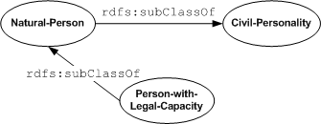
Base terminology (Query Access)
Graph: A set of triples.
  The assertion of an RDF graph amounts to asserting all the triples in it, so the meaning of an RDF graph is the conjunction (logical AND) of the statements corresponding to all the triples it contains

Slide 13
Base terminology (Query Access)
Collection:
  A set of Graphs

Slide 14
RDF(S) Model
RDF(S
RDF(S
)
)
rdfs:Class
rdfs:Class
The base structure for dealing with an instance.
rdfs:member
rdfs:member
rdfs:seeAlso
rdfs:seeAlso
rdfs:isDefinedBy
rdfs:isDefinedBy
rdfs:value
rdfs:value
“
“
property
property
”
”
rdfs:label
rdfs:label
rdfs:comment
rdfs:Resource
rdfs:comment
rdf:first
rdfs:Resource
rdf:first
rdf:subject
rdf:subject
rdf:predicate
rdf:predicate
rdf:type
rdf:object
rdf:type
rdf:object
rdfs:subclassOf
rdf:rest
rdfs:subclassOf
rdf:rest
rdfs:subPropertyOf
rdfs:subPropertyOf
rdf:Statement
rdf:List
rdf:Statement
rdf:List
rdfs:Container
rdfs:Container
rdf:Property
rdf:Property
rdfs:Literal
rdfs:Class
rdfs:Literal
rdfs:Class
rdfs:domain
rdfs:domain
The RDF(S) framework defines a directed, labeled graph data structure for representing information in the Web.
rdfs:range
rdfs:range
The nodes and arcs of the graph represent the things being described and the relationships between them.
The RDF(S) model defines the set of built-in nodes (things) and arcs (relationships), their semantics and entailment mechanisms, needed for structuring and reasoning about such information.
rdf:Bag
rdf:Bag
rdf:Seq
rdf:Seq
rdf:Alt
rdf:Alt
rdf:XMLLiteral
rdfs:Datatype
rdf:XMLLiteral
rdfs:ContainerMembershipProperty
rdfs:Datatype
rdfs:ContainerMembershipProperty
rdf:XMLLiteral
rdf:nil
rdf:XMLLiteral
rdf:nil
rdfs:member
rdfs:member
rdf
rdf
:_1
:_1
rdf
rdf
:_2
:_2
rdf
rdf
:_3
:_3
Notes:
This diagram shows the built-in RDF(S) vocabulary. The rectangles are classes and the links represent relationships between the classes. The name links represent specific built-in properties, whereas unnamed links represent subclass-of relationships.
As you can see the root class is Resource, and every other class is a subclass of it or of a “child” of it.
In the middle we can see the Class and Property classes which are, the main ones needed for building RDF(S) vocabularies. Both classes and properties can be organized in hierachies.

Slide 15
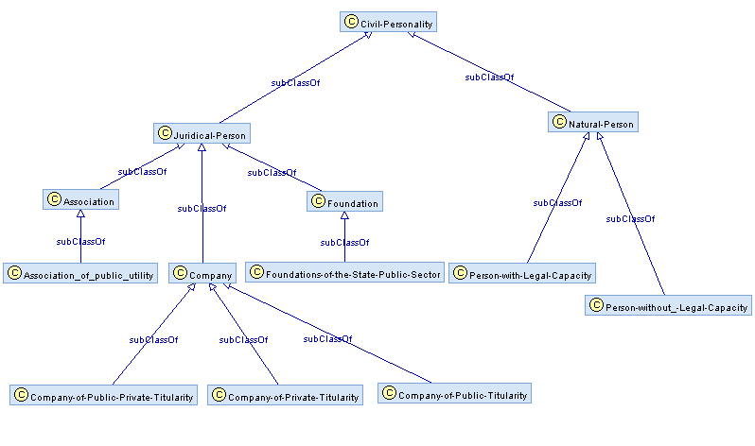
Base terminology (Ontology Access)
Repository:
  A set of RDF triples that are physically stored together.

Slide 16
Base terminology (Ontology Access)
Repository Selector:
  An entity that manages a set of repositories.

Slide 17
Base terminology (Ontology Access)
Ontological Access primitive:
  Data access operation based upon the model/formalism used for representing the data, taking into account:
    The structures defined by the formalism.
    The relationships between them.
Property::GetRange
This operation retrieves the classes that are defined as part of the range of the property, taking into account the class hierarchy if required.
Input
GetRangeRequest
  DataResourceAbstractName The abstract name of the resource the message is targeted at.
  RetrieveImplicitClasses? Whether or not retrieve implicit classes, that is, those classes that are subclasses of any that is in the range of the property.
Output
GetRangeResponse
  GetRangeDataSet
    DatasetFormatURI
    DatasetData
      ClassURI* The URI of the specific range class.
    NumberOfRangeClasses1 The number of classes that belong to the domain of the property.
Faults
No faults are defined for this message

Slide 18
RDF(S) Access
RDF(S) Query Access
PREFIX rdfs: <http://www.w3.org/2000/01/rdf-schema#>
PREFIX rdf: <http://www.w3.org/1999/02/22-rdf-syntax-ns#>
SELECT DISTINCT ?R WHERE { ?R rdf:type rdfs:Class }
Consumer
SPARQLExecute(
DataResourceAbstractName,
DatasetFormatURI
SPARQLQueryRequest)
RDF(S) Data Access Service
SPARQLAccess
SPARQLExecuteResponse(
Dataset)
As a Dataset
→
Semantics provided by the Consumer
http://webode.dia.fi.upm.es/RDFS/Civil_Personality#Foundations-of-the-State-Public-Sector
http://webode.dia.fi.upm.es/RDFS/Civil_Personality#Natural-Person
http://webode.dia.fi.upm.es/RDFS/Civil_Personality#Juridical-Person
http://webode.dia.fi.upm.es/RDFS/Civil_Personality#Civil-Personality
http://webode.dia.fi.upm.es/RDFS/Civil_Personality#Association_of_public_utility
http://webode.dia.fi.upm.es/RDFS/Civil_Personality#Foundation
http://webode.dia.fi.upm.es/RDFS/Civil_Personality#Company-of-Private-Titularity
http://webode.dia.fi.upm.es/RDFS/Civil_Personality#Company
http://webode.dia.fi.upm.es/RDFS/Civil_Personality#Company-of-Public-Private-Titularity
http://webode.dia.fi.upm.es/RDFS/Civil_Personality#Person-with-Legal-Capacity
http://webode.dia.fi.upm.es/RDFS/Civil_Personality#Company-of-Public-Titularity
http://webode.dia.fi.upm.es/RDFS/Civil_Personality#Association
http://webode.dia.fi.upm.es/RDFS/Civil_Personality#Person-without_-Legal-Capacity

Slide 19
RDF(S) Access
RDF(S) Ontology Access
Consumer
GetClassesRequest(classURI)
Repository Access Service
RepositoryAccess
GetClassesResponse(classList)
As a List of classes
→
Semantics provided in the response
http://webode.dia.fi.upm.es/RDFS/Civil_Personality#Foundations-of-the-State-Public-Sector
http://webode.dia.fi.upm.es/RDFS/Civil_Personality#Natural-Person
http://webode.dia.fi.upm.es/RDFS/Civil_Personality#Juridical-Person
http://webode.dia.fi.upm.es/RDFS/Civil_Personality#Civil-Personality
http://webode.dia.fi.upm.es/RDFS/Civil_Personality#Association_of_public_utility
http://webode.dia.fi.upm.es/RDFS/Civil_Personality#Foundation
http://webode.dia.fi.upm.es/RDFS/Civil_Personality#Company-of-Private-Titularity
http://webode.dia.fi.upm.es/RDFS/Civil_Personality#Company
http://webode.dia.fi.upm.es/RDFS/Civil_Personality#Company-of-Public-Private-Titularity
http://webode.dia.fi.upm.es/RDFS/Civil_Personality#Person-with-Legal-Capacity
http://webode.dia.fi.upm.es/RDFS/Civil_Personality#Company-of-Public-Titularity
http://webode.dia.fi.upm.es/RDFS/Civil_Personality#Association
http://webode.dia.fi.upm.es/RDFS/Civil_Personality#Person-without_-Legal-Capacity

Slide 20
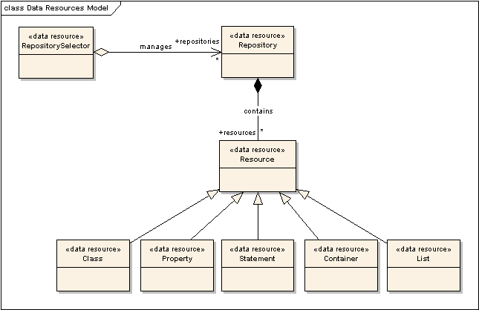
RDF(S) Data Resources
RDF(S) Data Resource: A data source or sink that is based on RDF(S) data model, together with any associated management infrastructure, that exhibits capabilities that are characteristic of RDF repositories.
Every Data Resource Manages it correspondent RDF(S) equivalent resource.
Provide the correspondent ontological primitives for querying or updating the resource data.
Manages an RDF(S) repos.
Provides Resource-based Ontological Primitives for Querying or Updating the Repository data.
Manages sets of RDF(S) repositories.

Slide 21
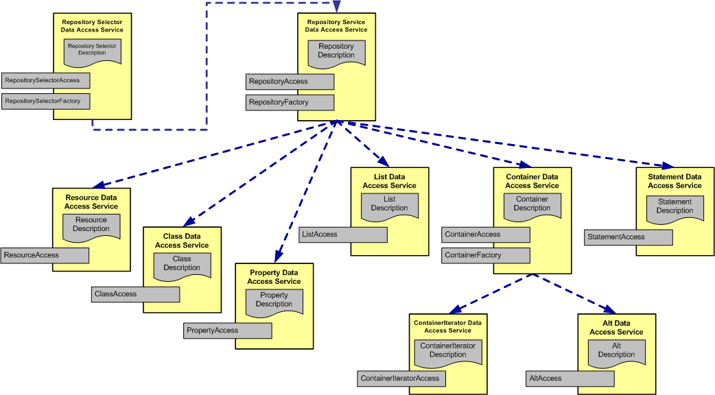
RDF(S) Ontology interfaces
Native interfaces:
Those interfaces that mimic the main classes of RDF(S) model and provide specific ontological access primitives targeted to that class.
Utility interfaces: Convenient abstractions that provide further functionalities that enhance the overall usability of the services.
RDF(S) interfaces: Base interfaces and corresponding properties defined in the WS-DAI spec. extended to provide access to RDF(S) data resources.

Slide 22
RDF(S) Ontology interfaces
Type of Operations
    Creation/deletion
      An operation that creates or deletes resources from a repository. (which deal with the management of instances)
    Retrieval
      An operation that retrieves information from a repository.
    Attachment/detachment
      An operation that creates or deletes relationships between resources in a repository (those for managing the relationships between resources).

Slide 23
Summary
Basic glossary defined, including:
  Definitions for basic DAIS terms
  Definitions of basic RDF(S) terminology
  Definitions of terms used in the RDF(S) access strawmans
Some figures:
  118 DAIS Terms
  67 RDF(S) Terms
  23 RDF(S) Access terms
Notes:
Summaryzing, we have created a set of interfaces for accessing RDF that provide ontology-based operations for the task. We have provided interfaces that mimic the RDF(S) data model or abstract a useful set of functionalities that enhance the “user” experience…
All of this has been done following object orientation practices.
Some figures about the spec…

Slide 24
Future work
Sanity check for…
  DAIS definitions
  RDF(S) definitions
Agree on RDF(S) access terminology

Slide 25

Thanks for your attention, questions?

