Slide 1
OMII-BPEL
Grid Services Orchestration using the
Business Process Execution Language (BPEL)
UCL Department of Computer Science
Liang Chen
Bruno Wassermann
Project Inspector: Wolfgang Emmerich
May/2007
Notes:
Grid Services has been a growing interest in Grid computing. Business Process Execution Language (BPEL) is the de facto industrial standard for service orchestration in a Service Oriented Architecture. OMII-BPEL focused on the expressiveness of BPEL as a scientific workflow language and investigated the sufficiency of open source BPEL engine in orchestrating Grid Services with distinct characteristics from those of business processes. In particular, we did it through extensive experiments on a chemical application, which looks for polymorphs of crystal structures. The case study was able to help us address those common challenges of Grid applications and how BPEL, and BEPL engine can cope with them in the Grid environment. We looked at the issues like, scalability, concurrency control, performance, reliability and security. With the tool and integrated BPEL environment that we released through OMII, we have successfully provided a life system that is regularly used by our Chemists. We are looking forward to introducing the experience of Grid service orchestration with BPEL broader in the community.
Present the results of the OMII-BPEL project.

Slide 2
Grid services, scientific workflows and BPEL
Grid services
  Service-oriented grid computing infrastructure
    i.e. Grid resource can be exposed as service through an interface and can be invoked by message.
Scientific workflows
  Grid services orchestration
BPEL
  Programming in large
Notes:
We define Grid Services as … by which we mean Grid resources can somehow exposed as services with an interface and can be invoked with some protocols. (The interaction between a service provider and service consumer is usually defined with service interface and invocation protocol. )
(WSDL) Interface: contract between service provider and service consumer. Analogous to java interface, declaring name, parameters, and return type.
(SOAP) Protocol: soap, defines how a service should be communicated. For example, which network protocol to bind with: http, smtp…
Services are not very useful on their owns.
What is the difference between the Grid Service and Web Service?
The short version, no, there is difference, especially from a service orchestration with bpel perspective. This is because Grid Service conforms to WS standards like WSDL and SOAP, which is all you need to orchestrate services with BPEL. And there is the long version. The main difference of a Grid Service from a Web Service is the high throughput and massive data volume being involved in Grid computing. For example, you don’t want to transmit GB data over the internet very so often! In such case, for example, an involved Grid Service implementation might want to look at WSRF.
JSDL

Slide 3
A polymorph search case study
Chemists look for polymorphs of crystals
  Important, e.g. drug manufacture
  Approach it by exhaustive search for all theoretically possible molecule packings and calculate energy of inter-molecular bonding of each
Notes:
Exhaustive computation approach: The chemists in UCL approach this by calculating all the possible structures in theory using the applications implemented by the chemical engineers, in contrast to finding it with carefully modelled and executed experiments in lab.
Suitable for being grid computing

Slide 4
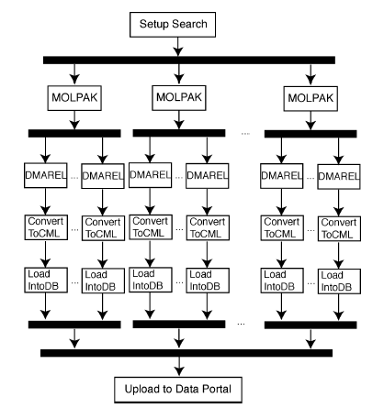
An overview

Slide 5
The application
Mainly a two-stage process that involves two executables and their input files and parameters
  MOLPAK ~38 packing types
  DMAREL ~200 molecule packings
  →38x200 independent jobs
  Large data volume up to 6GB/search
  Intensive message exchanges
  Hard coded workflow logics
  Used to run on dedicated server with human interactions
  Used to take from weeks to months
  Change of parameters on demand
  Data visualization
  …
Notes:
Change of workflow on demand: would like to change the workflow in a way of rectifying parameters. For example, tuning an accuracy of DAMREL outputs. How these parameters should be tuned properly is understood by the domain experts before a particular search is started.
Single server with 4 cpus
Human interactions: job submission, monitoring, data conversation, data analysis
Hardcoded workflow is not flexible to the changes of workflow.

Slide 6
The BPEL solution
Define process in BPEL
Deployed on and executed by BPEL engine

Slide 7
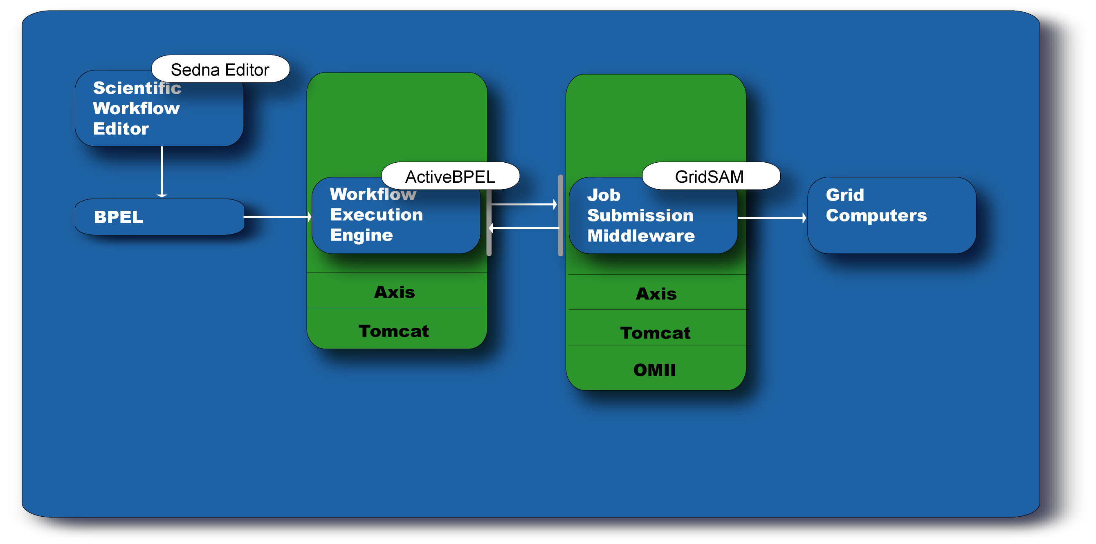
Architectural overview

Slide 8
BPEL processes and hierarchical composition
molpakdmarel
molpak
visualisation
dmarel
jobmanager
utilities

Slide 9


Deployment overview
Web client
soton
Plotting
cs.ucl
GridSAM
BPEL engine
IS UCL
Condor pool

Slide 10

OMII and OMII-BPEL
EPSRC founded project through Open Middleware Infrastructure Institute
OMII:
  Provides infrastructure for the e-science community across UK as well as internationally
  Makes available services and tools for the user’s convenience
    E.g. GridSAM, Grimoires, FIRMS
  Provides training and user support
OMII-BPEL
Introduces industry standard BPEL into scientific workflow modeling and orchestration
  Is BPEL suitable for scientific workflows?
  If so, can we use available BPEL engines for scientific workflows?
Offers integrated tools and BPEL environment in OMII stack
  Client BPEL GUI editor
    Workflow composition
  Server BPEL engine
    Workflow deployment and enactment
Notes:
FINS ws-eventing implementation
FIRMS: WS-Reliable Messaging
Grimoires: UDDI repository with extensions
OMII-BPEL is part of OMII. And like other MP, it focuses on the topic of interest of its own

Slide 11
BPEL Editors
BPEL Designer
  Eclipse-BPEL project (IBM/Oracle), early 2006
  Support of WS-BPEL 2.0
  Built on several Eclipse platforms, WTP, EMF, GEF…
  Server runtime plug-in, validation, auto-deployment
  Out-of-box toolset supports
    E.g. WSDL client, UDDI explorer, WSDL/Schema editor
Notes:
Indexed flow is an extension to the BPEL 1.1 semantics that enables enumeration of concurrent flows.

Slide 12
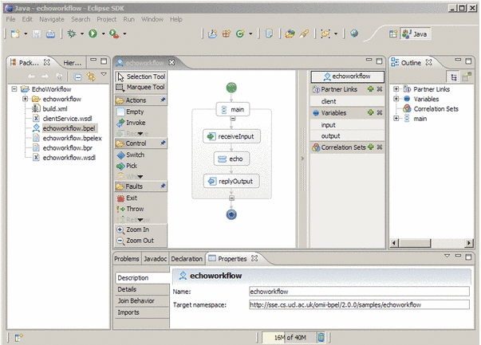
BPEL Designer

Slide 13
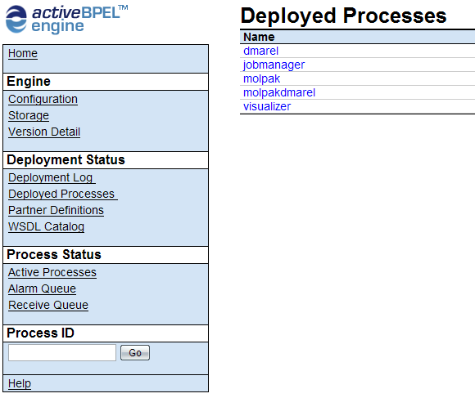
ActiveBPEL
Features
  Open source
  Tomcat, Axis
  One-stop web-based console
    Monitoring, administration, logging
    Per-process accessibility
  Hot-deployment
  Persistence
  Security
    (OMII)WS-Security, HTTPs
  Performance
    Stable
    Scalable
    Thread optimized
    Small overhead
Notes:
10,000 --- 3.680ms

Slide 14
The polymorph search case study
Flexibility
Accessibility
Scalability
Reliability
Security
Standardisation
Notes:
Hot deployment, frequent change of workflows
Web client, web-based console/solution,
Load-balancing, async/sync, hierarchical composition/ reuse
Persistency, compensation, fault handling, onalarm
Ws-security, https,
BPEL vs in-house customisation solutions, WSDL/SOAP/UDDI/WS-*, support after project life time, more choices of engines and community supports.

Slide 15
Conclusions
BPEL is suitable for Grid services orchestration
Adapting a standard means availability of commercial strength BPEL enactment environments, supports, training and large user community.

