Slide 1

WS-DAI RDF(S) Querying
DAIS Working Group
Said Mirza Pahlevi & Isao Kojima
Grid Technology Research Center
AIST
Japan

Slide 2

WS-DAI RDF(S) Querying
Introduction: motivation & design principle
The specification
Use cases

Slide 3
WS-DAI RDF(S) Querying: Introduction
DAIS Working Group
Said Mirza Pahlevi & Isao Kojima
Grid Technology Research Center
AIST
Japan

Slide 4
Motivation
Why do we need the RDF(S) querying specification?
  There are many Semantic Grid projects and they handle a large amount of RDF data
  The need to access & integrate the data with a standard RDF query language supported grid-based interface
Why is not (only) W3C SPARQL specifications?
  SPARQL query language, results XML format & protocol
  Lack of the grid general requirements
    No direct & indirect access using a (stateful) Web service
    No RDF data resource management

Slide 5
Design Principle & Features
Design principle
  Extend WS-DAI core while adopting components defined in the W3C SPARQL spec.
Features
  Focus on ontology instances, not schema.
    RDF Graph (Triples)
  Focus on accessing data using a query language, not APIs.
    W3C SPARQL (W3C Candidate Recommendation)

Slide 6
WS-DAI RDF(S) Querying: the Specification
DAIS Working Group
Said Mirza Pahlevi & Isao Kojima
Grid Technology Research Center
AIST
Japan

Slide 7
Outline
RDF Data Resource: RDFSCollection
  Consists of a set of graphs (RDF dataset)
  Non-hierarchical structure
  Each graph is uniquely identified by a URI
Two types of interfaces
  Data resource management: create, retrieve and remove RDF graph
  Data resource access: direct & indirect access using SPARQL

Slide 8
Data Resource Management
Similar to collection management of DAIX
RDFSCollectionAccess
  AddGraphs (by data or reference)
  GetGraphs
  RemoveGraphs
  GetCollectionPropertyDocument
    NumberOfGraph element
RDFSCollectionFactory
  GraphSelectionFactory: used when access to an individual RDF graph through a different port type is required

Slide 9
Data Resource Access
Two types of SPARQL query results
  Select/Ask: returns a set of bindings
    W3C SPARQL Query Results XML Format spec.
  Construct/Describe: return a set of triples (graph)
    RDF/XML or RDF/N3 format

Slide 10
Data Resource Access
SPARQLAccess (direct access)
  GetSPARQLPropertyDocument
    ExternalGraphAccess element: external graph support
    DatasetFormatURI: Query result format
  SPARQLExecute
SPARQLFactory (indirect access)
  SPARQLExecuteFactory
SPARQLResultSetAccess
  GetSPARQLItemsSetPropertyDocument & GetResults
SPARQLTripleSetAccess
  GetSPARQLItemsSetPropertyDocument & GetTriples

Slide 11
SPARQLExecute (Direct)
SPARQLExecute(DataResourceAbstractName,
DatasetFormatURI, SPARQLQueryRequest)
Consumer
RDF(S) Data Access Service
SPARQLAccess
SPARQLExecuteResponse(Dataset)
Input
  DataResourceAbstractName
  DatasetFormatURI
  SPARQLQueryRequest
Output
  Dataset with
    W3C SPARQL Query Result Format, or
    RDF/XML or RDF/N3 Format

Slide 12
SPARQLFactory (Indirect)
RDFS Data
Access Service
Consumer
SPARQLExecuteFactory (
DataResourceAbstractName,
PortTypeQName, ConfigurationDocument,
SPARQLQueryRequest )
SPARQL
Access Desc.
SPARQLFactory
Reference to SPARQL Query Results
SPARQLItemsSet
Data Access Service
SPARQLItemsSetDescription
GetResults (StartPosition,
ResultCounts )
SPARQLResultsSetAccess
Results

Slide 13
WS-DAI RDF(S) Querying: Use Cases
DAIS Working Group
Said Mirza Pahlevi & Isao Kojima
Grid Technology Research Center
AIST
Japan

Slide 14
Outline
Semantic matchmaking of Grid resources (direct access)
Distributed RDF storage for ubiquitous objects (direct access)
Federated SPARQL query processing (direct & indirect accesses)
RDF data snapshot (indirect access)

Slide 15
Semantic Matchmaking of Grid Resources

Slide 16
Introduction
Motivation
  Works describing Grid resources/services using RDF/OWL
    S-MDS, Said et al., S-OGSA, Oscar C. et al., OMM, Tangmunarunkit et al.
  The need for matching resources based on RDF-based resource descriptions provided by various systems
Goal
  Semantic Grid resource matching using SPARQL

Slide 17
S-MDS
Provides a mechanism to map a resource property (RP) into ontology and to aggregate and maintain the mapping results
mapping
RDF
data
WS
RP
RDF
data
WS
RDF
DB
RP
…
RDF
data
WS
RP

Slide 18

Data Grid Cluster
(Ganglia, Torque & Gram)
GRAM RP Mapping
<Host Name="dbgrid.x.x" UniqueID="dbgrid.x.x">
<Processor CacheL1="0" CacheL1D="0" CacheL1I="0"
CacheL2="0" ClockSpeed="3001" InstructionSet="x86"/>
<MainMemory RAMAvailable="19" RAMSize="1484"
VirtualAvailable="332" VirtualSize="2041"/>
<OperatingSystem Name="Linux"
Release="2.6.0-test5_2smp"/>
<Architecture SMPSize="2"/>
<FileSystem AvailableSpace="65511" Name="entire"
ReadOnly="false" Root="/" Size="82459"/>
<NetworkAdapter IPAddress="163.220.2.54"
InboundIP="true" MTU="0" Name="dbgrid.hpcc.jp"
OutboundIP="true"/>
<ProcessorLoad Last15Min="10" Last1Min="6"
Last5Min="8"/>
</Host>
dbgrid
pentium
<processor> Element Mapping
gneo
DG
Intel
<host> Element Mapping
cluster
GTRC
aobe
isa
itanium
ES
gtrc1
isa
athlon
mdcc1d1
isa
ID
CPU
AMD
mdcc2d2
isa
FG
BIRC
AIST
opteron
mdcc3d3
SG
master
isa
isa
gtrc2
super
genome
Sun
mdca1b1
MF
CBRC
Ultra
mdca2b2
BS
CPU Ontology
AIST Ontology
mdca3b3
GRAM Resource Property

Slide 19
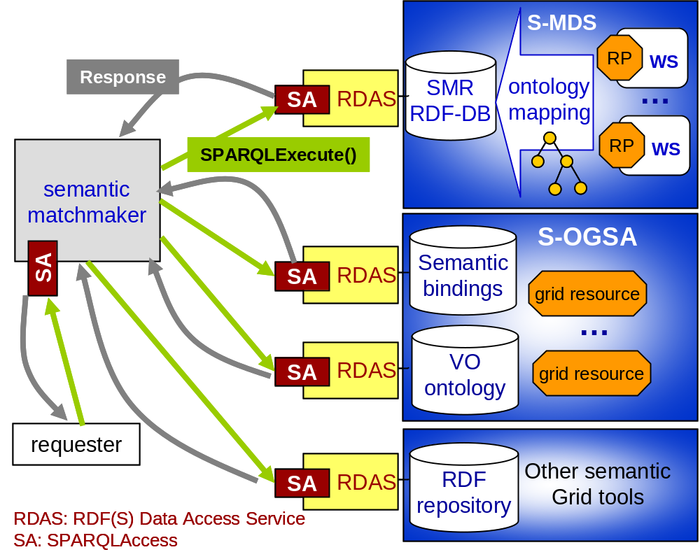
Matchmaking Scenario

Slide 20
Distributed RDF Storage for Ubiquitous Objects

Slide 21

Introduction
dc:creator
A farm
Motivation
  Ucode: Ubiquitous Code
    128 bit code for identifying ubiquitous object
    Uses in RFID tag applications
  A relation between objects/ucodes is modelled as Triple
  Triples, which are usually large in number, are stored in a wide area distributed database (UCR database)
  UCR database: SPARQL-supported RDF database
Goal
  Provide a robust & scalable federated database that supports seamless access over (heterogeneous) RDF databases
rdf:type
geo:spacialThing
tomato
B Shop

Slide 22
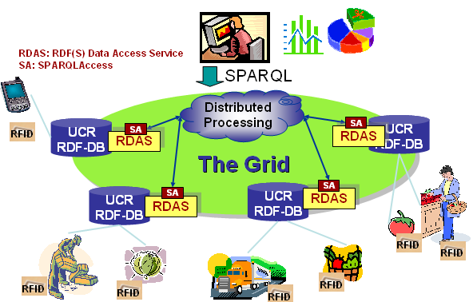
Distributed RDF Storage Scenario

Slide 23
Federated SPARQL Query Processing

Slide 24
Introduction
Drug Research Application Scenario
  Federate several RDF data resources with a single SPARQL query
  In discussion at W3C
SPARQL
MicroArray DB
RDF
Uniplot DB
RDF
ScreeningArray
RDF
Chemical Index
RDF
MouseToximity
RDF

Slide 25
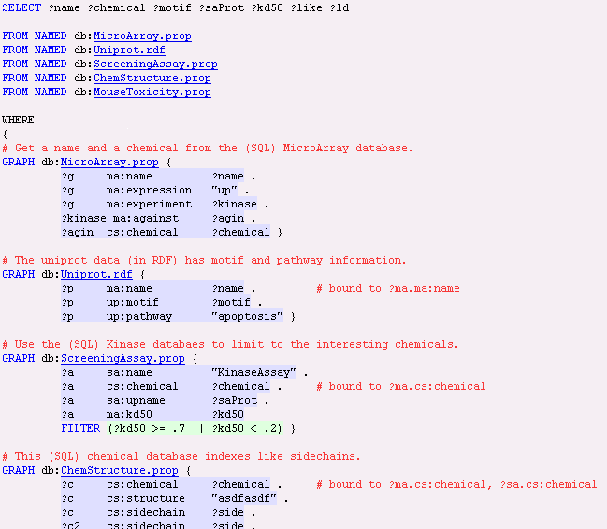
join based on name
join based on chemical

Slide 26
Query Processing
Naïve Approach
  Send each graph pattern in parallel to the target database to retrieve graphs and execute the whole query against the retrieved graphs
Distributed query processing with loop-join approach
  Send the graph pattern to MicroArray database, extract the names and use them for querying the Uniprot database, etc.

Slide 27
Federated SPARQL Scenario
RDF Federation Middleware
SPARQL
Execute
Factory
GRAPH db:MicroArray.prop {
?g ma:name ?name .
?g ma:expression "up" .
?g ma:experiment g?kinase .
?kinase ma:against ?agin.
?agin cs:chemical ?chemical }
Distributed
Join Operation
GRAPH db:Uniprot.rdf {
?p ma:name ?name .
?p up:motif ?motif .
?p up:pathway "apoptosis" }
SPARQLExecute
GetResults
SPARQLExecute
SPARQLFactory
SPARQLResultSetAccess
SPARQLAccess
Microarray
DB
ResultSet
create
Uniprot
DB
g | name | kinase | agin | chemical
g1 | name1 | kinase1 | agin1 | chemical1
g2 | name2 | kinase2 | agin2 | chemical2
g3 | name3 | kinase3 | agin3 | chemical3

Slide 28
RDF Data Snapshot

Slide 29
Introduction
Motivation
  Dynamic RDF data
    Processor load and available memory
    Road traffic and weather information
  The need to obtain a data snapshot of a certain time point
Goal
  Providing an RDF data snapshot

Slide 30
RDF Data Snapshot Scenario
RDF
DB
RDF(S)
Data Access Service
EPR
SPARQLFactory
SPARQLExecuteFactory()
RDF graph
(set of triples)
Consumer
GetTriples()
SPARQLTripleSetAccess
Response
SPARQLResponse
Data Access Service

