Slide 1
Service Oriented Architectures for
Remote Instrumentation
Michael Sutter
Forschungszentrum Karlsruhe
Institute for Data Processing and Electronics (IPE)

Slide 2
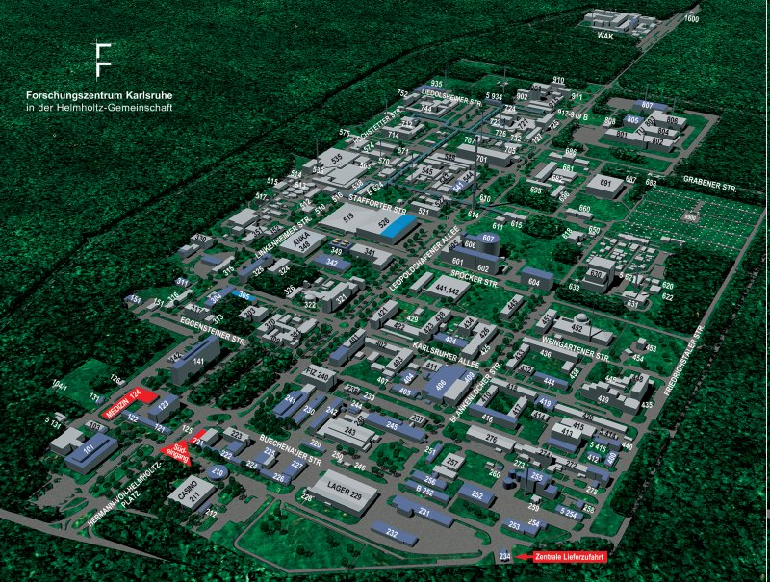
Forschungszentrum Karlsruhe
3500 Employees
22 Institutes
Research programs:
Structure of Matter
Earth and Environment
Health
Energy
Key Technologies

Slide 3
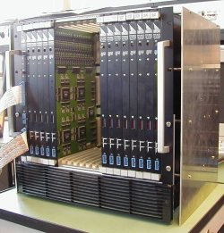
IPE
Development of data acquisition systems for applications in hard- and software
  Very high data rates
  High resolution
Software
  Algorithms and technologies for efficient data processing
  Grid computing
  Service Oriented Architectures (SOA)
  Web technologies

Slide 4
Projects involved
Auger
  Measurement of high energy cosmic ray showers
KATRIN (KArlsruher TRItium Neutrino Experiment)
  Determination of the mass of the electron neutrino
USCT (Ultrasound Computer Tomograph)
  3D imaging systems for cancer diagnosis
ITER
  Prototype of a fusion reactor
…

Slide 5
Objectives Grid
Remote instrumentation towards remote data acquisition
  World wide secure access
  Data handling
Data analysis with Grid technologies
  Decrease time for analysis
Ad hoc infrastructures - near real time
  Direct system response
Easy manageability of Grid technologies
  Increase acceptance

Slide 6
Service Oriented Architectures (SOA)
Requirements for process data processing
  Handling of data of any amount and complexity
    Scalability
  Ad hoc analysis in near real time
    Dynamic infrastructures
  Integration of problem solving environments
Usage of heterogeneous resources
  Linux, Windows, …

Slide 7
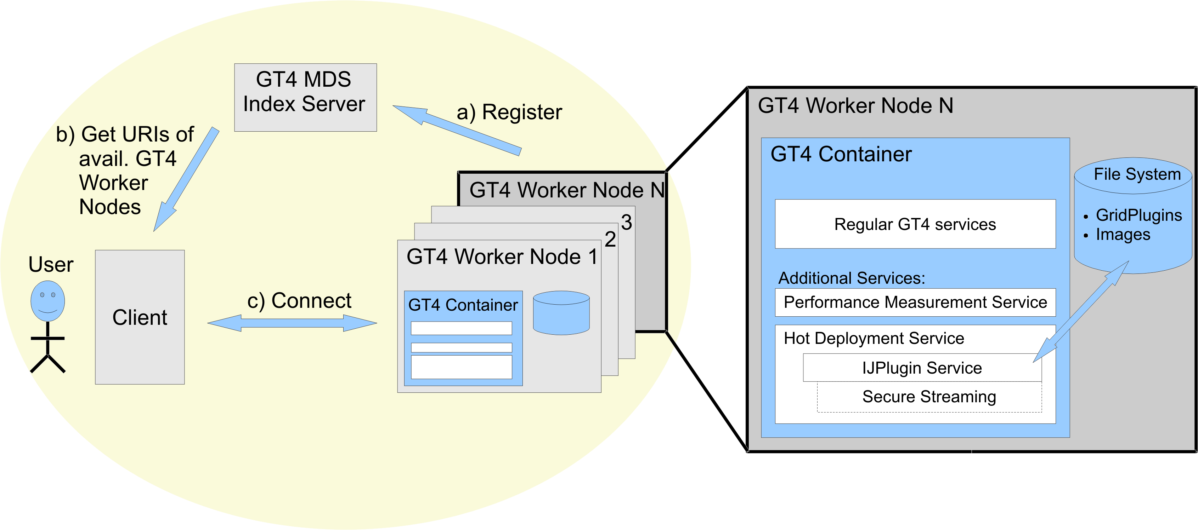
GridIJ
Service Oriented Architecture based on WSRF services

Slide 8
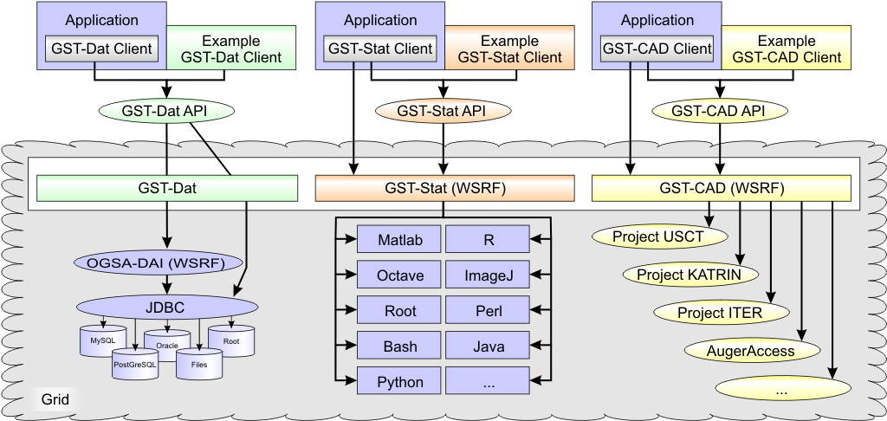
Grid Services Toolkit (GST)
Functional services for process data processing

Slide 9
Conclusion
RISGE: Remote instrumentation
  World wide secure access
  Virtual control room (GRIDCC)
Possible contributions
  Remote data acquisition
    Processing of data from detectors, sensors, …
    Data streaming
  Ad hoc data analysis
    Usage of Service Oriented Architectures
    (QoS)
  Easy and flexible management of heterogeneous resources
    Managing of resources from one central instance
    Deploy of new services without restart of container
    Adding workstations on demand
  Increase acceptance

Slide 10

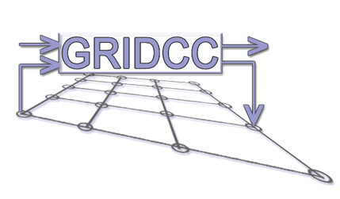




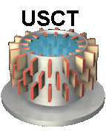

Thank you for your attention!

