Slide 1


Standards Compliance – Lessons Learned
Alexander Papaspyrou

Slide 2

Overview
Background
  Idea & Goals
  Requirements
Architecture
  Layers & Components
  Interaction
Standardization
Conclusion

Slide 3
Idea & Goal
Offer Standalone Solution for Scheduling of Distributed Resources
Cover both Research and Production Requirements
Allow Transfer of Models, Algorithms, and Strategies from University to Industry Domain
→ provide an extensible framework for scheduling in Grid environments

Slide 4
Requirements
Research
rich model, algorithm, and strategy support
strong evaluation capabilities
high simulation performance
extensible toolbox
Production
ease of deployment and configuration
support of open standards
scalability in large Grid communities
compatibility with standard tools

Slide 5
Architecture
Grid
Acceptance
Policy
Distribution
Policy
Decision Maker
Scheduler
Strategy
Information Provider
Site
Workload Submission
Description
Metrics
Description
Metrics
XML
Commons
Job Model
Lifecycle
CSV
Persistence
…
AWRT/U
DBM
Provenance
UR
RUS
Foundation
Event Management
Runtime Environment

Slide 6
Foundation Layer
Event Management
Event Driven Kernel
  isolated time handling
  extensible event types
Distinct Runtime Environments
  Simulation
    single/desktop
    parallel/cluster
  Production
    Enterprise Environments
    Community Grids
Type System
Kernel
Clock
Runtime Environment
Production
Container
Simulation
Engine
Debugging
System
…

Slide 7
Commons
Performance Measurement
Old school metrics
  AWRT
  UTIL
„Grid-related“ things
  OGSA-UR
  S/N-ratio
  („ooze-away“ rating)
Persistence Layer
→ delivers input for scheduler decisions
Job Model
Description
  JSDL (vanilla)
  Some time-related attributes (see SA)
Lifecycle
  State Model w/ timestamps
  Extension to BES states
Provenance
  Tracking of jobs
  Scheduling-specific!

Slide 8
Site Layer
Managed Set of Resources
  Compute Nodes
  Tape Libraries
Information Provider Entrypoint
  Resource description
  Metrics access
Scheduling System
  Flexible policies
  Dynamic (runtime) adaptation
Planning Advisory Protocol
  Strategy advises
  Scheduler vetoes
Workload Submission SPI
  WS-GRAM
  DRMAA
advise
decide
Scheduler
Strategy
FCFS
EASY
Description
MPP
Job Pool
Grid Aware
control
Schedule
Information Provider
Workload Submission
Metrics
Globus
SPI
DRMAA
SPI

Slide 9
Grid Layer
qsth
DRMAA
Decision Maker
Scheduler
BESng
Workload Submission
Submission Interface
  Local jobs (via IEEE 1003.1 Sect. 3, DRMAA)
  Remote jobs (via OGSA-BES, „The GSA Spec“)
Acceptance/Distribution Policies

Slide 10
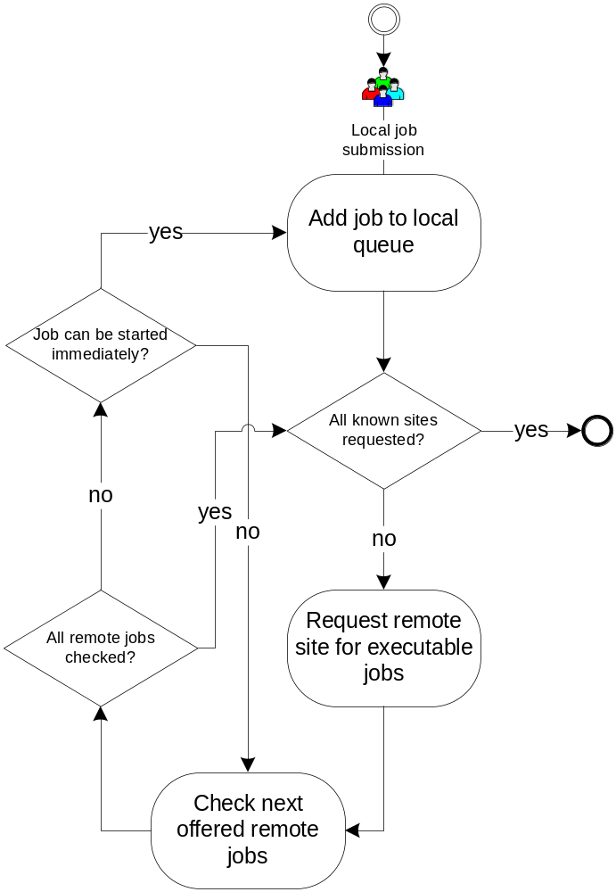
Protocol
Fairly simple
  No frills
  Power through Policies
Two-phase commit
  Ask for
  Say ok
Push/Pull model
  Offer
  Request

Slide 11


Interaction
One interface fits all
  Single
  Consistent
  Regardless of Client Type
It‘s all about responsibility
Grid
Site
Site

Slide 12
Lessons Learned
In a way, current „standards“ are
  too simple
  too complicated
For the EPS, it is important to have a
  grand unified view
  different means for submission of workload
Tracking the responsibility for a job is
  crucial for users
  helpful for schedulers

Slide 13
Conclusion
We haven‘t arrived, but are close
  Uniform „Submission“ Interface
  Richer than BES
  Covering Responsibilities
  Allowing Provenance
WS-Agreement nice, but insufficient

Slide 14




Thank You
Christian Grimme
christian.grimme@udo.edu
Joachim Lepping
joachim.lepping@udo.edu
Alexander Papaspyrou
alexander.papaspyrou@udo.edu
Robotics Research Institute
Information Technology Section
Dortmund University, Germany
http://ds.e-technik.uni-dortmund.de/~rmg/content/
http://ds.e-technik.uni-dortmund.de/~rmg/content/projects/teikoku/
http://tinyurl.com/2o3tnx

