Slide 1

Aggregate Usage Representation
OGF 24, Singapore

Slide 2
OGF IPR Policies Apply
“I acknowledge that participation in this meeting is subject to the OGF Intellectual Property Policy.”
Intellectual Property Notices Note Well: All statements related to the activities of the OGF and addressed to the OGF are subject to all provisions of Appendix B of GFD-C.1, which grants to the OGF and its participants certain licenses and rights in such statements. Such statements include verbal statements in OGF meetings, as well as written and electronic communications made at any time or place, which are addressed to:
    the OGF plenary session,
    any OGF working group or portion thereof,
    the OGF Board of Directors, the GFSG, or any member thereof on behalf of the OGF,
    the ADCOM, or any member thereof on behalf of the ADCOM,
    any OGF mailing list, including any group list, or any other list functioning under OGF auspices,
    the OGF Editor or the document authoring and review process
Statements made outside of a OGF meeting, mailing list or other function, that are clearly not intended to be input to an OGF activity, group or function, are not subject to these provisions.
Excerpt from Appendix B of GFD-C.1: ”Where the OGF knows of rights, or claimed rights, the OGF secretariat shall attempt to obtain from the claimant of such rights, a written assurance that upon approval by the GFSG of the relevant OGF document(s), any party will be able to obtain the right to implement, use and distribute the technology or works when implementing, using or distributing technology based upon the specific specification(s) under openly specified, reasonable, non-discriminatory terms. The working group or research group proposing the use of the technology with respect to which the proprietary rights are claimed may assist the OGF secretariat in this effort. The results of this procedure shall not affect advancement of document, except that the GFSG may defer approval where a delay may facilitate the obtaining of such assurances. The results will, however, be recorded by the OGF Secretariat, and made available. The GFSG may also direct that a summary of the results be included in any GFD published containing the specification.”
OGF Intellectual Property Policies are adapted from the IETF Intellectual Property Policies that support the Internet Standards Process.
Notes:
IPR Notices Note Well for OGF meetings

Slide 3

Outline
Overview
Anatomy of AUR v1.0
Aggregation Process
  Classification
  Recommendations to RUS-WG
Example Implementation

Slide 4
Overview
Aggregate Usage Record Format
  Version 1.0 (draft)
  Co-edited by EGEE/WLCG, OSG
  Proposed on Dec. 2006
  A standard for summary/aggregate usage representation in XML format
Document available at: https://forge.gridforum.org/sf/go/doc14534?nav=1

Slide 5
Motivation
Motivated by
  Accounting requirements
    Statistic usage reporting
  RUS advanced requirements
    server-side aggregation
  Management
    Performance tuning
  Usage monitoring
    Checking resource usage against allocated quotas

Slide 6
Usage Scenario
Accounting in WLCG
  Requires usage information collected from three grid infrastructure peers, OSG, NorduGrid and EGEE
  Only aggregate/summary usage information shared to GOC/CCLRC for statistic usage reporting on per site and per VO basis
  Data transportation
    APEL publisher/R-GMA
    Direct MySQL insertion
    Email SQL insert statement

Slide 7
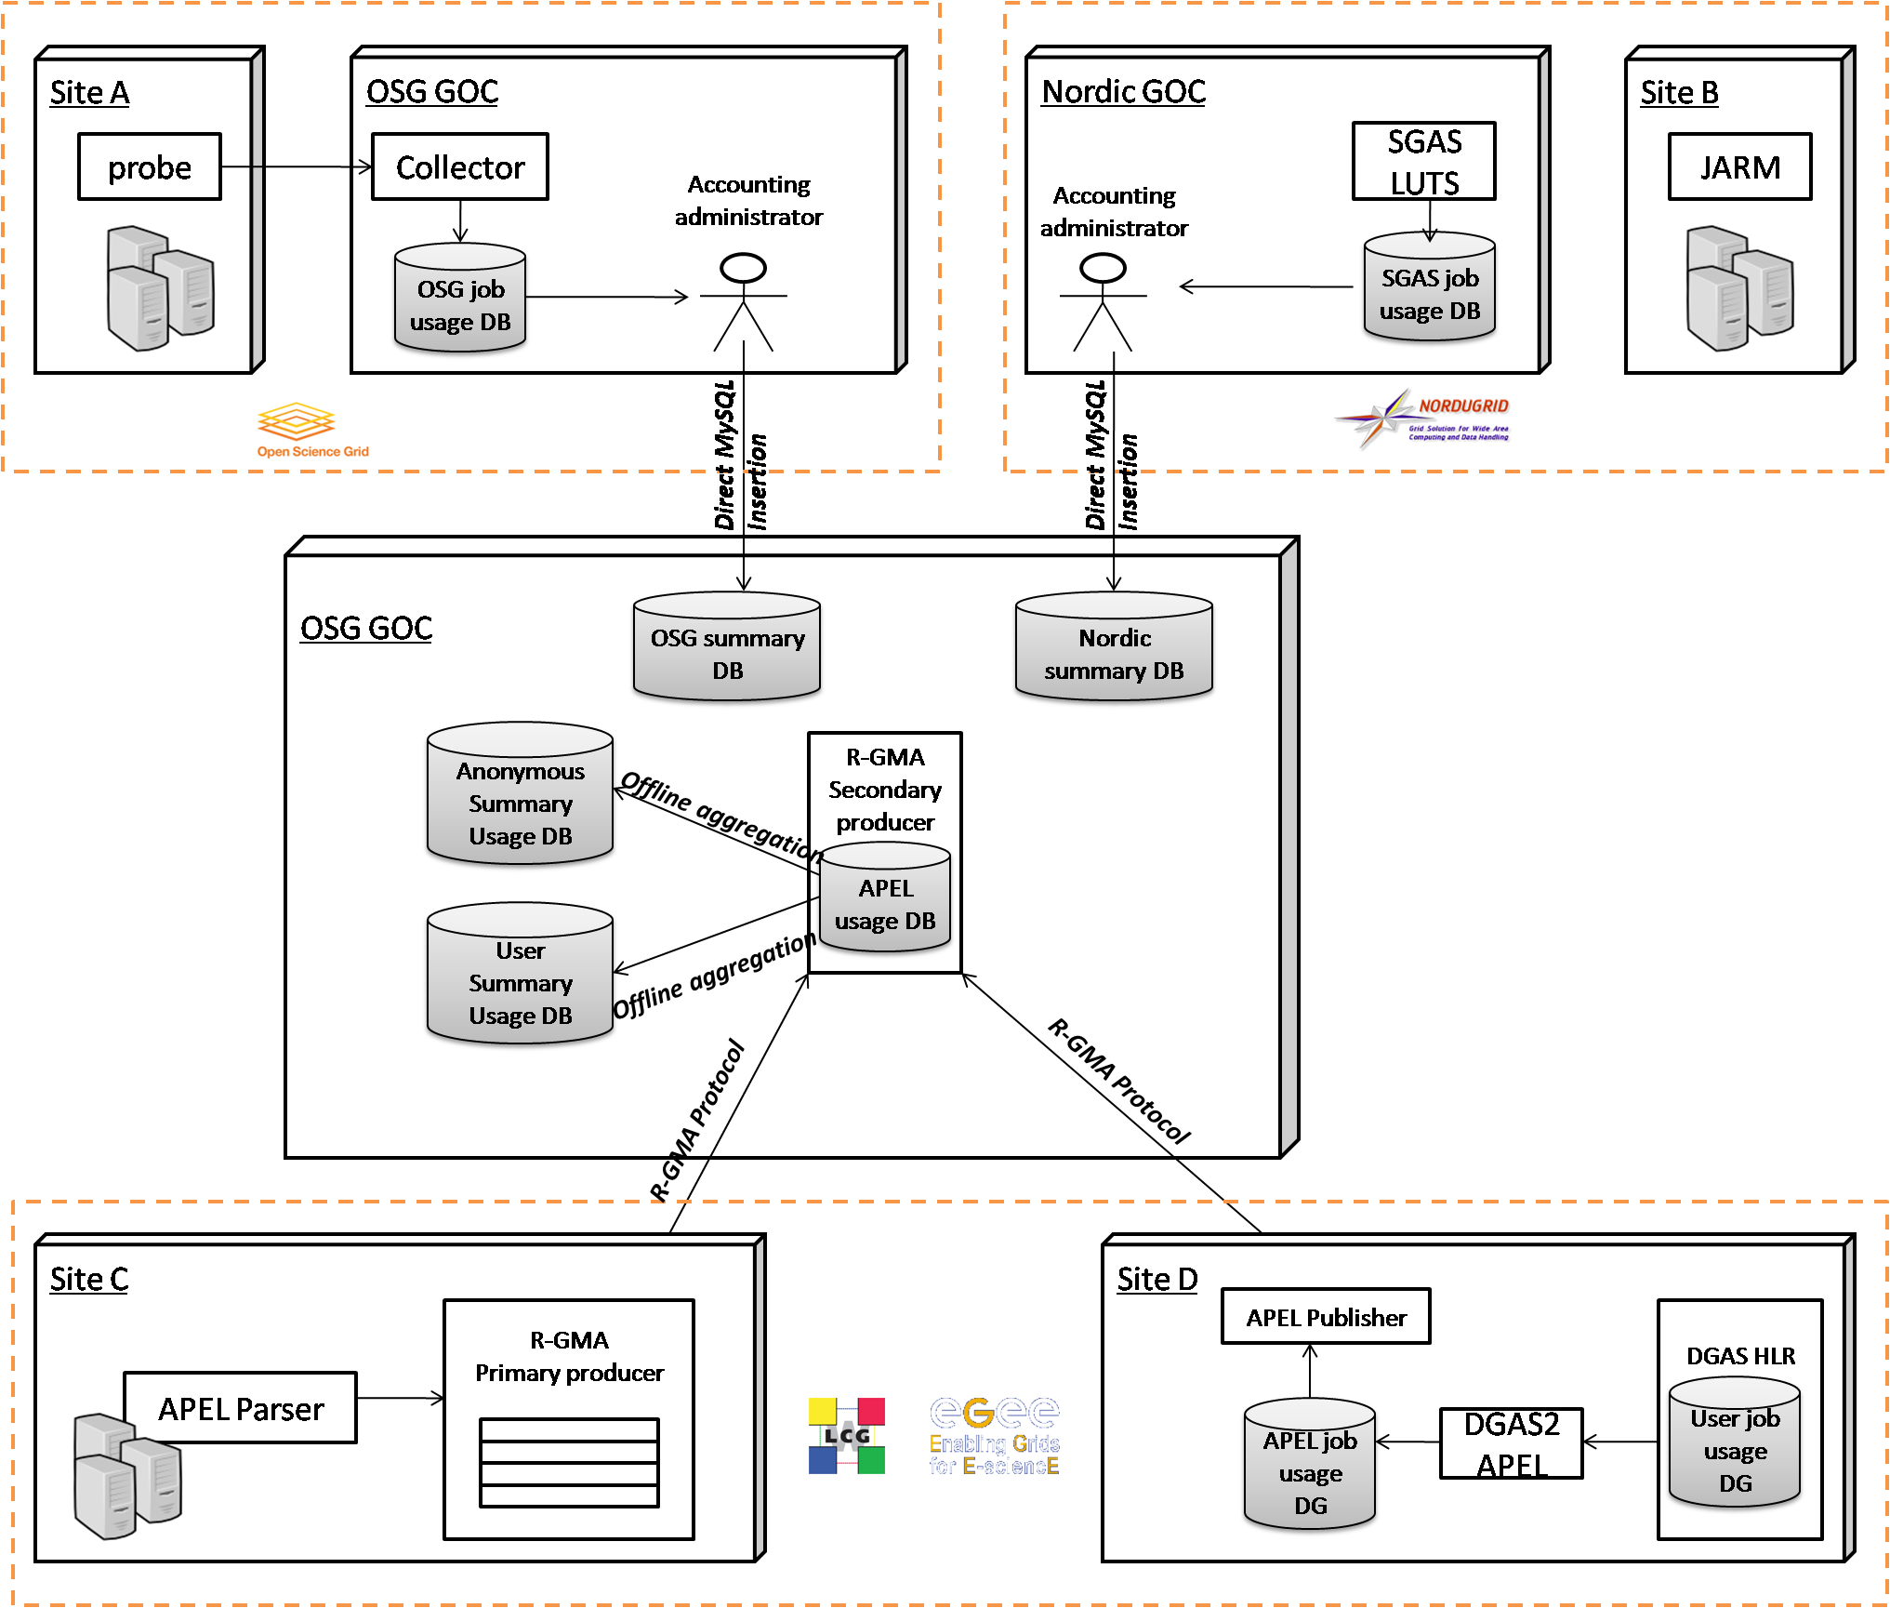
Usage Scenario

Slide 8
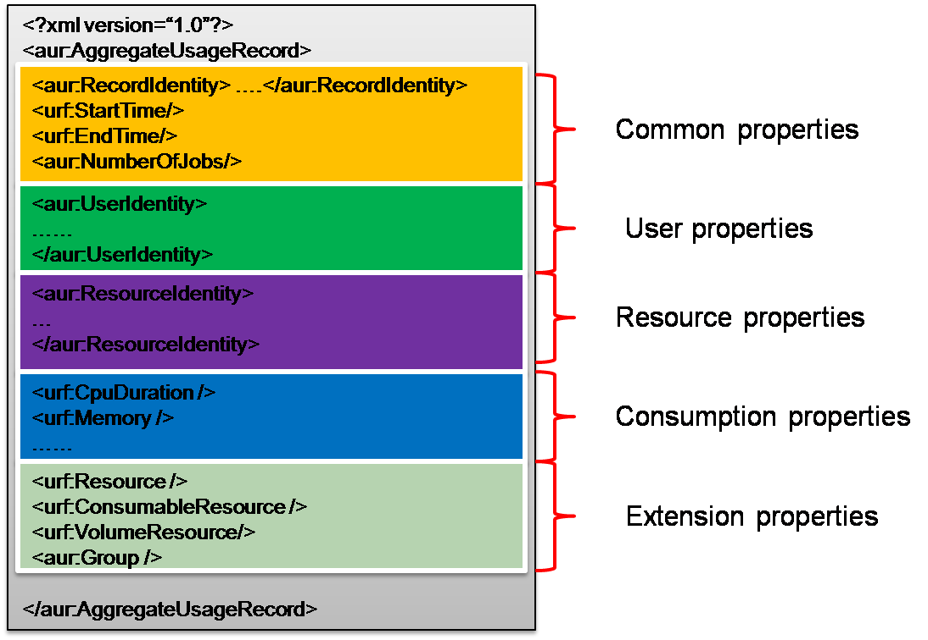
Anatomy of AUR
An aggregate usage record instance
  represents summary usage information of a number of jobs

Slide 9
Anatomy of AUR
User properties
  Ownership of jobs aggregated within a usage record instance
  Encapsulated within <aur:UserIdentity> element
Property | Description | Data Type (XSD)
urf:GlobalUserName | Global user identity(e.g user DN) | xsd:string
urf:LocalUserId | Local user identity | xsd:string
aur:UserFQAN | Full Qualified Attribute Name | xsd:string
aur:VOName | Virtual Organization name | xsd:string
urf:ProjectName | Project Name | xsd:string
ds:KeyInfo | Key information for encryption/decryption | ds:KeyInfoType

Slide 10
Anatomy of AUR
Resource properties
  Includes properties of logical or physical resources on which jobs aggregated executed
  Encapsulated within <aur:ResourceIdentity> element
Property | Description | Data Type (XSD)
aur:SiteName | Executing site name | xsd:string
aur:ClusterId | Executing cluster identity | xsd:string
urf:Queue | Queue name | xsd:string
urf:Host | Executing host name | xsd:string
urf:MachineName | Executing machine name | xsd:string
urf:SubmitHost | Submit host name | xsd:string
urf:ServiceLevel | Service level information | xsd:string

Slide 11
Anatomy of AUR
Common properties
  Properties shared by all aggregate usage instances
  Children of root element, <aur:AggregateUsageRecord>
Property | Description | Data Type (XSD)
urf:status | The status of all jobs aggregated within a record instance | xsd:string
aur:NumberOfJobs | The number of jobs aggregated within a record instance | xsd:int
urf:StartTime | The earliest job start time among jobs aggregated within a record instance | xsd:dateTime
urf:EndTime | The latest job end time among jobs aggregated within a record instance | xsd:dateTime
urf:RecordIdentity | The identity of a record instance | xsd:complexType

Slide 12
Anatomy of AUR
Consumption Properties
  Computational usage
    Processors, CPU, WCT, Node count…
  Storage usage
    Memory, swap, disk…
  Networking usage
    Network
  Credit usage
    Charge
All from UR version 1
  Except representing summary usage of all jobs aggregated within a record instance

Slide 13
Anatomy of AUR
Extension Framework
  UR extension framework
    Resource definition out of scope of UR
  AUR extension framework
    Group definition specifying custom aggregation criteria

Slide 14
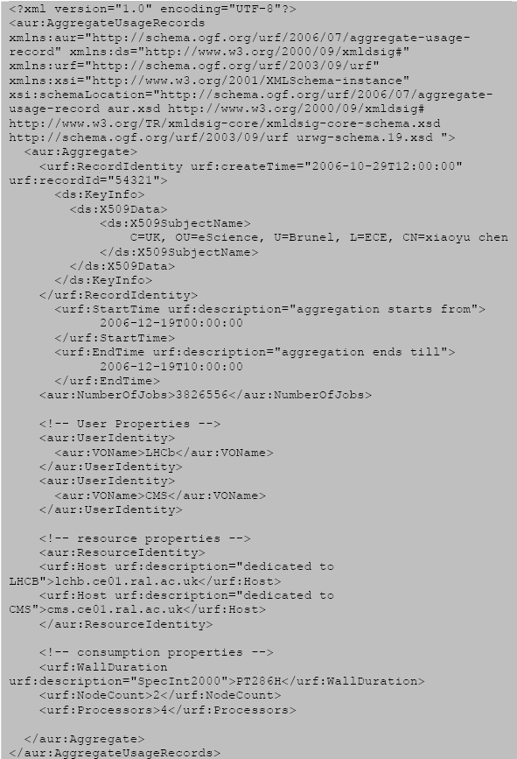
Sample

Slide 15
Aggregation Process
Simplified aggregation process
UR
Aggregation Process
AUR
…
UR
grouping
strategy

Slide 16
Aggregation Process
Classification
  RUS logics
    Aggregation as insertion
    Aggregation as extraction
  Aggregation Time
    On-demand
    Persistent aggregation

Slide 17
Aggregation Process
Persistence aggregation as Insertion
  A persistent storage for AUR
  Insert UR or AUR through RUS::InsertUsageRecords interface
  Aggregation strategy can be either specified with request message or hard-coded within RUS
UR
Aggregation strategy
UR
UR
AUR
RUS
UR
UR
AUR
Aggregation strategy

Slide 18
Aggregation Process
Persistence aggregation as extraction
  A persistent storage for AUR
  Query summary usage information through RUS::extractUsageRecords API
UR
AUR
UR
RUS
AUR

Slide 19
Aggregation Process
On-demand aggregation as insertion
  No persistent storage for AUR
  works a utility function that accepts UR as input and returns AUR as output
  Aggregation strategy can be either specified with request message or hard-coded within RUS
Aggregation strategy
UR
UR
UR
RUS
UR
UR
AUR
Aggregation strategy

Slide 20
Aggregation Process
On-demand aggregation as extraction
  No persistent storage for AUR
  Invocated through RUS::extractUsageRecords APIs
  Aggregation Strategy can be either specified with input message or hard-coded within RUS
Aggregation strategy
UR
UR
UR
AUR
RUS
Aggregation strategy

Slide 21
Aggregation Process
Recommendation to RUS
  Current draft (version 1.0)
    Not extensible
    Does not allow AUR input/output
  Prospective draft (Core WS-I)
    Extensible
    AUR as request/response extensions through xsd:any
    Does not allow grouping strategy input/output

Slide 22
Aggregation Process
Proposes to RUS sever-side aggregation
  Solution 1: aggregate strategy as header
  Solution 2: requires efforts on request/response message definition
<env:Envelop>
<env:Header>
<rus:groupBy aggregate=“true|false”>
<urf:StartTime>xsd:dateTime</urf:StartTime>
<urf:EndTime>xsd:dateTime</urf:EndTime>
<rus:usage>xsd:Qname<rus:Usage>
{xsd:any}
</env.groupBy>
<.env:Header>
<env:SOAP>
The <rus:groupBy> can be used for two purposes:
1). An alternative way to specify extraction criteria without using xpath expression. In this model, the aggregate attribute is set as false
2). Used to specify aggregation strategy and set aggregate attribute as true.

Slide 23
Aggregation Process
Proposes to RUS sever-side aggregation
  Solution 1: aggregate strategy as header
  Solution 2: requires efforts on request/response message definition
<env:Envelop>
<env:Header>
<rus:groupBy aggregate=“true|false”>
<urf:StartTime>xsd:dateTime</urf:StartTime>
<urf:EndTime>xsd:dateTime</urf:EndTime>
<rus:usage>xsd:Qname<rus:Usage>
{xsd:any}
</env.groupBy>
<.env:Header>
<env:SOAP>
<urf:StartTime> and <urf:EndTime> are two mandatory properties to limit aggregation durtion

Slide 24
Aggregation Process
Proposes to RUS sever-side aggregation
  Solution 1: aggregate strategy as header
  Solution 2: requires efforts on request/response message definition
<env:Envelop>
<env:Header>
<rus:groupBy aggregate=“true|false”>
<urf:StartTime>xsd:dateTime</urf:StartTime>
<urf:EndTime>xsd:dateTime</urf:EndTime>
<rus:usage>xsd:Qname<rus:Usage>
{xsd:any}
</env.groupBy>
<.env:Header>
<env:SOAP>
<rus:Usage> is used to specify consumption information to be aggregated or returned.
e.g.
.<rus:Usage>urf:CpuDuration</rus:Usage>

Slide 25
Aggregation Process
Proposes to RUS sever-side aggregation
  Solution 1: aggregate strategy as header
  Solution 2: requires efforts on request/response message definition
<env:Envelop>
<env:Header>
<rus:groupBy aggregate=“true|false”>
<urf:StartTime>xsd:dateTime</urf:StartTime>
<urf:EndTime>xsd:dateTime</urf:EndTime>
<rus:usage>xsd:Qname<rus:Usage>
{xsd:any}
</env.groupBy>
<.env:Header>
<env:SOAP>
Extensions are used to specify aggregation resource entities, e.g. urf:host, urf:MachineName, or other resources specified with UR extension framework.

Slide 26
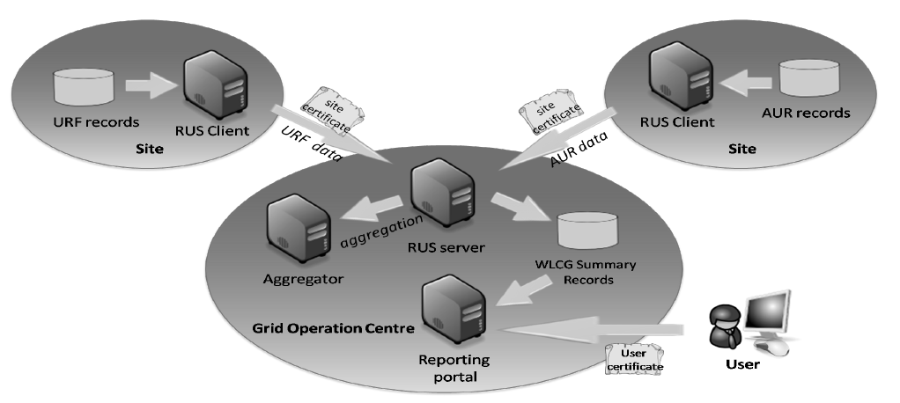
WLCG-RUS
An alternative data transport for usage sharing in WLCG using RUS
Push Model
  Site RUS push either job or aggregate usage records to GOC RUS server
  On-demand & persistent aggregation is realised through aggregator component

Slide 27
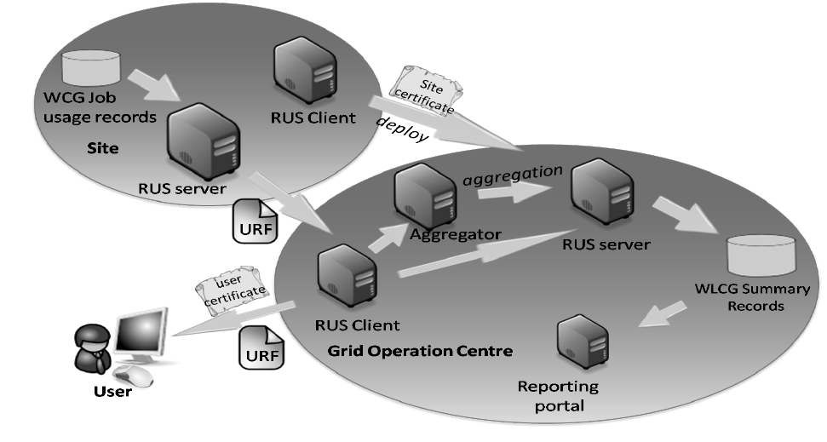
WLCG-RUS
An alternative data transport for usage sharing in WLCG using RUS
Pull Model
  Site has a RUS running that maintains job usage records only;
  GOC RUS maintains a list of site RUS service endpoint list
  Site administrator deploy site-specific RUS service endpoint through register interface
  Aggregator periodically contact site RUS and aggregate on behalf of site, and store aggregated results

Slide 28
Full Copyright Notice
Copyright (C) Open Grid Forum (2008). All Rights Reserved.
This document and translations of it may be copied and furnished to others, and derivative works that comment on or otherwise explain it or assist in its implementation may be prepared, copied, published and distributed, in whole or in part, without restriction of any kind, provided that the above copyright notice and this paragraph are included on all such copies and derivative works.
The limited permissions granted above are perpetual and will not be revoked by the OGF or its successors or assignees.
Notes:
OGF Full Copyright Notice if necessary

