Slide 1
TeraGrid GLUE 2 Implementation
Warren Smith, TACC
JP Navarro, U. of Chicago/ANL
TeraGrid Grid Infrastructure Group
OGF 28
March 18, 2010
Notes:
NSF TeraGrid Review
January 10, 2006
Charlie Catlett (cec@uchicago.edu)

Slide 2
Overview
Initial Goals
  Provide information for meta-scheduling resource selection
  Provide information for predicting queue wait times
  Integrated with our XML based information service
Status
  Production on 10 of 14 TeraGrid HPC compute resources
Approach
  Use GLUE 2 standard to improve interoperability and minimize effort
  Develop only the SUBSET that provides information need
  Automated local resource manager/scheduler information gathering
  Useable for other purposes besides initial goals, locally extensible
March 18, 2010
OSG 28 - TeraGrid Glue 2 Status

Slide 3
Schema
TeraGrid has defined our own XMLSchema
  Using the GLUE 2.0 specification
  http://software.teragrid.org/pacman/ctss4/glue2/teragrid_glue_2.0_r01.xsd
This schema is flat
  Base element is Entities
  All other major elements are children of Entities
  Entities are associated with each other using IDs
We still prefer a flat schema
  Easier to compose information
  Partial information doesn’t require filler information to be valid
  As easy to read with our usage – each document has information about exactly one system
March 18, 2010
OSG 28 - TeraGrid Glue 2 Status

Slide 4
Information Gathering I
Implemented as a set of Python scripts
  Each script outputs XML
  Generic classes for major GLUE 2.0 entities
    Computing{Activity,Endpoint,Manager,Service,Share}
    ExecutionEnvironment
  Specific implementations as subclasses
    PBSComputingActivity
    TeraGridGramEndpoint
Scripts typically organized in a hierarchy
  Invoke child scripts to gather any unknown information
  ComputingManager -> ComputingShare -> ComputingActivity
March 18, 2010
OSG 28 - TeraGrid Glue 2 Status

Slide 5
Information Gathering II
Installed and configured on each compute resource
Top-level script is periodically invoked via cron
  On a login or admin node
  As a normal user
Top-level script:
  Invokes all scripts necessary to gather information about a resource
  Writes an XML document to each of two files
    One document has all public information
    Other document has sensitive information (job descriptions)
TeraGrid Local Information Services read and publish these XML documents
March 18, 2010
OSG 28 - TeraGrid Glue 2 Status

Slide 6
Local Resource Managers/Schedulers
Supported Local Resource Managers/Schedulers:
  Cobalt (HPC job management suite for IBM BlueGene)
  Condor
  LoadLeveler
  LSF
  Moab/Maui
    ComputeActivity only
    Provides jobs in schedule order
  PBS Variants
  SGE
March 18, 2010
OSG 28 - TeraGrid Glue 2 Status

Slide 7
High-Level Design
TeraGrid Local
Information Services
TeraGrid Wide
Information Services
Information Users
TeraGrid Meta-Scheduler
(Condor MatchMaker)
TeraGrid Batch Queue Predictor
(Karnak)
…
Local Resource Manager/
Scheduler
March 18, 2010
OSG 28 - TeraGrid Glue 2 Status
Notes:
NSF TeraGrid Review
January 10, 2006
Charlie Catlett (cec@uchicago.edu)
This is both a high-availability and high-throughput design
Dynamic DNS provides a 15 minute ttl in failover situations
Automated difference detection, manual synchronization

Slide 8
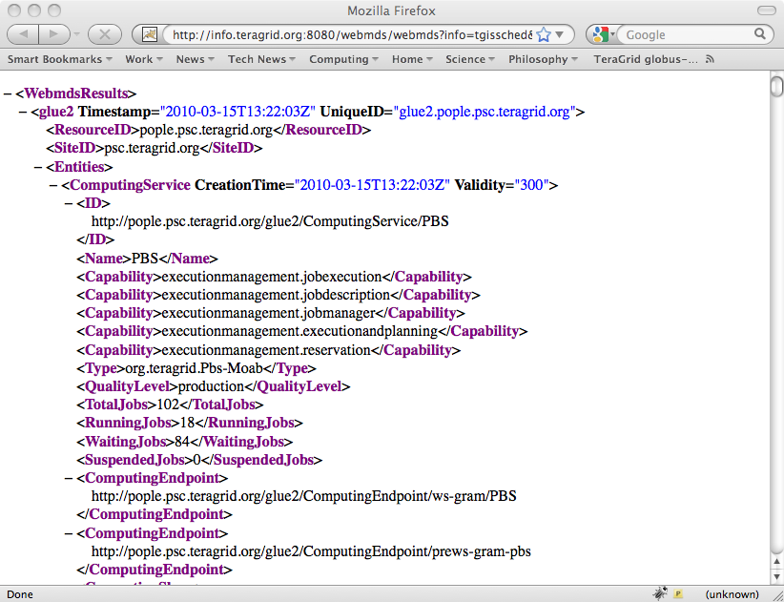
Sample Content
http://info.teragrid.org:8080/webmds/webmds?info=tgissched&xmlSource.tgissched.param.xpathQuery=//glue2
March 18, 2010
OSG 28 - TeraGrid Glue 2 Status

Slide 9
More Information
TeraGrid GLUE 2 Design and Coordination
  Warren Smith wsmith@tacc.utexas.edu
TeraGrid Information Services Coordination
  JP Navarro navarro@mcs.anl.gov
Public GLUE 2 Implementation
  http://software.teragrid.org/pacman/ctss4/glue2
TeraGrid Information Service
  http://info.teragrid.org/
March 18, 2010
OSG 28 - TeraGrid Glue 2 Status

