Slide 1

Network Services Interface
OGF30: Connection Services
Guy Roberts, 27th Oct 2010

Slide 2
OGF IPR Policies Apply
“I acknowledge that participation in this meeting is subject to the OGF Intellectual Property Policy.”
Intellectual Property Notices Note Well: All statements related to the activities of the OGF and addressed to the OGF are subject to all provisions of Appendix B of GFD-C.1, which grants to the OGF and its participants certain licenses and rights in such statements. Such statements include verbal statements in OGF meetings, as well as written and electronic communications made at any time or place, which are addressed to:
    the OGF plenary session,
    any OGF working group or portion thereof,
    the OGF Board of Directors, the GFSG, or any member thereof on behalf of the OGF,
    the ADCOM, or any member thereof on behalf of the ADCOM,
    any OGF mailing list, including any group list, or any other list functioning under OGF auspices,
    the OGF Editor or the document authoring and review process
Statements made outside of a OGF meeting, mailing list or other function, that are clearly not intended to be input to an OGF activity, group or function, are not subject to these provisions.
Excerpt from Appendix B of GFD-C.1: ”Where the OGF knows of rights, or claimed rights, the OGF secretariat shall attempt to obtain from the claimant of such rights, a written assurance that upon approval by the GFSG of the relevant OGF document(s), any party will be able to obtain the right to implement, use and distribute the technology or works when implementing, using or distributing technology based upon the specific specification(s) under openly specified, reasonable, non-discriminatory terms. The working group or research group proposing the use of the technology with respect to which the proprietary rights are claimed may assist the OGF secretariat in this effort. The results of this procedure shall not affect advancement of document, except that the GFSG may defer approval where a delay may facilitate the obtaining of such assurances. The results will, however, be recorded by the OGF Secretariat, and made available. The GFSG may also direct that a summary of the results be included in any GFD published containing the specification.”
OGF Intellectual Property Policies are adapted from the IETF Intellectual Property Policies that support the Internet Standards Process.
Notes:
IPR Notices Note Well for OGF meetings

Slide 3
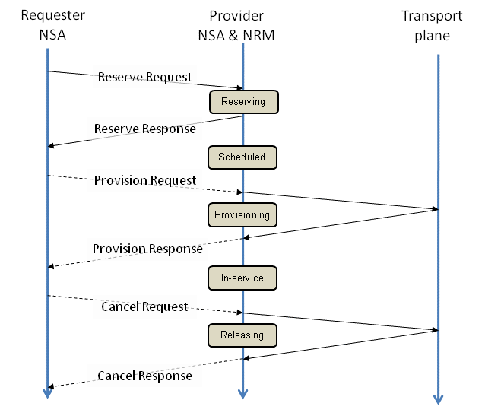
Connection Service
Basic primitives:
ReserveRequest
ProvisionRequest
CancelRequest

Slide 4
Reservations
Advance reservation
Immediate reservation
1 Phase Commit
Automatic and Explicit provisioning
Two types of time identified: resource and service times
Automatic provisioning uses service time
Explicit provisioning uses resource time

Slide 5
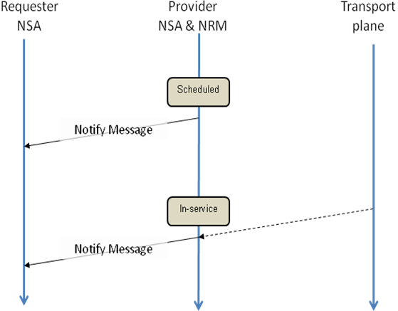
Notify primitive
A notify primitive has been specified to support spontaneous notifications

Slide 6
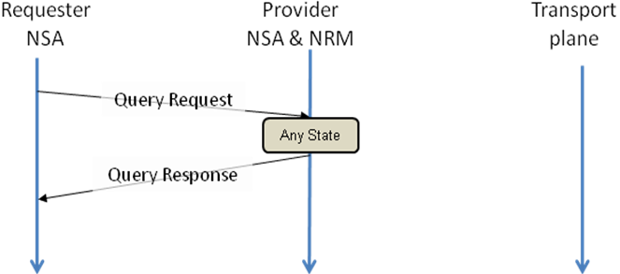
Query
A notify primitive has been specified to support querying of provider state.

Slide 7
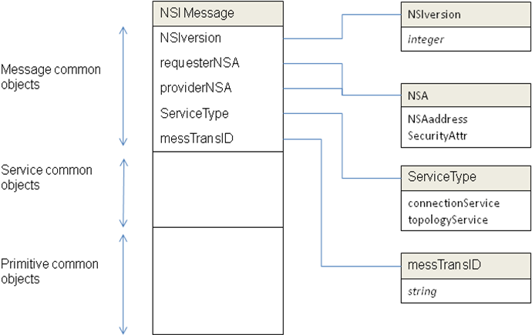
Messages: common attributes
Message divided into 3 parts: common, service and primitive
Common attributes includes information common to all service

Slide 8
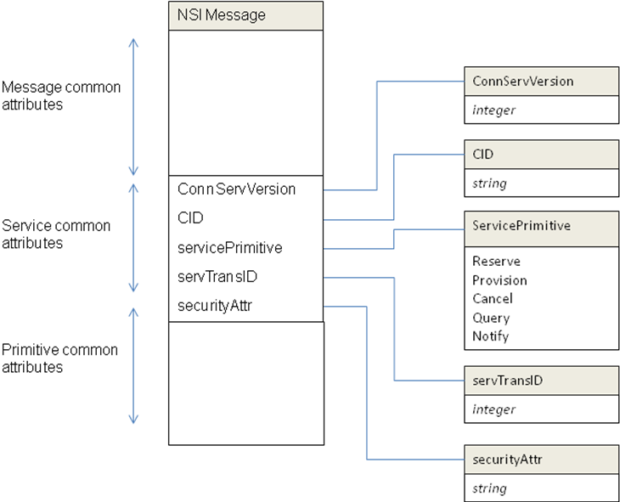
Messages: Service attributes
Service attributes includes information common to all one service
Connection service includes service version, Id, primitive…

Slide 9
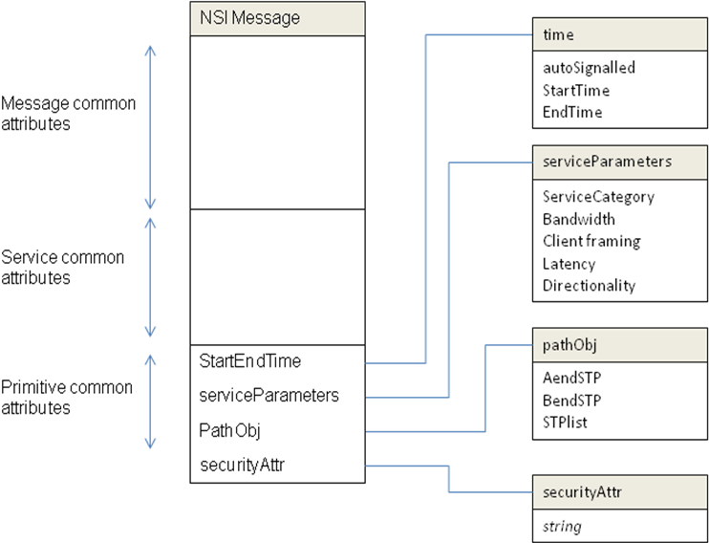
Messages: Primitive attributes
Primitive attributes includes information common to all one primitive
Reservation primitive attributes includes times, SD parameters, path

Slide 10
Service Definition attributes
The Service Definition (SD) describes the service supported
The SD has a set of attributes that describe the service
The serviceCategory identifies the service type to be provided
Provider NSA must support the serviceCategory for the request to be valid
An example of a ServiceCategory could be an Ethernet VLAN service. In this case the ServiceParameters attributes might be:
Client framing: client tagged VLAN as per 802.1Q
Bandwidth: 100Mb/s to 10Gb/s with a granularity of 100Mb/s
Latency: 1ms to 1000ms, granularity of 1 ms
Directionality: unidirectional/bidirectional

Slide 11
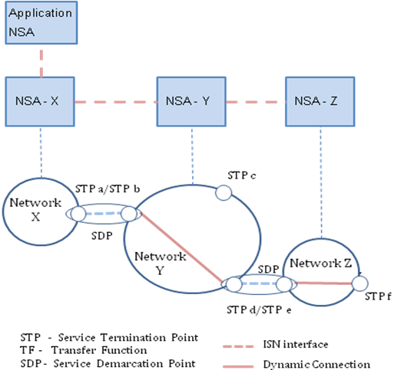
Paths
Path == [CID-1 (STP:X:a,CID-2 (STP:Y:b, STP:Y:d, CID-3(STP:Z:e, STP:Z:f)))]

Slide 12
Issues
NSF changed to NSIF Framework for Network Services (FNS)? NSvF NSAF. - propose to keep NSF
Move common message attributes from CS to NSF? Yes.. Copy to NSF with modifications
Which transport protocols for NSI?
Support for multiple transport protocols?
Greater detail required for usage of Notify and Query primitives
Do we need Modify primitive in rel 1.0?
More concise definition of time
Is Federating NSA a suitable term? Term is overloaded, needs disambiguation. Proposal is to identify only the combination of provider and requester in one Agent
Highlight that the name identifies the *role* of the NSA. Possible name: Broker NSA, RequesterProvider NSA, intermediate NSA, Note that role changes with context/usage. Distinguish capabilities and roles.

Slide 13
Full Copyright Notice
Copyright (C) Open Grid Forum (2008-2010). All Rights Reserved.
This document and translations of it may be copied and furnished to others, and derivative works that comment on or otherwise explain it or assist in its implementation may be prepared, copied, published and distributed, in whole or in part, without restriction of any kind, provided that the above copyright notice and this paragraph are included on all such copies and derivative works.
The limited permissions granted above are perpetual and will not be revoked by the OGF or its successors or assignees.
Notes:
OGF Full Copyright Notice if necessary

