Slide 1

Session Introduction and
Current Status of
Network Services Interface-WG
NSI-WG meeting, OGF31 at Taipei, Taiwan
Co-chairs: Guy Roberts, Tomohiro Kudoh, Inder Monga
21st Mar. 2011

Slide 2
OGF IPR Policies
“I acknowledge that participation in this meeting is subject to the OGF Intellectual Property Policy.”
Intellectual Property Notices Note Well: All statements related to the activities of the OGF and addressed to the OGF are subject to all provisions of Appendix B of GFD-C.1, which grants to the OGF and its participants certain licenses and rights in such statements. Such statements include verbal statements in OGF meetings, as well as written and electronic communications made at any time or place, which are addressed to:
    the OGF plenary session,
    any OGF working group or portion thereof,
    the OGF Board of Directors, the GFSG, or any member thereof on behalf of the OGF,
    the ADCOM, or any member thereof on behalf of the ADCOM,
    any OGF mailing list, including any group list, or any other list functioning under OGF auspices,
    the OGF Editor or the document authoring and review process
Statements made outside of a OGF meeting, mailing list or other function, that are clearly not intended to be input to an OGF activity, group or function, are not subject to these provisions.
Excerpt from Appendix B of GFD-C.1: ”Where the OGF knows of rights, or claimed rights, the OGF secretariat shall attempt to obtain from the claimant of such rights, a written assurance that upon approval by the GFSG of the relevant OGF document(s), any party will be able to obtain the right to implement, use and distribute the technology or works when implementing, using or distributing technology based upon the specific specification(s) under openly specified, reasonable, non-discriminatory terms. The working group or research group proposing the use of the technology with respect to which the proprietary rights are claimed may assist the OGF secretariat in this effort. The results of this procedure shall not affect advancement of document, except that the GFSG may defer approval where a delay may facilitate the obtaining of such assurances. The results will, however, be recorded by the OGF Secretariat, and made available. The GFSG may also direct that a summary of the results be included in any GFD published containing the specification.”
OGF Intellectual Property Policies are adapted from the IETF Intellectual Property Policies that support the Internet Standards Process.
Notes:
IPR Notices Note Well for OGF meetings

Slide 3
NSI meetings in OGF31
NSI working session
Sunday 11:00am– 12:30pm
Room: Conference room 1, AC
The session from 9:00am was cancelled
Agenda
  1. Session introduction - Tomohiro Kudoh
  2. Current status of NSI - 30 minutes Tomohiro Kudoh
  3. Service definition next steps - 15 minutes Takahiro Miyamoto

Slide 4
NSI documents
GFD.173 Network Services Framework
The NSF is a framework to support Network Services
Supports many services – initial service is Connection Service
Possible future services, e.g.: Network Topology Exchange Service
Status – NSF v1.0 has been published on Dec. 15, 2010
GFD.XXX Connection Service Architecture
Allows an application or network provider to request and automatically reserve and provision circuits from other network providers
Designed to support circuits that transit multiple service providers
Status – draft
GFD.XXX NSI Protocol
Normative definition of the NSI protocol.
Status: protocol is in process of being defined

Slide 5
Ad-hoc meetings after OGF30
At SC10, Nov. 17, 2010
At GLIF tech WG winter meeting, Feb.23-25, 2011

Slide 6
Things discussed
We will use Web Services for the first version of NSI protocol
Discussion on 1PC vs. 2PC for provisioning: We will use simple scheme which can emulate 2PC behavior
State machines

Slide 7
CS ID discussion
Each NSA has a globally unique ID = NSA_ID
RA generated Request ID to identify a connection service conversation must be unique within a given NSA = REQ_ID
Unique identification of the conversation is a combination of the RA generated request ID and the RA NSA identifier that generated the request = REQ_ID + NSA_ID = CS_Instance_ID
No requirement for the RA generated ID to be globally unique
There is a field in the message structure for optional use that an RA or PA can use to globally identify a connection. Its use is not mandated by the protocol so is an optional field
Note: You can have multiple connection service requests between the same RA-PA pair for the same connection request*****

Slide 8
Connection Service
Message Primitives
Agreed as mandatory primitives
  Reserve
  Provision
  Release
  Cancel
  Query (just for status polling of a reservation)
Still under discussion
  Notification
    Asynchronous notification from PA to RA mainly to notify errors
  Modify

Slide 9
Connection Service
Message Primitives
Reserve
  Request:
    Direction: RA → PA
    Purpose: Make a request to reserve network resources for a connection between two STP’s constrained by a certain service parameters
  Response: Direction: PA → RA
    Confirmed
      Purpose: The request to reserve the resources has been granted [includes segmentation]
      All children
    Failed
      Purpose: The request to reserve the resources could not meet the requested service parameters, may include error reason
      Means there are no residual children reservations anywhere in the system

Slide 10
Connection Service
Message Primitives
Provision
  Request:
    Direction: RA → PA
    Purpose: PA has been given permission to setup the reservation on RA’s behalf subject to the constraints of the requested service
  Response: Direction: PA → RA
    Confirmed
      Purpose: The provisioning of the resources has been completed [includes children]
    Failed
      Purpose: The provisioning of the resources could not be completed, self or children

Slide 11
Provisioning Failure discussion
When a child fails their provisioning, the child PA sends an Provisioning failure message to the corresponding RA
The RA notifies the Aggregator Function in the NSA. The Aggregator function may try to recover, if cannot, it will release all children and generate a provisioning failure event to its PA
That PA will send a provisioning failure up to its parent RA, and this process will do the same recursively till we get to the ultimate parent RA
The ultimate RA will, based on the internal policy function, decide to do something - possibilities including terminating the reservation with cancel or trying alternatives. What the ultimate RA does is out of the scope of the protocol discussion

Slide 12
Connection Service
Message Primitives
Release
  Request:
    Direction: RA → PA
    Purpose: PA should release the provisioned resources without removing the reservation.
  Confirm
    Direction: PA → RA
    Purpose: The releasing of the resources is done
  Fail
    Direction: PA → RA
    Purpose: The releasing of the resources failed
    Informational message, and stay in releasing state

Slide 13
Connection Service
Message Primitives
Cancel
  Request:
    Direction: RA → PA
    Purpose: PA should release the provisioned resources and cancel the reservation.
  Confirmed
    Direction: PA → RA
    Purpose: The releasing of the resources is done

Slide 14
Connection Service
Message Primitives
Query
  Request:
    Direction: RA → PA
    Purpose: This message is used as a status polling mechanism.
    This is a management function for CS
  Response
    Direction: PA → RA
    Purpose: The query information in a structured output as defined.

Slide 15
Query discussion
Not historical in nature. Only for currently active connections
If the connection does not exist, it returns the information that it does not exist
Query serves the function of recovery if the notification service has an error.
It serves as the management function for the CS

Slide 16
Connection Service
Optional Message Primitives
Notify
    Direction: RA → PA or PA → RA (?)
    Purpose: Informational message of notifying events mainly errors

Slide 17
Connection Service
Optional Message Primitives
Modify
  Request:
    Direction: RA → PA
    Purpose: Mechanism for RA to request a change in service definition while the reservation/connection service is in progress. The parameters allowed are ones that can be implemented without changing the state of the connection if it is in service
    It is fine for PA not to implement this, and ignore/reject the modify message
  Granted
    Direction: PA → RA
    Purpose: The query information in a structured output as defined.
  Not Granted
    Direction: PA → RA
    Purpose: Not accepted, reason for rejection

Slide 18
Provisioning Sequence
There had been a long discussion on 1PC/2PC, auto/manual start, guard time etc.
A simple provisioning sequence which can (in a sense) solve those issues was proposed and accepted.

Slide 19
Simple rule
Provisioning sequence starts at the reservation start time or when a provisioning message is received, WHICHEVER LATER, that’s it.
  If a provisioning message is received before the reservation start time, a provisioning sequence starts at the reservation start time, by using provider’s own clock
  If a provisioning message is received after the reservation start time, a provisioning sequence starts when the message is received
If a requested reservation start time is earlier than the time a reservation is confirmed, it is a immediate reservation
  Still can be handled by the above rule
No need to distinguish automatic/manual or immediate/advance

Slide 20
Case 1a
Requester
Provider
Provision message is received after the reserved start time
  Provision sequence starts when the provision message is received
Release is done at the end time
  De-provisioning sequence starts at the end time by using provider’s clock
reserve
confirm
Start
time
provision
provisioning
complete
Reserved
period
In service
End
time

Slide 21
Case 1b
Requester
Provider
Provision message is received before the reserved start time
  Provision sequence starts at the start time, by using provider’s clock
reserve
confirm
provision
Start
time
provisioning
complete
Reserved
period
In service
End
time

Slide 22
Case 2
Requester
Provider
Start time is earlier than the time a reservation is confirmed (immediate)
Provision message is received after the reserved start time
  Provision sequence starts when the provision message is received
Semantics not changed
Start
time
reserve
confirm
provision
provisioning
complete
Reserved
period
In service
End
time

Slide 23
Case 3 (manual release)
Requester
Provider
Release message is received before the end time
  De-provisioning sequence starts when the release message is received
reserve
confirm
provision
Start
time
provisioning
complete
Reserved
period
In service
release
release
confirm
End
time

Slide 24
Protocol State Machines
State machines for PA (Provider Agent) and RA (Requester Agent) were defined
These are state machines of message sequences, not of functions
Error (provisio fail) is reported to the requester NSA, but state transition is the same as the provision confirm case.

Slide 25
PA/RA state machines which only handle message exchange and sequence
(no behavior of NSA are modeled in the SM)
NSA
RA SM
NSI messages
NSA
Input/output internal to an NSA
PA SM
RA SM
RA SM
NSA
NSA
PA SM
PA SM
NRM
RA SM
NRM

Slide 26
Requestor Agent (RA) messaging state machine
Initial
Provisioning
>reserve_start
>rsv.rq
>provision_start
<prov.cf
>prov.rq
<provision_complete
Reserving
Reserved
Provisioned
<prov.fl
<rsv.cf
<provision_failed
<reserve_ok
<rel.cf
>release_start
<release_complete
Releasing
>rel.rq
<rsv.fl
<reserve_ng
Not necessary?
Terminated
Canceling
Any
state
<cncl.cf
>cancel_start
<cancel_complete
>cncl.rq
Input
red : an input/output event which is an NSI message
blue : an input/output event which is not an NSI message
>: Downstream input/output
<: Upstream input/output
rsv: reserve, prov: provision, rel: release, cncl: cancel
.rq : request, .cf: confirm, fl: failed
Output
RA SM

Slide 27
Provider Agent (PA) messaging state machine
Initial
Provisioning
>rsv.rq
>reserve_start
>prov.rq
<provision_complete
>provision_start
<prov.cf
Reserving
Reserved
Provisioned
<provision_failed
<reserve_ok
<prov.fl
<rsv.cf
<release_complete
>rel.rq
<rel.cf
Releasing
>release_start
<reserve_ng
<rsv.fl
Not necessary?
Terminated
Canceling
Any
state
<cancel_complete
>cncl.rq
<cncl.cf
>cancel_start
Input
red : an input/output event which is an NSI message
blue : an input/output event which is not an NSI message
>: Downstream input/output
<: Upstream input/output
rsv: reserve, prov: provision, rel: release, cncl: cancel
.rq : request, .cf: confirm, fl: failed
Output
PA SM

Slide 28
Sample Function State Machines
Sample state machines of ultimate provider and aggregator were discussed.
These are just sample state machines, and not a part of the protocol
  Other implementations which conforms NSI protocol are possible
Note that auto/manual start is handled only by the ultimate provider and protocol state machines do not distinguish them

Slide 29
Example: NS with Ultimate Requester(UR), Ultimate Provider(UP) and Aggregator (AG)
NSA
UR
RA SM
NSA
PA SM
AG
RA SM
RA SM
NSA
NSA
PA SM
PA SM
AG
UP
NRM
UP
RA SM
NRM

Slide 30
Sample Ultimate Provider with NSI messages
>rsv.rq, (reservation ok)
>prov.rq
(start_time, provision_succeeded)
Initial
<rsv.cf
Scheduled
Auto
Start
<prov.cf
(start_time)
(start_time, provision_failed)
>rsv.rq, (reservation ng)
<prov.fl
<rsv.fl
Idle
>prov.rq (provision_succeeded)
provisioned
<prov.cf
>prov.rq (provision_failed)
<prov.fl
(end_time)
(cancel)
>rel.rq
>cncl.rq
(release) <rel.cf
Any
state
Terminated
(cancel) <cncl.cf
Not necessary?
(end_time)
(release) (cancel)
Input
red : an input/output event which is an NSI message
>: Downstream input/output
<: Upstream input/output
rsv: reserve, prov: provision, rel: release, cncl: cancel
.rq : request, .cf: confirm, fl: failed
(event): internal event
,: “all” condition
Output

Slide 31
Sample Aggregator function with NSI messages
Initial
Provisioning
<prov.cf*
<prov.cf
>rsv.rq
>rsv.rq*
>prov.rq
>prov.rq*
<prov.fl#
Reserving
<rsv.cf*
Reserved
<prov.fl
In
Service
<rsv.cf
<rsv.fl&
<rel.cf*
>rel.rq
<rsv.fl
>cncl.rq*
<rel.cf
Releasing
>rel.rq*
Not necessary?
Terminated
Canceling
Any
state
<cncl.cf*
>cncl.rq
<cncl.cf
>cncl.rq*
red : an input/output event which is an NSI message
>: Downstream input/output
<: Upstream input/output
rsv: reserve, prov: provision, rel: release, cncl: cancel
.rq : request, .cf: confirm, gr: granted, ng: not granted
*: for input, receive from all children
for output, send to all children
&: received one or more of this message
#: received one or more prov.fl from children, and received prov.cf from other children (if exist)
Note: here, downstream agent is assumed to return cncl.cf (or ignore cncl.rq for the orange case) if there is no corresponding reservation.
Input
Output

Slide 32
NSI-WG: Status update
John MacAuley (SurfNet) is working on WSDL. An proposal already sent to the NSI mailing list
We are working hard to release draft protocol specification by the end of this month
  Prepare a description on how the Service Definitions are to be used – this will go into the CSA document.
  Prepare a section describing the use of STPs for the CSA document.
    STP naming will be made up of two fields: the first field will identify the network; the second field will identify the point. The syntax of these fields is for further study.
  Prepare a section describing connection service primitives and their attributes for the CSA document.
  State machines descriptions to provide a draft CSA document.
Error handling is an issue
  The draft protocol spec. will not specify much about errors

Slide 33
NSI-WG: Status update
Aiming to demonstrate first protocol implementations at SuperComputing in Nov. 2011 as well as GLIF in Sep.
  GLIF is aiming to use NSI as the API for their GOLEs.
  OSCARS (Esnet), AutoBAHN (GÉANT), DRAC (SURFnet), G-lambda (JGN) are all actively investigating implementing NSI when it has been released.
  LHCONE is planning to implementing NSI in exchange points

Slide 34
GLIF’s involvement in NSI implementation
GLIF (Global Lambda Integrated Facility) will support NSI as a community
Plan was discussed at the GLIF Tech WG meeting at Hong Kong, Feb. 2011

Slide 35
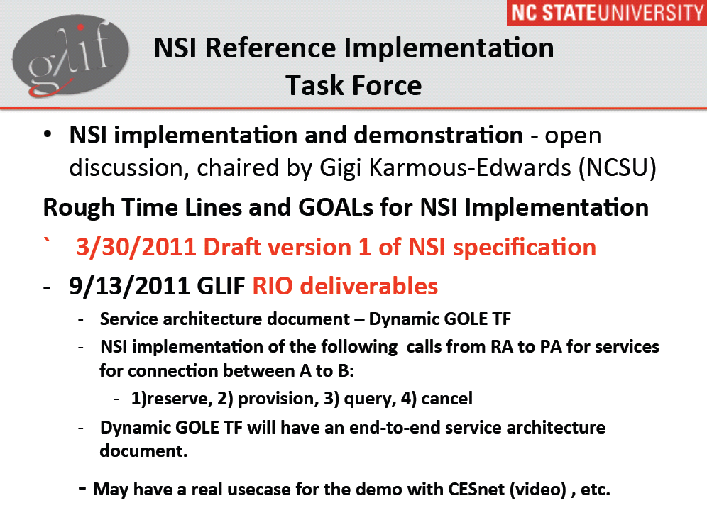
Slide by Gigi Karmous-Edwards
(NC state University)

Slide 36
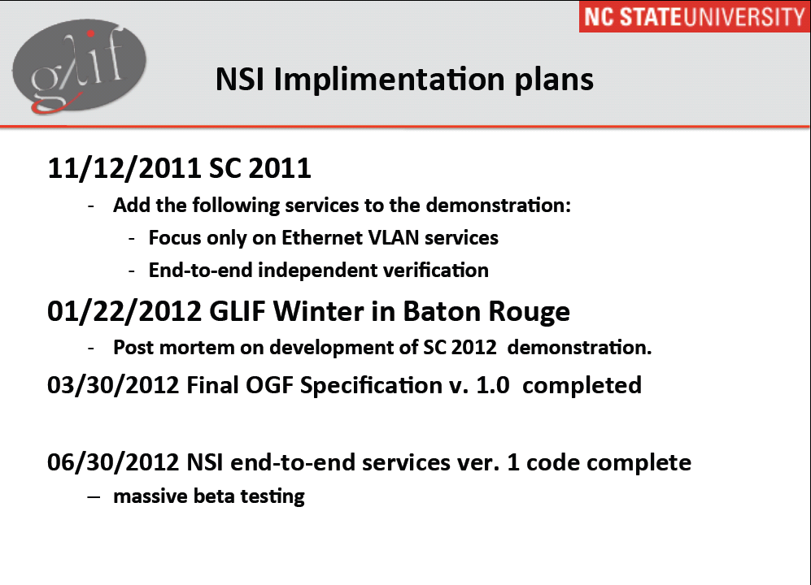
Slide by Gigi Karmous-Edwards
(NC state University)

Slide 37
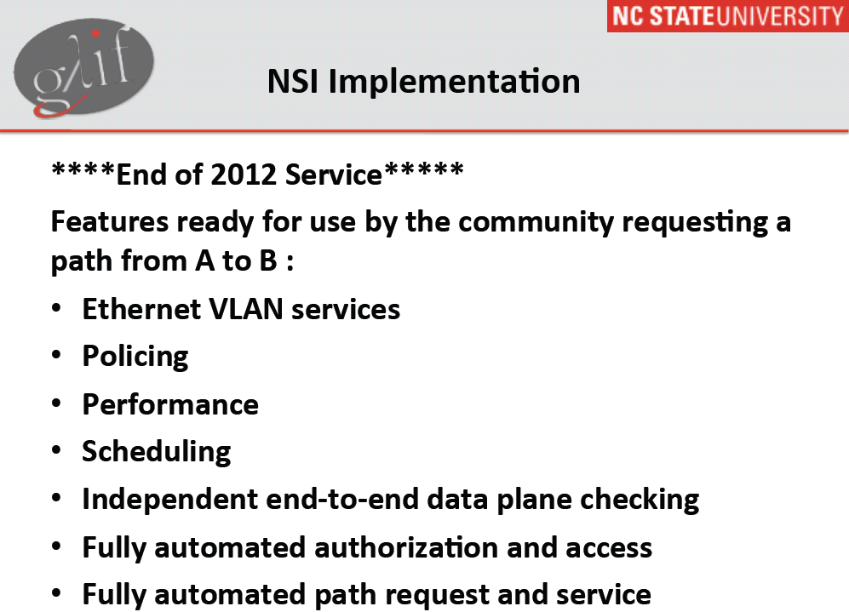
Slide by Gigi Karmous-Edwards
(NC state University)

Slide 38
Full Copyright Notice
Copyright (C) Open Grid Forum (2008-2011). All Rights Reserved.
This document and translations of it may be copied and furnished to others, and derivative works that comment on or otherwise explain it or assist in its implementation may be prepared, copied, published and distributed, in whole or in part, without restriction of any kind, provided that the above copyright notice and this paragraph are included on all such copies and derivative works.
The limited permissions granted above are perpetual and will not be revoked by the OGF or its successors or assignees.
Notes:
OGF Full Copyright Notice if necessary

