Slide 1
NSI implementation plan of G-lambda
Atsuko Takefusa and Tomohiro Kudoh,
National Institute of Advanced Industrial Science and Technology (AIST)
http://www.g-lambda.net/

Slide 2
G- lambda project overview
Joint collaboration project of KDDI R&D labs., NTT, NICT and AIST.
G-lambda project has been started in December 2004.
The goal of this project is to establish a common web services interface (GNS-WSI) between Grid resource manager and network resource manager.
Draft specification of GNS-WSI3 is available at:
http://www.g-lambda.net/

Slide 3
G-lambda’s plan to implement NSI
G-lambda is a collaboration to define an interface
Implementation of GNS-WSI has been carried out by AIST, NTT and KDDI R&D labs. Independently
We have three implementations of GNS-WSI3
AIST, KDDI R&D labs. and NTT will implement NSI independently
AIST implementation will be (partly) ready by GLIF Rio
KDDI implementation may be ready by GLIF Rio
NTT will implement NSI by SC11
NTT has a plan to use NSI at SC11 demonstration
Graphical simulation of measurement-based path selection
Application-driven global path switchover without packet loss
(Switches over to better path, according to the performance fluctuation)

Slide 4
AIST will implement NSI as proxies to GNS-WSI
Key differences between GNS-WSI and NSI
GNS-WSI has a factory service which creates a SM for each reservation
In NSI, there is no explicit such service. A SM is created when a reservation request is received.
GNS-WSI does not support repetitive provision/release
Provisioned at the start time
De-provisioned at the end time or a cancel message
GNS-WSI supports auto-start only
No manual provisioning
GNS-WSI supports two-phase commit
Commit of a reservation is required before auto-provisioning
Assumes timeout in a certain period of time

Slide 5
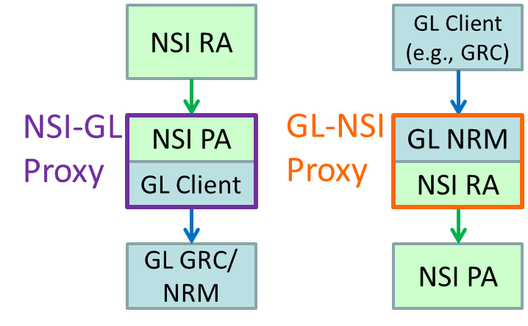
NSI and G-lambda GNS-WSI (GL) Proxies
Implement NSI-GL Proxy and GL-NSI Proxy
NSI-GL Proxy invokes "create" before "reserve"
GL supports NSI provision and release
NSI_provision, NSI_release
Coexistence of manual (NSI) and auto (NSI/GL) provisioning
Add "NSI = true" option as a reservation attribute
If NSI == true, proxy waits "provision"
Otherwise, proxy invokes "provision" immediately after commit
1PC (NSI) and 2PC (GL) conversion

Slide 6
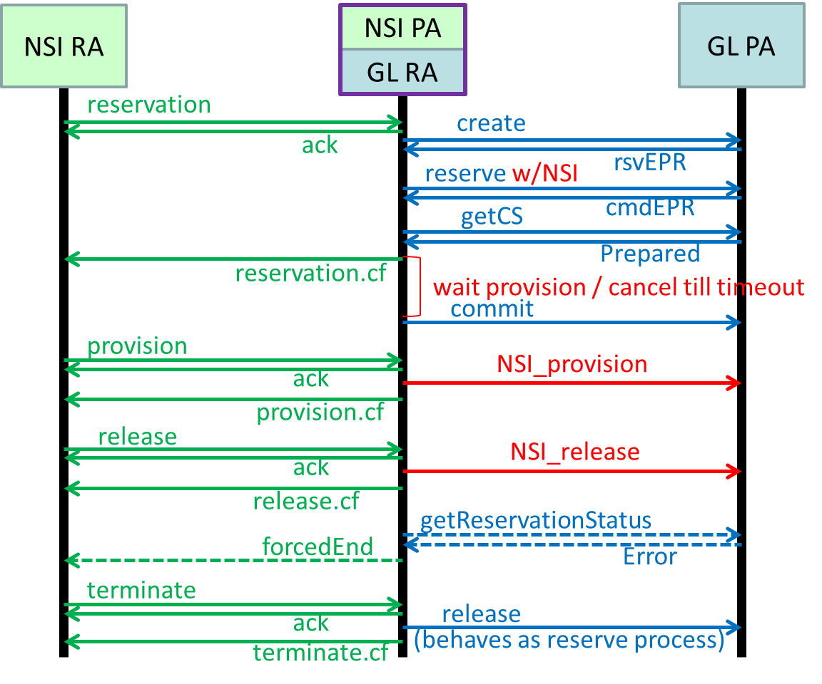
NSI-GL Proxy

Slide 7
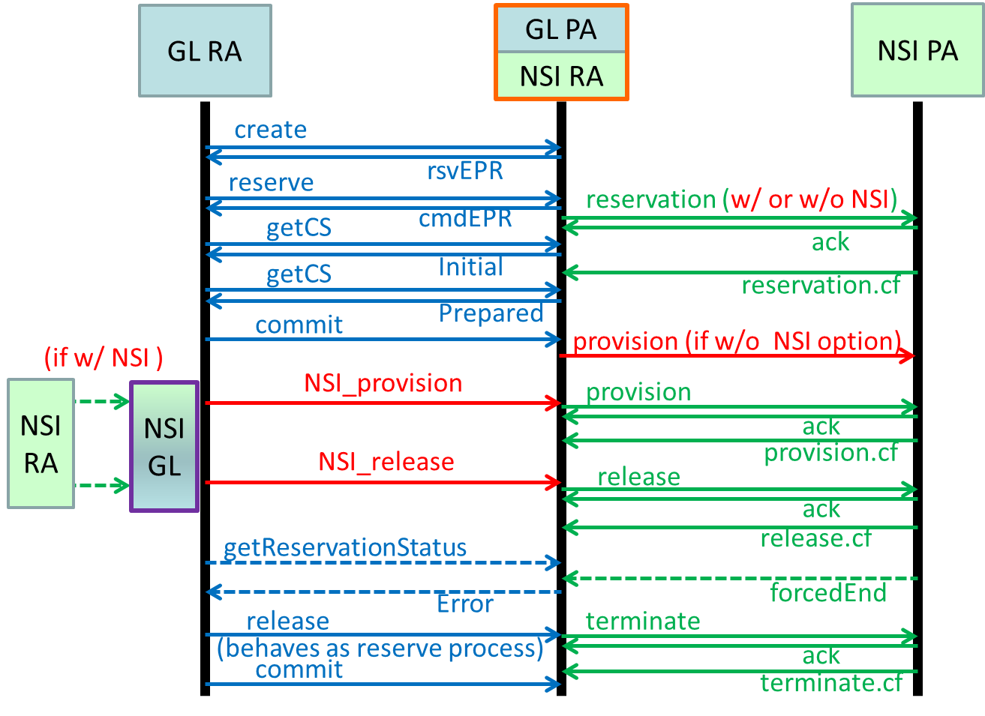
GL-NSI Proxy

Slide 8
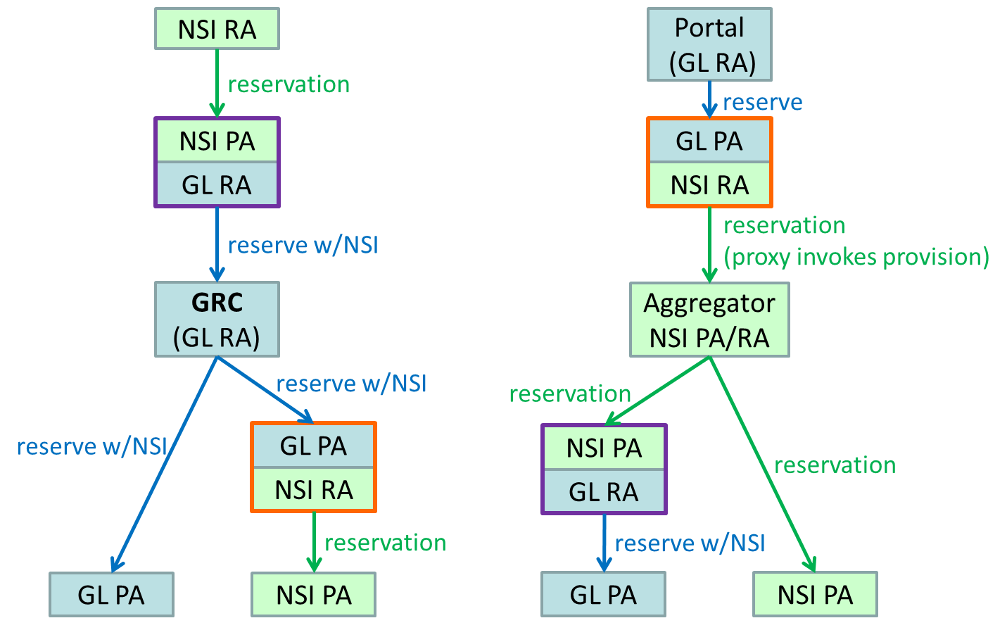
Demo scenarios

