Slide 1

Network Services Interface
OGF 37, Charlottesville
NSI-CS version 2.0 changes
John MacAuley, SURFnet
11th March 2013

Slide 2
Key changes
Refactored common NSI header elements out of each message into a common protocol header.
Hierarchical service exceptions to maintain error information up the tree, and allow for multiple failure points
Made ServiceExceptionType variables element optional in ogf_nsi_framework_types_v2_0.xsd
Generic type/value pair to replace more complex SAML attributes except for security elements.

Slide 3
Key changes
Query result restructuring
  Included requesterNSA associated with the reservation.
  Listed associated child connectionId in summary for NSA-by-NSA traversal.
Separated summary and detailed query into two separate operations querySummary() and queryRecursive().
Added synchronous querySummarySync() operation to return summary information in the SOAP response instead of separate asynchronous confirmed.
Modeling of new state machine(s).

Slide 4
Key changes
Reservation versioning.
Modify operations.
STP and ERO definitions
  Removed orientation element.
Removed NetworkIdType definition.
Removed unused SAML XSD import from ogf_nsi_connection_types_v2_0.xsd.
Change WSDL so connection identifier is allocated by provider NSA
  Removed connectionId from reservation request.
  Returned allocated connectionId in response to reservation request (instead of ACK).

Slide 5
NSI restructuring

Slide 6
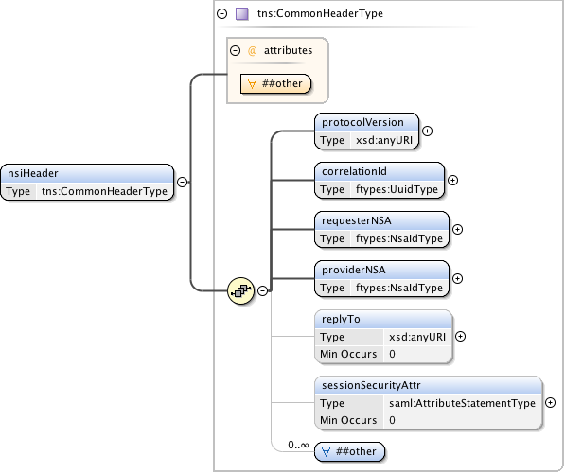
Refactored header

Slide 7
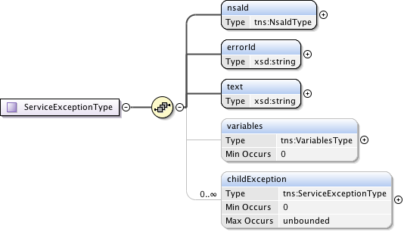
Hierarchical service exceptions
Allow an NSA or a client to access service exceptions from downstream NSA for the operation_x0016_

Slide 8
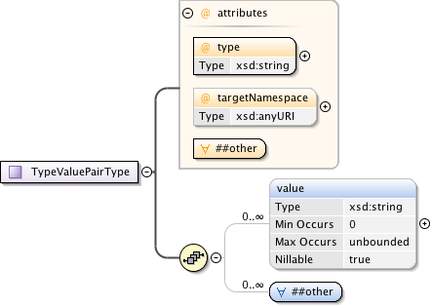
Type/Value pairs
Introduced an NSI specific type/value pair to model generic attributes.
Replaces use of SAML attribute except for security.

Slide 9
Query changes

Slide 10
Query Operation – v1 issues
There is currently no way to determine the direct parent NSA associated with a reservation.
  Does not provide the requesterNSA associated with a connection reservation
There is no indication if the reservation was further broken down into child NSA requests
  What is the connectionId and providerNSA associated with each child reservation?
The path object is ambiguous
  Does not clearly describe the true direction of the path used in the reservation.

Slide 11
Query Operations – v2 Changes
Separation of summary and detailed query logic:
  querySummary
  querySummaryConfirmed
  querySummaryFailed
  queryRecursive
  queryRecursiveConfirmed
  queryRecursiveFailed
Definition of a synchronous summary query:
  querySummarySync
  querySummarySyncConfirmed
  querySummarySyncFailed

Slide 12
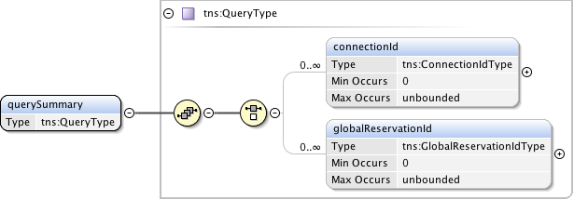
querySummary

Slide 13
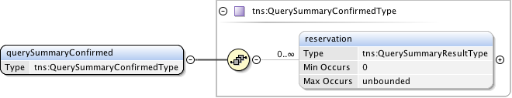
querySummaryConfirmed

Slide 14
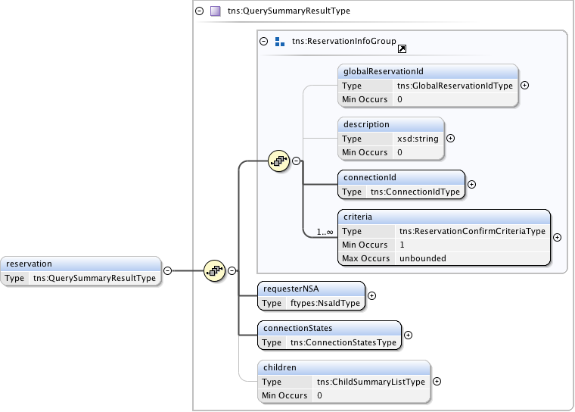
QuerySummaryResultType

Slide 15
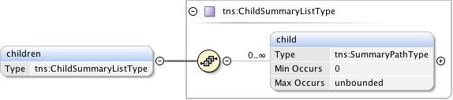
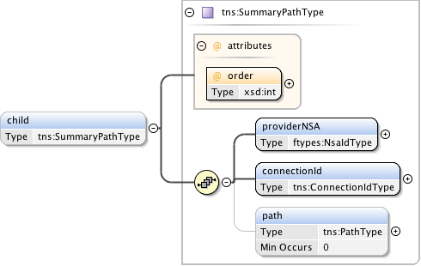
QuerySummaryResultType/Children

Slide 16

queryRecursive

Slide 17
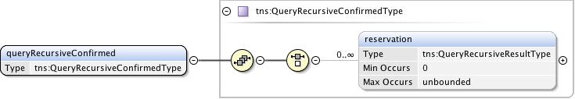
queryRecursiveConfirmed

Slide 18
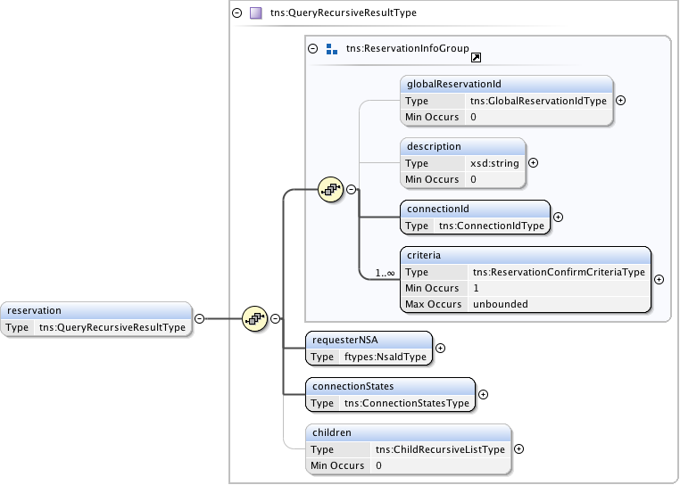
QueryRecursiveResultType

Slide 19
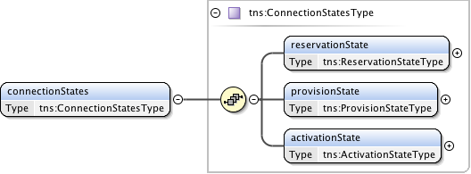
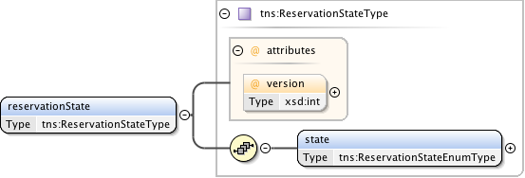
QueryRecursiveResultType /ConnectionStates

Slide 20
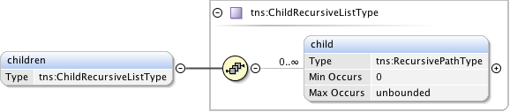
QueryRecursiveResultType / children

Slide 21
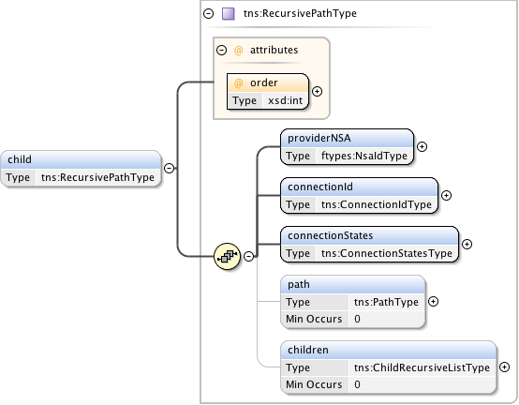
QueryRecursivePathType / child

Slide 22
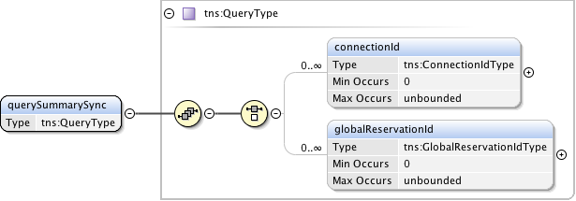
querySummarySync

Slide 23
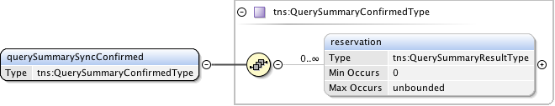
querySummarySyncConfirmed

Slide 24
PathType changes

Slide 25
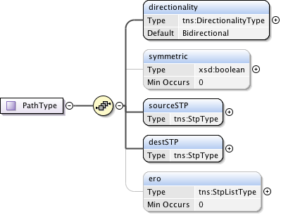
PathType

Slide 26
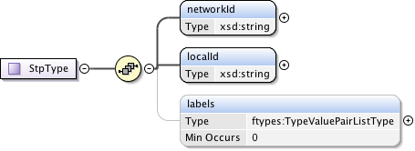
StpType

Slide 27

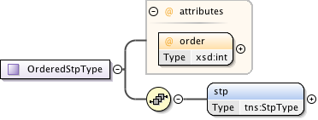
ERO - StpListType

Slide 28
Reservation changes

Slide 29
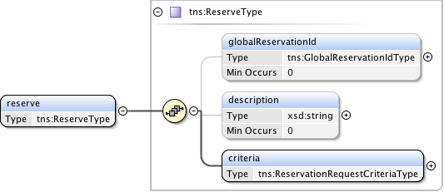
reserve

Slide 30
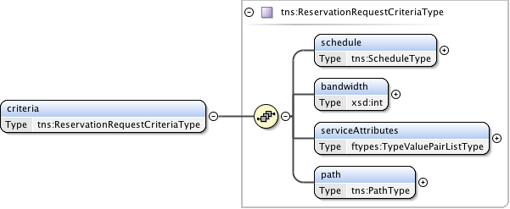
ReserveType / criteria

Slide 31

reserveResponse

Slide 32
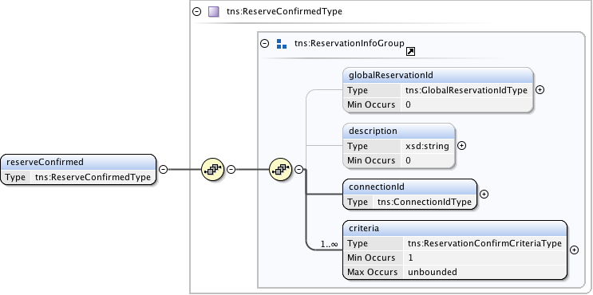
reserveConfirmed

Slide 33
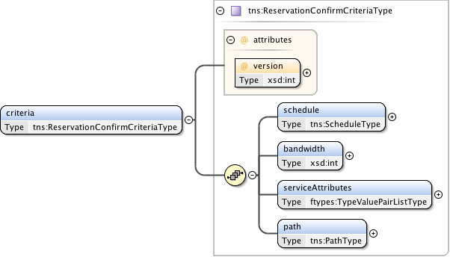
reservationConfirm criteria

Slide 34
Modify

Slide 35
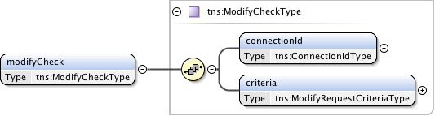
ModifyCheck

Slide 36
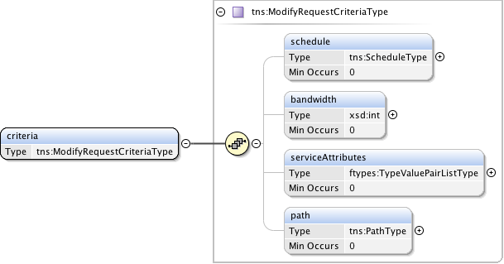
ModifyCheckType / criteria

Slide 37
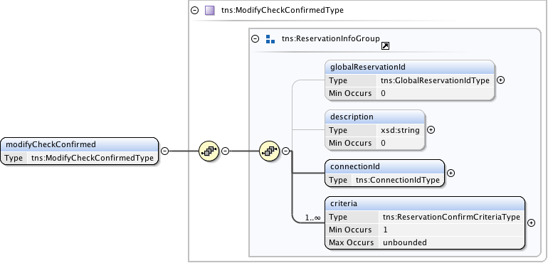
modifyCheckConfirmed

