Slide 1

Network Services Interface
OGF 37, Charlottesville
Interface Discovery
John MacAuley, SURFnet
12th March 2013

Slide 2
Why do we need it?
Make the NSI protocol self-descriptive
  Describe the interfaces and versions of interfaces supported by an NSA
  Dynamically discover protocol capabilities supported by an NSA
Permit protocol version negotiation
  Allow NSA to negotiate a mutually supported version of the protocol based on supplied meta data
Bootstrap peer communications with minimal configuration

Slide 3
Why are these important?
Managing new versions of NSI-CS protocol
  At the moment we all must upgrade simultaneously, or statically manage which version of NSI-CS a peer can support.
Introducing new NSI interfaces and capabilities
  As new NSI protocol interfaces are introduced (OAM, Topology, etc.) we need to determine what a peer NSA can support.
Simplify provisioning of NSA peering
  Do not to manually provision protocol versions and endpoint values.

Slide 4
Bootstrapping peer NSA
NSA administrators must configure local peering relationship:
  Exchange TLS certificates and discovery endpoints with peer administrator.
  Provision peer TLS certificate in NSA’s local trust store, certificate DN in NSA authorization module, and discovery URL for NSI protocol bootstrap.
  Optionally, provision if the NSA is a uRA only to avoid need to discover.

Slide 5
Bootstrapping peer NSA
On NSA peering initialization:
  Connect to discovery service on peer NSA using configured discovery endpoint and TLS.
  Retrieve meta data for NSA describing supported interfaces and capabilities.
  For each service on local NSA, determine highest common interface version described in peer meta data.**
  Utilize determined set of interfaces as need.
** Both NSA should determine the same set of interface versions to use, however, the decision is made by the NSA behaving in the requester role.

Slide 6
Basic Request/Response
The Discovery service uses a basic request/response messaging model with an HTTP binding:
  HTTP GET carries the discovery request operation
  HTTP 200 OK response carries result of the operation
  HTTP socket blocks until result it returned (synchronous)
We use a synchronous model since data set is small and hosted on the target NSA (no tree or chaining required)
HTTP GET /nsi/discovery
Requester
NSA
Provider
NSA
200 OK <discovery />

Slide 7
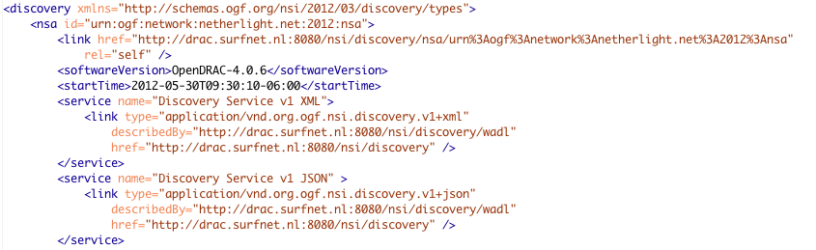
Example
GET /nsi/discovery HTTP/1.1
Host: drac.surfnet.nl
Accept: application/vnd.org.ogf.nsi.discovery.v1;charset=UTF-8
HTTP/1.1 200 OK
Date: Mon, 11 March 2013 22:38:34 GMT
Last-Modified: Sun, 10 March 2013 23:11:55 GMT
Content-Type: application/vnd.org.ogf.nsi.discovery.v1+xml;charset=UTF-8

Slide 8
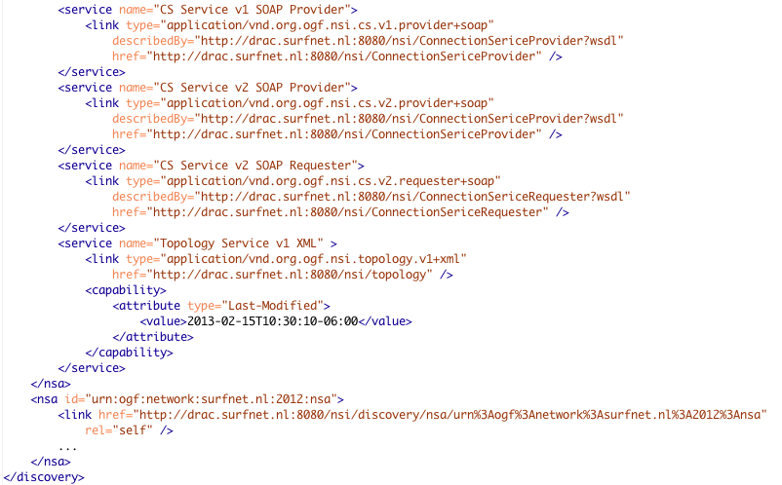
Example

Slide 9

Schema: discovery

Slide 10
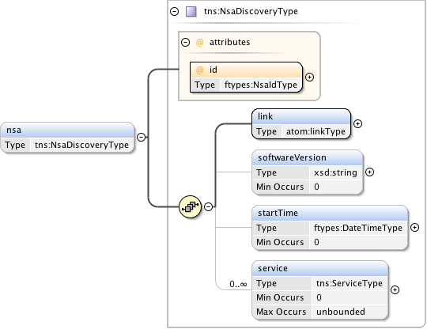
Schema: nsa

Slide 11
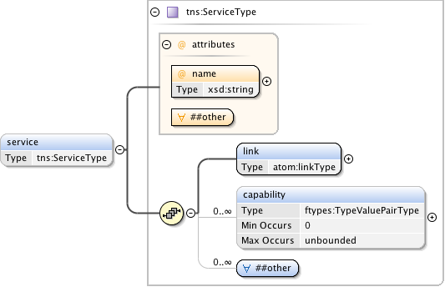
Schema: service

Slide 12
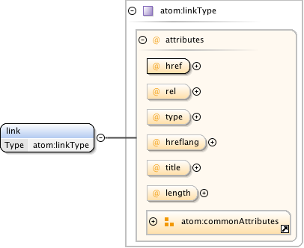
Schema: link

Slide 13

Discussion?
Questions?

