Slide 1
NSI-based experiment plan for optical path network and topology description
Tomohiro Kudoh
(AIST)

Slide 2
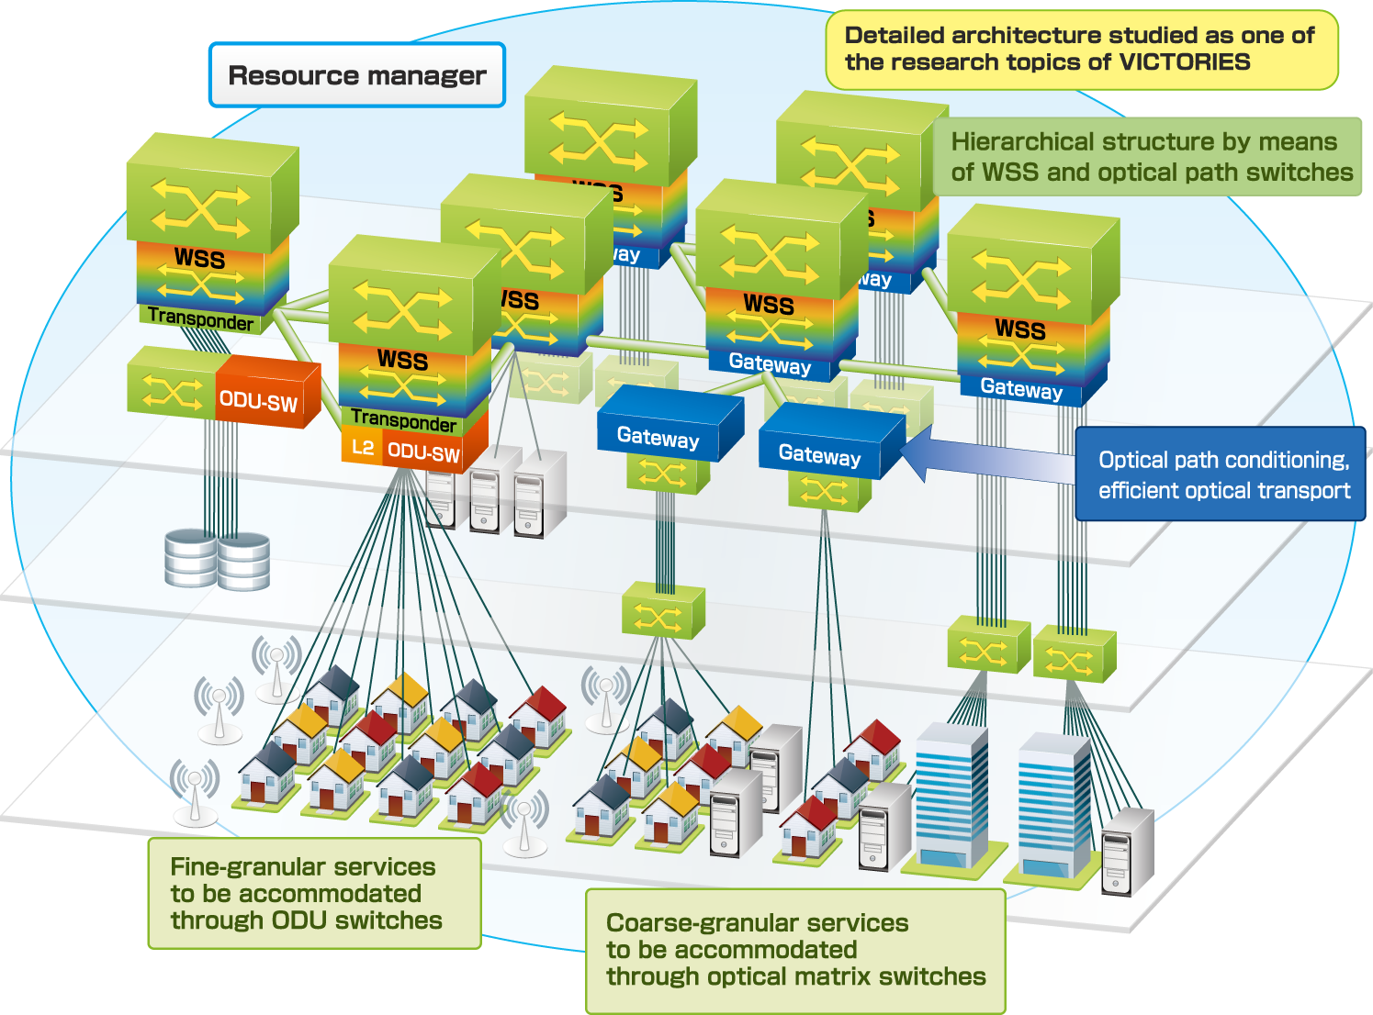
Victories project and its network model
Vertically Integrated Center for Technologies of Optical Routing toward Ideal Energy Savings (VICTORIES) was established in 2008 within AIST
Aims to produce a dynamic optical path network technology that can realize a huge throughput with a significantly lower power consumption.
Experiment and demonstration planned in Oct. 2014.
In the experiment, extended-NSI will be used for resource management of network and other resources.

Slide 3
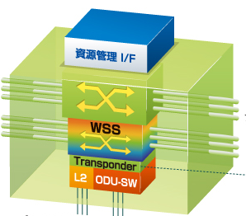
Dynamic node
Multi-layer network node consists of:
Fiber cross-connect switch
Wavelength selective switches
ODU switches
Ethernet switches

Slide 4
Experimentation topology

Slide 5
A dynamic node
Opt.
SW
Northbound I/F:
NSI
WSS
d
NSA
(uPA)
TPA
d
d
E-SW
And
Trans.
d
Northbound I/F:
NSI + VOD-SD
App.
VOD-SA
d
: network

Slide 6
Resource management model of VoD application
We will use NSI framework for both network and video service resources
★Resource discovery
①request
Sub.
Resource
database
VoD
Coordinator
Res. Usage
history
User
database
NW provider
Resource
Aggregator
NRM
Opt. path NW
④Deliver
Monitoring
②resource rsv.
DC
NSA
NW provider
VOD-SA
VOD-SA
Opt. path NW
DC
VoD Servers
Contents archive
③deploy contents

Slide 7
Service plane overview
VoD requester (tablet)
C: VoD client
UG
Contents DB
Resource Coordinator
(Aggregator）
Path Finder
NSI Aggregator
NSI/VOD
Aggregator
NSI uPA
NSI uPA
VOD-SA
UG
B: VOD-Server
VOD-SA
A: archive

Slide 8
Topology description
Topology consists of:
Topology
Constraints definitions

Slide 9
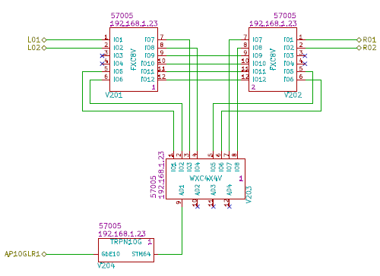
Schematic description of topology
Schematic CAD for digital circuits is used
KiCAD eeschema (GPL v2 licensed)
Hierarchical design is supported
Developed Python script to convert KiCAD native netlist to topology descripition in JSON format.

Slide 10
Device description
"urn:ogf:network:victories_demo:2014:_Dnode1_WXC4X4V_1": {
"address": "192.168.1.23", # NSA address
"constrain": "constraininfo.json#WXC4X4", # pointer to constraints info
"exchangeCapable": ["ODU"], # label swapping capability class
"ports": { # start of port descriptions
"1": {
"name": "urn:ogf:network:victories_demo:2014:_Dnode1_WXC4X4V_1_IO1",
"protocol": "ANY",
"type": "LAMBDA"
},
--- snip ---
"10": {
"name": "urn:ogf:network:victories_demo:2014:_Dnode1_WXC4X4V_1_AD2",
"protocol": "ANY",
"type": "LAMBDA"
},
}
}

Slide 11
SDP (net) description
"$118": { # net_id, (an id of SDP, used internally)
"_attribute_": {
"Delay": [
350.5
],
“OpticalPower": [
-6.5
],
"media": "SMF",
},
"urn:ogf:network:victories_demo:2014:_Dnode5_FXC16V_2": 4,
"urn:ogf:network:victories_demo:2014:_Dnode6_FXC8V_1": 1
},

Slide 12
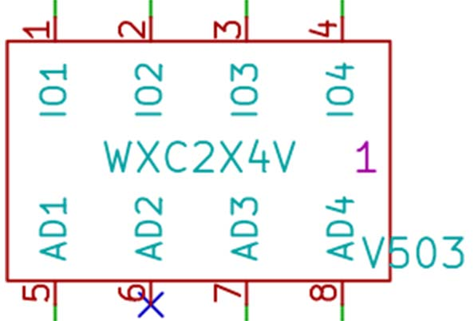
Network and its constraint description
Network is described as a “device” in schematic CAD
Each “device” is associated with a constraint description

Slide 13
Constraints: connectivity
Internal connectivity matrix（✔: can be connected）
Constraint description
 | IO1 | IO2 | IO3 | IO4 | AD1 | AD2 | AD3 | AD4
IO1 | ✔ | ✔ | ✔ | ✔ | ✔ | ✔ | ✔ | ✔
IO2 | ✔ | ✔ | ✔ | ✔ | ✔ | ✔ | ✔ | ✔
IO3 | ✔ | ✔ | ✔ | ✔ | ✔ | ✔ | ✔ | ✔
IO4 | ✔ | ✔ | ✔ | ✔ | ✔ | ✔ | ✔ | ✔
AD1 | ✔ | ✔ | ✔ | ✔
AD2 | ✔ | ✔ | ✔ | ✔
AD3 | ✔ | ✔ | ✔ | ✔
AD4 | ✔ | ✔ | ✔ | ✔
"AvailableConnections" : {
"ColumnIndex" : [1, 2, 3, 4, 5, 6, 7, 8 ],
"1" : [1, 2, 3, 4, 5, 6, 7, 8 ],
"2" : [1, 2, 3, 4, 5, 6, 7, 8 ],
"3" : [1, 2, 3, 4, 5, 6, 7, 8 ],
"4" : [1, 2, 3, 4, 5, 6, 7, 8 ],
"5" : [1, 2, 3, 4 ],
"6" : [1, 2, 3, 4 ],
"7" : [1, 2, 3, 4 ],
"8" : [1, 2, 3, 4 ]
}

Slide 14
Constraints: labels
Optical Add Drop Multiplexer (OADM)
Port 1 IN
Port 1 OUT
Port 2 IN
Port 2 OUT
Port 3 IN
Port 3 OUT
Port 4 IN
Port 4 OUT
Port 5 OUT
Port 5 IN
Port 6 OUT
Port 6 IN
Port 7 OUT
Port 7 IN
Port 8 OUT
Port 8 IN
"AvailablChannels" : {
"1" : "1-32",
"2" : "1-32",
"3" : "1-32",
"4" : "1-32",
"5" : "1-32",
"6" : "1-32",
"7" : "1-32",
"8" : "1-32"
}
"MaximumChannels" : {
"1" : 32,
"2" : 32,
"3" : 32,
"4" : 32,
"5" : 1,
"6" : 1,
"7" : 1,
"8" : 1
}

Slide 15
Protection Capability
1
active port
protected port
5
2
standby port
3
6
4
"Protectable" : true,
"ProtectablePorts" : [5, 6],
"ActiveSystemPorts" : [1, 2, 3, 4],
"StandbySystemPorts" : [1, 2, 3, 4]

Slide 16
Gain and OSNR
"Gain" : {
"ColumnIndex" : [1, 2, 3, 4, 5, 6, 7, 8 ],
"1" : [-7.0, -7.0, -7.0, -7.0, -7.0, -7.0, -7.0, -7.0],
"2" : [-7.0, -7.0, -7.0, -7.0, -7.0, -7.0, -7.0, -7.0],
"3" : [-7.0, -7.0, -7.0, -7.0, -7.0, -7.0, -7.0, -7.0],
"4" : [-7.0, -7.0, -7.0, -7.0, -7.0, -7.0, -7.0, -7.0],
"5" : [-7.0, -7.0, -7.0, -7.0, null, null, null, null],
"6" : [-7.0, -7.0, -7.0, -7.0, null, null, null, null],
"7" : [-7.0, -7.0, -7.0, -7.0, null, null, null, null],
"8" : [-7.0, -7.0, -7.0, -7.0, null, null, null, null]
}
"OSNR" : {
"ColumnIndex" : [1, 2, 3, 4, 5, 6, 7, 8 ],
"1" : [2.2E-3, 2.2E-3, 2.2E-3, 2.2E-3, 2.2E-3, 2.2E-3, 2.2E-3, 2.2E-3],
"2" : [2.2E-3, 2.2E-3, 2.2E-3, 2.2E-3, 2.2E-3, 2.2E-3, 2.2E-3, 2.2E-3], "3" : [2.2E-3, 2.2E-3, 2.2E-3, 2.2E-3, 2.2E-3, 2.2E-3, 2.2E-3, 2.2E-3], "4" : [2.2E-3, 2.2E-3, 2.2E-3, 2.2E-3, 2.2E-3, 2.2E-3, 2.2E-3, 2.2E-3], "5" : [2.2E-3, 2.2E-3, 2.2E-3, 2.2E-3, null, null, null, null],
"6" : [2.2E-3, 2.2E-3, 2.2E-3, 2.2E-3, null, null, null, null],
"7" : [2.2E-3, 2.2E-3, 2.2E-3, 2.2E-3, null, null, null, null],
"8" : [2.2E-3, 2.2E-3, 2.2E-3, 2.2E-3, null, null, null, null]
}

Slide 17
An example constraint description
"WXC4X4" : {
"Comment" : "Combination of TPA and WSS consists a WXC",
"NumberOfPort" : 8,
"AvailableConnections" : {
"ColumnIndex" : [1, 2, 3, 4, 5, 6, 7, 8 ],
"1" : [1, 2, 3, 4, 5, 6, 7, 8 ],
<SNIP>
"8" : [1, 2, 3, 4 ]
},
"AvailablChannels" : {
"1" : "1-32",
<SNIP>
"8" : "1-32"
},
"MaximumChannels" : {
"1" : 32,
<SNIP>
"8" : 1
},
"Protectable" : true,
"ProtectablePorts" : [5],
"ActiveSystemPorts" : [1, 2, 3, 4],
"StandbySystemPorts" : [1, 2, 3, 4],
"Gain" : {
"ColumnIndex" : [1, 2, 3, 4, 5, 6, 7, 8 ],
"1" : [-7.0, -7.0, -7.0, -7.0, -7.0, -7.0, -7.0, -7.0],
<SNIP>
"8" : [-7.0, -7.0, -7.0, -7.0, null, null, null, null]
},
"OSNR" : {
"ColumnIndex" : [1, 2, 3, 4, 5, 6, 7, 8 ],
"1" : [2.2E-3, 2.2E-3, 2.2E-3, 2.2E-3, 2.2E-3, 2.2E-3, 2.2E-3, 2.2E-3],
<SNIP>
"8" : [2.2E-3, 2.2E-3, 2.2E-3, 2.2E-3, null, null, null, null]
}
}

