Slide 1

Network Services Interface
Authorization in NSI
Content shamelessly stolen from Hans Trompert, SURFnet
John MacAuley, ESnet
4th February, 2015

Slide 2
About
While working through the long and complex issue of NSI security with Hans I decided to capture some thoughts on the topic. Much of the content in this slide pack is liberated from Hans and the AAI document he has written. Do not take this slide package as any sort of agreement on security as at the moment it is just informational. The AAI document will be the official source for the security agreements.

Slide 3
Content
Foundational Principals
  The cornerstones of security in NSI.
Ultimate Requester
  Creation of the originatingIdentifier.
End-User/Application Authorization
  Where NSI fits in.
  Overview of OAuth and attribute certificates.
  Mechanism for transport of user authorization information.

Slide 4
Foundational principles
  The NSI control plane consists of a set of NSA that are allowed to connect to each other through a prearranged administrative agreement.
  NSI control plane security is based on transitive trust: I trust my neighbours and the neighbours they trust.
  uRA authorize a user’s access to the control plane, they do not authorize a user’s access to network resources.
  uPA authorize a user’s access to network resources.
  How the uRA and uPA authorize a user’s access is a deployment time decision and out of the scope of the NSI protocol.
  An aggregator is contractually obligated to accept NSI messages from peers, perform path computation if needed, and propagate messages to peers along a path to the target uPA or uRA depending on direction of message.

Slide 5
A control plane of trust
NSI uses Client Authenticated TLS as a transport protocol to ensure the integrity and confidentiality of the messages traveling through the control plane.
  NSAs will mutually authenticate each other using X.509 certificates.
  All traffic between two peering NSAs will be encrypted while in transit.
The mechanism used for NSAs to authenticate each other can differ from peer to peer. For example, one group of NSAs can agree on the use of a common trusted Certificate Authority, while others will just exchange certificates on a peer-by-peer basis.
The Subject DN of the authenticated certificate is verified against Subject DN that was exchanged beforehand to uniquely identify the remote NSA and authorize access to the control plane.

Slide 6


Control Plane
AG perform path resolution and route messages between uRA and target uPA.
Control Plane
AG
User/Application
TLS
TLS
AG
uPA
uRA
AG
TLS
TLS
TLS
Network
Resources
TLS
AG
TLS
TLS
uRA provide users access to NSI connection services.
uPA
uPA
uPA broker access to network resources.
TLS
uPA
Network
Resources
Network
Resources
Network
Resources

Slide 7
Proper operation
A group of NSAs that form a control plane will be self-regulating.
Misbehaving NSAs will be called to account by the community, and in the worst case such an NSA will be removed from the control plane.
There are no automated mechanisms for removing an NSA deemed to be “misbehaving”.

Slide 8
A control plane of mistrust
A suggestion was made that we need to introduce a way for downstream NSA to systematically block misbehaving NSA from sending messages into the control plane.
This would change our principle of a control plane of trust, and if we make this step, where do we stop?
Do we believe this is a discrete item that needs to be addressed in the protocol?

Slide 9
Ultimate Requesters

Slide 10
Ultimate Requester Agents
  Responsible for providing users/applications access to NSI connection services.
  Are the source of NS connection service messages into the control plane:
    Initiate messaging at the root of the tree or start of the chain, hence the “Ultimate” requester agent.
  Responsible for establishing the identity of the requesting user/application:
    The uRA must authenticate the user/application requesting access to NSI connection services.
    How identity is established is a local matter (TLS client authentication, IDP, local user accounts, etc).
    The uRA is responsible for populating each NSI connection service message with a reference to this user/application’s identity.
    It must be possible for an NSA in the network to back trace this identity reference to the actual user of the service.
  Authorize a user’s access to the control plane, they do not authorize a user’s access to network resources
    How the uRA authorizes a user is a local matter, and may be something as simple as providing access if the user’s identity can be established (open policy) or something more restrictive based on an authorization server (restrictive policy).

Slide 11
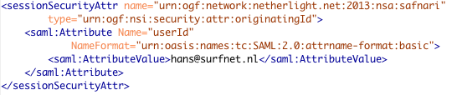
Originating Identifier
The uRA populates all NSI CS request messages with a <sessionSecurityAttr> element in the NSI message header containing its NSA identifier and the identity of the user/application.
<sessionSecurityAttr> element
  “name” attribute contains the NSA identifier of the uRA.
  “type” attribute contains the NSI security attribute type identifier “urn:ogf:nsi:security:attr:originatingId”.
  <Attribute> elements contain user identification information as specified by the uRA.

Slide 12
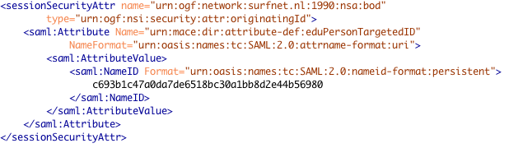
Originating Identifier
The following is an example of an internal identifier being sent instead of a user friendly identifier, allowing the identity of the user to be hidden, but still resolvable at the IDP.
NSA are obligated to pass along all <sessionSecurityAttr> to all children NSA involved in the reservation
An NSA may decide to replace the originatingId with its own identity information, in which case the NSA is assuming responsibility for the operation on behalf of the user.

Slide 13
End User/Application Security

Slide 14
Authorization in NSI
NSI does not specify how a specific network deployment performs end user authentication or authorization.
By making authentication and authorization a deployment time decision we have provided the most flexibility for networks
  Each network can decide on how they would like to authenticate user’s locally, and how they would like to authorize access to their resources.
  Obviously, a single solution that covers the entire deployment would provide the best end-user experience, but support for multiple solutions is provided for practical reasons.
NSI provides the flexible <sessionSecurityAttr> infrastructure for securely transporting security related information between NSA within the trusted control plane.
Security attributes introduced by the uRA are securely transported to all uPA involved in the reservation

Slide 15
Authorization
Control plane is considered secure transport.
Policy-based routing can utilize user information for path resolution.
Control Plane
AG
User/Application
TLS
TLS
AG
uPA
uRA
AG
TLS
TLS
TLS
Network
Resources
TLS
AG
TLS
TLS
Does user have access to network resources?
Does user have access to NSI connection services?
uPA
uPA
TLS
uPA
Network
Resources
Network
Resources
  The NSI architecture does not dictate where the network resource Policy Enforcement Point (PEP) is implemented, just that there is one “associated” with the uPA.
Network
Resources

Slide 16
OAuth
OAuth provides a method for clients to access a protected resource on behalf of a resource owner.
Before a client can access a protected resource, it must first obtain an authorization grant from the resource owner and then exchange the authorization grant for an access token.
The access token represents the grant's scope, duration, and other attributes granted by the authorization grant.
The client accesses the protected resource by presenting the access token to the resource server.
In some cases, a client can directly present its own credentials to an authorization server to obtain an access token without having to first obtain an authorization grant from a resource owner.
The access token provides an abstraction, replacing different authorization constructs for a single token understood by the resource server.

Slide 17
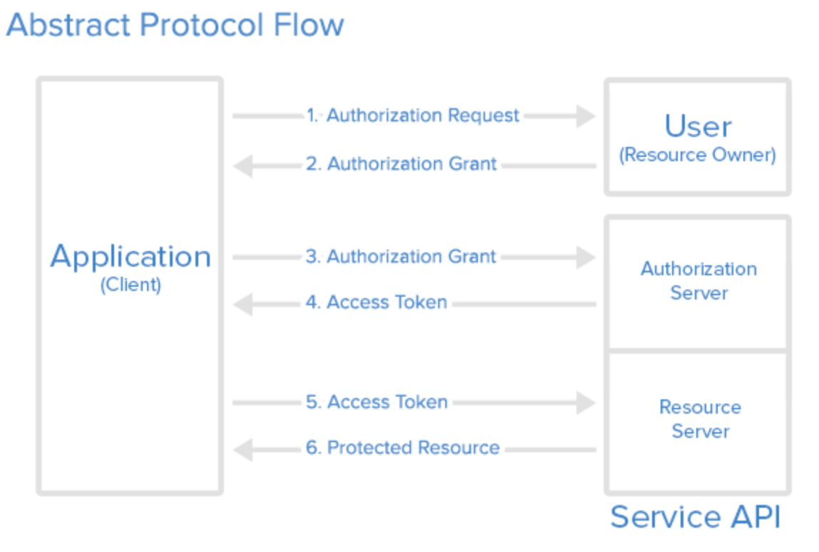
OAuth abstract flow

Slide 18
OAuth observations
OAuth assumes a point-to-point interaction model.
The application client uses SSL/TLS for secure communications with the authorization server and the resource server.
The application client is responsible for maintaining the context of the access token (i.e. it must know the resource server corresponding to the access token).
The authorization server has the concept of “realm” so a single access token could grant access to resources on multiple resource servers.
The application client is responsible for maintaining the secrecy of the access token as an intercepted token can be used to gain access to resources.

Slide 19
OAuth and NSI
User/Application
The user is responsible for obtaining any access tokens needed for resources associated with their reservation.
This may imply communicating with multiple authorization servers depending on the nature of the reservation (endpoints used), and the number of authorization domains implemented in the network.
The user passes all access tokens associated with the request to the uRA which populates them in the NSI header.
These access tokens are passed down the reservation tree with the NSI request to the uPA.
The uPA extracts the access tokens applicable to the local domain, and queries the Authorization server to determine if the token is valid, and if the user is granted access to the resources associated with the reservation.
Authorization
Server
1) auth grant
2) access_token
2) access_token +
reservation request
uRA
4) access_token placed in NSI header
6) Confirm access_token and determine associated resources
Secure
Transport
AG
uPA
5) extract access_token
NRM
7) confirm reservation
Logically, the uPA/NRM is acting as the Resource Server in OAuth terminology.
Network
Resources

Slide 20
Observations
We do not current specify the form of the Application -> uRA interface, and therefore, cannot specify how token gets into the uRA.
We do not have a single Authorization Server for the network. We must support the ability to have Authorization Server per uPA at a minimum, however, we should be flexible enough to have an arbitrary number of Authorization Servers, each uniquely identified by naming scheme.
The Application must be able to specify across the Application -> uRA interface multiple "tokens" depending on the number required to utilize resources associated with the connection request.
We need a way to identify to which uPA/Resource Server a specific token will apply. Given it is the application securing tokens from a plethora of Authorization Servers within then network, it will be the responsibility of the application to provide the addition realm identification information across the Application -> uRA interface.
We need the ability to transport Authorization Server specific error messages back from the uPA through the uRA to the requesting Application via the NSI ServiceException.

Slide 21

Including tokens in the NSI header
OAuth tokens are included in the NSI header using the <sessionSecurityAttr> element:
  “name” attribute contains the unique OAuth provider “realm” identifier.
  “type” attribute contains the NSI security attribute type identifier “urn:ogf:nsi:security:attr:realm”..
  <Attribute> elements contain the OAuth access_token(s) associated with the target resources of the reservation.
It is the responsibility of the user/application to supply the uRA with enough information to properly create the <sessionSecurityAttr> element for all tokens needed for a successful reservation
The format of the any security related parameters inside the <sessionSecurityAttr> is left up to solution implementation.

Slide 22
Authorization Certificates
Authorization (or attribute) certificates are digital certificates containing attributes associated to the holder by the issuer.
The issuer (resource owner for example) creates the certificate with their private key, signing the attributes they would like to assign the holder (user).
This certificate can then be verified by any policy enforcement points using the issuer’s public certificate, providing the list of attributes associated with the user.
In contrast to OAuth, authorization certificates carry the authorization information in the certificate itself, whereas OAuth requires the access_token be used to lookup the user’s authorization information.
The user workflow for obtaining an authorization certificate can be considered similar to OAuth:
  User identity is authenticated (typically using their X.509 certificate) by Authorization server (Attribute Authority).
  User requests an authorization grant to a set of resources, roles, etc. from Authorization server.
  Authorization server validates user’s access, generates a certificate listing a set of attributes associated with the user (access permissioned modeled in attributes), and returns certificate to user.
  User presents this authorization certificate to the Resource server along with access request.
  Resource server uses the Authorization server’s public key to verify the presented authorization certificate was indeed created by the Authorization server, and once verified, grants access based on the attributes presented in the authorization certificate.

Slide 23
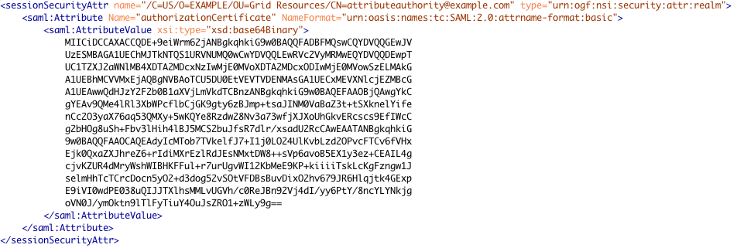
Including certificates in NSI header
Authorization certificates can be included in a <sessionSecurityAttr> element using base64Binary encoding:
  “name” attribute contains the DN of the issuing Attribute Authority.
  “type” attribute contains the NSI security attribute type identifier “urn:ogf:nsi:security:attr:realm”..
  <Attribute> element contains the base64Binary encoded certificate associated with the target resources of the reservation.

Slide 24
The end

