Slide 1
OGSA SEC WG
co-chairs
Nataraj Nagaratnam
IBM, USA
Marty Humphrey
University of Virginia, USA
GGF9, Chicago, Illinois, US

Slide 2
OGSA SEC WG History
Pre-GGF5 (~ June 2002)
  “Security Architecture for Open Grid Services”
  “OGSA Security Roadmap”
GGF5: Mini-BOF (July 2002)
  Raj and Frank gave presentations, led discussions
  Consensus was to go-ahead
Pre-GGF6: Formation of WG (~ Sept 2002)
Some slides from GGF6 (Oct 2002)…

Slide 3
WS Security Roadmap exists, so why do we?
  What if boxes never materialize?
  What if boxes appear too late?
  What if there are licensing issues with box(es)?
  What if “their roadmap” is missing pieces?
  What if Grid Computing != Web Services?
  MS-IBM Roadmap is wire-oriented; we need to be wire-oriented AND service-oriented (i.e., portTypes)
    How do we make our existing security services “fit” with OGSA Architecture?

Slide 4
OGSA SEC WG Charter
“enumerate and address the Grid Security requirements in the context of the OGSA”
“leverage… WS-Security… and… WS Security Roadmap”
Primary outcome:
  doc #1: The Security Architecture for Open Grid Services
  doc #2: OGSA Security Roadmap
Secondary outcome:
  Creation of new GGF WGs to address “gaps” identified by #2
Synergistic with other efforts (e.g., OASIS, W3C)

Slide 5
[GGF6] WG Methodology
What requirements are unique/necessary in Grids?
Do the Architecture/Roadmap cover these?
  If not, how to extend documents?
What components need to be built based on these requirements?
Are any specifications not listed?
Are any of these boxes actively being constructed outside of the GGF?
  What are these? Where are these? Who are building them?
Which of the (inactive/pending) boxes are urgent?
  Based on the identified set of specifications that we need to work on, try to prioritize the list and come up with a dependency/deliverable graph
  Suggest spinning off workgroups based on specs identified to be started under GGF

Slide 6
Current/proposed specs
Building on the SOAP Foundation
WS-Secure
Conversation
WS-Federation
WS-Authorization
This is a composable Architecture
“only use what you need”
WS-Policy
WS-Trust
WS-Privacy
WS-Security
today
time
SOAP Foundation

Slide 7
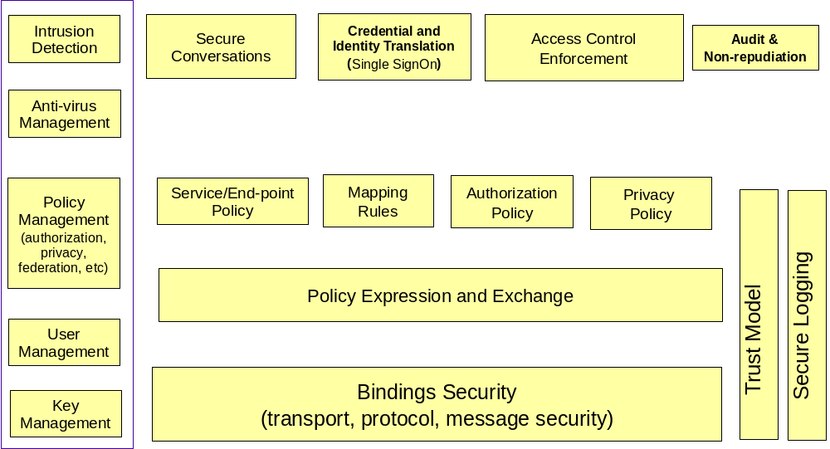
OGSA Security Components

Slide 8
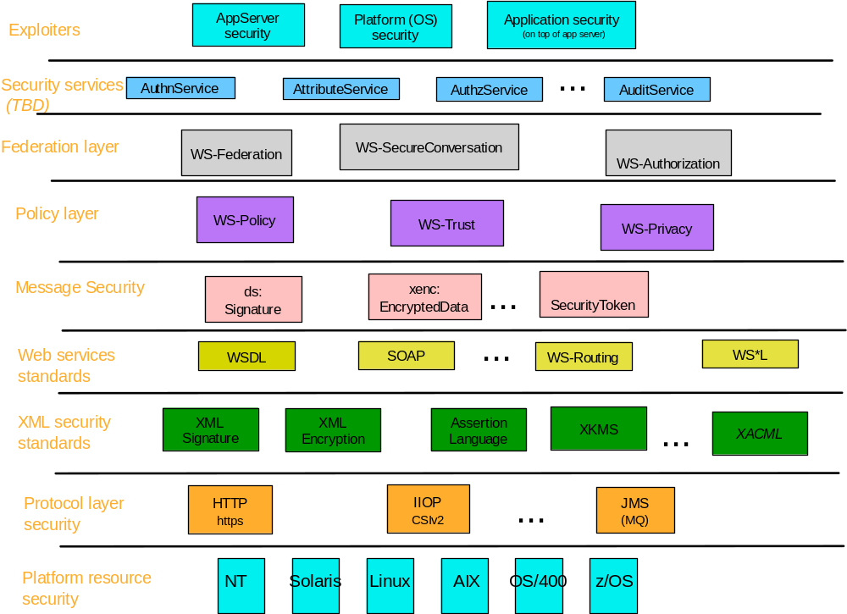
Building Blocks

Slide 9
Roadmap: Proposed Specs. (1)
Category | Specifications
Naming | OGSA Identity OGSA Target/Action Naming OGSA Attribute and Group Naming Transient Service Identity Acquisition
Translation between Security Realms | Identity Mapping Service Generic Name Mapping Policy Mapping Service Credential Mapping Service
Authentication Mechanism Agnostic | OGSA Certificate Validation Service OGSA-Kerberos Services
Pluggable Session Security | GSSAPI-SecureConversation
Pluggable Authorization Service | OGSA-Authorization Service

Slide 10
Roadmap: Proposed Specs. (2)
Proposed Specs. (2)
Category | Specifications
Authorization Policy Management | Coarse-grained Authorization Policy Management Fine-grained Authorization Policy Management
Trust Policy Management | OGSA Trust Service
Privacy Policy Management | Privacy Policy Framework
VO Policy Management | VO Policy Service
Delegation | Identity Assertion Profile Capability Assertion Profile

Slide 11
Roadmap: Proposed Specs. (3)
Proposed Specs. (3)
Category | Specifications
Firewall Friendly | OGSA Firewall Interoperability
Security Policy Expression and Exchange | Grid Service Reference and Service Data Security Policy Decoration
Secure Service Operation | Secure Service’s Policy and Processing Service Data Access Control
Audit and Secure Logging | OGSA Audit Service OGSA Audit Policy Management

Slide 12
Non-GGF Progress Since GGF6 (Oct 2002)
Dec 18: WS-Policy, WS-PolicyAttachment, WS-PolicyAssertions, WS-SecurityPolicy, WS-Trust, WS-SecureConversation
  WS-Policy 1.1 et. al. May 28
July 2003: WS-Federation
OASIS WSS TC docs for public review (Sept 9)
  SOAP Message Security, Username Token Profile, X.509 Cert Token Profile
XACML ratified as OASIS Open Standard
SAML v1.1 (Sept, 2003)
WS-I moves forward

Slide 13
GGF progress since Oct 2002
We need to let non-GGF activities progress….
… but we need to make progress where we can:
  Use of WS-* et. al. specs and SDKs (e.g., WSE)
  Focus on an Authorization Service (OGSA AuthZ WG)
  OGSA SEC WG is “idle” at the moment

