Slide 1
OGSA-WG Use Cases
GGF9 OGSA-WG
10/1/2003
Jeffrin J. Von Reich
Hewlett Packard

Slide 2
Outline
Introduction
Use cases for OGSA
OGSA requirements
Next steps

Slide 3
OGSA-WG Use Case Scope
To produce and document the use cases that drive the definition and prioritization of OGSA components, as well as document the rationale for our choices.
We want to use this to
To identify requirements and prioritize OGSA
  ( services, hosting environments ,protocol bindings ,interoperability …)
To define standard OGSA profiles
  ( i.e., sets of OGSA components that meet specific set of requirements. )
To define relationships between GGF and other standards

Slide 4
How use cases were/will be used
Commercial
Data Center
Use cases
Analyze & Extract
Requirements
(Functions)
Data Sharing
OGSA-WG
Evaluate & Prioritize
Mechanism
(Services)
Data Management
OGSA
Architecture
Dispatch
OGSA-DAI
interface
DAIS-WG
Existing or new WGs

Slide 5
Outline
Introduction
Use cases for OGSA
  Previous use cases
  New use cases
    List of new use cases
    E.g. Interactive grid details
    Short descriptions of new use cases
OGSA requirements
Next steps

Slide 6
Previous Use Cases
Science Grid
  National Fusion Collaboratory (Kate Keahey)
  Severe Storm Modeling (Dennis Gannon)
  Virtual Organization Grid Portal (Charles Severance, rewritten by Fred Marciel )
Commercial Grid
  Commercial Data Center (Hiro Kishimoto)
  IT Infrastructure and Management (Ravi Subramaniam)
  Online Media and Entertainment (Tan Lu)
Grid Technologies
  Grid Resource Reseller (Jon MacLaren)
  Service-Based Distributed Query Processing (Nedim Alpdemir)
  Grid Workflow (Takuya Araki)
See “Open Grid Service Architecture Use Cases” in detail

Slide 7
New Use Cases
WG use cases
  Persistent archives (PA RG)
  Application Use Cases (P2P WG)
  Mutual Authorisation (SAAA WG )
  Reality grid use case ( GRAAP WG )
  Resource Usage Service ( RUS WG )
Non WG use Cases
  Commercial Grid
    Inter Grid (Jeffrin J Von Reich)
  Grid Technologies
    Interactive Grid (Jeffrin J Von Reich)
    Grid Lite (Jeffrin J Von Reich)
See “Open Grid Service Architecture Use Cases” for detail

Slide 8
New Use Cases e.g. Interactive grids
Batch Applications
Interactive Applications
Session based
DigitalContentCreation
CAD/CAM
Financial markets
Video Games
Streaming
LifeSciences
Graphics
Application Hosting
SW development
Use Case Reference– Interactive Grid, Hewlett Packard Labs

Slide 9
Interactive grid Domain
What problem is being solved?
Defining architecture for a next generation grid that enables interactive applications,
eg: CAD/Financial/LifeSciences/Batch domains.
Interactive Grid characteristics:
secure connection to virtualized resource
Run apps with seamless access to user data
Supports hierarchical sessions such as XTerm
Provides session level QoS
Use Case Reference– Interactive Grid, Hewlett Packard Labs

Slide 10
Grid requirements – Batch and Interactive
First Generation- Batch jobs
Next Generation- Interactive jobs
Virtualization
Authentication
Authorization
Registry service
Discovery service
Job submission
Job query
Notification
Accounting
Billing
Resource reservation
Data management
Scheduling
QoS/SLAs
Dynamic accounts
Export remote desktop
Security
-access control
-account mgmt
Session(s) management
-QoS issues, SLAs
-Admission control
Monitoring services
Real-time schedulers
Staging data
+
Use Case Reference– Interactive Grid , Hewlett Packard Labs

Slide 11
New Use Cases – short descriptions
Inter Grid
  grid across multiple companies that agree to collaborate
  interoperability with web services standards
  Mixed operating environments ( mainframes to Laptops )
  applications that are not grid enabled
  mixed grid and non grid data centers
  a combination of compute/service/data grids working together
  industrial concerns like migration, maintenance requirements
Grid Lite
  extends grids to small devices – PDAs, cellphones.
  A set of essential grid services (profile) for PDAs for example.
  grid client has to be of smaller footprint and more efficient.
  Virtualising layer2 devices with embedded OS
  Hard to solve mobility and offline synchronisation

Slide 12
New Use Cases – short descriptions
Reality grid (http://www.realitygrid.org)
        aims to predict the realistic behaviour of matter based on the properties of the microscopic components
      uses diverse simulation methods (Lattice Boltzmann, Monte Carlo)
      on-line, high-end visualization.
      significant work package devoted to performance control
      many advance reservation requests
Resource Usage service
    facilitates the mediation of resource usage metrics produced by applications, middleware, operating systems, and physical (compute and network) resources in a distributed, heterogeneous environment.
    exploited by customers interested in measuring resource consumption
    support a wide variety of usage scenarios –
        cost allocation (i.e., chargeback); capacity and trend analysis;
        fraud and intrusion detection; dynamic provisioning;
        service level agreement compliance; pricing of web services;

Slide 13
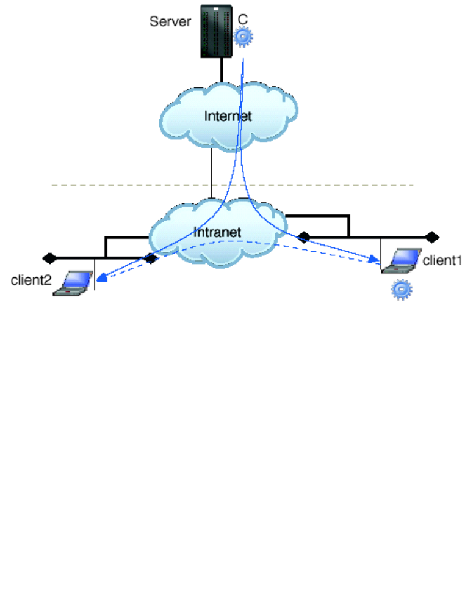
New Use Cases – short descriptions
Application ( P2P )
  pc grid computing
  file sharing
  content delivery
Fig: P2P content delivery

Slide 14
New Use Cases – short descriptions
Mutual authorisation
  requirement comes in general from large site customers with specific security needs to protect the (IP) of the Grid job or the resultant data
  user submits a Grid job which produces sensitive data
  The Grid VO may trust a variety of computers but the user may not want this job run on an OS known for security breaches
  User wants authorisation rights during secondary job submission too.
Persistent Archives
  build preservation environments using the capabilities provided by virtual data grid technology
  in addition to an “execution state” that is transient, a “completion state” is preserved
  support archival processes - Appraisal , Access, Arrangement, Preservation etc.
  for discovery and retrieval of the registered digital entities

Slide 15
Outline
Introduction
Use cases for OGSA
OGSA requirements
  Function requirements
  service requirements
Next steps

Slide 16
OGSA Functions impacted by new use cases
Discovery and brokering ( Grid Lite, Interactive grid)
Metering and accounting ( RUS, interactive grid)
Scheduling and Reservation ( Reality grid, Interactive, Grid Lite, PA)
Virtual organizations ( SAAA, Inter grids)
Monitoring ( Interactive, RUS, Grid Lite)
Security ( Mutual authorisation, Inter Grid , Grid Lite)
Collaboration ( Inter Grid ,Reality grid )
Policy ( Interactive grid , Inter Grid, SAAA )
Program execution standards ( Inter grids )
The new use cases will add new content to these OGSA functional areas ( next ver. of OGSA arch.)
Notes:
Discovery and brokering ( Grid Lite – mobility and L2 devices, Interactive grids – recognising these kinds of grid clients )
Metering and accounting ( RUS WG case )
Data sharing
Scheduling and Reservation ( Reality grid, Interactive grid , Grid Lite - mobility)
Virtual organizations ( SAAA, Inter grids – across firewalls, domains, geographies )
Monitoring ( Interactive grid, RUS, Grid Lite - mobility )
Security ( Mutual authorisation, SAAA-perimeter security solutions, Inter Grid , Grid Lite - mobility)
Collaboration ( Inter Grid ,Reality grid )
Policy ( Interactive grid , Inter Grid )

Slide 17
Unexplored OGSA Functions as per new use cases
Content Caching and synchronisation ( P2P, Inter Grid )
Bulk Operations with Minimal commands ( PA )
Proxy clients ( Grid Lite )
Session management ( Interactive grid)
Transport Management ( Interactive grid)
Grid interoperability ( Inter grids )
Maintainability ( Inter grid)
Life cycle manageability ( Inter grid )
Notes:
Content Caching and synchronisation ( P2P, Inter Grid )
Bulk Operations with Minimal commands ( PA )
Proxy clients ( Grid Lite – for non upgradeable devices)
Session management ( Interactive grid - Hierarchical sessions are supported ; global, individual, sub, sessions )
Transport Management ( Interactive grid – manage BW dynamically )
Grid interoperability ( Inter grids )
Program execution standards ( Inter grids – realtime requirements, tolerance to errors and delays, )
Maintainability ( Inter grid – troubleshooting, mixed operating environments .. )
Life cycle manageability ( Inter grid – upgrading without casualties)

Slide 18
OGSA Services impacted by new use cases
Name resolution and discovery( Grid Lite, Interactive)
Security ( Grid Lite, SAAA)
Policy. ( Grid Lite, SAAA , Interactive)
Data management. ( Grid Lite, Inter grid, Reality grid)
Metering and accounting. (RUS, Interactive grid)
Service orchestration ( Grid Lite)
Administration ( Inter Grid)
Reservation and Scheduling ( Reality grid, PA, Interactive, Grid lite)
Fault handling (Interactive)
Monitoring ( RUS,Interactive , Grid lite)
Notes:
Name resolution and discovery( Grid Lite – mobility, interactive)
Security ( Grid Lite – mobility )
Policy. ( Grid Lite – offline synchronisation,
Data management. ( Grid Lite – very low bandwidth )
Messaging, queuing, and logging.
Events.
Metering and accounting. (RUS)
Service orchestration ( Grid Lite – small footprint)
Administration
Reservation ( PA )

Slide 19
Unexplored OGSA Services as per new use cases
Session ( Interactive )
Transport (Interactive)
Web-service access interfaces (Virtual Portal )
Content Caching ( P2P, Inter)
bulk Data services (PA)
Proxy client services( Grid lite)
Notes:
Web-service access interfaces
Content Caching ( P2P )
bulk Data services (registration, load, unload, and delete, with minimal commands - PA)
Proxy client services( Grid lite – for non software updateable devices)

Slide 20
Outline
Introduction
Use cases for OGSA
OGSA requirements
Next steps
  Next steps
  Call to action

Slide 21
Next Steps
Use cases
  Collect and refine working group use case descriptions
  Publish a reviewed versioned use case doc by GGF-10
Requirements and services
  Analyze and extract requirements from use cases
  Evaluate and prioritize OGSA services using use case info
  Update and merge it into OGSA architecture document
Weekly tele-conference on Thursday 4pm CDT
Interim F2F meetings

Slide 22
Call to Action
The working group use cases have j begun to come in. Not complete and are not fully according to templates yet.
Provide your use cases (espescially WGs). That will help OGSA evolve in new directions ( e.g. Grid Lite )
Use the use case template to
  Give detailed and prioritized requirements and identify functions as per template.
  Input your thoughts to identify and prioritize important services, as well service composition for OGSA profiles.

