Slide 1
INFOD Working Group – A Use Case In Detail
GGF16 in Athens
February 13-16, 2006

Slide 2
GGF Intellectual Property Policy
All statements related to the activities of the GGF and addressed to the GGF are subject to all provisions of Appendix B of GFD-C.1, which grants to the GGF and its participants certain licenses and rights in such statements. Such statements include verbal statements in GGF meetings, as well as written and electronic communications made at any time or place, which are addressed to any GGF working group or portion thereof,
Where the GFSG knows of rights, or claimed rights, the GGF secretariat shall attempt to obtain from the claimant of such rights, a written assurance that upon approval by the GFSG of the relevant GGF document(s), any party will be able to obtain the right to implement, use and distribute the technology or works when implementing, using or distributing technology based upon the specific specification(s) under openly specified, reasonable, non-discriminatory terms. The working group or research group proposing the use of the technology with respect to which the proprietary rights are claimed may assist the GGF secretariat in this effort. The results of this procedure shall not affect advancement of document, except that the GFSG may defer approval where a delay may facilitate the obtaining of such assurances. The results will, however, be recorded by the GGF Secretariat, and made available. The GFSG may also direct that a summary of the results be included in any GFD published containing the specification.

Slide 3
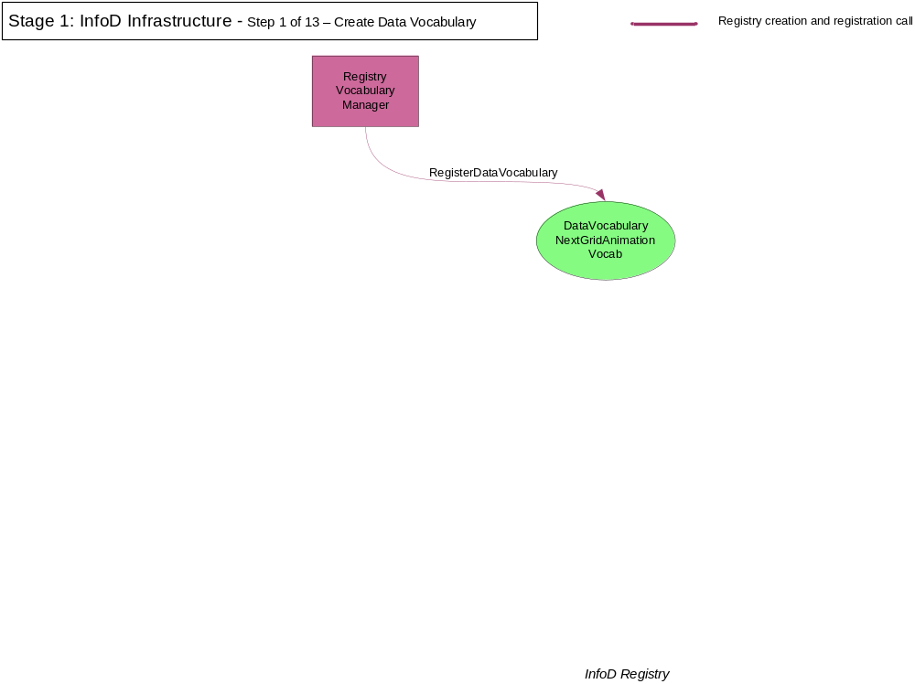

Slide 4
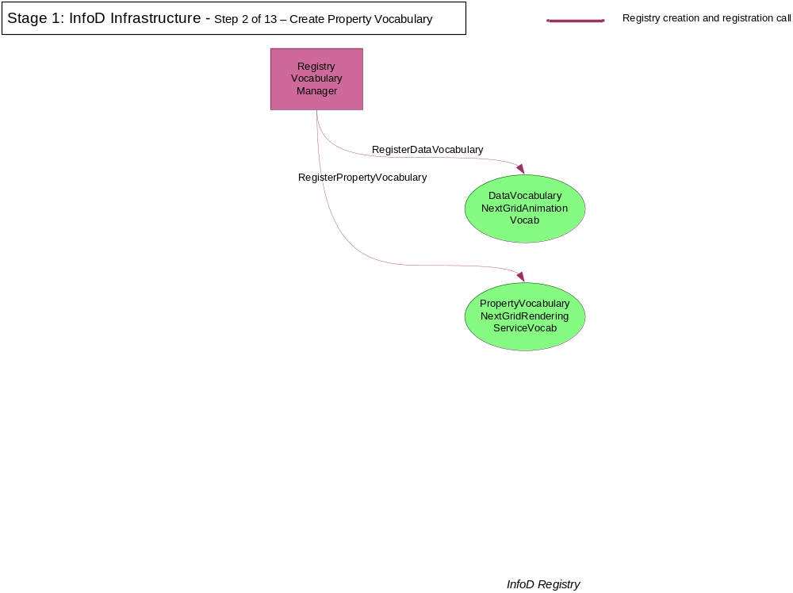

Slide 5
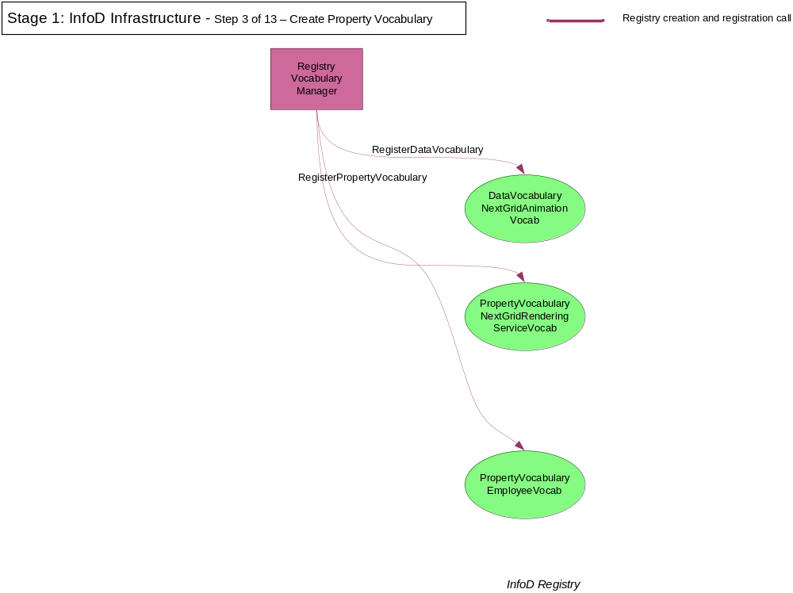

Slide 6
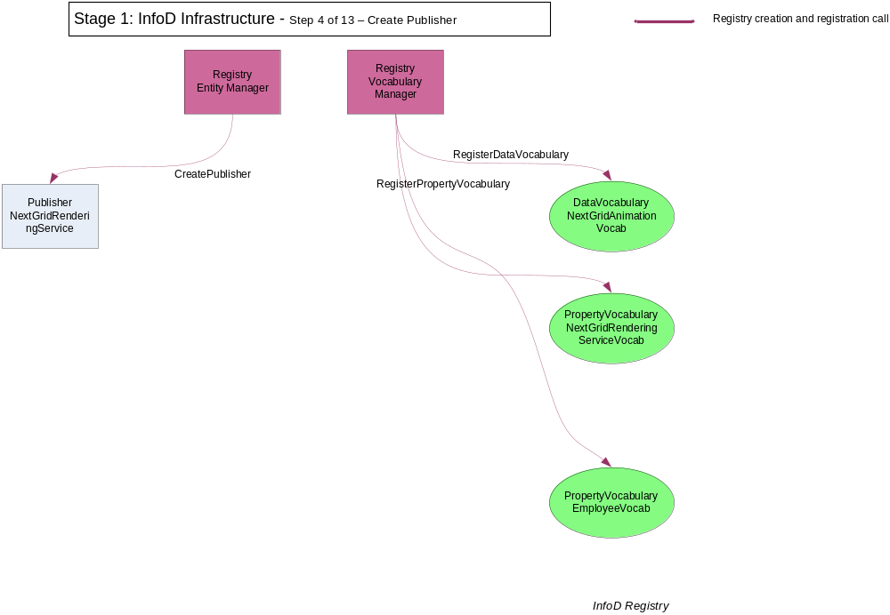

Slide 7
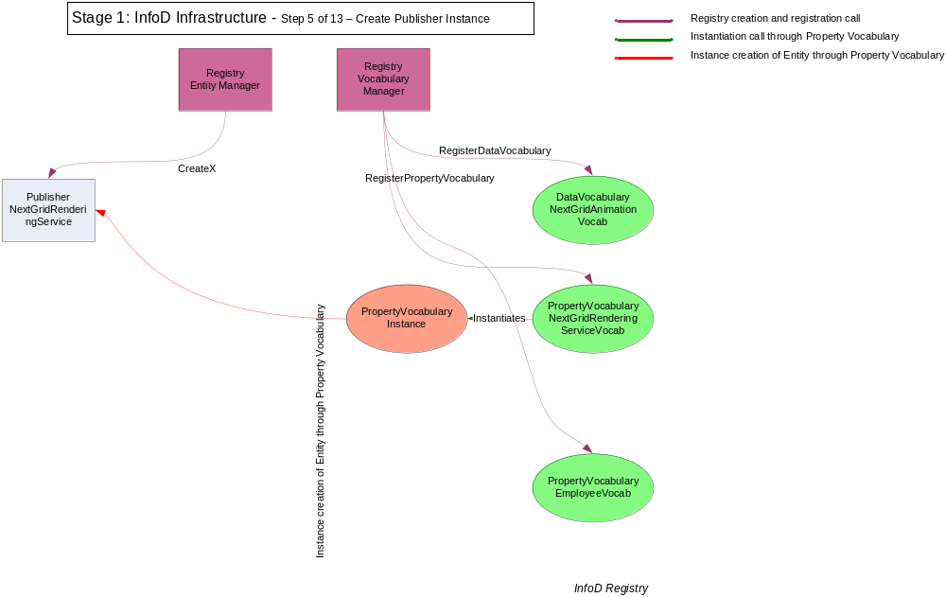

Slide 8
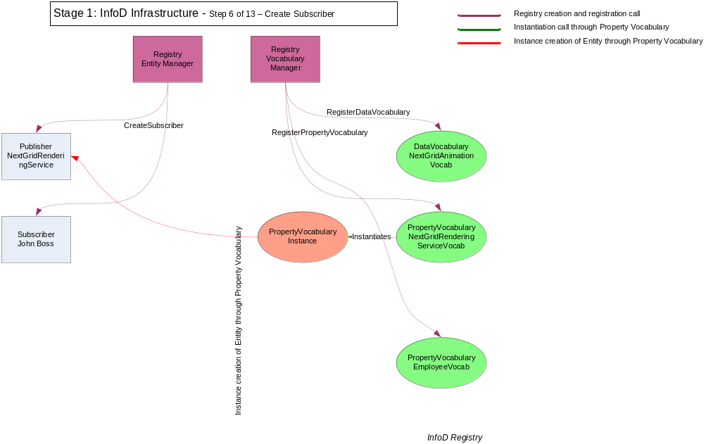

Slide 9
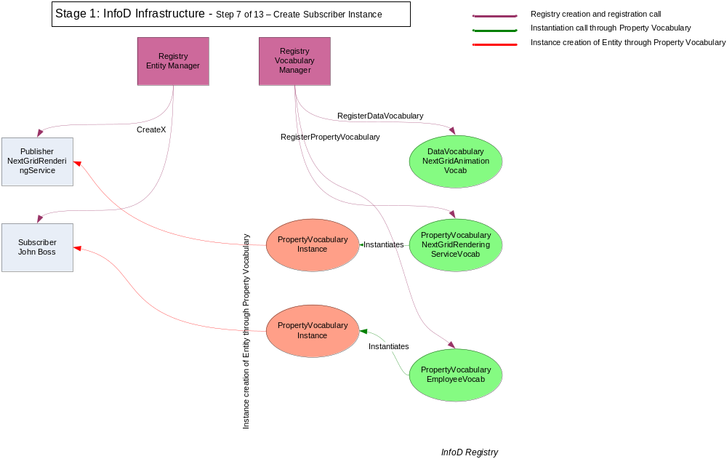

Slide 10
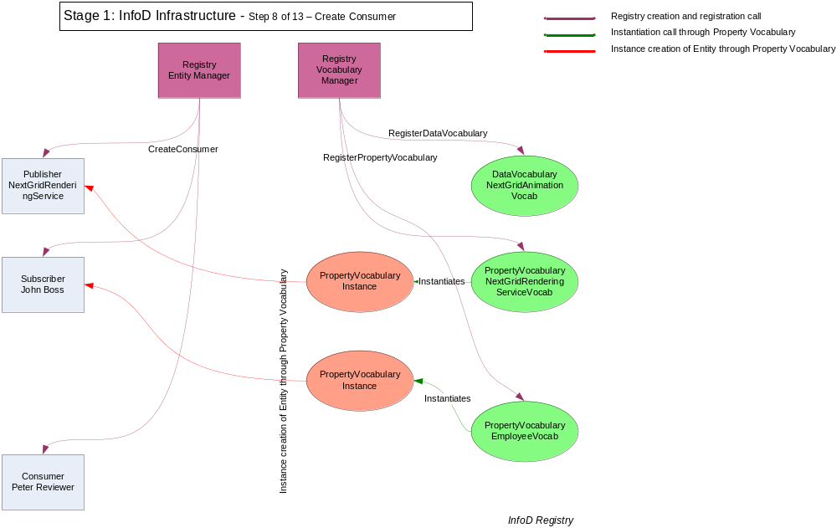

Slide 11
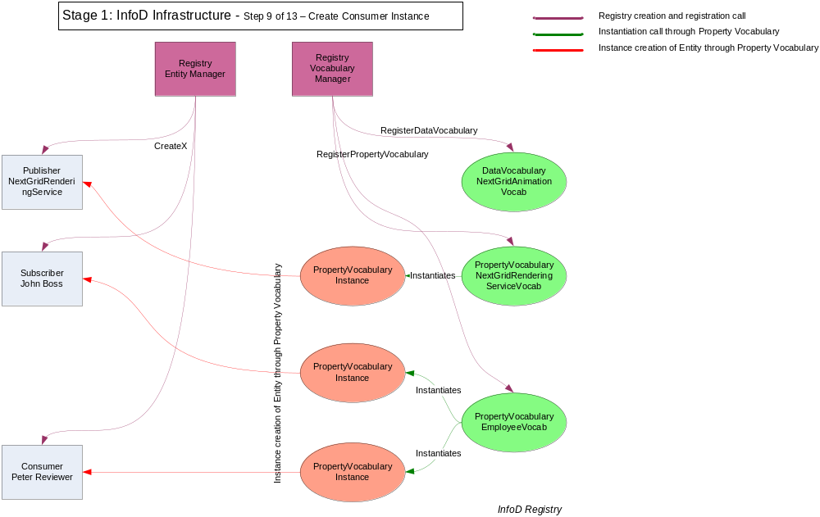

Slide 12
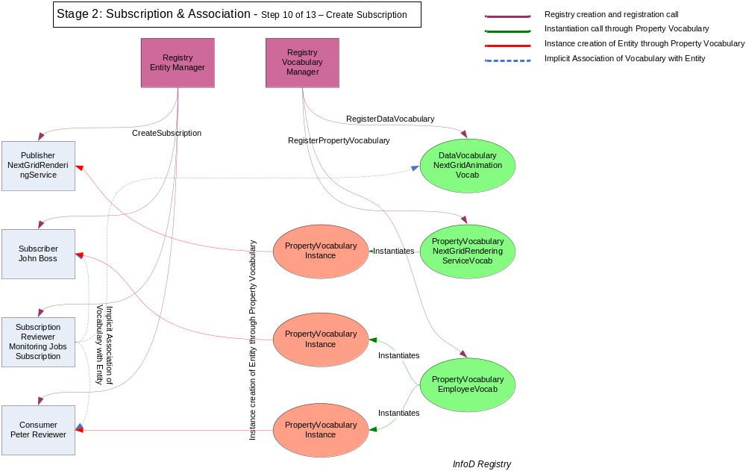

Slide 13
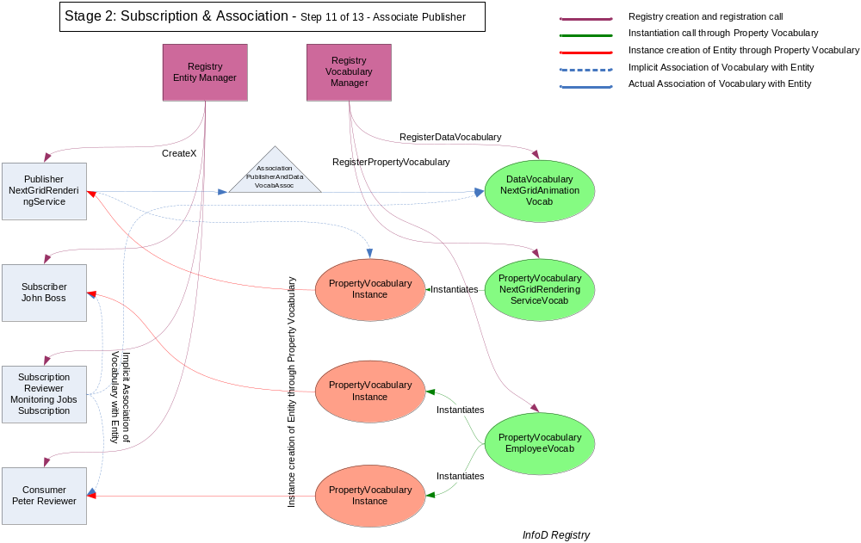

Slide 14
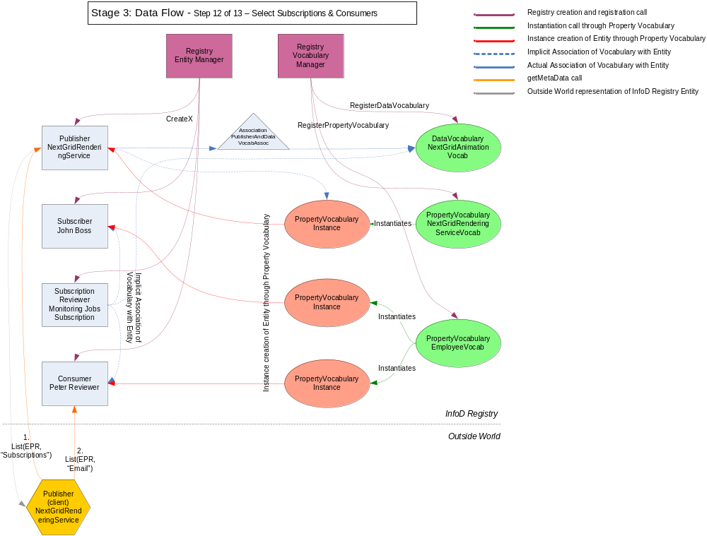

Slide 15
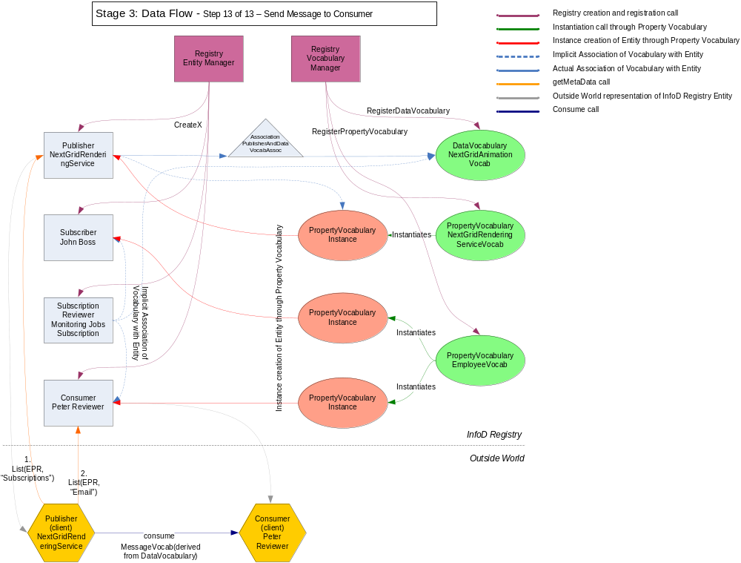

Slide 16


