Slide 1
OGSA
Logging Services
Discussion
Jim Warnes IBM
OGSA-WG F2F
September, 2003

Slide 2
OGSA Logger System: Requirements
Support for Legacy Logger Systems
- eg zOS System Logger, NT events, and UNIX syslog
Log as an intermediary
- multiple suppliers & multiple consumers
Decoupling of Message Supplier from Message Consumer
- eg audit, management, problem determination
Support for Filtering
- as close to source as possible
Persistency
- fundamental requirement, potentially different QoSs
Push and Pull Consumption Patterns
- need both push-based and pull-based
Representation of Log Artifacts
- standard xsd for log artifacts
Coexistence w/ OGSA Messaging
- OGSA Messaging provides the fabric!

Slide 3
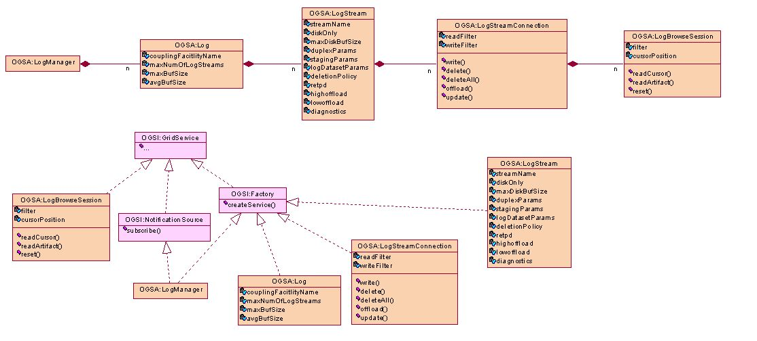
OGSA Logger System: Strawman

