Slide 1
GLOBALGRIDFORUM.ORG
OGSA-WG
Program Execution Status Update
GGF9
Chicago, USA
October, 2003

Slide 2
Agenda
Introducing the PE Sub-group
Status update
What’s next

Slide 3

We are Program Execution Sub-group
Ming Xu, Chris Smith Platform
Karl Cazjkowski, Alan Andrieux &
Steve Tuecke Globus
Jay Unger, Asit Dan & John Rofrano IBM
Ravi Subramaniam Intel
Hiro Kishimoto, Andreas Savva Fujitsu
Andrew Grimshaw Avaki
John Tollefsrud Sun
_{When we first got together}
_{four months ago →}

Slide 4
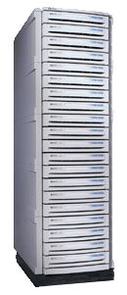
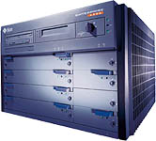

PE Applications and Resources
Data Size
Modeling
and
Simulation
Finance
EDU/Gov
Interactive Information Retrieval
Processing of large
inter-related
applications with large data sets
High
Life
Science
Industrial
Manufacturing
End of day processing with 15,000 to 500,000 processes to be run
High Volume
Trade pricing
EDA
_{EDA Simulations}
Low
Real-time
Information Display
Short bursty
Compute
Intensive requests
Computation
Intensiveness
Low
High
Notes:
There’s lots of ways to classify workload. I use the simpliest way. When you buy machines, the first two considerations are
How fast (2) how big the mem. This is because you already have a clue as to the speed and size requirements of your program.

Slide 5

Decide what we want…
What’s the end-point characteristics for OGSA PE Services?

Slide 6

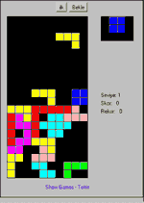

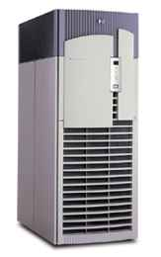

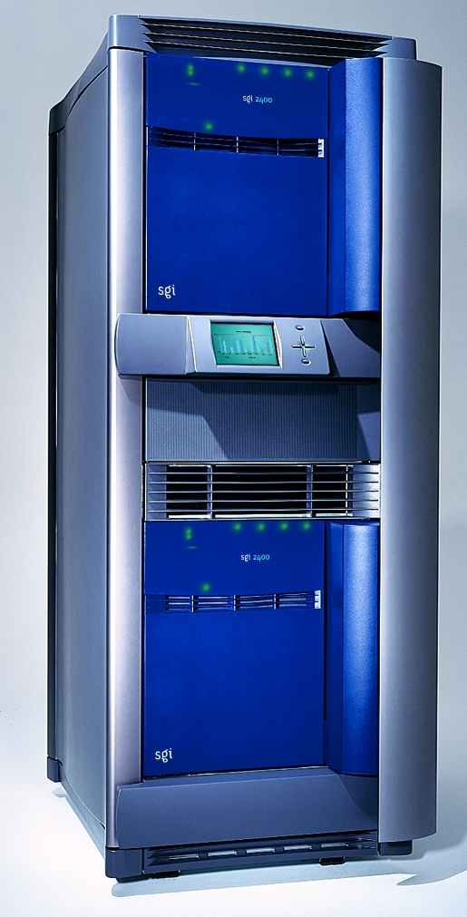
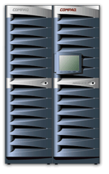
Breaking down the dividing walls
_{Division A}
_{Division B}
_{Division C}
_{VO2}
_{VO1}
_{LSF}
_{PBS}
_{SGE}
Notes:
Game of Tetris…
Work has variety of shapes and colors…It takes different time to process. Some can only fit in large machines. But most can fit all.
The goal is to spread the work most intelligently and quickly so that no work build up at any location.
However, today, this is the problem with siloed infrastructure.
To play tetris well, you need to be able to do three things. (1) see where the open space (2) see the workload types (3) move very fast

Slide 7
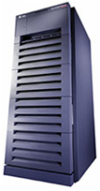
End Point Characteristics of PE services
Through OGSA PE services, IT can precisely measure, dynamically allocate
and
control the distribution of capacity,
where it is needed
when it is needed
to meet their business objectives for cost, risk, and productivity
app
app
app
app
OGSA PE services
Notes:
Messing the application part

Slide 8
Status: how we got here
Consensus
We’ve just started
WS-Agreement
Refactor the services
WS-Agreement
Proposed
OGSA-F2F
Meeting
First spec based
on CSF
PE Terms
- Andrew Grimshaw
time
June
August
Sept
Oct
Reference
Implementation
Of WS-Agreement
(CSF)
Ravi proposed
The Workload Realization Model
(Refactorization)
Sub-group
Teleconferences

Slide 9




Why isn’t OGSI enough?
_{createService(…)}
_{CreateionParams}
_{& port types}
_{LSF Style}
_{createService(…)}
_{CreateionParams}
_{& port types}
_{PBS Style}
_{createService(…)}
_{CreateionParams}
_{& Port types}
_{SGE Style}

Slide 10
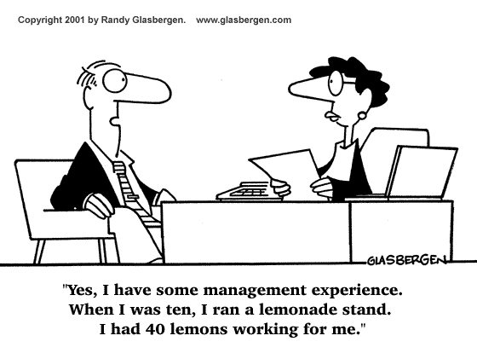
WS Agreement & related working groups
_{Service}
_{Provider}
_{Initiator}
_{WS-Agreement}
_{GRAAP}
_{Agreement Terms}
_{JSDL, GESA, DAIS…}

Slide 11
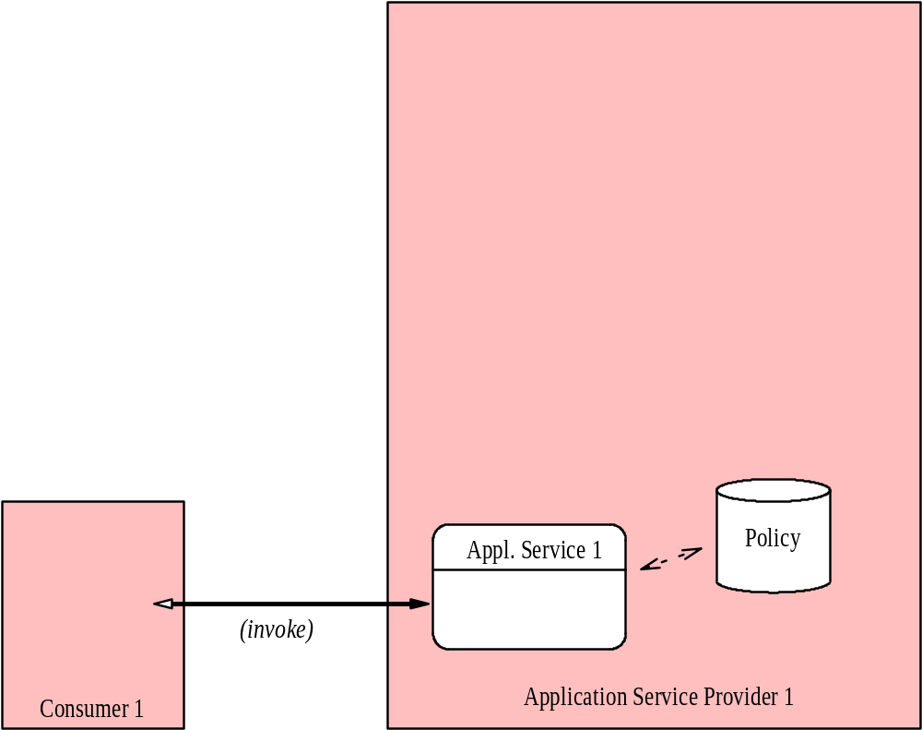
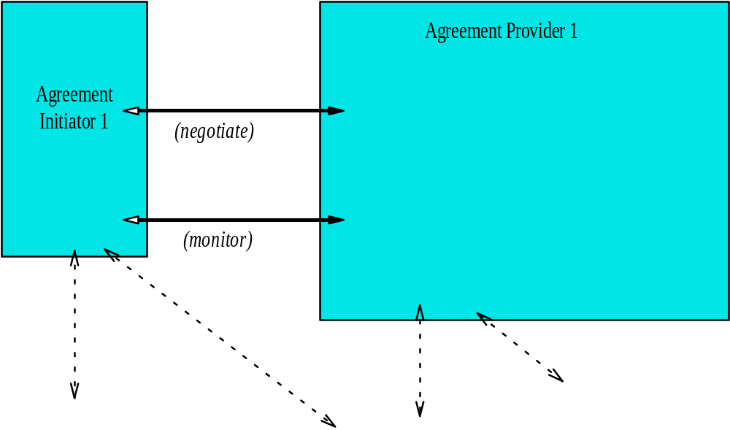
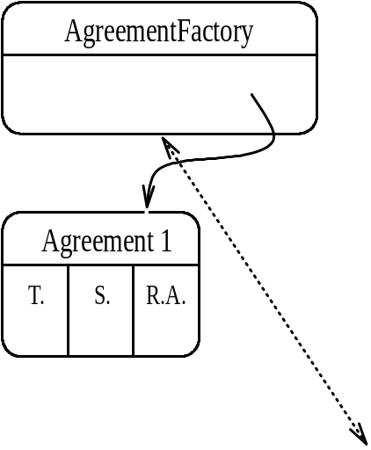
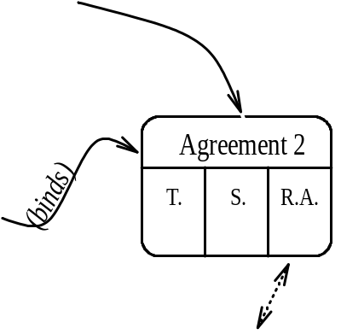
Two Proposals
_{Agreement}
_{Based}
_{PE}
_{Service}
_{Interfaces}
_{Service Refactorization}

Slide 12
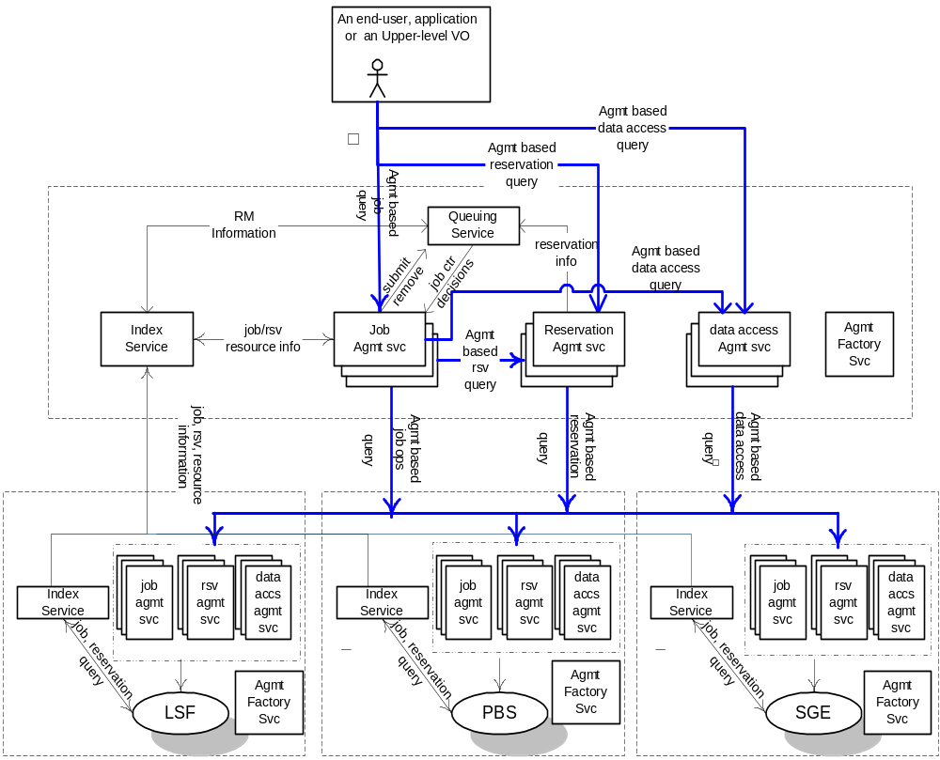
Agreement based Proposal: Bridging the demand & supply
_{VO}

Slide 13
Agreement terms for Advance Reservation
<metascheduler:agreement>
<wsp:All wsp:Usage="wsp:Required">
<metascheduler:ResReq gsa:Negotiability="gsa:Fixed">
<resReq>type==LINUX86</resReq>
</metascheduler:ResReq>
<metascheduler:hostTerm
gsa:Negotiability="gsa:Fixed">
<host>dev04</host>
</metascheduler:hostTerm>
<metascheduler:userTerm
gsa:Negotiability="gsa:Fixed">
<userName>bingfeng</userName>
</metascheduler:userTerm>
<metascheduler:cpuTerm gsa:Negotiability="gsa:Fixed">
<number>32</number>
</metascheduler:cpuTerm>
<metascheduler:startTime
gsa:Negotiability="gsa:Fixed">
<time>2003-08-29T17:00:00.000Z</time>
</metascheduler:startTime>
<metascheduler:endTime gsa:Negotiability="gsa:Fixed">
<time>2003-08-29T23:00:00.000Z</time>
</metascheduler:endTime>
</wsp:All>
</metascheduler:agreement>
_{CONT}

Slide 14
Job Terms
Draft Spec “Job Terms for specifying computational jobs” by Globus and Platform
Submitted for consideration to JSDL group
Attend the JSDL session !

Slide 15
Service Refactorization
“Demand”
“Supply”
Workload Mgmt.
Framework
Resource Mgmt. Framework
Environment
Mgmt.
Primary Interaction
Resource
Factory
CMM
Reservation
User/Job
Proxies
Policies
Job
Factory
Information Provider
Resource
Allocation
(or Binding)
Meta - Interaction
Dependency management
Resource Provisioning
Optimizing Framework
Workload Optimizing Framework
Scheduling
Resource Optimizing Framework
Queuing Services
Capacity Management
Workload Optimization
Workload Optimization
Resource Placement
Workload Post Balancing
Resource – Workload
Optimal Mapping
Admission Control (Resources)
Workload Models (History/Prediction)
Quality of Service (Resources)
Workload Orchestration
Resource Selection
Selection Context (e.g. VO)
Admission Control (Workload)
SLA Management (Workload)
Represents one or more OGSA services

Slide 16
Placement: At runtime (i.e. post dispatch)
Resource map/optimization: pre-dispatch
System Inputs
Capacity Mgmt.
Workload Mgmt.
Queues
Workloads
Work Priority/
Work Migration/
Work Pre-emption
Provisioning
Interactive
Workload
Topology &
Dependencies
Resource
Topology
Placement
Events
Schedules &
Resource
Agreements
Resource
Balancing
Scheduler
Expected
Work
Allocation
(Workload to
Resource Binding)
Get
Agreements
Models
Reservation
Establish
Agreements
Workload Prediction
Expected
Resource
Availability
Dispatch/
Binding
Work - Resource
combinations
Resource
Estimation
Resource Mapping
Running Job –
Used Resources
Resource
Maps
Running Job –
Used Resources
System
Operation
Assessments
Running Job –
Used Resources
System
Analytics
Resource
Topology
Optimizer
(Framework + Models)

Slide 17
OGSI (Grid Service): Factory, Notification, introspection, lifecycle, policy
Platform Hosting Env.
Work
Workload & Resource
Optimization
Services
Distributed State
Workload Management
Services
Capacity
Management Services
(Resource Mgmt. & Provisioning)
Workload
Scheduling
Services
Grid
Resource
Manager or
Virtualized
Instance
Resource
Agent
Resource
Binding & Allocations
Job
Configuration
Services
Service Level Management Services
Admission
Control
Business Services - Subscription, Accounting, Billing
Security Services - (WS-Security; GSI) - Authentication, Authorization, Identity management, identity propagation and delegation, audit)
Support Services - Auditing, Logging, Monitoring, Messaging, Event Management, Sensors, Metrics

Slide 18
What’s next
Planning 101
Decide where exactly we want to get to
Gap analysis
Set milestones
Execute “JUST DO IT!”

