Slide 1
Policy & Agreement in OGSA
Asit Dan, John Rofrano,
IBM

Slide 2
Why do we need agreement?
Guarantee specification is fundamental to all service agreements
  Provides assurances to clients on service level and/or resource availability
    Bound on average response time of web service operations during weekdays
    Guarantee on service or resource availability
  Avoid fixed allocation of resources in a service provider (key to virtualization)
    Associates importance on meeting this guarantee – e.g., penalty assessment
  Means for dealing with exceptions (e.g., surge in client requests, failure of nodes)
    Penalty assessment or other protocols for handling violations

Slide 3
Example Scenarios
Service level specification: repeated client invocations of a service
  Service level on performance (e.g., response time, throughput), availability (e.g., downtime, recovery time), etc. may be guaranteed on per invocation or across invocations
  Important agreement scenario for web service invocation
Resource requirement specification: Advance resource reservation
  Client confidence in resource availability
  Protocols for handling exceptions

Slide 4
Service & Guarantee Definition
Service definition is domain dependent
  Defines service elements or attributes
    Definition of operations in WSDL
    Network connectivity definition
    Job definition via RSL
Definition of guarantees on service qualities or attributes are domain independent
  Defines qualifying conditions, guarantees on attributes and violation handling
  Examples
    Service level (e.g., performance & availability) definition of web service operations
    Service level (bandwidth, jitter, availability) definition of network connectivity
    Assurance in resource availability of job submission

Slide 5
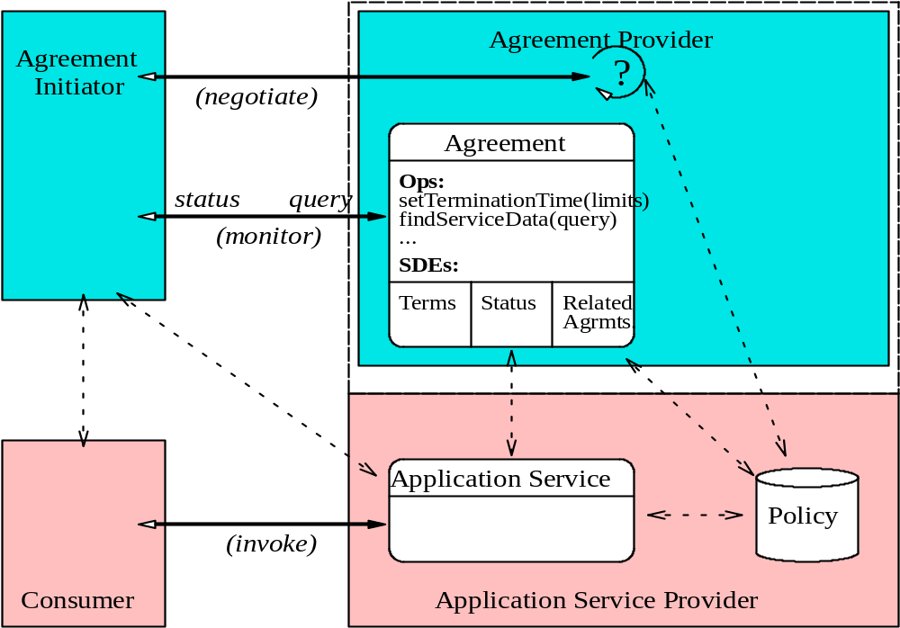
WS-Agreement Model
What agreements can be supported?
How to manage service levels?

Slide 6
Guarantee Specification in WSLA
Three components of a guarantee specification
  Guarantee expression:
    An expression that must hold - guaranteeing service level or resource availability
    Example: average response time < 1 sec, availability > 99%, etc.
  Qualifying conditions:
    Must be met for a guarantee to be valid - expressed over parameters not controlled by provider
    Example: Time (weekdays, prime time), request rate < 50 trx /sec
  Penalty or violation handling:
    Qualitative impact specification (e.g., $ amount)
    Explicit action statement (e.g., suspend, terminate request)
References: http://www.research.ibm.com/wsla/

Slide 7
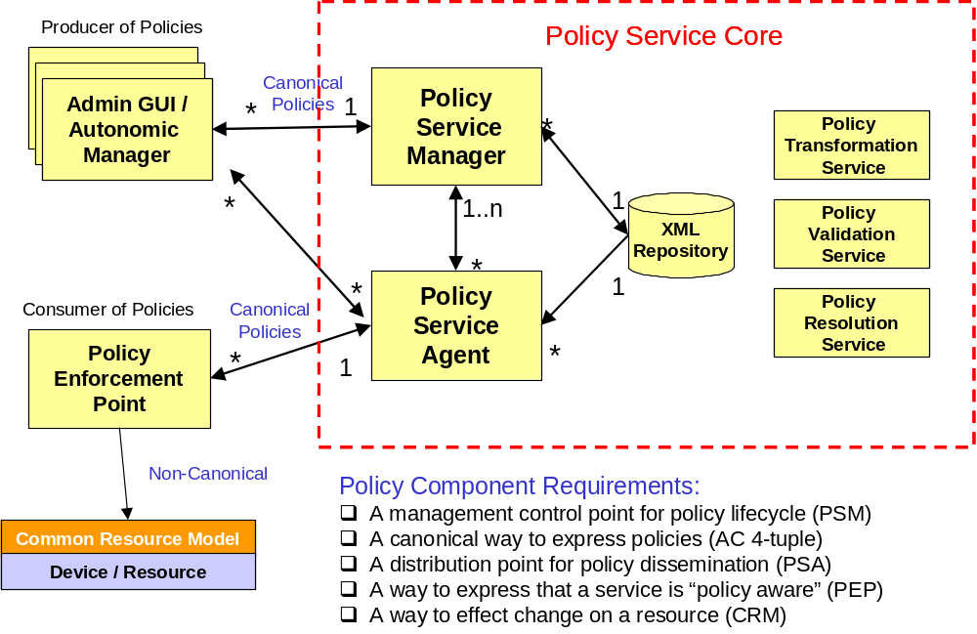
Policy deployment
CMM

