Slide 1
OGSA Profile Definition - Status
Hiro Kishimoto, Tom Maguire, Jem Treadwell, David Snelling
OGSA Status and Future, OGSA-WG #1
28 June, 2005 (GGF14 in Chicago) 10-11:30am

Slide 2
What is a Profile?
A profile defines requirements on referenced specifications for the purposes of improving interoperability.
Conformance to a Profile is adherence to the set of requirements defined for a specific target.
  Targets: SENDER, RECEIVER, CLIENT, SERVER
MUST, SHOULD, MAY words apply (RFC2119).
Implementers may claim “Conformance” to all or part of a Profile (all is better for interoperability).
No validation of claims at this time.

Slide 3
Specification References - Status
De Facto Standard. A specification that is used widely with multiple implementations available.
Institutional Standard. An approved specification from a generally recognized standards development organization with open membership. “Approved” is defined by the processes of the institution in question.
Evolving Institutional Standard. A specification that is evolving toward an Institutional Standard. The referenced draft has been approved by a formal process of that organization and satisfies the intellectual property considerations of the organization..
Draft Institutional Standard. A specification that is evolving towards an Institutional Standard. Working drafts.
Consortium Specification. An approved specification developed and promoted by a consortium of multiple companies or organizations, with a possible closed membership. “Approved” is defined by the processes of the consortium in question.
Evolving Consortium Specification. A specification that is evolving toward a Consortium Specification.
Draft Specification. Any specification that is arguably implementable in its current state, but still evolving and not yet part of a standards or consortium process.

Slide 4
Specification Reference – Adoption Level
Unimplemented. Although the specification exists and may be viewed as stable, no implementation exists. There may be prototypes under development within various organizations, but are not available outside those organizations.
Implemented. There exists at least one implementation that is generally available for testing or deployment that, according to the authors (or third parties), implements the specification.
Interoperable. There exist at least two implementations, as defined above, that interoperate. There must be a report detailing at least one interoperability workshop.
Community. At least one of the interoperable implementations, as defined above, is deployed and used on a regular basis by a specific community. The limited use may be due to either a lack of acceptance of the specification by the community at large or due to the specialist nature of a specific specification.
Adopted. There exist two or more interoperable implementations, as defined above, and they are both (or all) used across several communities. Commercially supported implementations are available, either as a product or as support for an open source implementation. There may be some restriction on which platforms support the implementations or other aspects that restrict the availability of the implementations.
Ubiquitous. Interoperable implementations exist for virtually all platforms. Commercial support is available, but provided transparently as part of the supporting infrastructure.

Slide 5
Profile Type Distinction
Information Profile
  Status: No restriction
  Adoption Level: No restriction
Recommended Profile as Proposed Recommendation
  Status: Institutional Standard, De Facto Standard, or Evolving Institutional Standard.
  Adoption Level: Interoperable, Community, Adopted, or Ubiquitous.
Recommended Profile as Grid Recommendation
  Status: Institutional Standard or De Facto Standard
  Adoption Level: Community, Adopted, or Ubiquitous

Slide 6
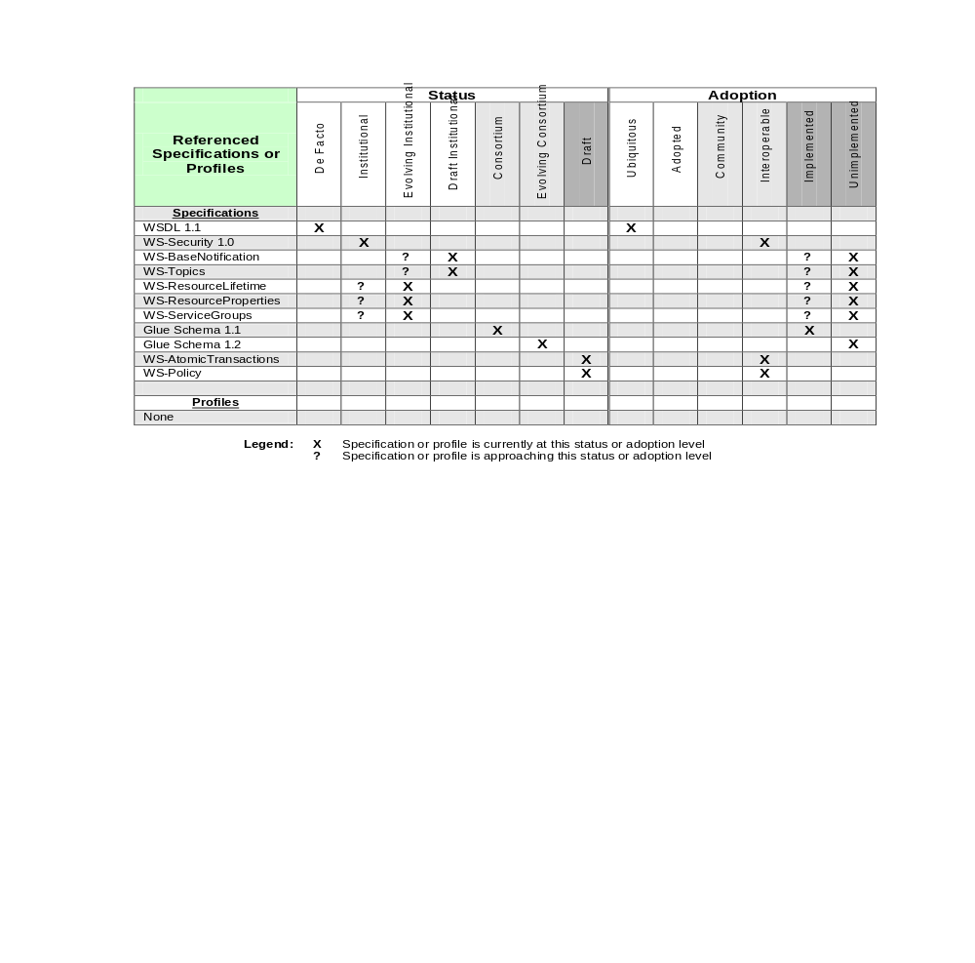
Example Status and Adoption Levels

