Slide 1
OGSA Profile Definition
Tom Maguire, David Snelling, Jem Treadwell
OGSA Documents, OGSA-WG #3
28 June, 2005 (GGF14 in Chicago) 2:30-4:00pm

Slide 2
What is a Profile?
A profile defines requirements on referenced specifications for the purposes of improving interoperability.
Conformance to a Profile is adherence to the set of requirements defined for a specific target.
  Targets: SENDER, RECEIVER, CLIENT, SERVER
MUST, SHOULD, MAY words apply (RFC2119).
Implementers may claim “Conformance” to all or part of a Profile (all is better for interoperability).
No validation of claims at this time.

Slide 3
Reference Specification Requirements
To identify a referenced specification or profile, the reference MUST be exact and stable.
  MUST include complete bibliographic reference information, including date and version numbers.
  Where online schema or other documentation is required, there MUST be a complete and persistent URL.
    The URL SHOULD refer to a document on an institutional web site where there is every expectation that the site will remain supported for the lifetime of the institution and possibly longer. The area of the institution’s web site SHOULD be persistent, which means that once placed on the web site the document’s name and location will remain unchanged indefinitely.
When only a sub-section or part of a specification or profile will apply complete subsection references MUST be provided. These references MUST include section numbers and titles, and SHOULD include page numbers where possible.

Slide 4
Required Features
For each specification or profile (or part thereof if appropriate) the level of support required by Profile-compliant implementations MUST be indicated. In particular it MUST be stated
  if support for the entire specification or profile is required; or
  if only the mandatory parts of the specification or profile are required; or
  if the mandatory parts and some of the optional parts of the specification or profile are required.

Slide 5
Restrictions
In some cases, a specification or profile allows multiple interpretations of aspects of itself. Where this variability in interpretation is likely to affect interoperability, the Profile SHOULD restrict the interpretation. The nature of these restrictions may range from a simple clarification of meaning in a specification or profile to the inclusion of "mini" specifications for missing content in the referenced document. Note that if such a "mini" specification becomes significant in size or relevance outside the given Profile, it SHOULD be spun out as a separate normative specification and referenced externally.

Slide 6
Extensions
Similarly, there may be cases where, to achieve the goals of interoperability, extensions to specifications are necessary. As with significantly complex restrictions, large or externally significant extensions should be fed back into the specification development process of the referenced specification, with a view to the eventual removal of the extension from the Profile. Where it seems likely that such an extension may never be included in the referenced specification, the Profile developers should seek alternative solutions to the problem.
All extensibility points in the referenced specifications MUST be noted in (at a minimum) an appendix in the referencing Profile.

Slide 7
Interactions
Where interactions between one or more specifications in a Profile (or referenced profiles) affect interoperability, these interactions MUST be discussed and procedures to ensure interoperability outlined. These procedures may be conditional on different approaches within various scenarios.

Slide 8
Specification References - Status
De Facto Standard. A specification that is used widely with multiple implementations available.
Institutional Standard. An approved specification from a generally recognized standards development organization with open membership. “Approved” is defined by the processes of the institution in question.
Evolving Institutional Standard. A specification that is evolving toward an Institutional Standard. The referenced draft has been approved by a formal process of that organization and satisfies the intellectual property considerations of the organization..
Draft Institutional Standard. A specification that is evolving towards an Institutional Standard. Working drafts.
Consortium Specification. An approved specification developed and promoted by a consortium of multiple companies or organizations, with a possible closed membership. “Approved” is defined by the processes of the consortium in question.
Evolving Consortium Specification. A specification that is evolving toward a Consortium Specification.
Draft Specification. Any specification that is arguably implementable in its current state, but still evolving and not yet part of a standards or consortium process.

Slide 9
Specification Reference – Adoption Level
Unimplemented. Although the specification exists and may be viewed as stable, no implementation exists. There may be prototypes under development within various organizations, but are not available outside those organizations.
Implemented. There exists at least one implementation that is generally available for testing or deployment that, according to the authors (or third parties), implements the specification.
Interoperable. There exist at least two implementations, as defined above, that interoperate. There must be a report detailing at least one interoperability workshop.
Community. At least one of the interoperable implementations, as defined above, is deployed and used on a regular basis by a specific community. The limited use may be due to either a lack of acceptance of the specification by the community at large or due to the specialist nature of a specific specification.
Adopted. There exist two or more interoperable implementations, as defined above, and they are both (or all) used across several communities. Commercially supported implementations are available, either as a product or as support for an open source implementation. There may be some restriction on which platforms support the implementations or other aspects that restrict the availability of the implementations.
Ubiquitous. Interoperable implementations exist for virtually all platforms. Commercial support is available, but provided transparently as part of the supporting infrastructure.

Slide 10
Profile Type Distinction
Information Profile
  Status: No restriction
  Adoption Level: No restriction
Recommended Profile as Proposed Recommendation
  Status: Institutional Standard, De Facto Standard, or Evolving Institutional Standard.
  Adoption Level: Interoperable, Community, Adopted, or Ubiquitous.
Recommended Profile as Grid Recommendation
  Status: Institutional Standard or De Facto Standard
  Adoption Level: Community, Adopted, or Ubiquitous

Slide 11
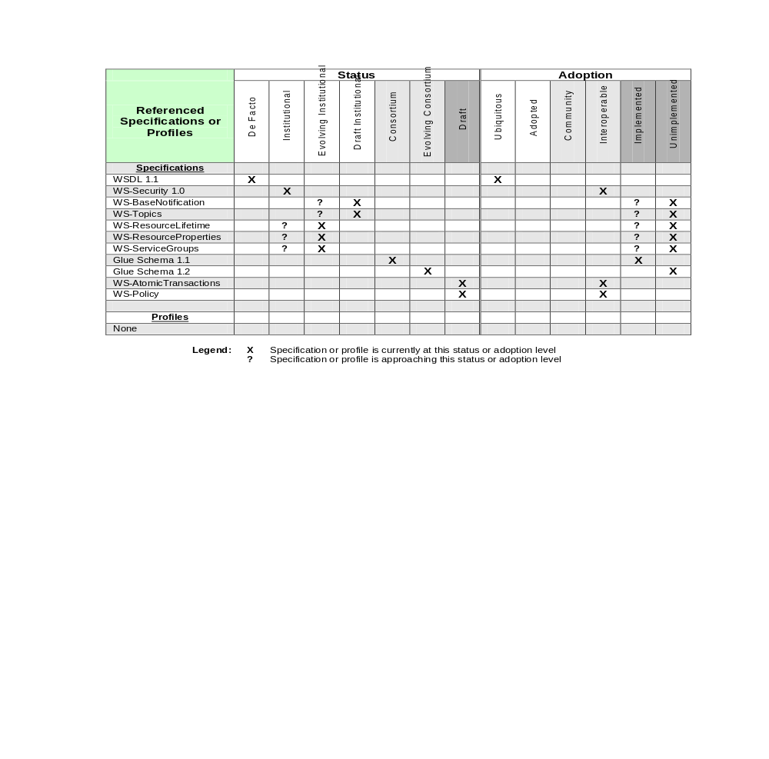
Example Status and Adoption Levels

Slide 12
Q&A

