Slide 1
OGSA-WG
Security
GGF9, Chicago, 10/6/03
Frank Siebenlist
The Globus Project (www.globus.org)
Mathematics and Computer Science Division
Argonne National Laboratory
franks@mcs.anl.gov

Slide 2
OGSA & Security
Security Services are Core Services
Grid Security not fundamentally different from general distributed security
  Leverage existing efforts like Web Service Security,
  Liberty Alliance, OASIS SAML/XACML, etc.
Difference in focus
  Crossing of administrative boundaries
  Concept of Virtual Organizations to enable collaborations
OGSA Security WG
  Architecture + Roadmap
  “Gap” analysis
  Spin-off WGs if needed: OGSA-Authorization WG

Slide 3
Grid Solution:
Use Virtual Organization as Bridge
Certification
Certification
Authority
Authority
Policy
Policy
Authority
Authority
Sub-Domain A1
Sub-Domain B1
Domain A
Domain B
Task
common mechanism
Server X
Server Y

Slide 4
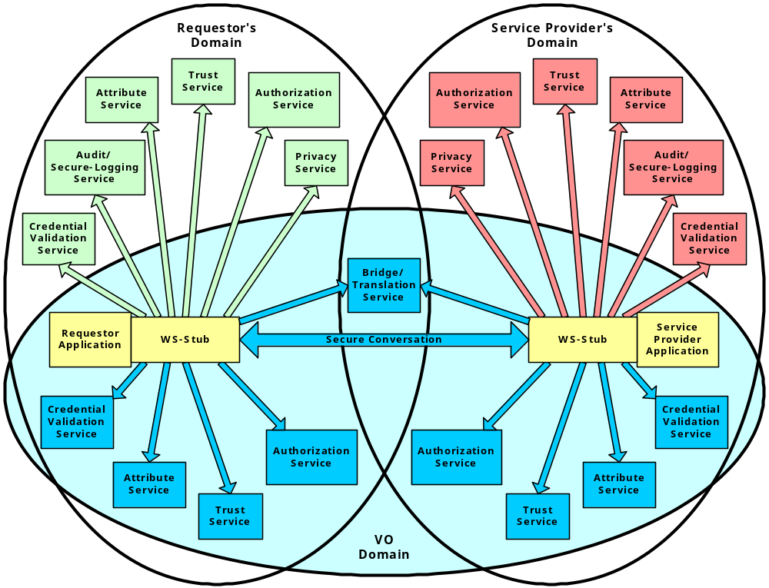
Security Services & VO

Slide 5
OGSA-Security WG
Chairs:
Marty Humphrey
Nataraj (Raj) Nagaratnam
Charter:
The Open Grid Services Architecture (OGSA) is a proposed Grid service architecture based on the integration of Grid and Web Services concepts and technologies. At this time, the only existing GGF activity directly related to the development and standardization of the OGSA architecture is the Open Grid Services Infrastructure (OGSI) WG. While the OGSI WG has acknowledged/discussed security-related issues, the focus of the OGSI WG is on the OGSI-compliant service definition/discovery/invocation, and not directly on the security issues or ramifications.

Slide 6
OGSA-Authorization WG
Chairs:
Von Welch
Rebekah Lepro
Andrew McNab
Charter:
The objective of the OGSA Authorization WG is to define the specifications needed to allow for basic interoperability and pluggability of authorization components in the OGSA framework. There are a number of authorization systems emerging in the Grid today (Akenti, PERMIS, CAS, VOMS, Cardea, etc.), these specifications will allow these solutions to be interchangeably used with middleware that requires authorization functionality. This group will leverage authorization work that is ongoing in the Web services world (e.g. SAML, XACML, the WS Security suite) and define specification for how these should be used for Grid services.

