Slide 1
caBIG
the cancer Biomedical Informatics Grid
Arumani Manisundaram
caBIG - Project Team

Slide 2
What is caBIG ?
The cancer Biomedical Informatics Grid, or caBIG™, is a voluntary network or grid connecting individuals and institutions to enable the sharing of data and tools, creating a World Wide Web of cancer research.

Slide 3
Goal: The goal is to speed the delivery of innovative approaches for the prevention, detection and treatment of cancer.
The infrastructure and tools created by caBIG also have broad utility outside the cancer community. caBIG is being developed under the leadership of the National Cancer Institute and its Center for Bioinformatics.
.

Slide 4

Informatics tower of Babel
Each cancer research community speaks its own scientific “dialect”
Overwhelming volume of data from a multitude of sources
Integration critical to achieve promise of molecular medicine

Slide 5



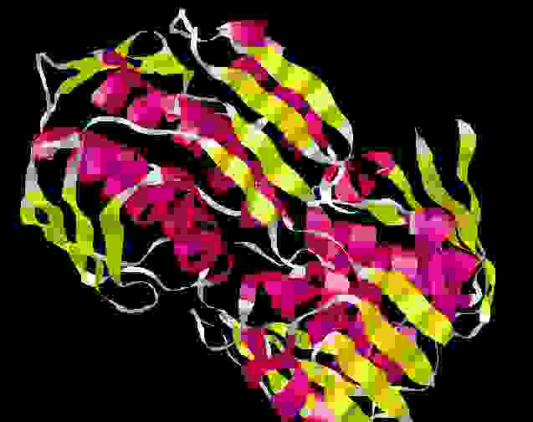
caBIG infrastructure joins diverse data
within an institution

Slide 6
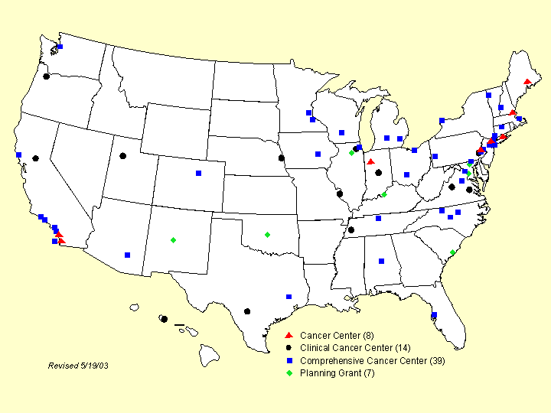
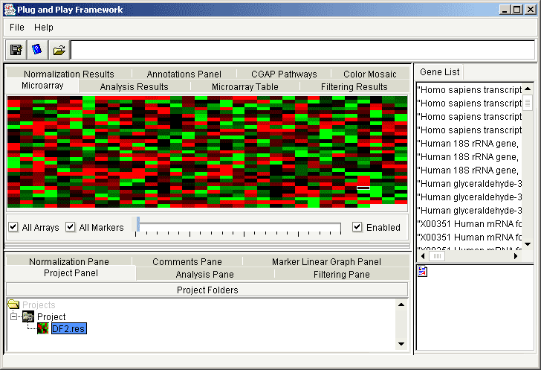
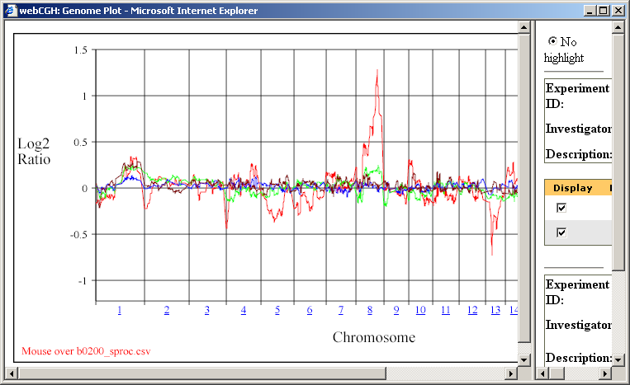
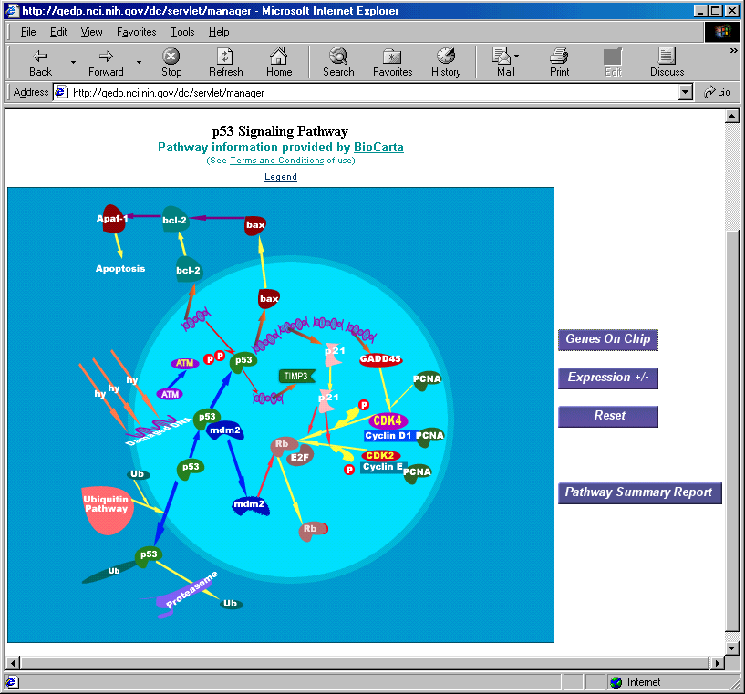
caBIG will facilitate sharing of
infrastructure, applications, and data

Slide 7
Cancer Biomedical Informatics Grid
Common, widely distributed infrastructure permits cancer research community to focus on innovation
Shared vocabulary, data elements, data models facilitate information exchange
Collection of interoperable applications developed to common standard
Raw published cancer research data is available for mining and integration

Slide 8
caBIG Principles
    Open source
    Open access
    Open development
    Federated

Slide 9
caBIG Principles
Open source:Products that are funded by NCI in connection with the caBIG initiative must be made available under licenses that permit unrestricted use and redistribution by any party, whether commercial, academic, or non-profit. Therefore, these compatibility guidelines and any resources or specifications related to caBIG interoperability standards must also be distributed according to these terms.
    Open access
    Open development
    Federated

Slide 10
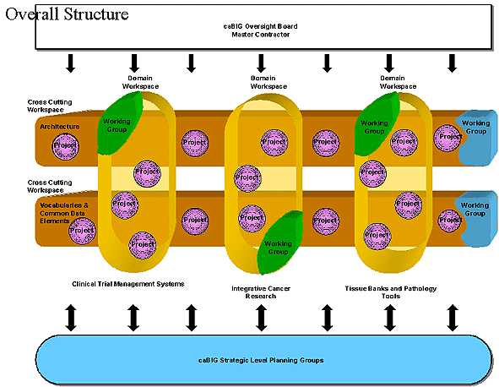
caBIG Structure

Slide 11
Domain Workspaces
Clinical Trials Management Systems
Tissue Banks and Pathology Tools
Integrative Cancer Research

Slide 12
Clinical Trials Management Systems
Purpose: Deploy and develop caBIG compliant tools to support data capture/analysis and management of clinical trials.
caBIG Deliverables
Componentized, standards-based Clinical Trials Management System to handle, in an automated fashion, all aspects of developing, managing, conducting, and reporting Clinical Trials
  e-IND filing/regulatory reporting with FDA
  Electronic management of trials
  Integration of diverse trials

Slide 13
Tissue Banks and Pathology Tools
Purpose: Develop a set of tools to inventory, track, mine, and visualize tissue samples and related information from a geographically dispersed repository.
caBIG Deliberables
Tissue Management System
  Systematic description and characterization of tissue resources – tools to inventory, track, mine, and visualize tissue samples from geographically dispersed repositories
  Ability to link tissue resources to clinical and molecular correlative descriptions

Slide 14
Integrative Cancer Research
Purpose: Assemble data, tools, and infrastructure that facilitate the cross silo use of cancer biology information to promote integrated cancer research.
caBIG Deliverables
“Plug and Play” analytic tool set
  microarray
  proteomics
  pathways
  data analysis and statistical methods
  gene annotation
Diverse library of raw, structured data
Facilitate the integration of different types of data
Provide tools for the integration of clinical and basic research

Slide 15
Cross Cutting Workspaces
Vocabularies & Common Data Elements
Architecture

Slide 16
Cross Cutting Workspaces
Vocabularies & Common Data Elements
Architecture

Slide 17
Architecture Workspace
Purpose: Extend architecture/infrastructure frameworks and standards to support caBIG tools and data access. Topics in this workspace include Middleware, Application and data access APIs, Data transmission formats, Web services components, Grid computing services, and security architecture.

Slide 18
Architecture SIGs
Identifiers
Security Access Control and Identity
Common Query Language
Workflow
Best Practices
Regulated Information Exchange
caGRID Team

Slide 19
Vocabularies and Common Data Elements
(VCDE)
Purpose: Create and maintain software systems for content development and content delivery; provide assessment of, and recommendations on vocabularies and common data elements.

Slide 20
Vocabularies and Common Data Elements
(VCDE)
Purpose: Create and maintain software systems for content development and content delivery; provide assessment of, and recommendations on vocabularies and common data elements.

Slide 21
Achieving Syntactic and Semantic Interoperability
When considering how to overcome the obstacles to interoperability, the caBIG program members arrived at four areas that need to be addressed.
    Programming and Messaging Interfaces
    Vocabularies and Ontologies
    Common Data Elements
    Information Models

Slide 22
Achieving Syntactic and Semantic Interoperability
Programming and Messaging Interfaces
  Computer programs and the people who write them are able to access resources from other programs through programming and messaging interfaces. Each of these interfaces responds to a particular syntax for its communications. Agreement upon standards for these interfaces is necessary to overcome barriers to syntactic interoperability.

Slide 23
Achieving Syntactic and Semantic Interoperability
Vocabularies and Ontologies
  Biomedical information includes a substantial body of specialized concepts that are represented by terms. Agreement upon the basic concepts, terms and definitions that are inherent in all biomedical information is essential for achieving semantic interoperability. Terminology development systems that use description logic are helpful tools for managing these concepts.

Slide 24
Achieving Syntactic and Semantic Interoperability
Common Data Elements
  Data that is collected on a given study or trial must be defined and described such that remote users of that data can understand what it means. These metadata descriptions are referred to as data elements. When many groups use the same (common) data elements (CDEs), then larger-scale studies can be conceived, since consistency and comparability of across sites, studies, and time becomes possible. CDEs are therefore critical constructs for semantic interoperability.

Slide 25
Achieving Syntactic and Semantic Interoperability
Information Models
Individual types of data are rarely collected or presented in isolation. Rather, they are assembled into a contextual environment that includes closely and more distantly associated data and information. These associations and relationships can be presented in the form of an information model. These models convey both a human and a machine understandable representation of the contextual environment of data in an information resource, and are important for achieving the highest degree semantic interoperability.

Slide 26
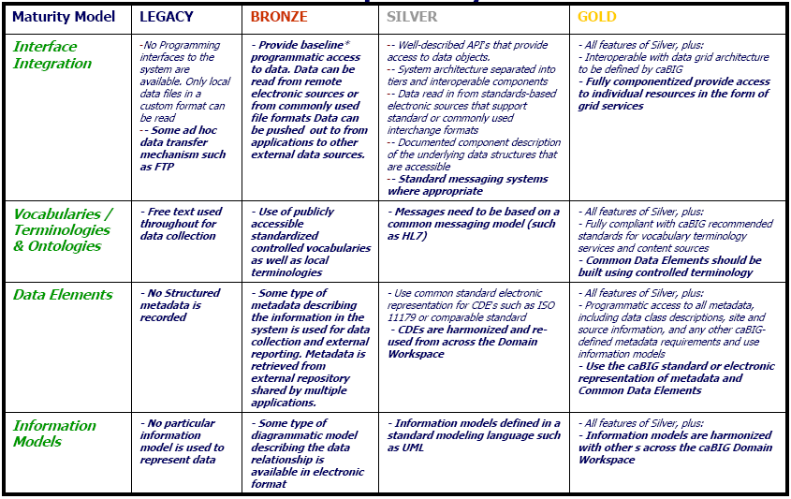
Architecture Compatibility Matrix

Slide 27
What does a semantic Grid buy us?
When I get a Gene object from you, I know what all of the fields mean
When you and I both use Gene objects, we can determine if they are semantically equivalent
When I publish a Gene object and you publish a microarray object, we know the geneID fields are semantically equivalent

Slide 28
What is a CDE?
A Data Element is
  a unit of data for which definition, identification, representation, and permissible values are specified by means of a set of attributes; the smallest unit of data.
A Common Data Element is
  a unit of data that has been identified for general usage; maybe a data standard.

Slide 29
Benefits of CDEs
Facilitates common data collection by defining content and scope
Supports semantic data relationships
Defines valid values for enumerated data
Improves understanding of data
Simplifies and documents data analysis
Provides historical context for data collections
Encourages reuse of existing data structures.

Slide 30



Standards Supporting Infrastructure
Enterprise Vocabulary Services (EVS)
  Browsers, APIs
cancer Bioinformatics Infrastructure Objects (caBIO)
  Applications, APIs
cancer Data Standards Repository (caDSR)
  CDEs
  Case Report Forms
  Object models
  ISO 11179 model
Developer Toolkits
  caCORE SDK, HL7 SDK

Slide 31
Strategic Level Working Groups
Strategic Planning
Data Sharing and Intellectual Capital
Training

Slide 32
caBIG Pilot Status
Pilot – NCI designated Cancer Centers
Members: 50 institutions – executed base agreements
  Developers, Adopters, Working group members
Volunteers
  Academic Centers, Industry
Statistics
  80 organizations
  600 active participants
  285 teleconferences
  10 face-to-face meetings

Slide 33
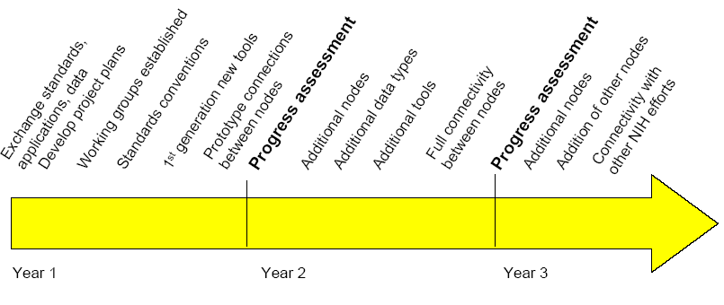
caBIG Milestones

Slide 34
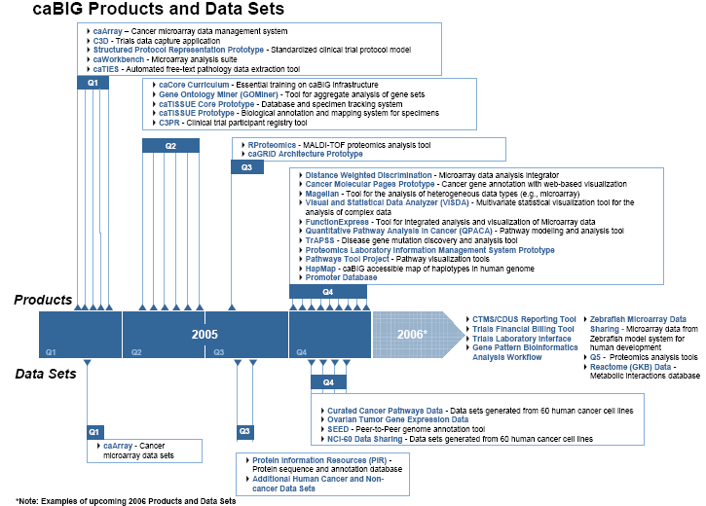

Slide 35
Getting Involved
WWW site: http://caBIG.nci.nih.gov
  Products
  Participants
  Calendar - teleconferences
  Electronic Forums
Electronic Newsletters
  What’s BIG this Week (weekly)
  caBIG Program Update (monthly)
  caBIG Center Director’s Update
Teleconferences
  Workspace teleconferences
  Special Interest Groups

Slide 36
caBIG Into the Future
New activities
  Imaging
  Proteomics
  Integrated Cancer Biology Program
  Clinical Research/Health Information Technology interface
New opportunities
  Interagency Oncology Task Force
    Clinical Research Information Exchange (CRIX)
    Shared infrastructure with FDA
  Clinical Trials Working Group
    Electronic case report forms
    Expanded use of caBIG infrastructure
New Communities
  Cooperative Groups, SPORE community
  International Partners, Commercial Partners

Slide 37
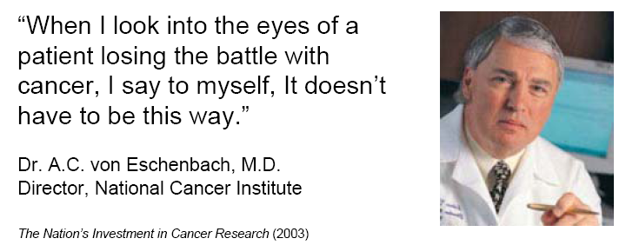
The NCI challenge goal:
… eliminate death and suffering due to cancer

Slide 38
Learn more about caBIG http://caBIG.nci.nih.gov/

Slide 39
Questions ?

