Slide 1
A Parallel Data Transfer Solution for Grids
Yves Denneulin
Christian Guinet, Pierre Lombard
ID-IMAG/INRIA Laboratory - Grenoble, France

Slide 2
Outline
Parallel storage on clusters
  The NFSp solution
Parallel Data Transfer
  Motivations
  Description
  Implementation
  Performances

Slide 3
Storage facilities on grids
Grid architecture
  high performance computers are not the only nodes
  there are a lot of beowulf clusters too
Storage
  Dedicated servers (typically using NFS for a cluster)
    SAN
  Network of SANs for large amount of data
But…
  SANs are expensive
  Solutions based on network of PCs exist too
    PVFS is well known
    NFSp is an alternative
      separation between metadata and data

Slide 4

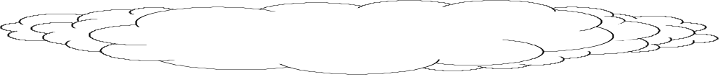


NFS server for clusters
The cluster is the file system
Request
Interconnect (udp)
NFS client unchanged
adaptative placement
(stripping / mirroring)
files placement
  parallel access
Extension to fault tolerance
  duplication of IODs
Distributed
files
Metaserver
I/O daemons

Slide 5
Data transfer between NFSp nodes
Availability of high bandwidth network between NFSp nodes
  fast transfer possible
But…
  the storage nodes are on a commodity network
  typical ftp transfer limited by the bandwidth of the server
Idea
  Doing direct IOD to IOD transfers
  Possibility to increase bandwidth even with low-end fast-ethernet connected PCs
  Goal: maximize throughput

Slide 6
Point-to-point Data Transfer
Metaserver
Metaserver
Large bandwidth
Data transfer between servers (metaserver)

Slide 7
Parallel Data Transfer between clusters
Initial negotiation
Network
Phase 1: negotiation between the metaservers
Phase 2: communication between each metaserver and its IODs
Phase 3: actual data transfer between IODs
Phase 4: acknowledgements

Slide 8

Architecture of Gxfer
Components
  daemon on each metaserver node
  daemon on each storage(IOD) node
Independent of NFSp
Gxfer metaserver
Gxfer IOD
Gxfer IOD
Gxfer metaserver
SAN

Slide 9
A get operation
Remotely get a file from another site
Sequence of events
  1. look for the address of the metaserver storing the file
  2. connect to it and get metadata for the file including how it is stored
  3. create the metadata to locally store this file
    including the set of IODs on which the data will be stored
  4. open connections with the local IODs that will store the file
    send transfer order to the local IODs: parameter = the two metadata
  5. each IOD compute the needed transfers and the IODs that has to contribute
  6. each IOD creates connections with the IODs that contains the data
  7. actual transfer occurs
  8. each IOD sends an ACK to its metaserver

Slide 10
Implementation
Gxfer library
  can put or get a file remotely through a grid
Everything is highly customizable
  local FS, type of storage (centralized/distributed),…
Communication protocol between metaservers
  exchange metadata, including storage description
Communication protocol between IODs
  Any data point-to-point data transfer service can be used
    ftp
    babarftp
    currently implemented with TCP
Interface IOD <=>gxfer
  create and modify files
  define where data of a file are stored (list {iod ref, file, offset})

Slide 11
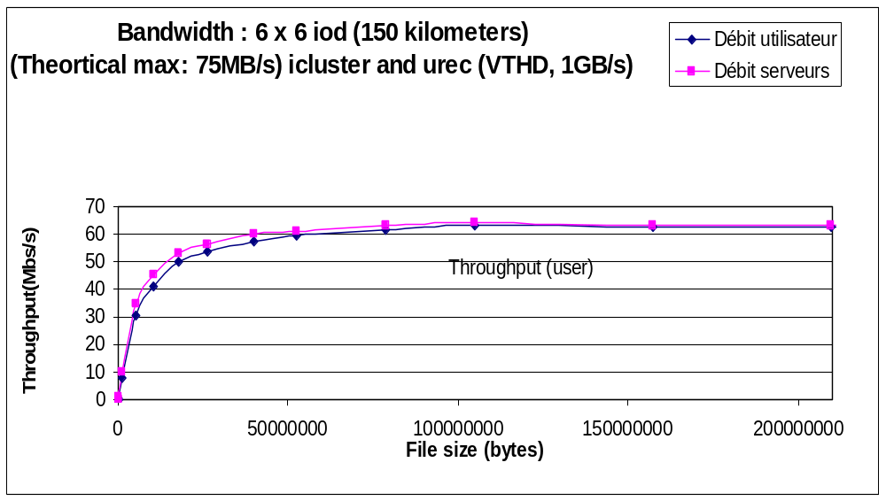
Performances (1)
It scales well

Slide 12
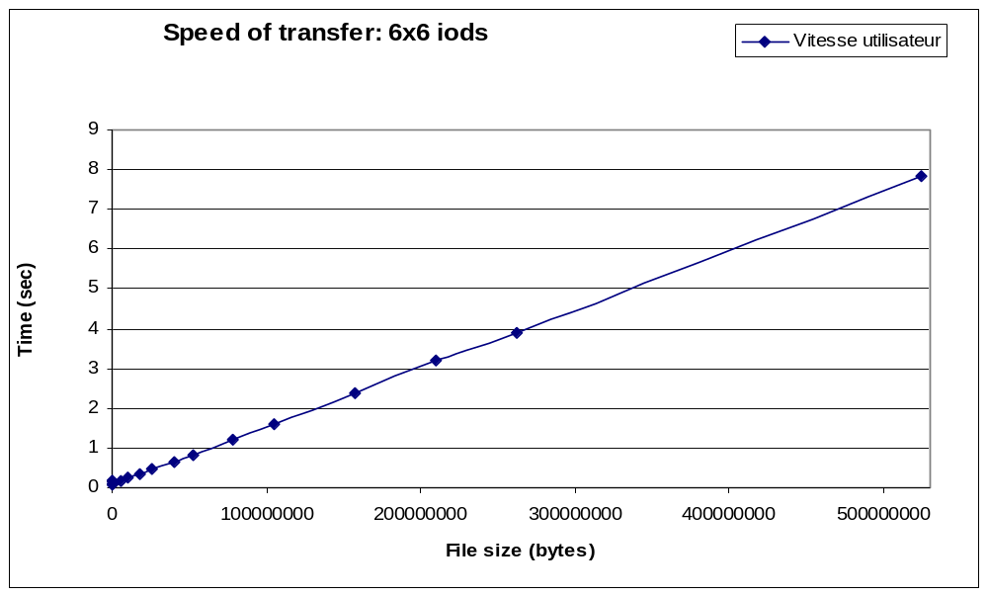
Performances (2)

Slide 13
State of the implementation
Working (and stable)
  being deployed on the Etoile testbed (~300 PCs on 10 sites)
  available for download soon
  porting to Globus in progress
Interfaces
  specific to NFSp now
  interface with any local FS or NFS in the works (mid july)
~5000 lines of C++
  highly adaptable

Slide 14
Topics of interest
Feedback
Structure
  separation between metadata and data
  description of the metadata
  description of how a file is stored (part of the metadata)
    stripping
    replication
Interactions between
  metaservers: know how a file is stored
  iods: transfer chunks of files
  metaservers and local FS: create a file, access it
  IOD and local FS: create a file, access it
Framework to study various solutions
  transport protocol for example

Slide 15
What about gridftp?
Our proposal isn’t linked to globus
  the grid architecture is stored in a database
We have a lot of flexibility regarding storage locations
Goal:(?) define a generic framework in which both (and more) solutions could fit and interact

Slide 16
Movement and data distribution
Distributed file system
  NFSp:distributed extension of NFS for clusters of low-end PCs
  extension to fault tolerance
Efficient transfert on grids
  Simultaneous multi-nodes transfert
  NFSp storage nodes to multiplex communications
  performances very close to the optimal bandwidth (600MBs transfered in 6s)
Peer-to-peer storage system
  Definition of storage stratégies
VIODs
IOD
IOD
VIODs
IOD
IOD
Nfspd
VIODs
IOD
IOD
VIODs
IOD
IOD

