Slide 1
Performance evaluation of Virtual Filesystem Directory Service (VFDS)
Kazuaki Anami, Takuya Ishibashi (SOUM), Osamu Tatebe (AIST)

Slide 2
Implementation of VFDS
Grid Service in Java based on Globus Toolkit 3.2.1
Conforms to the VFDS Specification document on June 2004
  Entry and Reply classes, and all subclasses
  list, lookup, delete, create, move, update operations
PostgreSQL Server 7.4.5 for the backend database
Extended features
  ACL

Slide 3
Measurement environment
Specification of Client and Server
  CPU: dual 2.8GHz Xeon
  Memory: 1 GB
  OS: RedHat Linux 8
  Gigabit Ethernet
Globus Toolkit 3.2.1 (WS-Core）
Sun's Java 2 SDK, Standard Edition 1.4.2_05
PostgreSQL 7.4.5 (running on the service host)

Slide 4
Points of evaluation
Response time of list() operation
  with various number of entries in a directory
    from 10 to 10,000 entries
  with various messaging securities
    GSI SIGNATURE
    GSI ENCRYPTION
    No Authentication
  with various network latencies
    Within the same LAN
    Between Tsukuba and Tokyo (50 Km)

Slide 5
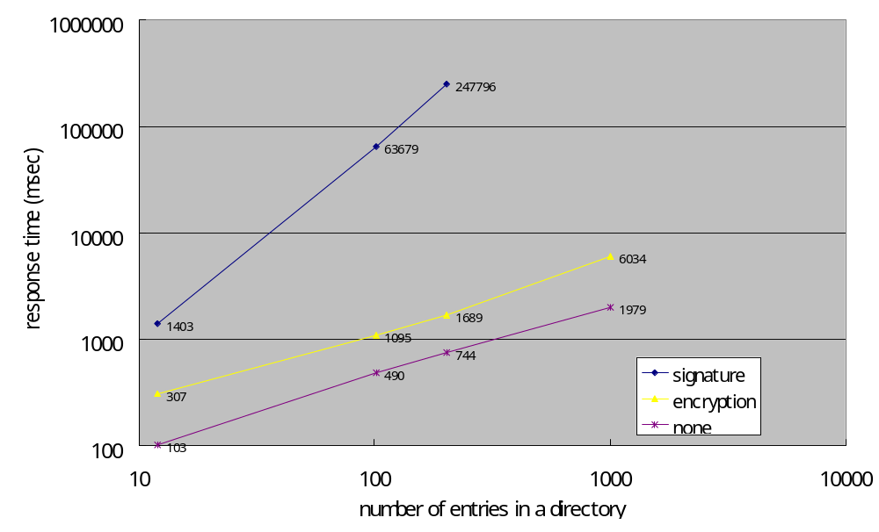
Default heap size (64 MBytes)
OutOfMemoryError
at 1,000. (signature)
OutOfMemoryError
at 10,000. (encryption)
OutOfMemoryError
at 10,000. (none)

Slide 6
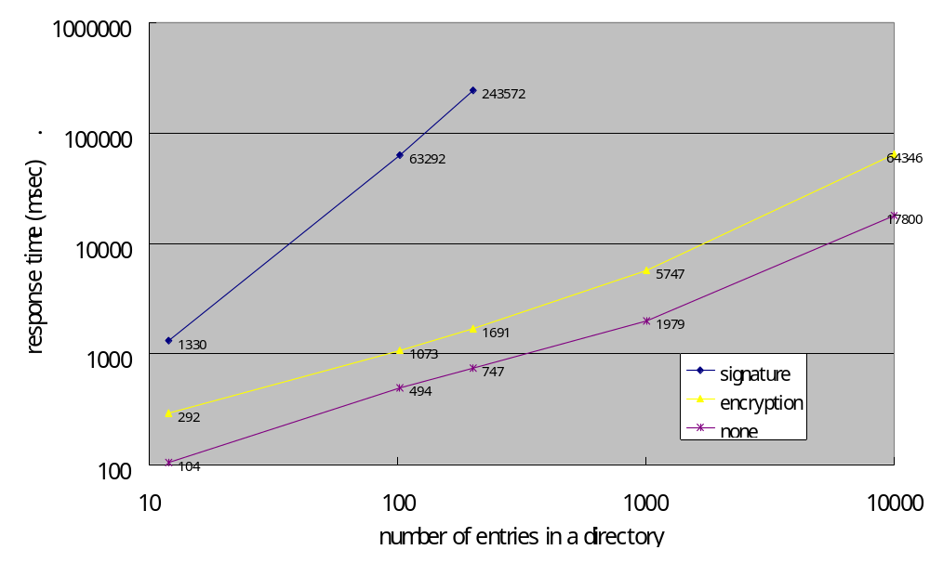
256 MBytes heap size
Omitted measurement at 1,000
because it took too long time (signature)

Slide 7
Response time of list() operation
180 seconds to list 10,000 entries
OutOfMemoryError occurred when listing only 10,000 entries from a single client
When listing 200 entries,
Messaging security | Response time
GSI SIGNATURE | 243,572 msec
GSI ENCRYPTION | 1,691 msec
Non-authentication | 747 msec

Slide 8
Response time of list() operation
GSI ENCRYPTION degrades performance 50~75% from non-authentication case
GSI SIGNATURE degrades performance 90~99.7% from non-authentication case

Slide 9
Investigation of SOAP massages with GSI security
Message is . . .
  signed in GSI SIGNATURE
  signed and encrypted in GSI ENCRYPTION
GSI ENCRIPTYON should take longer than GSI SIGNATURE, but . . .
Difference is number of tags in SOAP Message
  In GSI ENCRYPTION,
    Message is encrypted
    It cuts down the number of tags

Slide 10
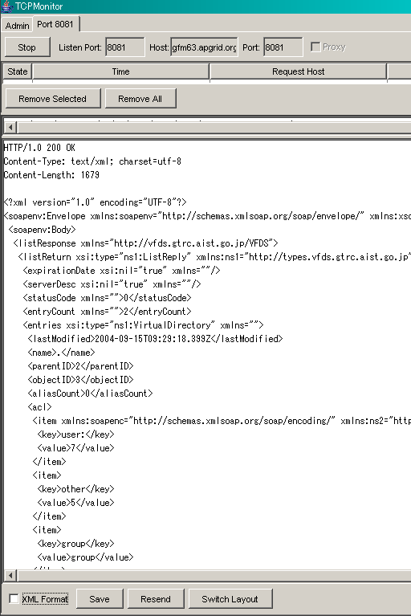
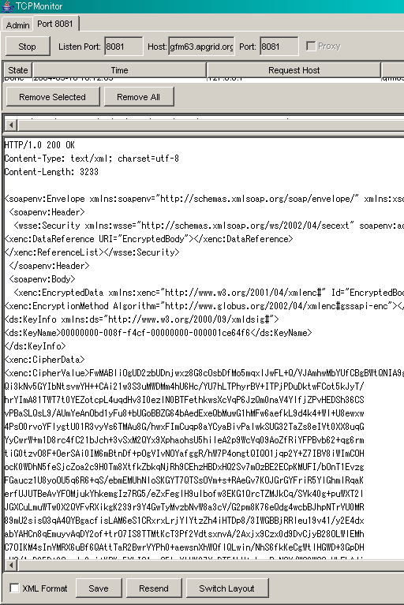
SOAP messages in each security
No Authentication,
GSI SIGNATURE
GSI ENCRYPTION
Each data is in each tag
All data is encrypted in a single tag

Slide 11
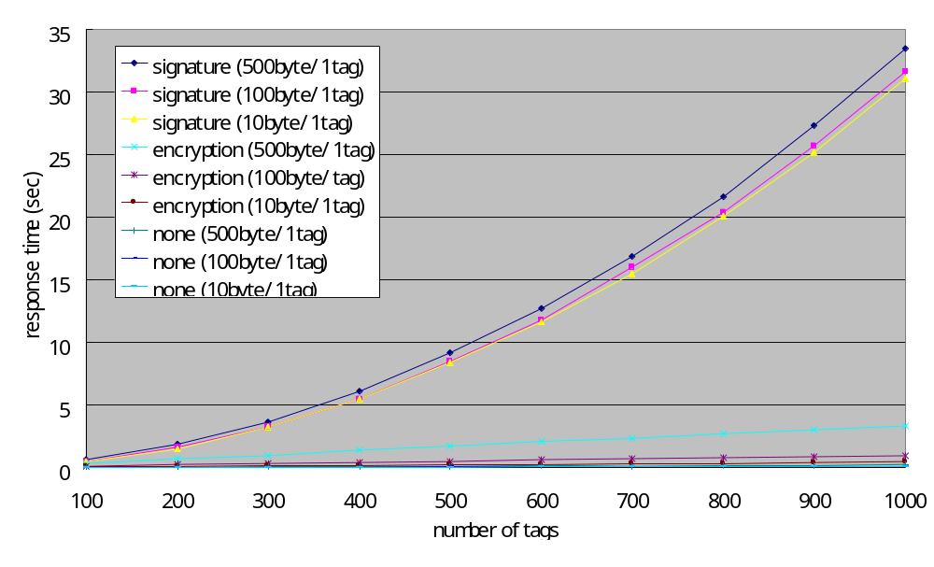
Number of tags vs. Response time

Slide 12
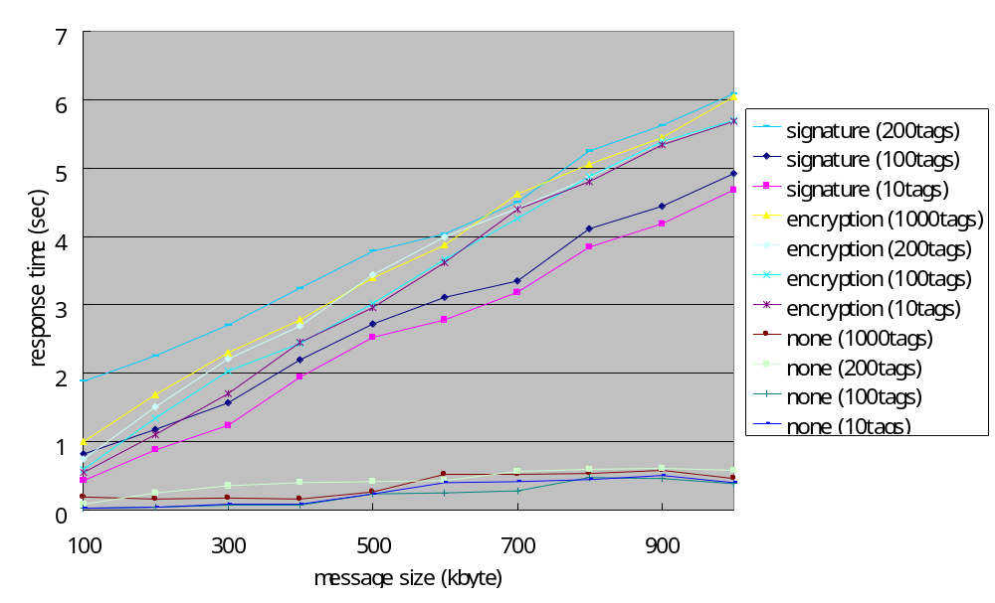
Message size vs. Response time
31~35 sec in signature (1000tags)

Slide 13
Result of investigation
No authentication and GSI ENCRYPTION
  Response time increases in proportion to the total amount of message size.
  The number of tags doesn't influence at response time.
GSI SIGNATURE
  Response time increases in proportion to the total amount of message size.
  Response time also increases as the number of tags increases.
  The number of tags affects to response time more strongly than the amount of message size.

Slide 14
One way to avoid degradation with GSI
To improve performance, message size and number of tags should be small
To reduce the message size and number of tags, change the WSDL interface in binary format using serialization of entry object
Moreover, apply compression of the serialized data in gzip format

Slide 15
Content-length and response time when listing 100 entries
 | in text format as usual | in binary format using serialization | in binary format with compression
GSI SIGNATURE | 81 KBytes 60,000 msec | 60 KBytes 260 msec | 5 KBytes 140 msec
GSI ENCRYPTION | 101 KBytes 530 msec | 81 KBytes 280 msec | 7 KBytes 130 msec
Non-authentication | 80 KBytes 200 msec | 60 KBytes 80 msec | 4 KBytes 95 msec
Note that the binary format is dependent on language (or serialization method)

Slide 16
Influence of network latency
Measured response time
  In the same LAN
    Gigabit Ethernet (RTT 0.1 msec)
  Between Tokyo and Tsukuba (50 Km)
    Gigabit Ethernet (RTT 1.3 msec)
Result
  Almost no difference is observed.

Slide 17
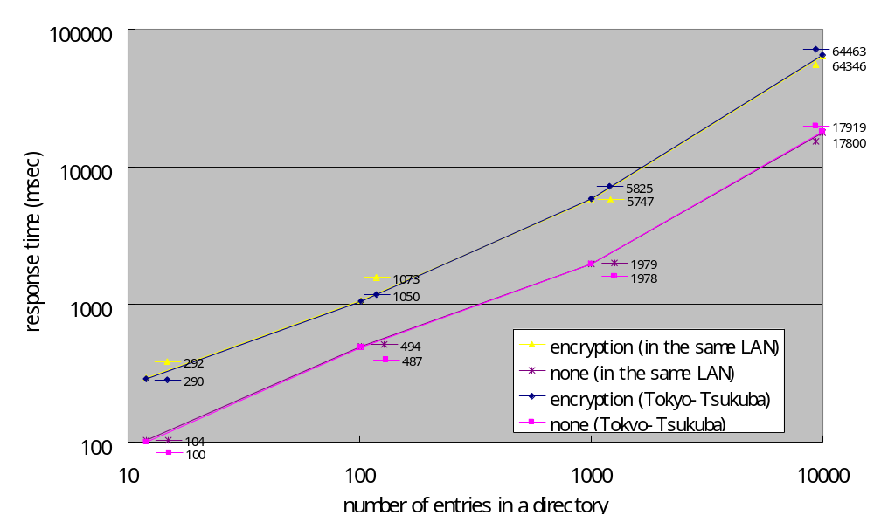
Influence of network latency
Measured with 256Mbyte
heap size.

