Slide 1
Architecture of Grid File System (GFS)
- Based on the outline draft -
Arun swaran Jagatheesan
San Diego Supercomputer Center
Global Grid Forum 11
Honolulu, Hawaii
Notes:
Please say “Aloha” from the GFS-WG members to all the GSM-WG members attending this talk.
First please state that this is based on the draft – but the draft decides the standard. Also please ask some one to take notes. I would also like to to know the comments/suggestions from GSM with respect to this big picture.

Slide 2
IP & ©
Intellectual Property Statement
The GGF takes no position regarding the validity or scope of any intellectual property or other rights that might be claimed to pertain to the implementation or use of the technology described in this document or the extent to which any license under such rights might or might not be available; neither does it represent that it has made any effort to identify any such rights. Copies of claims of rights made available for publication and any assurances of licenses to be made available, or the result of an attempt made to obtain a general license or permission for the use of such proprietary rights by implementers or users of this specification can be obtained from the GGF Secretariat.
The GGF invites any interested party to bring to its attention any copyrights, patents or patent applications, or other proprietary rights which may cover technology that may be required to practice this recommendation. Please address the information to the GGF Executive Director.
Copyright (C) Global Grid Forum (2004). All Rights Reserved.
This document and translations of it may be copied and furnished to others, and derivative works that comment on or otherwise explain it or assist in its implementation may be prepared, copied, published and distributed, in whole or in part, without restriction of any kind, provided that the above copyright notice and this paragraph are included on all such copies and derivative works However, this document itself may not be modified in any way, such as by removing the copyright notice or references to the GGF or other organizations, except as needed for the purpose of developing Grid Recommendations in which case the procedures for copyrights defined in the GGF Document process must be followed, or as required to translate it into languages other than English.
The limited permissions granted above are perpetual and will not be revoked by the GGF or its successors or assigns.
This document and the information contained herein is provided on an "AS IS" basis and THE GLOBAL GRID FORUM DISCLAIMS ALL WARRANTIES, EXPRESS OR IMPLIED, INCLUDING BUT NOT LIMITED TO ANY WARRANTY THAT THE USE OF THE INFORMATION HEREIN WILL NOT INFRINGE ANY RIGHTS OR ANY IMPLIED WARRANTIES OF MERCHANTABILITY OR FITNESS FOR A PARTICULAR PURPOSE."
Notes:
This has to be displayed on all GGF presenatations

Slide 3
Talk Outline
Grid File System (GFS) Terminology
Why GFS?
GFS Architecture Components
GFS Service Interactions
GFS-WG and GSM-WG
Summary
Notes:
Outline

Slide 4
Some Terminology 1st
Autonomous Administrative Domains
Digital Entities
GFS/Grid Resources
GFS perspective of these generic terms
Notes:
Every one in the room knows these generic definitions. But, we need to make we are on the same page when we mention these over-loaded generic terms. This slide is to tell them out right – yes you these terms, but we are going to define our architecture based on these terms

Slide 5
Autonomous Administrative Domain
A Grid Entity that:
  Manages one or more grid resources
  Can make its own policies
  Might abide by a superior or global policy
  Can be act as a resource provider or requestor or both
  Examples:
    A department or research lab in an university
    A HR or finance department of a company (sub-organization)
    Or simply a single computational or storage resource that manages it self governed by some policies
  GFS contains one or more autonomous administrative domains with distributed heterogeneous resources
Notes:
Self explanatory.
Note the third example is little different

Slide 6
Digital Entities
Data in digital format (raw data)
Information in digital format (Policy, ACL, …)
Logical behavior in digital format (services)
Representations of grid entities (users, storage .)
GFS provides location-independent human-readable logical view of distributed heterogeneous entities
These digital entities can be grouped into three categories of resources from GFS perspective…
Notes:
Note that we consider representing storage as digital entity with some XML representation

Slide 7
GFS/Grid Resources
Context (Information)
  Information about digital entities (location, size, owners, ..)
  Relationship between digital entities (replicas, collection, .)
  Behavior the digital entities (services)
Content (Data)
  Structured and unstructured
  Virtual or derived
Commodity (Producers and consumers)
  Storage resources
  Also providers, brokers and requestors
Notes:
GFS has to manage/organize these resources:
Context or information regarding the digital entities (who can access the data, where are the places it is located, what are the other related data or collections of the data, these are the context of the real data)
Content as in the real data that this distributed across multiple organizations in the grid or virtual organization. (by replication and other means that might require GFS to manipulate or operation the physical content of the data)
Commodity (ok, I tried all these words to be in “C”). Anyways I refer to the resources that might be associated with either the context or the content above. This would include the organization involved, storage servers involved etc.,

Slide 8
Why GFS? (abridged)
Organization of Grid Resources
  Human readable naming system to organize grid information (mapping service oriented URIs as collections)
Location independent logical naming
  Data-intensive applications can execute anywhere in grid
  Data handling system must provide location transparency
Dynamic provisioning of heterogeneous storage
  Storage space from multiple administrative domains and multiple heterogeneous storage systems
  Logical storage resource identifiers (in spite of the storage virtualization) for QoS and Technology Migration
Notes:
There are TWO VERSIONS of this. Either use this slide (if you have less time) or Use the three slides that follow [DON’T USE BOTH}
If you use this:
Organization: This is like similar to the “logical views” in database terms. How you organize the GFS into different collections. Is it based on usage-pattern or is it based the real physical distribution or is it based on the applications (business or experiments) that use the GFS
- Location independent Naming; The data naming has to be logical as it can be used in any where in the grid –the distribution of the data has to be hidden. The location names must not be present along with the data name. This allows for a true logical namespace where the data can be moved freely or replicated but still have the same name (so applications need not worry about the physical name changes).
Dynamic provisioning
Plug-n-play of storage or data resources on demand (might look like an hyped advertisement statement – but has very good advantages for people with data centers and largely distributed environments) . THE GFS need not have any mount point. But just logical resources that can be added to it any time.

Slide 9
Why GFS? - Organization of Resources
Resources and WSRF
  URIs to denote resources (data, service, …)
Organization of Grid Resources
  Human readable naming system
  Single system for organization of distributed grid state
Data Model to aggregate and organize
  Mapping URIs / WS-Addresses to digital collections
  Meta-data associated with each digital entity
Notes:
Organization: This is like similar to the “logical views” in database terms. How you organize the GFS into different collections. Is it based on usage-pattern or is it based the real physical distribution or is it based on the applications (business or experiments) that use the GFS
Also the grid resources like the storage has to be organized using so that users can use (or place data) based on the QoS or proximity or resources.

Slide 10
Why GFS? - Logical Naming
Distributed Data Grid Infrastructure
  Data-intensive applications can execute anywhere in grid
Location independent logical naming
  Data handling system must provide location transparency
Logical Data Identifiers
  A logical namespace of data identifiers are mapped to the physical systems
Notes:
- Location independent Naming; The data naming has to be logical as it can be used in any where in the grid –the distribution of the data has to be hidden. The location names must not be present along with the data name. This allows for a true logical namespace where the data can be moved freely or replicated but still have the same name (so applications need not worry about the physical name changes).
The logical naming is done using logical data identifiers

Slide 11
Why GFS? - Dynamic Provisioning
Heterogeneous distributed resources
  Storage resources from multiple administrative domains
Dynamic provisioning of heterogeneous storage
  Storage virtualization
  Facilitate “plug-n-play” of distributed storage on demand
Logical storage resource identifiers
  Aggregation of storage resources into a logical resource
  Classifying resources for ease of management
  Allows managing QoS and Technology Migration
Notes:
Dynamic provisioning
Plug-n-play of storage or data resources on demand (might look like an hyped advertisement statement – but has very good advantages for people with data centers and largely distributed environments) . THE GFS need not have multiple mount points. But just logical resources that can be added any time.

Slide 12
GFS Architecture Components
GFS Resource Provider
  Provides content / context / commodity storage
GFS Administrative Domain
  A sub-organization that has one or more of the GFS resources
GFS Service Provider
  Provides the GFS standard service interface for one or more of the GFS Administrative domains
Notes:
I am just reminding the audience here about wat we talked about and saying that they are actually the components of the architecture.
Don’t spend time here. It is easy to show the pictures and the audience will be able to understand from the pictures themselves

Slide 13
GFS Resource Providers
GFS Resource Providers (GRP) providing content and/or storage
GRP
GRP
/txt3.txt
Notes:
I start with by introducing the reality.
We have some data and storage on some disk/ hierarchical resource. IT can have its own directories or physical names for the data. These are Grid Resource providers from the GFS perspective.
Later these resource providers could be other sources like service registries or any thing dealing with a naming system or catalog.
It is highly tempting to say that GFS Resource providers are nothing but SRM – at least looks for me to be so. But please refrain from doing that. We need to have the GSM also agree to this picture.

Slide 14
GFS Administrative Domain
GFS Administrative Domain with one or more GFS Resource Providers
Research Lab
GRP
GRP
/txt3.txt
Notes:
Multiple such resource provides could be present in an organization or autonomous administrative domain as we called before.

Slide 15
GFS Administrative domains
Research Lab
data + storage (10)
Storage-R-Us Resource Providers
data + storage (50)
Finance Department
data + storage (40)
GRP
GRP
GRP
GRP
GRP
GRP
GRP
GRP
/…/text1.txt
/…//text2.txt
/txt3.txt
Notes:
There could be multiple administrative domains like this that makes up an virtual enterprise or what we call as the Grid

Slide 16
GFS Service Provider
/home/arun.sdsc/exp1
/home/arun.sdsc/exp1/text1.txt
/home/arun.sdsc/exp1/text2.txt
/home/arun.sdsc/exp1/text3.txt
data + storage (100)
Logical Namespace (Need not be same as physical view of resources )
Research Lab
data + storage (10)
Storage-R-Us Resource Providers
data + storage (50)
Finance Department
data + storage (40)
GRP
GRP
GRP
GRP
GRP
GRP
GRP
GRP
/…/text1.txt
/…//text2.txt
/txt3.txt
Notes:
The resources (data + storage) from all these autonomous administrative domains could be presented as an logical ensemble. The logical namespace created need not reflect the physical layout. Also the logical names do not have any location dependency

Slide 17
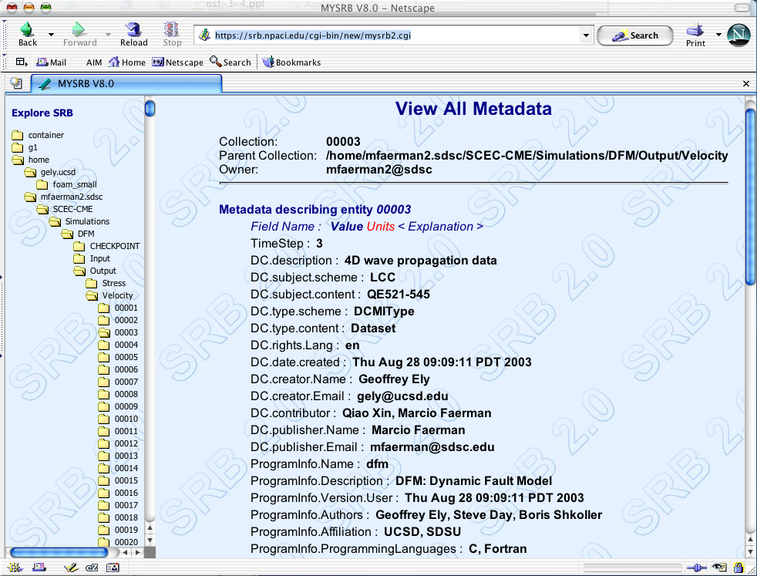
GFS Service (Client + GRP)
GFS Service (client)
GFS Service (GRP)
Research Lab
data + storage (10)
Storage-R-Us Resource Providers
data + storage (50)
Finance Department
data + storage (40)
GRP
GRP
GRP
GRP
GRP
GRP
GRP
GRP
/…/text1.txt
/…//text2.txt
/txt3.txt
Notes:
(Here is a tricky or confusing slide – handle carefully: the service boxes are actually a single thing which I have made it look like two different things for the client and the GRP).
What this means is:
- All the resource providers use a service based interface to connect or plug-in to the GFS.
- The Clients of GFS used the GFS service to manage the GFS.
So the GFS service has two major components one targeting the resources and the other targeting the clients.

Slide 18
GFS Service Access
Interface for GFS clients
GFS Service (client)
Interface for GFS resource to plug in
GFS Service (GRP)
Research Lab
data + storage (10)
Legacy File System Clients
(NFS, CIFS, …)
GRP
GRP
/txt3.txt
Notes:
This is to answer how the legacy clients will be handled.
There has to be wrappers that translate the traditional file APIs to their respective actions in GFS Services components.
This is actually a picture of the content as stated by the OGSA Data Services document. IT has been decided by the OGSA design team that this transformations from the legacy API to new GFS client services would be scope outside of GGF. But, we will mention it is possible.

Slide 19
GFS and local Grid Resource Provider
/home/arun.sdsc/exp1
/home/arun.sdsc/exp1/text1.txt
/home/arun.sdsc/exp1/text2.txt
/home/arun.sdsc/exp1/text3.txt
data + storage (100)
GFS Service (client)
GFS Service (GRP)
Logical namespace, can represent the physical namespace
Local storage, data and directories, can be physical
GRP
GRP
/txt3.txt
Notes:
This tries to actually pictorially show the relation between the GFS and the Grid Resource provider. GFS is actually a logical namespace above the GRP layer.

Slide 20
GFS-WG and GSM-WG
Is Grid Resource Provider = Grid Storage Manager (SRM)?
What model of interaction between GFS and GSM?
  Publish – subscribe?
  Transactional?
  Service-based?
Bulk data management?
GSM Plug-n-play with the GFS?
Notes:
I just throw up these questions – just to have some discussion. I hope someone takes notes here. I also intend to talk to Arie and Peter about this. SO, this is just a starting point – its ok if we don’t have immediate conclusions.

Slide 21
Summary
Grid File System (GFS) Terminologies
  Autonomous Administrative Domains
  Digital Entities (context, content, commodity)
  GFS Resources
Why GFS
  Logical Namespace for distributed heterogeneous data
GFS Architecture Components
  GFS Resource Provider
  GFS Administrative Domain
  GFS Service Provider (Client and plug-in-interface for resources)
Notes:
Thanks for all those who stayed back – it must be later there now.
From the the GFS-WG members, to GSM-members have a nice stay and enjoy Hawaii ☺

