Slide 1
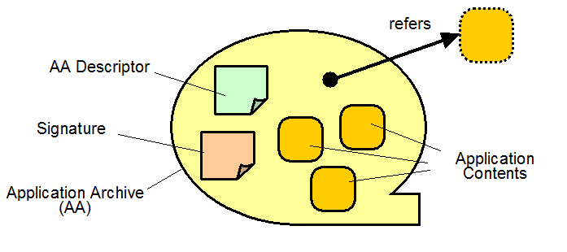

Application Content Service (ACS)
Working Group (WG)
R2AD, LLC.
P.O. Box 10872
McLean, VA 22012
(703) 714-0442
http://www.r2ad.com
official@r2ad.com
Trusted Software Distribution
May 2005
Michael Behrens
draft

Slide 2
Agenda Bashing
What is “The Grid”
  Grid Operating Environment
  Command and Control Grid Computing
  OGSA
Application Fielding Issues
ACS-WG
Face2Face meeting:
When: 23/24 May 2005
Where: Northrop’s Colshire Facility
POC: Pete Ziu: 571.235.0208 ©
Location: 7575 Colshire Drive
McLean, VA 22102
2nd Floor, Room 2207W

Slide 3







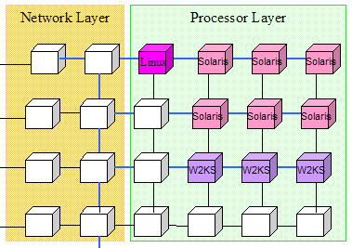
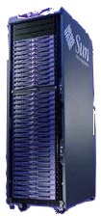

The grid is a collection of Virtual Organizations
R2AD
DoD Enterprise, edge grid caching and processing
Sync
Sync
Update
Virtual Grid Cache
Repository
Query
Control
Query
Post
Post
Results
Grid Cache
Results

Slide 4
Grid Details
Major Grid Types
  Data Grid
    Provides global access to distributed data
    Supporting replication and global access
  Computational Grid (agent support)
    Provides CPU and other resources “on-demand”
    Applications and Services available securely from CM
    High performance/throughput computing
  Collaboration
Resource Virtualization
  Communities of Interest
  Shared Resources – between and amongst commands
  PKI Secure

Slide 5
What is OGSA
OGSA is a working group under the Global Grid Forum
Open service-oriented architecture based on Web services for addressing Grid scenarios
Component-oriented architecture
  Interchangeable components
Meta OS functionalities
  Distributed and heterogeneous environment
A rendering of these functions, based on Web service architecture and specifications
A GGF’s flagship architecture and the blueprint for industry standard grid computing
Open Grid Service Architecture (OGSA)
Open Grid Service Architecture is a distributed interaction and computing architecture based around the Grid Computing service, assuring interoperability on heterogeneous systems so that different types of resources can communicate and share information.

Slide 6
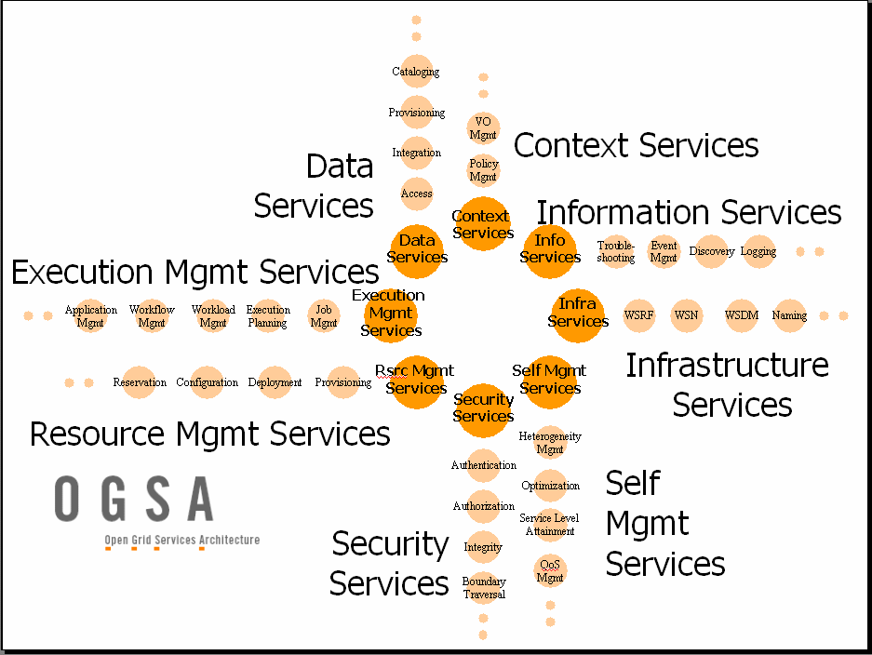

Slide 7
Application Fielding Considerations
Patches/Version
  Where is what installed
  Scheduled/Timed with world wide usage in mind
  Rollback support? Backwards Compatibility
  common vulnerabilities and exposures (CVE) - IAVA
System Comparisons
  What is different between two systems which should be the same? Support automated re-hosting of services
System Updates and Migration
  Incorporate old-version support (via service brokers)
  Monitor process, metric gathering & status, alerting
Content Distribution
  Large file distribution
  Data and Service edge caching
Note: The ACS-WG defines a number of
use-cases which convey requirements

Slide 8

Services Around the World
Requirements
& Design
Develop
& LAN Testing
System Integration
WAN Testing
Operational
Development Environment
  geographically dispersed, different developers
  Setup to including installing all locally required components
    Configuration Management, Version history/access
    Compilers
    Editors/IDEs (and plug-ins)
    Project Management, Design tools
    Test grid containers
Manufacturing Environment
  Software Release
    Unit, Stress Testing
    Installation Description
    Documentation, Delivery
  Maintenance
Production environment
  Geographically dispersed secure virtual grid containers
  Service Level Agreement
    Monitoring, Adaptive, healing
Virtualization
R2AD

Slide 9

ACS Working Group collaboration
ACS-WG Collaboration
  IBM’s Solution Installation, OASIS SDD TC
  NAREGI-PSE Grid (Japan)
  Possible Integration with Sun’s N1? DISA CM-Mont? NCCP FDCE?
  ACS-WG 1st Face-to-Face meeting
    Washington, DC
    Northrop Grumman, Colshire
    23rd - 24th May, 2005
  Configuration Description, Deployment and Lifecycle Management (CDDLM)
    Working Group within GGF
    Deploying complex, distributed services
    Dynamic service configuration and management
    Automatically deploy, manage and remove services
  WSDM (Web Services Distributed Management)
    Technical Committee within OASIS, standard Mar05

Slide 10

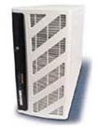
Example workflow
1. Develop application
and Store in repository
Federated
PKI Secure
Repository
2. Edit application, make final build.
ARI
AAF
ACS
3. Retrieve (recursively) all components not local which are needed, comparing, checking, security, etc
Distributes to nodes
Entry Point
ESM, JSDL, CDDLM, GRAM
Grid nodes
Grid Container

Slide 11

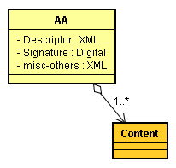
Example, from draft ACS Specification
https://forge.gridforum.org/projects/acs-wg
<acs:AAID>
<acs:name>
http://example.org/application1
</acs:name>
<acs:version>
<acs:major>1</acs:major>
<acs:minor>0</acs:minor>
<acs:revision>0</acs:revision>
</acs:version>
</acs:AAID>
Terms:
Application Archive (AA)
Application Archive ID (AAID)
AA File
AA
AA
Descriptor
Register
ACS (site 1)
EPR
<wsa:EndpointReference>
<wsa:Address>
http://site1.example.org/ACS
<wsa:Address>
<wsa:ReferenceProperties>
<acs:AAID>
...
</acs:AAID>
</wsa:ReferenceProperties>
</wsa:Address>
</wsa:EndpointReference>
AA Repository
Transfer
<wsa:EndpointReference>
<wsa:Address>
http://site2.example.org/ACS
</wsa:Address>
<wsa:ReferenceProperties>
<acs:Originator>
http://site1.example.org/ACS
</acs:Originator>
<acs:AAID>
...
</acs:AAID>
</wsa:ReferenceProperties>
</wsa:Address>
</wsa:EndpointReference>
ACS (site 2)
EPR
AA Repository

Slide 12

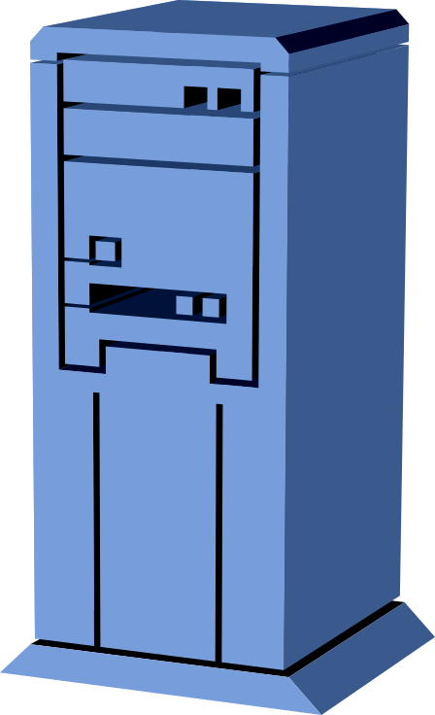
Possible Usage at DISA
Application (Service) Repository
  Grid Provisioning Appliance
  Secure (Signed & Trusted applications)
  Used by provisioning systems - a trusted repository
program binaries,
initial data,
configuration data,
deployment procedures,
self-management policies,
and so on...
Secure DADS CM’d Repository
(Accredited Software)
Development & Test Environment
Deployed Systems
AA File
Pull Segment
archive
register
R2AD
develop
test
AA File
submit segment
submission parameter
Global Information Grid (GIG)
Business Activity Manager (e.g.: DISA CM)
Application Developer
Army Battle Lab - Ft. Wachucha

Slide 13










INFORMATION MARKETPLACES
ENTERPRISE REPOSITORY
Software
Developers
Document Repository
Engineers
Pre Delivery Metadata
Consolidated Life-Cycle Metadata
Test Labs
Secured
Software
Repository
Testers
E-Delivery Staging
Physical
Delivery
Electronic Distribution
Federal
Express
Field Users
Physical Storage
Repro

Slide 14
References
GGF Standards Body
  http://www.ggf.org/
  OGSA Working Group
    https://forge.gridforum.org/projects/ogsa-wg
  ACS Working Group
    https://forge.gridforum.org/projects/acs-wg
ACS-WG Structure of Application Archive

