Slide 1
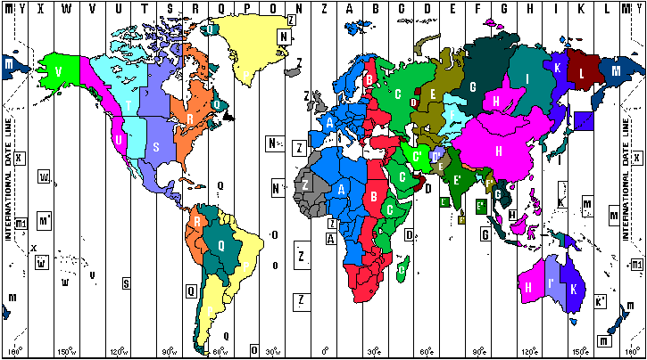

Distributing Software Life Cycles
R2AD, LLC.
P.O. Box 10281
McLean, VA 22012
(703) 714-0442
http://www.r2ad.com
behrens@r2ad.com
ACS Future Objectives
Join the ACS Team
GGF-16, Athens

Slide 2
Current situation and future for ACS
Collaboration Partners
  NAREGI
  SDD Extension Points (OASIS SDD TC)
  CDDLM
  OGSA Data Services
Among the other possibilities
  OS Virtualization, Metadata Semantics via ACS types
  Granularity/Scope
  Not planned yet, but…
Beyond the limit
  Future Vision: 24 hour ACS

Slide 3
Possibilities: OS Virtualization
Virtual OS products
  VMWare, Xen or others
Need verbose descriptions of image contents
  Metadata can be either in Application contents or as ACS typed (not in current)
    What OS name/version
    What is installed in image
    What is running at boot time
    Policy for usage
    Licensing information
Among the possibilities: VM images can be stored as AA in ACS.
  Deployment Description contains how to unfreeze the VM image on VM.
  Resource Requirement Description contains requirements for a VM to run the VM image, i.e. Virtual Memory size, cpu allocation, amount of disk storage, external I/O, etc. (VM spec. dependent)
  Data staging description is for the VM image to run.

Slide 4
Possibilities: Granularity/Scope
Small grid oriented tasks
  Normal in most grids today
  Fits current use-cases in ACS
Large complex multi-node systems
  Multiple ACS content archives involved
  Inter-archive content dependencies
  Some timing issues
    Need to declare installation and conditional start/stop
An Entire server enclave
  Many nodes involved (N-Tier)
  Network Configuration also
    Not just software, but also devices such as routers, switches
Grid
  bare metal to grid

Slide 5
Not planned yet, but…
Open Source ACS Project
  SourceForge or Java.net (Internet Presence)
Support for other standards?
  WebDAV & JSR-170
  GAR (Grid Archive)

Slide 6
24 Hour ACS...
Supporting multiple development zones

Slide 7



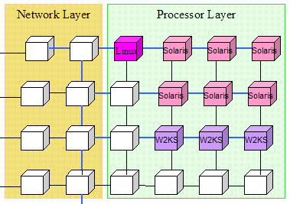
24 hour development - Around the World
Runtime environment
  Geographically dispersed grid containers
Development Environment
  Also geographically dispersed
    Around the Clock development! Multiple timezone teams.
  Setup to including installing all locally required components
    Configuration Management, Version history/access
    Compilers
    Editors/IDEs (and plug-ins)
    Project Management, Design tools
    Test grid containers
  Software Release
    Unit, Stress Testing
    Installation Description
    Documentation, Delivery
Virtualization
R2AD
Around the World

Slide 8


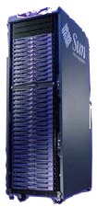
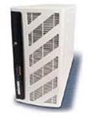

Time-Zone Example workflow
2. Edit instance specifics, scripts/code in a different timezone (i.e: Europe)
1. Develop application and Store in repository (i.e: Asia)
ACS
3. Submit
Task
Request
to Grid
3. Grid retrieves (recursively) all components not local which are needed, comparing, checking, security, etc
Distributes to nodes
Entry Point
Grid nodes
Grid Production Container

Slide 9
Distribution Challenges
System Comparisons
  What is different between two systems which should be the same?
  Where is what installed (Usage Statistics)
Patches/Version
  Scheduled updates with all time-zones in mind (synchronized)
  Rollback support?
  common vulnerabilities and exposures (CVE)
System Updates and Migration
  Monitor process, metric gathering & status
  Reporting, disseminating, alerting
Efficient Content Distribution
  Large file distribution, edge caching

Slide 10
More to Consider
Communication on Network
  Security
    PKI Infrastructure
    Policy Management
    Auditing
Repository (ala ACS)
  Large and Distributed
  Supporting multiple versions of contents simultaneously
  Multiple distributed users (access policy)
  Access Control, workflow rules engine
  Reliable, robust, complete
  Local checkouts, locking and synchronization
  IDE Integration
  Administration Portlet (JSR 168)

Slide 11
General Packaging Considerations
Components
  Data Sources
    database
    file
    network
    inherit
  Executable
    Binary
    Source
  Metadata
    Description of the software component
    Relationship to other components
    Rules
  Security
    Policy
Object Oriented
  Encapsulation
  Extensibility
  Inheritance
  Polymorphism
  Abstraction
  Modeling
  Persistence
  Binding

