Slide 1

Reference Model Overview
OGSA F2F, Sunnyvale, August 2007

Slide 2

Outline
Schedule
Model Parts
GLUE Alignment

Slide 3
Schedule
Reference Model 2.0
  Draft: August 2007
  Public Comment: November 2007
  Publication: February 2008
Reconciling OGSA and EGA Reference Model
  Draft: July 2007
  Public Comment: November 2007
  Publication: December 2007

Slide 4
Reference Model
Grid Component UML Model
  Core conceptual model of the Data Centre
Grid Management Entity
  Logical Grid Component responsible for management
Lifecycle
Management Model

Slide 5
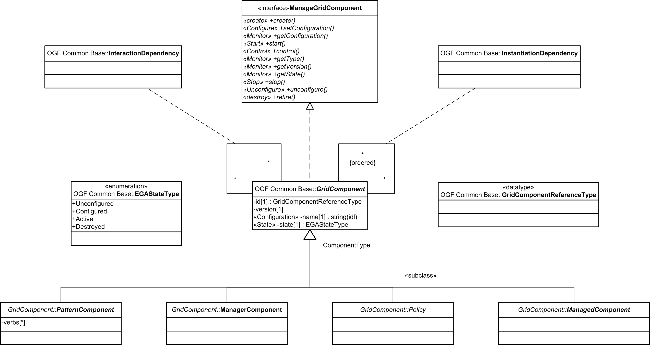
Grid Component

Slide 6
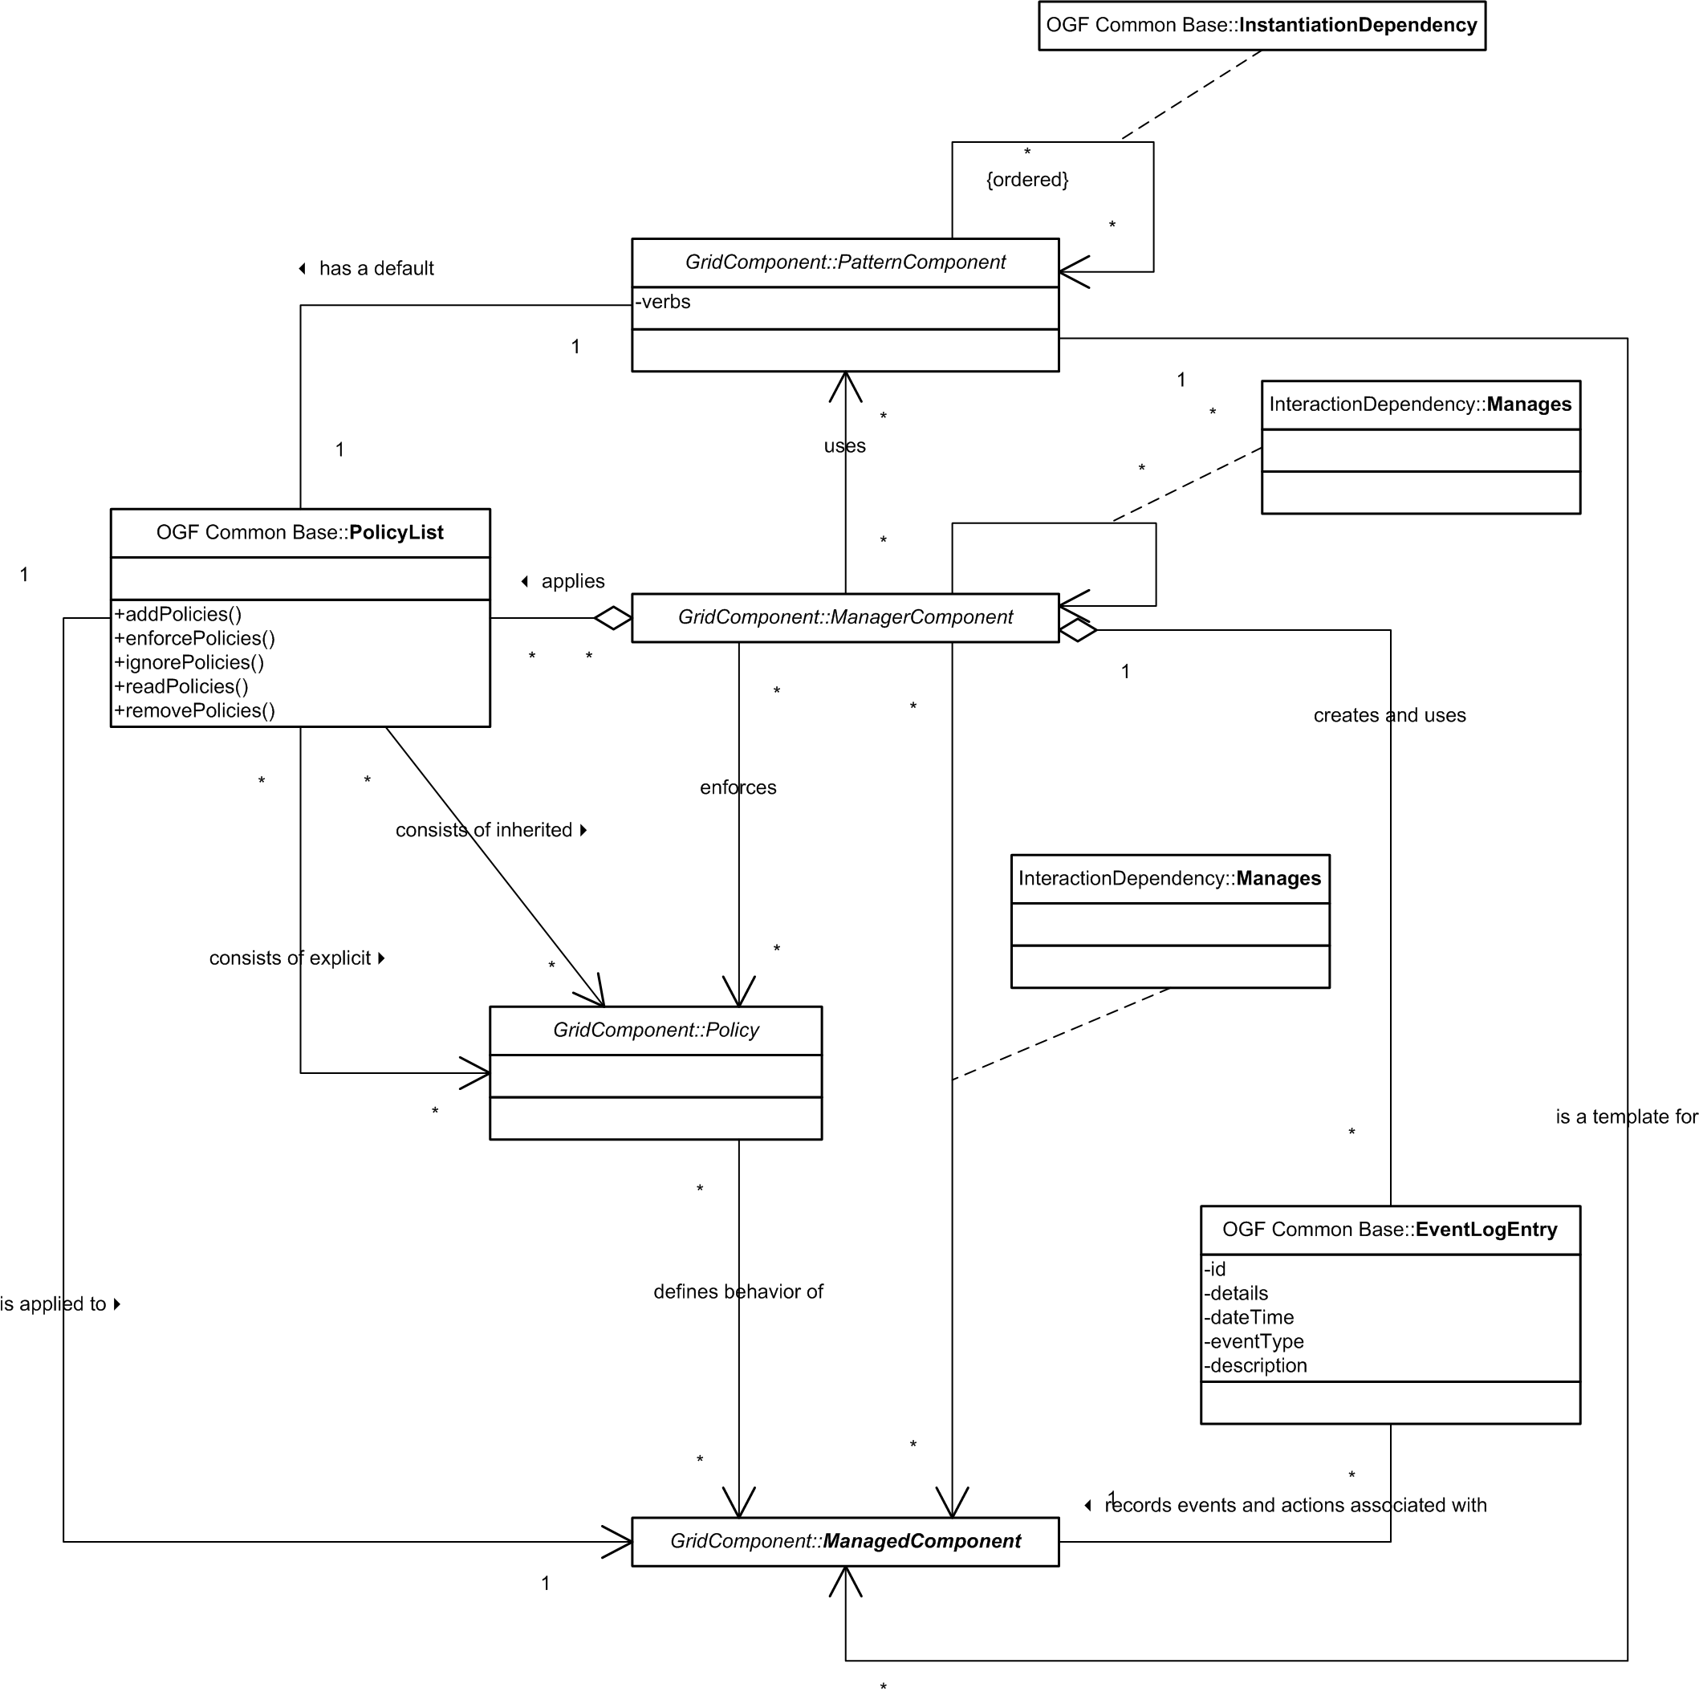
Relationships

Slide 7
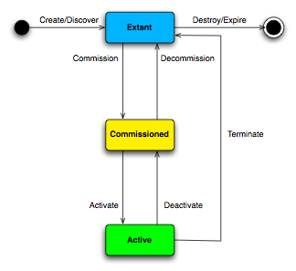
Lifecycle

Slide 8
Management Model

Slide 9
Alignment with GLUE
Mostly at different levels of abstraction
GLUE a rendering of an information model compatible with the RM
Interesting Questions
  Policy as a Grid Component?
  Relationship between a GLUE Share and a Policy?

