Slide 1
WSDM
R2AD, LLC.
P.O. Box 10872
McLean, VA 22012
(703) 714-0442
http://www.r2ad.com
info@r2ad.com
ACS-WG

Slide 2
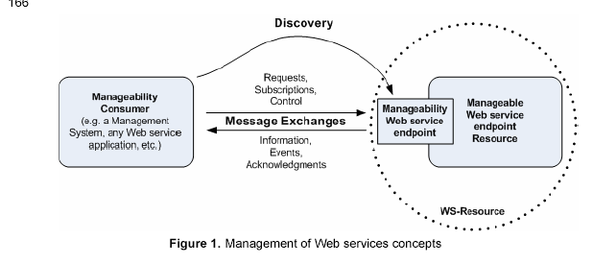
WSDM - Background
OASIS Recommendation March 2005
  http://www.oasis-open.org/committees/tc_home.php?wg_abbrev=wsdm
WSDM has two parts: MUWS and MOWS
  Web Services Distributed Management: Management Using Web Services(MUWS)
  Web Services Distributed Management: Management Of Web Services (MOWS)
Collaborate with W3C, GGF, DMTF, OASIS

Slide 3
Web Service Architecture – MTF
Defining the manageability characteristics of the architectural elements of the Web Services architecture, i.e.:
  Identification - data that uniquely identifies the element
  Status - information about operational state of a element (up: busy/idle; down: stopped/saturated/crashed)
  Configuration - a collection of behavioural properties which may be changed (persistent over instances)
  Metrics - raw atomic, unambiguous information for managmement purposes e.g. response times
  Operations - methods that control or help manage the entity (instance specific)
  Events - changes in the state of the entity e.g a lifecycle state change, or a state change.

Slide 4
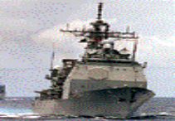



Service Management
Service Provider
Local
Services
Advertised
Services
Service
Consumer
Invoke
Management
Agent
Monitor
Enterprise
Service Registry
Service Level Mgr
NET OPS
Alerts System
Network Mgmt
System Mgmt
Enterprise Service Manager
Standards Base: Web Services Distributed Management (WSDM)

Slide 5

Service Management
Integrating the Services Environment with Computing Infrastructure
Service
Service
Service
Service
Service
Service
Service
Service
Service
Service
Service
Service
Service Management
Service
Service
Service
Applications/Systems
Management
Computing
Infrastructure
Management
Communications
Management
Monitoring and management of the runtime environment
Evolving marketplace and standards
Potential for redundant or conflicting capabilities
  Sub-optimization through optimization?

Slide 6
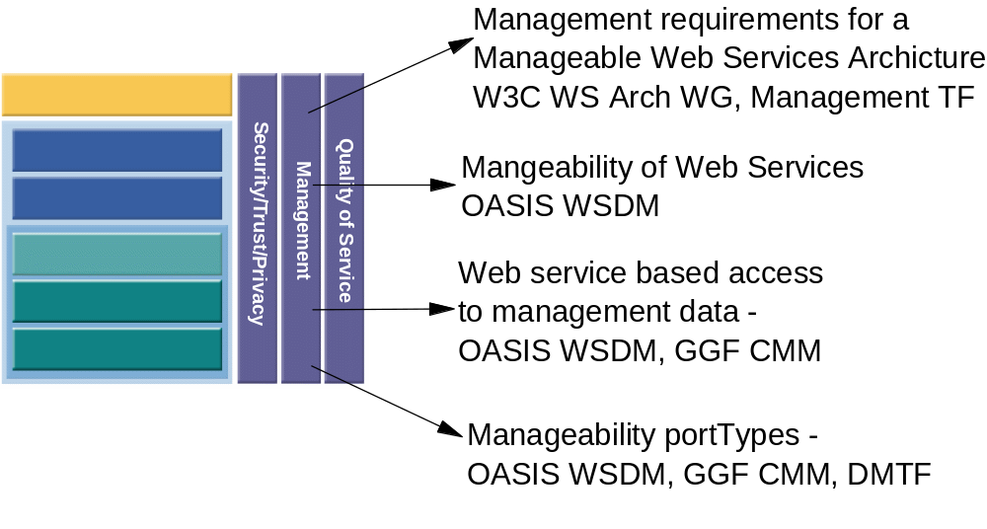
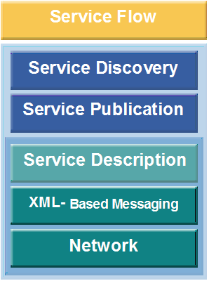
Web Services stack

Slide 7
WSDM in ACS
Management Suggestions
  isConsistent/Healthy
  getVersion (redundant)
  getInstallDate
  Metrics?
    LastAccessed
    AA Count
  getPointOfContactInfo
  isMaster (backup?/clone/replication management)
  etc.
Manageability shall be provided via WSDM MOWS Version 1.0 provided by the OASIS WS-DM TC

Slide 8
ACS specific Manageability Capabilities
Draft Spec
  Manageability shall be provided via WSDM MOWS Version 1.0 provided by the OASIS WS-DM TC (url to spec)
Next Version
    isConsistent/Healthy
    getVersion (redundant)
    getInstallDate
    Metrics?
      LastAccessed
      AA Count
    getPointOfContactInfo
    isMaster (backup?/clone/replication management)
    Configuration Elements
      Bindings to security
      Audit level
    Events
      Failure/Success messages
to be edited

Slide 9
ACS & WSDM
WSDM Interface
Manageable Resource
Should ACS specification state that that all implementation must provide?:
  MOWS required
  Additional MOWS optional required by ACS
  ACS specific required
  ACS specific optional
ACS Implementation
ACS ARI
ACS Management Interface (WSDM-MOWS)

Slide 10
Links
OASIS (ebXML, UDDI, XRI, WSDM)
  http://www.oasis-open.org/
Web Service Architecture
  http://www.w3.org/2002/ws/arch/
WSIL
  http://www-106.ibm.com/developerworks/webservices/library/ws-wsilspec.html

Slide 11
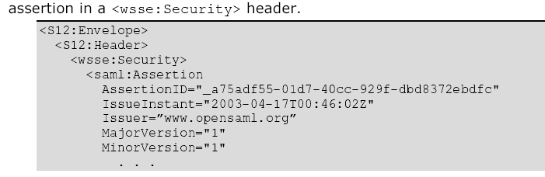
ACS Security Considerations
R2AD, LLC.
P.O. Box 10872
McLean, VA 22012
(703) 714-0442
http://www.r2ad.com
info@r2ad.com
ACS-WG F2F May 2005

Slide 12
Draft ACS Requirements (Fukuisan)
[3-a] ARI: Security features must be deployable according to the business requirements.
[3-b] ARI: Appropriate access control to archives is required.
  Business Manager credentials (user-id) verified via PKI - Role
  Deployer credentials also verified using PKI - Role
[3-c] AAF/ARI: Secure transport of archives must be realized. For example, mechanisms for keeping confidentiality of archive contents and detection of alteration and spoofing are required.
  Digital Signature - WS-Signature?
Follow On
  Security Discussion Tomorrow

Slide 13
Integrity
ACS performs?
WS-Signature
Who Creates signature? Who Verifies it?
  Based on this, depends on if signature is created by ACS
  ACS can be asked if it is the same as what is stored
    This would mean that the specification would need to address this
  Compare -is this the same as what I have
Draft can make a reference to this
Post GGF14 can expand

Slide 14
Naming Status
R2AD, LLC.
P.O. Box 10872
McLean, VA 22012
(703) 714-0442
http://www.r2ad.com
info@r2ad.com
WS-Naming

Slide 15
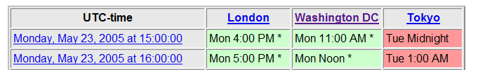
First Naming Telecomm
May 16th
  I missed it
  Notes not yet published, however these were
    draft Charter
    Stawman discussion document on other specifications (WS_Addressing, WS-Discovery, Handle).
    Requirements
    They’ll be considering XRI (next slides)
The May 23 call will not take place. Instead interested parties will caucus at the OGSA F2F meeting in London.
  Tuesday 4pm GMT on agenda to explain issues and Approach
    skype or UK toll free: 0808 1005145

Slide 16
XRI Being looked at too...
XRI-URI are
  Abstract - XRI-URIs are intended primarily to identify things that are not otherwise concretely identified on the network (such as HTTP endpoints, SMTP mailboxes, etc)
  Human-friendly - XRI-URIs are intended to supported names that are parseable, memorable, and semantically meaningful to humans.
  Reassignable - XRI-URIs are intended to be "reassignable". This means that they can both resolve to different networked resources or representations as well as semantically refer to different resources themselves over time.
  Multiple paths of hierarchy - Each "segment" of an XRI-URI corresponds to a local key in a directory/namespace. No assumption is made about the segments used to "reach" a particular directory -- there can be multiple "paths" to get to a particular directory/namespace.
XRI-URNs are:
  Abstract - XRI-URNs are intended primarily to identify things which are not otherwise concretely identified on the network (such as HTTP endpoints, SMTP mailboxes, etc)
  Efficiently Machine Resolvable - An important feature of XRI-URNs is that they are very efficiently resolvable. Efficient resolvability is favored over support for human readability.
  Permanent - XRI-URNs have the semantics of other URN schemes – an XRI-URN refers to the same logical resource from the time it is defined globally and forever.

Slide 17
XRI Examples
XRI
  xri://’naming.authority’/local/part
  (abstract identifiers)
  xri://naming.authority.com/local/part
  (leveraging DNS)
  xri://(http://root.cross-reference.com).leaf/local/part
  (cross referencing leveraging other URI scheme – abstract identifiers)
  xri://=AlbertEinstein/theory/relativity
  (shortcut mnemonics for convenience of humans)
XRN
  urn:xri://.naming.authority/local/part
  (abstract identifiers)
  urn:xri://.(urn:pin:999).leaf/local/part
  (cross referencing leveraging other URN scheme – abstract identifiers)

Slide 18
ACS Impact
ACS will follow OGSA guidance
Draft Specification
  Statement about EPRs to reference AA

