Slide 1

Network Measurements
Working Group
Agenda Session 1
Chairs: Eric Boyd
Richard Hughes-Jones
Mark Leese
GGF21, Seattle, 15th October 2007,
Session 1: 9:00-10:30

Slide 2

OGF IPR Policies Apply
“I acknowledge that participation in this meeting is subject to the OGF Intellectual Property Policy.”
Intellectual Property Notices Note Well: All statements related to the activities of the OGF and addressed to the OGF are subject to all provisions of Appendix B of GFD-C.1, which grants to the OGF and its participants certain licenses and rights in such statements. Such statements include verbal statements in OGF meetings, as well as written and electronic communications made at any time or place, which are addressed to:
    the OGF plenary session,
    any OGF working group or portion thereof,
    the OGF Board of Directors, the GFSG, or any member thereof on behalf of the OGF,
    the ADCOM, or any member thereof on behalf of the ADCOM,
    any OGF mailing list, including any group list, or any other list functioning under OGF auspices,
    the OGF Editor or the document authoring and review process
Statements made outside of a OGF meeting, mailing list or other function, that are clearly not intended to be input to an OGF activity, group or function, are not subject to these provisions.
Excerpt from Appendix B of GFD-C.1: ”Where the OGF knows of rights, or claimed rights, the OGF secretariat shall attempt to obtain from the claimant of such rights, a written assurance that upon approval by the GFSG of the relevant OGF document(s), any party will be able to obtain the right to implement, use and distribute the technology or works when implementing, using or distributing technology based upon the specific specification(s) under openly specified, reasonable, non-discriminatory terms. The working group or research group proposing the use of the technology with respect to which the proprietary rights are claimed may assist the OGF secretariat in this effort. The results of this procedure shall not affect advancement of document, except that the GFSG may defer approval where a delay may facilitate the obtaining of such assurances. The results will, however, be recorded by the OGF Secretariat, and made available. The GFSG may also direct that a summary of the results be included in any GFD published containing the specification.”
OGF Intellectual Property Policies are adapted from the IETF Intellectual Property Policies that support the Internet Standards Process.
Notes:
IPR Notices Note Well for OGF meetings

Slide 3
Agenda
Agenda bashing
  Note Takers Please
perfSONAR update Jason
UK update Mark / Richard
GEANT2 E2E Circuit Monitoring Richard
The Version 2 Schemata – Discussion of status & updates Martin
Making the V2 Schemata an OGF draft Recommendation. Martin
Detailed discussions – Session 2 All
Admin actions for NM-WG – living charter, timescales Richard

Slide 4
Agenda - Advert for Session 2
Agenda bashing
  Note Takers Please
perfSONAR update Jason
UK update Mark / Richard
GEANT2 E2E Circuit Monitoring
The Version 2 Schemata – Discussion of status & updates Martin
Making the V2 Schemata an OGF draft Recommendation. Martin
Detailed discussions – Session 2 All
Admin actions for NM-WG – living charter, timescales Richard

Slide 5
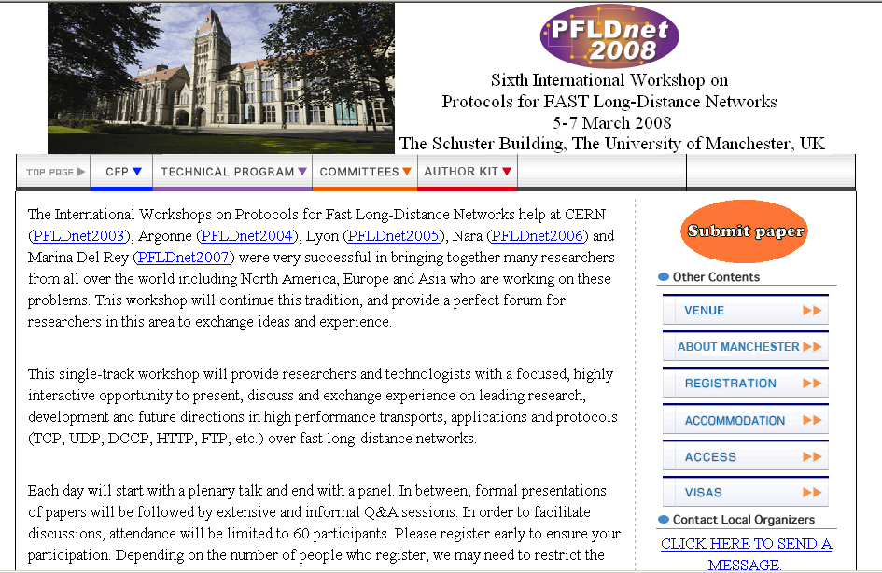
PFLDnet 2008 5-7 March 2008
Protocols For Long Distance Networks 2008
http://www.hep.man.ac.uk/PFLDnet2008/

Slide 6
Network Measurements
Working Group
Agenda Session 2 & 3
Chairs: Eric Boyd
Richard Hughes-Jones
Mark Leese
GGF21, Seattle, 15th October 2007,
Session 1: 9:00-10:30

Slide 7
OGF IPR Policies Apply
“I acknowledge that participation in this meeting is subject to the OGF Intellectual Property Policy.”
Intellectual Property Notices Note Well: All statements related to the activities of the OGF and addressed to the OGF are subject to all provisions of Appendix B of GFD-C.1, which grants to the OGF and its participants certain licenses and rights in such statements. Such statements include verbal statements in OGF meetings, as well as written and electronic communications made at any time or place, which are addressed to:
    the OGF plenary session,
    any OGF working group or portion thereof,
    the OGF Board of Directors, the GFSG, or any member thereof on behalf of the OGF,
    the ADCOM, or any member thereof on behalf of the ADCOM,
    any OGF mailing list, including any group list, or any other list functioning under OGF auspices,
    the OGF Editor or the document authoring and review process
Statements made outside of a OGF meeting, mailing list or other function, that are clearly not intended to be input to an OGF activity, group or function, are not subject to these provisions.
Excerpt from Appendix B of GFD-C.1: ”Where the OGF knows of rights, or claimed rights, the OGF secretariat shall attempt to obtain from the claimant of such rights, a written assurance that upon approval by the GFSG of the relevant OGF document(s), any party will be able to obtain the right to implement, use and distribute the technology or works when implementing, using or distributing technology based upon the specific specification(s) under openly specified, reasonable, non-discriminatory terms. The working group or research group proposing the use of the technology with respect to which the proprietary rights are claimed may assist the OGF secretariat in this effort. The results of this procedure shall not affect advancement of document, except that the GFSG may defer approval where a delay may facilitate the obtaining of such assurances. The results will, however, be recorded by the OGF Secretariat, and made available. The GFSG may also direct that a summary of the results be included in any GFD published containing the specification.”
OGF Intellectual Property Policies are adapted from the IETF Intellectual Property Policies that support the Internet Standards Process.
Notes:
IPR Notices Note Well for OGF meetings

Slide 8
Agenda - Session 2
Agenda bashing
  Note Takers Please
perfSONAR update Jason
UK update Mark / Richard
The Version 2 Schemata – Discussion of status & updates Martin
Making the V2 Schemata an OGF draft Recommendation. Martin
Detailed discussions – Session 2 All
Admin actions for NM-WG – living charter, timescales Richard

Slide 9
Agenda
Agenda bashing
  Note Takers Please
perfSONAR update Jason
UK update Mark / Richard
The Version 2 Schemata – Discussion of status & updates Martin
Making the V2 Schemata an OGF draft Recommendation. Martin
Detailed discussions – Session 2 All
Admin actions for NM-WG – living charter, timescales Richard

Slide 10
Admin: Experimental doc
Suggested Timescales:
  Draft document on Characteristics use OGF21 Sep 07
  Try for OGF22
Involvement
  Coordination:
    Eric Boyd
    Richard Hughes-Jones – Promised to make the draft
    Mark Leese
  The experts:
    Dan Gunter
    Martin Swany – editing the work
    Jason Zurawski
    …
  More experts: you are welcome

Slide 11
Admin: Living Charter
It’s on GridForge:
  Badly needs a review
  We were asked for an update by GFSG
Deliverables
  Version 2 Schemata doc
  Experimental report on Characteristics doc
Web pages
  Not much on GridForge Richard to update
  Rather out of date on the Internet2 Site

Slide 12
Contact Details
Chairs:
  Eric Boyd (Internet2), eboyd@internet2.edu
  Richard Hughes-Jones (University of Manchester),
  R.Hughes-Jones@manchester.ac.uk
  Mark Leese (Daresbury Laboratory), m.j.leese@dl.ac.uk
Website under re-construction: http://nmwg.internet2.edu
Mailing list: nm-wg@ogf.org
  To subscribe, https://forge.gridforum.org/sf/projects/nm-wg
  then Subscribe and fill in the web form

Slide 13
Full Copyright Notice
Copyright (C) Open Grid Forum (2006,2007). All Rights Reserved.
This document and translations of it may be copied and furnished to others, and derivative works that comment on or otherwise explain it or assist in its implementation may be prepared, copied, published and distributed, in whole or in part, without restriction of any kind, provided that the above copyright notice and this paragraph are included on all such copies and derivative works.
The limited permissions granted above are perpetual and will not be revoked by the OGF or its successors or assignees.
Notes:
OGF Full Copyright Notice if necessary

