Slide 1

NSI Use-case:
SCARIe
Guy Roberts
Seattle, 3rd Oct 2008

Slide 2

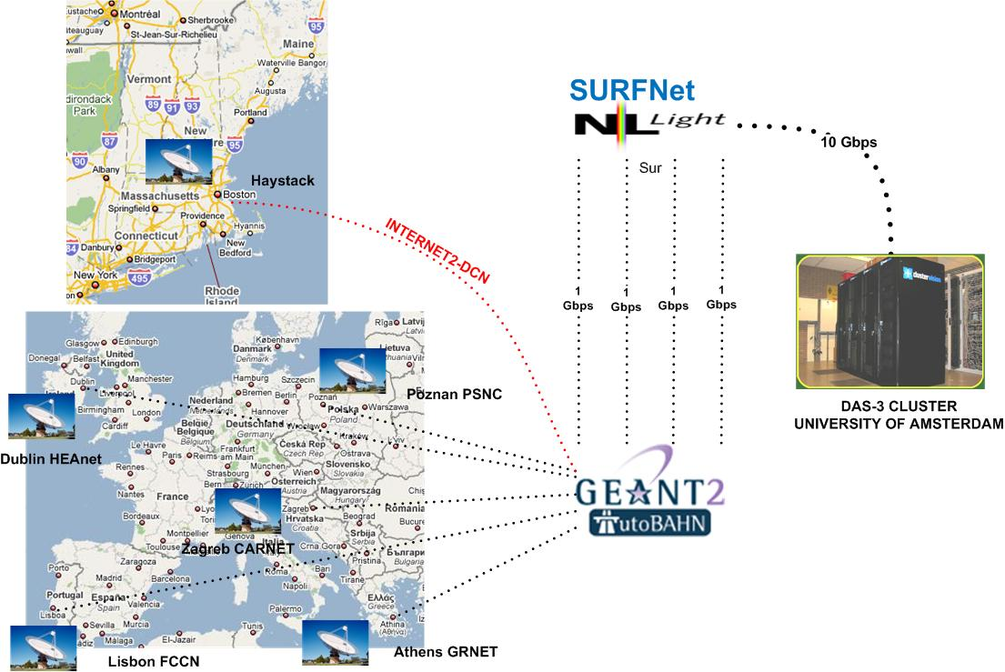
SCARIe demo

Slide 3
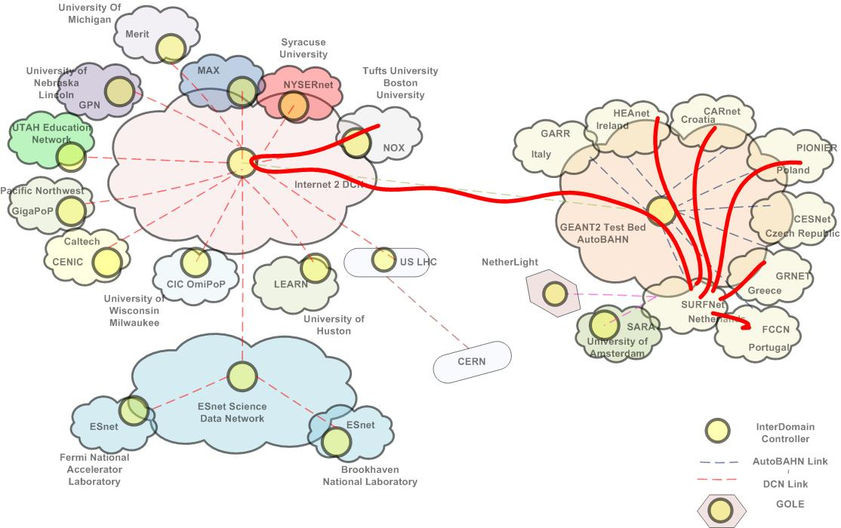
SCARIE Data Plane

Slide 4



SCARIe Control plane
SCARIe Project
WS
API
Correlator
WS UI
Poznan
IDC-P
IDC-P
WS
API
IDC
IDC
IDC
IDM
NOX
AutoBAHN
Zagreb
Internet2
Haystack
Dublin
Athens
Lisbon

Slide 5
Interfaces – WS API
"userName"=dmarchal
"userEmail"=dmarchal@science.uva.nl
"userDomain"="Undefined"
"justifcation"=“Reservation"
"startPort"=10.10.32.29
"stopPort"= 10.10.32.30
"startTime"=2008-10-03T17:15:00.004Z
"stopTime"= 2008-10-03T18:15:00.004Z
"capacity"= 1000000000
"description"= "No description"
"maxDelay"= 10000
"bidirectional"= True
"priority"= "HIGHEST"
"resiliency"= "NONE"

Slide 6
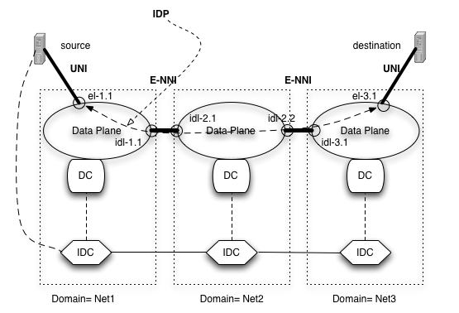
Interfaces – IDC

Slide 7
Path request is initiated by source IDC
ResReq {[GRI, Transaction-id, path], [time, duration], [circuit parameters], [setup parameters]}
The ResReq is used to communicate between IDCs to come up with a Confirmed circuit satisfying the initial request.
Path selection operates when a Loose InterDomain Path (LIDP) is in the request. When it receives an LIDP an IDC may modify the LIDP to make it a SIDP. The IDC must be sure that the LIDP includes the path segment for the IDC domain.

Slide 8
Interfaces – IDC
A Strict InterDomain Path (SIDP) includes ingress and egress link for each domain between the starting link and termination link of the path. A SDP must be described as a set of link-id URNs.
{URN= [urn:ogf:network:domain=net1:node=city1.switch:port=A3:link=1],
URN= [urn:ogf:network:domain=net1:node=city2.idsw:port=10.1.1.2:link=1],
URN= [urn:ogf:network:domain=net2:node=city2.bigswitch:port=101:link=1],
URN= [urn:ogf:network:domain=net2:node=city3.switch:port=A1:link=1]
}.

