Slide 1

Inter-network concatenation model
STP and how it works
Tomohiro Kudoh

Slide 2
Sample physical transport configuration
Slot 1
Slot 2
Slot 3
Switch 1
Switch 1
Switch 2
Network A
Network B
Note: Here, to make the example simple, assume switches of two networks are located at one room (housing facility), and there is no management ownership of the cables between the network.

Slide 3
Agreement between A and B
Owners of network A and B agree to:
  Connect each other using one GbE (green) and one 10GbE (red)
  Use VLAN 1-8 on the green cable, and no VLAN on the red cable
  Assign logical label C1 and C2 to the green and the red cable respectively, and assign label C1/1 – C1/8 to the VLANs on cable green.
Slot 1
Slot 2
Slot 3
C1: GbE, VLAN 1-8 can be used
C1/1 – C1/8
Switch 1
Switch 1
Port 8
Port 2
C2: 10GbE, No VLAN
Switch 2
Port 13
Port 7
Network A
Note: There is no management ownership of the patch cables.
Network B

Slide 4
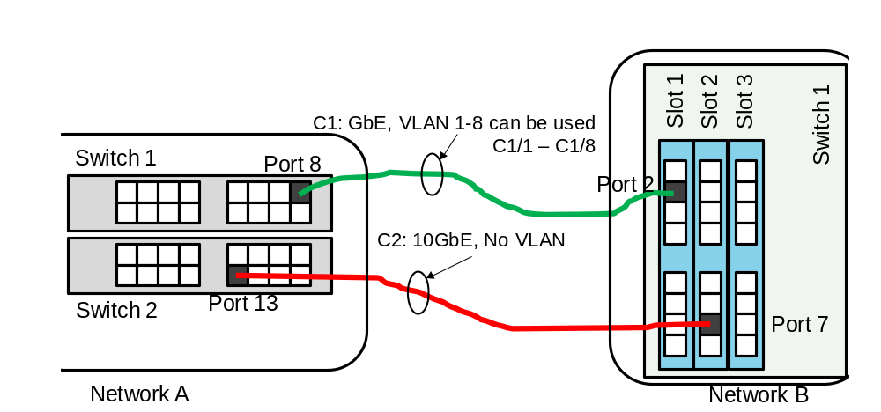
Logical transport view and internal mappings
Logical view (topology)
Network A internal mapping:
  Switch 1/Port8 : C1
  Switch1/Port8/VLAN1: : C1/1
  Switch 1/Port8/VLAN8 : C1/8
  Switch 2/Port13 : C2
Network B internal mapping:
  Switch 1/Slot1/Port2 : C1
  Switch 1/Slot1/Port2 /VLAN1 : C1/1
  Switch 1/Slot1/Port2 /VLAN8: C1/8
  Switch 1/Slot2/Port7 : C2
STP: C1/1
STP: C1
STP: C1/2
STP: C1:8
STP: C2
Network A
Network B
STP:C1 : GbE
STP C1/1 – C1/8 : VLAN on GbE
STP C2: 10GbE

Slide 5
How it works
Only logical topology (left hand side of the previous slide) is advertised to requesters
  (assume network A and B have edge X and Y respectively)
  Requester NSA divides connection (X-Y )to (X-C1/4) and (C1/4-Y), and requests these to network A and B respectively.
Network A receives the connection request (X-C1/4)
  Then Network A internally translates C1/4 to Switch1/Port8/VLAN4
  Checks its own calendar for availability of the internal connection, and grants the request. (Of course, similar translation should be done for X too.)
Network B does the same thing for the request (C1/4-Y)
When the reserved time arrives:
  Network A provisions physical connection:(X-Switch1/Port8/VLAN4)
  Network B provisions physical connection:(Switch1/Slot1/Port2/VLAN4-Y)
In this way, connection (X-Y) is successfully provisioned.

