Slide 1

Network Services Interface
Working Group
Agenda
Chairs: Guy Roberts
Tomohiro Kudo
Inder Monga
Seattle, 3rd Oct 2008

Slide 2

OGF IPR Policies Apply
“I acknowledge that participation in this meeting is subject to the OGF Intellectual Property Policy.”
Intellectual Property Notices Note Well: All statements related to the activities of the OGF and addressed to the OGF are subject to all provisions of Appendix B of GFD-C.1, which grants to the OGF and its participants certain licenses and rights in such statements. Such statements include verbal statements in OGF meetings, as well as written and electronic communications made at any time or place, which are addressed to:
    the OGF plenary session,
    any OGF working group or portion thereof,
    the OGF Board of Directors, the GFSG, or any member thereof on behalf of the OGF,
    the ADCOM, or any member thereof on behalf of the ADCOM,
    any OGF mailing list, including any group list, or any other list functioning under OGF auspices,
    the OGF Editor or the document authoring and review process
Statements made outside of a OGF meeting, mailing list or other function, that are clearly not intended to be input to an OGF activity, group or function, are not subject to these provisions.
Excerpt from Appendix B of GFD-C.1: ”Where the OGF knows of rights, or claimed rights, the OGF secretariat shall attempt to obtain from the claimant of such rights, a written assurance that upon approval by the GFSG of the relevant OGF document(s), any party will be able to obtain the right to implement, use and distribute the technology or works when implementing, using or distributing technology based upon the specific specification(s) under openly specified, reasonable, non-discriminatory terms. The working group or research group proposing the use of the technology with respect to which the proprietary rights are claimed may assist the OGF secretariat in this effort. The results of this procedure shall not affect advancement of document, except that the GFSG may defer approval where a delay may facilitate the obtaining of such assurances. The results will, however, be recorded by the OGF Secretariat, and made available. The GFSG may also direct that a summary of the results be included in any GFD published containing the specification.”
OGF Intellectual Property Policies are adapted from the IETF Intellectual Property Policies that support the Internet Standards Process.
Notes:
IPR Notices Note Well for OGF meetings

Slide 3
Agenda
Agenda bashing
  Note Takers Please
Guy Roberts to present group charter and summary of Singapore discussions -20 min
Tomohiro Kudoh to present GNS-WSI3 -20 min
Eduard Escalona: use case Phosphorus/Alcatel-Lucent- 30 min
Guy Roberts: Scarie use case -15 min
Use case discussion
John Vollbrecht: NSI Architecture -20 min
Relationship between OGF NSI and other standards bodies –IETF/ETSI etc
AoB
Review action items
Next meeting: Catania January 2009

Slide 4
Resources
NSI now has a GridForge site
Reachable at OGF page -> Gridforge -> projects
http://forge.gridforum.org/sf/projects/nsi-wg
Includes:
  Document repository
  Group wiki page
  Source code repository

Slide 5
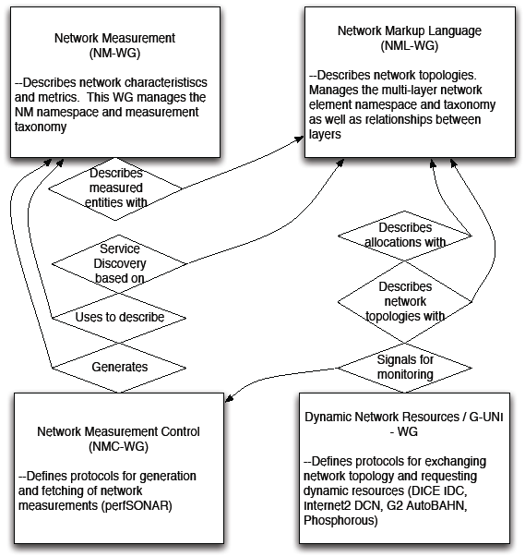
Relationship to other groups
Network Service Interface

Slide 6
NSI Charter
The NSI WG will provide a recommendation for a generic network service interface that can be called by a network external entity such as end users, middleware, and other network service providers.
The recommendation will define the information exchange, the required messages and protocols, operational environment, and other relevant aspects.

Slide 7
Positions
Co-Chairs:
Guy Roberts | DANTE
Tomohiro Kudoh | AIST
Inder Monga | NORTEL
Editors:
John Vollbrecht | Internet2
Eduard Escalona | University of Essex
Georgios Zervas | University of Essex

Slide 8
Deliverables
Network Service Interface use cases
An informational document describing the key use cases and user requirements.
Network Service Interface architecture
A recommendation document describing the architecture for NSI including requirements and functionalities.
Network Service Interface common message and protocol specification
A set of recommendations describing protocols and message specification for the NSI.
NSI “User-to-Network” and “Network-to-Network” specification
A recommendation detailing protocols and message specifications associated with the “User-to-Network” and “Network-to-Network” interfaces.

Slide 9
Deliverable 1
Title: Network Service Interface use cases
A informational document describing the key use cases and user requirements.
Use cases describing requirements of a variety of users, including Grid Middleware, Grid Applications, and by other Network service providers
Identification of requirements for users and network service providers.

Slide 10
Deliverable 2
Title: Network Service Interface architecture
A recommendation document describing the architecture for NSI including requirements and functionalities.
Definition of the NSI positioning (User-Network, Network-Network).
Specification of NSI functionality and interface protocol requirements.

Slide 11
Deliverable 3
Title: Network Service Interface common message and protocol specification
A set of recommendations describing protocols and message specification for the NSI.
It is expected that the NSI will be modular in its structure and will include several message sets.
Each message set will be associated with a particular task. For example, different message sets may be used to describe network service requests, network service monitoring, discover network service capabilities etc.
Any given instance of the NSI interface (User-to-Network, Network-to-Network) may implement a subset of the available message sets.

Slide 12
Deliverable 4
Title: NSI “User-to-Network” and “Network-to-Network” specification
It is expected that in addition to a complete definition of the message sets provided by Deliverable 3, two additional documents will be provided in this deliverable.
These will be reference profiles of NSI, namely the user-to-network instance of NSI and the network-to-network instance of NSI

Slide 13
Deliverable 4 (continued)
Title: NSI “User-to-Network” and “Network-to-Network” specification
The first document will be targeting on providing the information required to deploy the NSI as a “User-to-Network” interface. Special attention will be paid to limiting the complexity and length of the document in order to attract large number of users that may not have experience of networking. This document will consist of only the information exchange and specific messages required for such an interface.
Similarly the second document will be driven by the information exchange required to provide interoperability between Network Service providers.
Both documents will refer to Deliverable 3 for further details regarding the message description. In this way, both instances will have a common message description document and also be easily adapted by different communities.

Slide 14
Actions from Singapore

Slide 15
Contact Details
Chairs:
  Guy Roberts (DANTE), guy.roberts@dante.org.uk
  Tomohiro Kudoh (AIST) , t.kudoh@aist.go.jp
  Inder Monga (Nortel), imonga@nortel.com
Editors:
  John Vollbrecht (Internet2), jrv@internet2.edu
  Georgios Zervas (University of Essex), gzerva@essex.ac.uk
  Eduard Escalona (University of Essex), eescal@essex.ac.uk
Mailing list: nsi-wg@ogf.org
  To subscribe, https://forge.gridforum.org/sf/projects/nsi-wg
  then Subscribe and fill in the web form

Slide 16
Agenda
Agenda bashing
  Note Takers Please
Guy Roberts to present group charter and summary of Singapore discussions -20 min
Tomohiro Kudoh to present GNS-WSI3 -20 min
Eduard Escalona: use case Phosphorus/Alcatel-Lucent- 30 min
Guy Roberts: Scarie use case -15 min
Use case discussion
John Vollbrecht: NSI Architecture -20 min
Relationship between OGF NSI and other standards bodies –IETF/ETSI etc
AoB
Review action items
Next meeting: Catania January 2009

Slide 17
Full Copyright Notice
Copyright (C) Open Grid Forum (2008). All Rights Reserved.
This document and translations of it may be copied and furnished to others, and derivative works that comment on or otherwise explain it or assist in its implementation may be prepared, copied, published and distributed, in whole or in part, without restriction of any kind, provided that the above copyright notice and this paragraph are included on all such copies and derivative works.
The limited permissions granted above are perpetual and will not be revoked by the OGF or its successors or assignees.
Notes:
OGF Full Copyright Notice if necessary

