Slide 1
SensorNet: Wide-Area Infrastructure for Interoperable Sensor Networks
- Info-D Use Cases
Mallikarjun Shankar, Ph.D.
Computational Science and Engineering Division
Oak Ridge National Laboratory shankarm@ornl.gov

Slide 2
Outline
SensorNet Goals
  Standards
  Typical deployments
Operational Prototypes
  Node device
  Infrastructure
Data-Sharing/Dissemination Scenarios

Slide 3
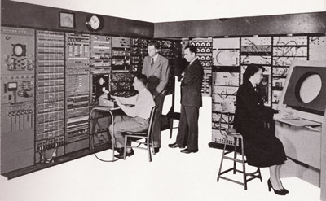
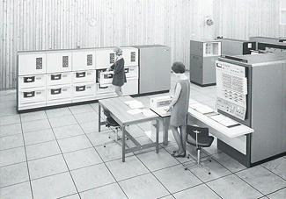
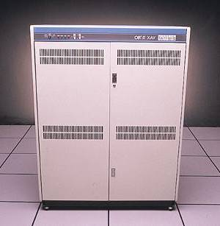
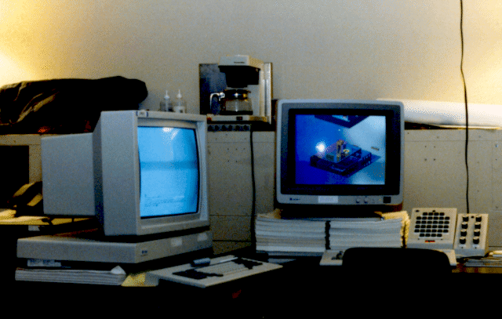
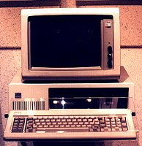
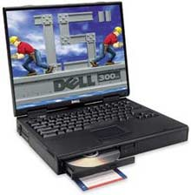
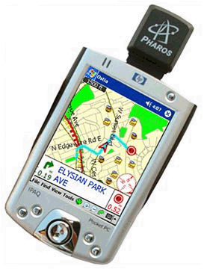
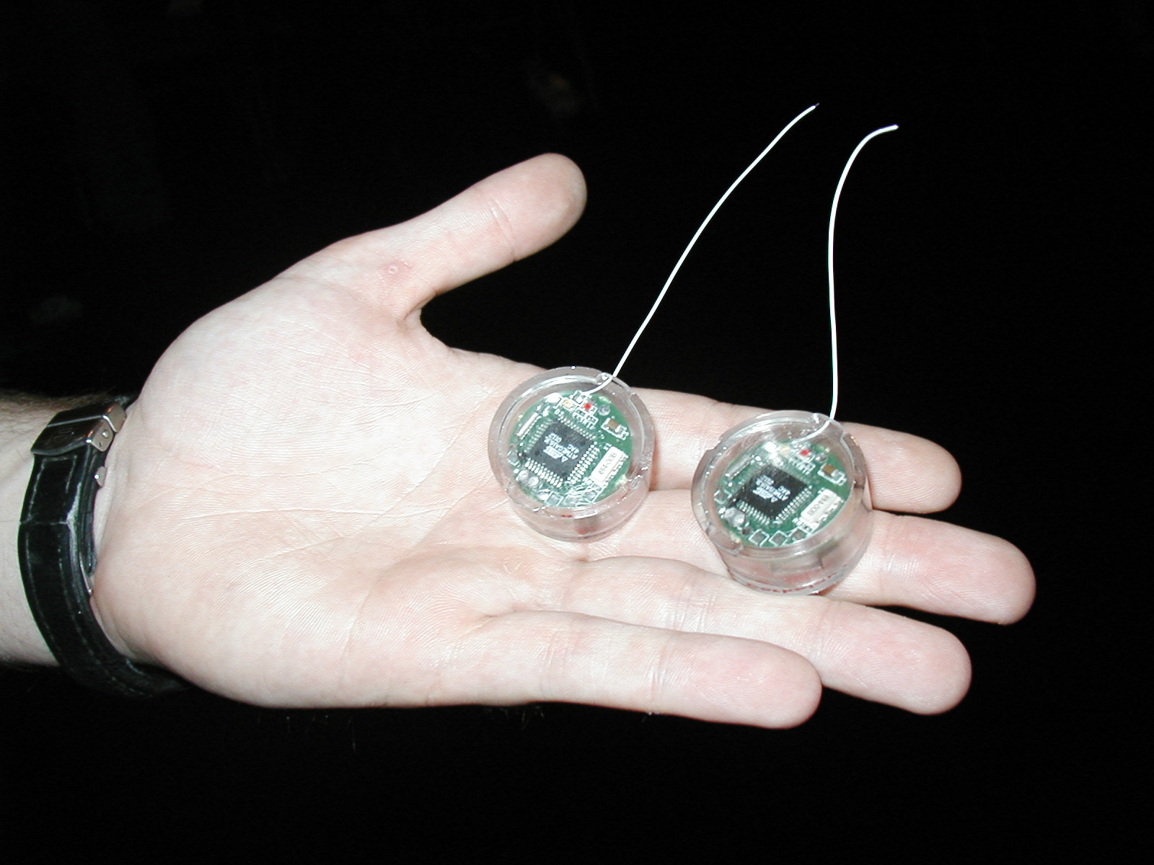
Proliferation of IT revolution: Bell’s Law
number Crunching
data Storage
Log (people per computer)
productivity
interactive
1
streaming
information
to/from physical
world
Year
1980
Adapted from D. Culler 2004

Slide 4

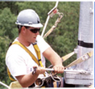
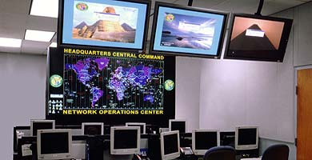
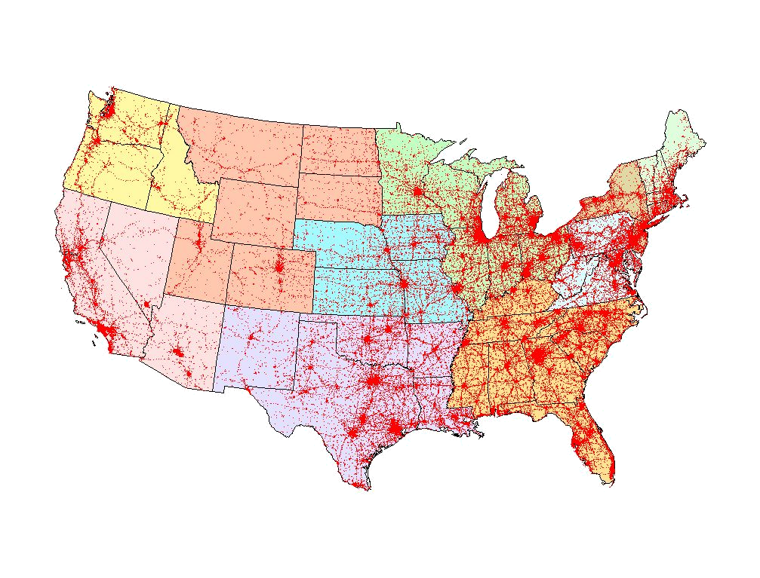

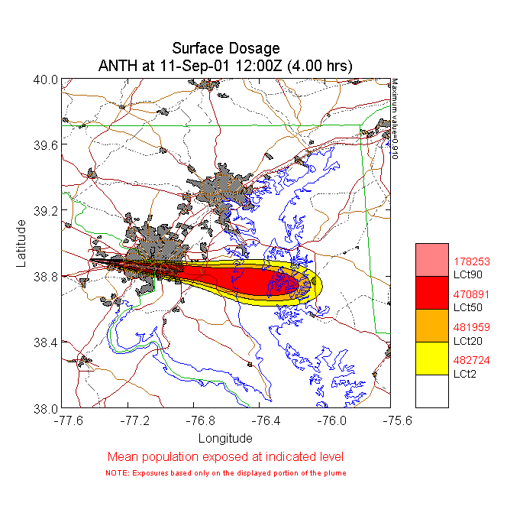
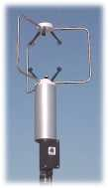
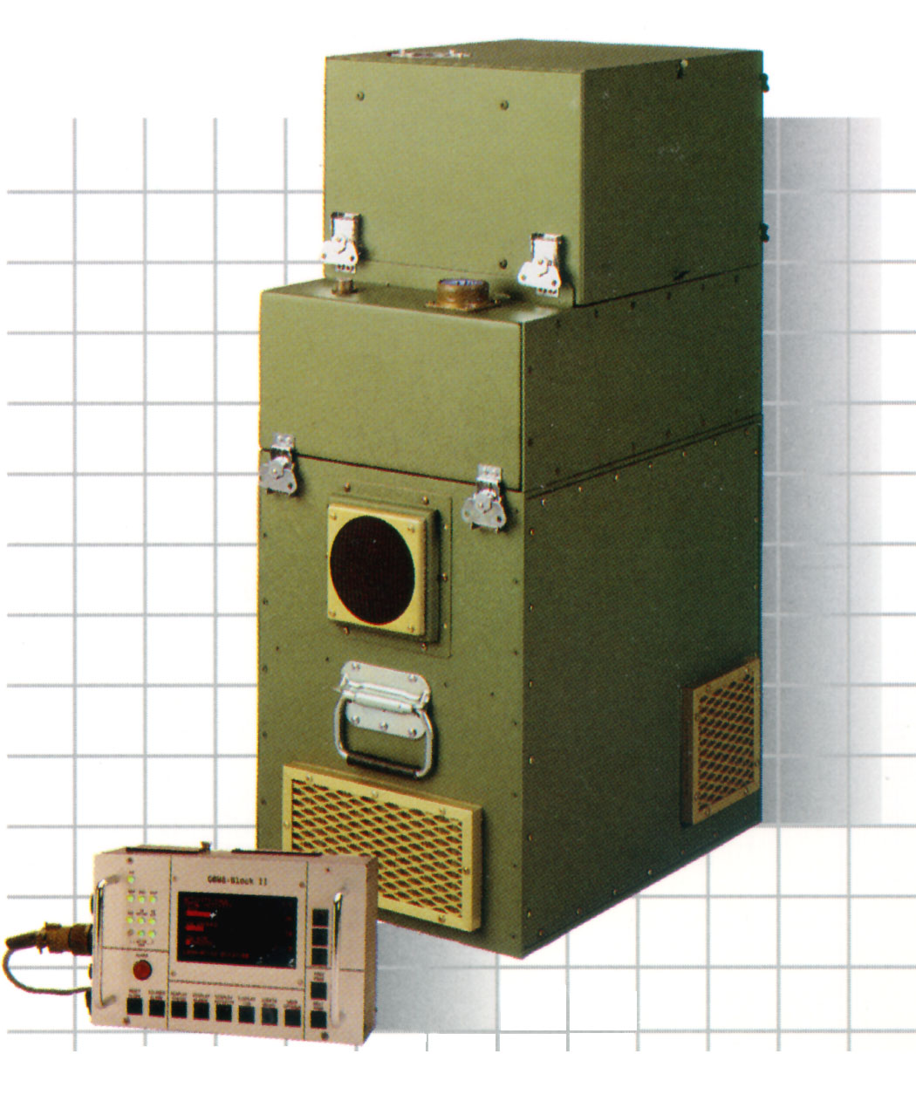
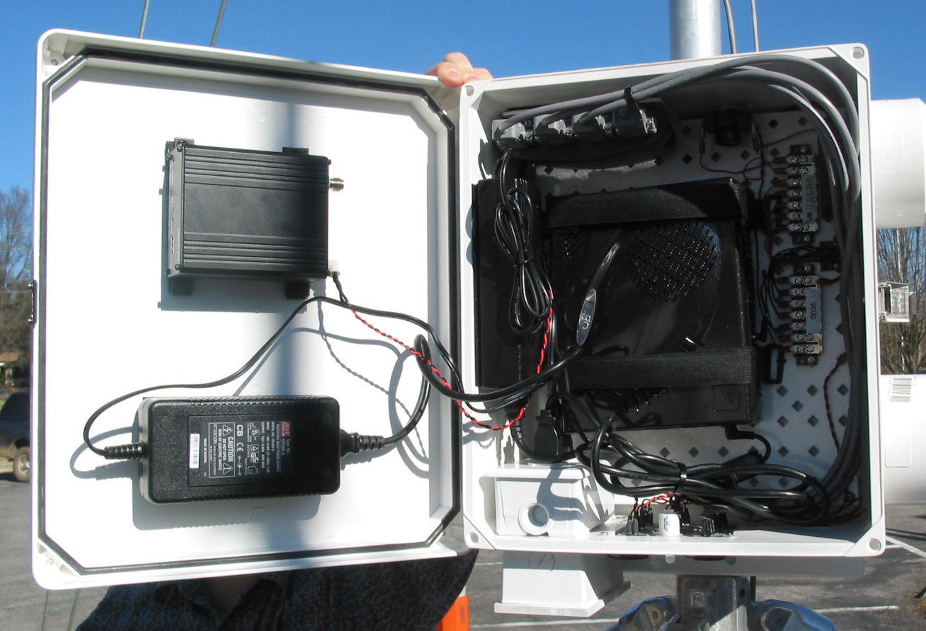
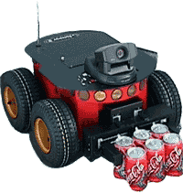
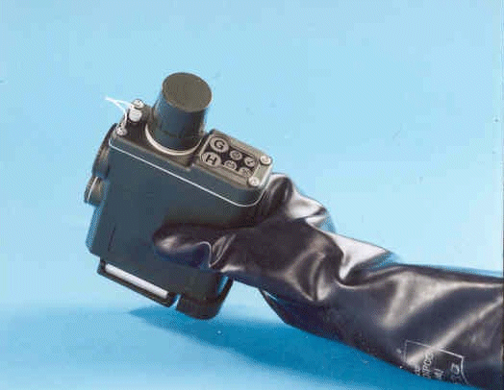
SensorNet Goals
To catch big fish you need a big net – Ancient Proverb
Distributed Operations
Centers
Automated Hazards
Analysis
First Responders
Strategic Sites
Sensor Systems
Control and Enhanced Communications
Ubiquitous Sensing for Protection and Utility

Slide 5
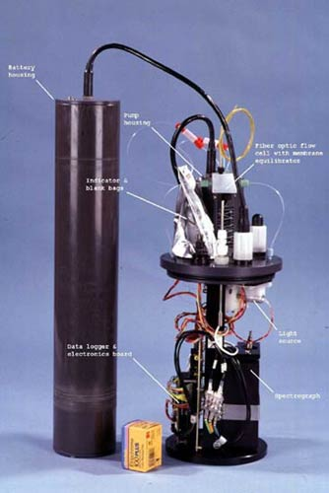
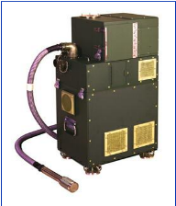
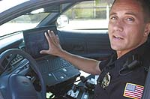
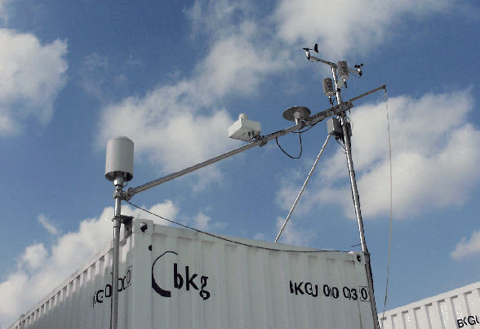
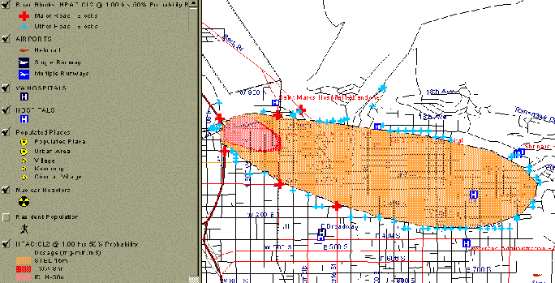
Data-Sharing through a Standards based Framework
Many Sensors
Many Applications
Net-Centric
Enterprise
Services/ Global Information Grid
Open
Geo-
spatial
Services
(OGC’s
Web
Feature
Services)
IEEE
1451
&
TEDS
Command-and-Control
Field and End-User
Support
Pervasive,
Securable,
Scalable,
Interoperable
and Reliable
Plug
and Play
Open and
Extensible
Non-Proprietary
Analysis, Modeling, and Prediction

Slide 6
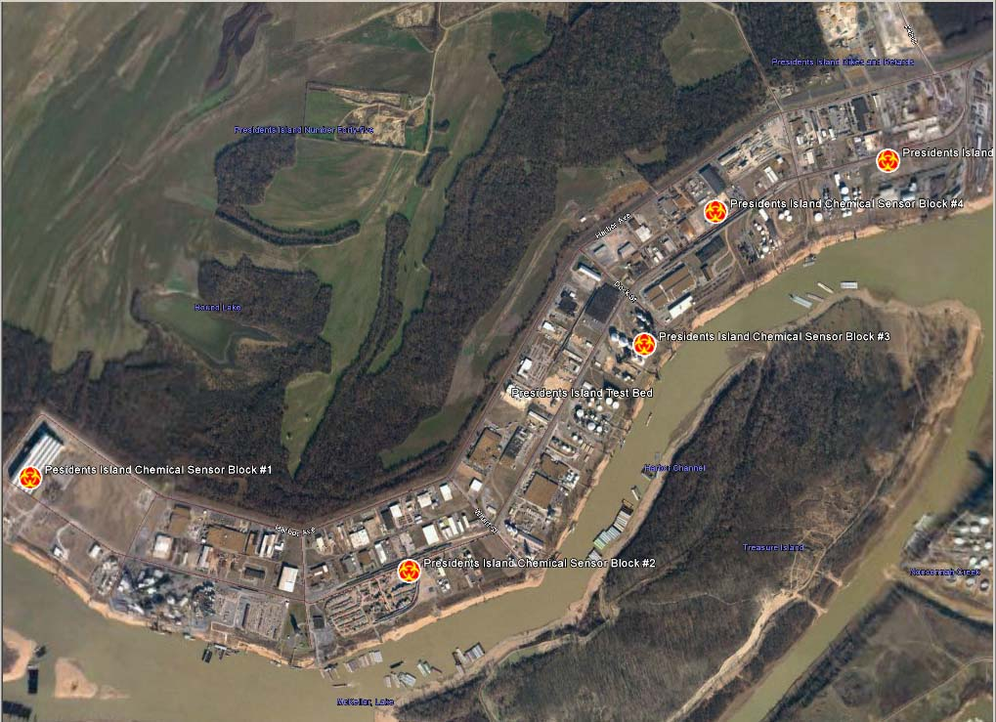
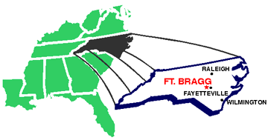
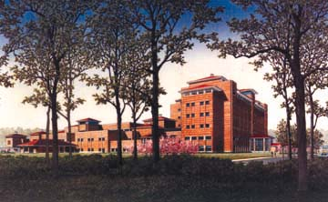
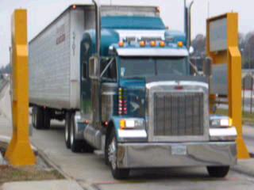
Sample Deployments
Wireline+Powered Deployments
Pre-defined Analysis
Integrating Multiple Sources of Data
Notes:
Powered deployments.
Not layer 1 and 2, but layer 3-4 and above.
Class of sensors determine the kind of sensor net you want..
Integrating data from multiple sources
Thus dispelling the myth of traffic..

Slide 7
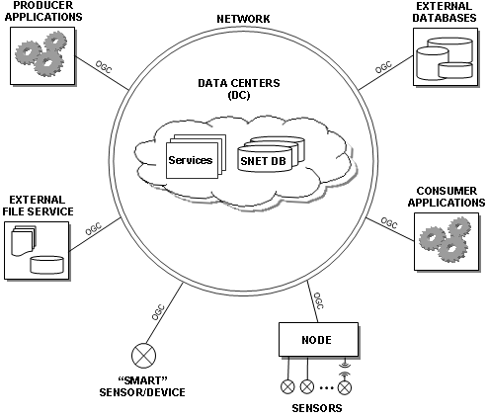
Information-Sharing Clouds
Notes:
Big concern is information sharing in systematic ways..
User community wants a variety of sensors, share the data, develop frameworks to make things
interoperate. If we show how relevant science/algorithms integrate with the deliverable, that is always
a win.

Slide 8
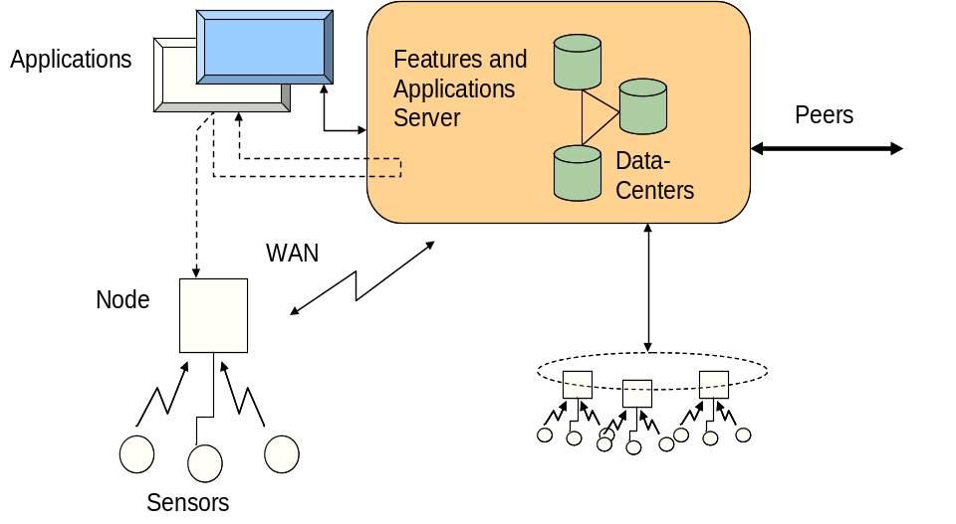
SensorNet Node
Edge of SensorNet (< few thousand feet control)
Sensor Agnostic
  Serial cable, Ethernet, Wireless
  IEEE 1451
Connectivity with SensorNet
  Interaction with Regional Data Center (RDC)
  Basic Services (Open Geospatial Consortium, etc.)
Notes:
Where is the first site of interoperability..
The last mile device.. in our design, called the Node
Layered scheme.. this is the analog of the gateway..

Slide 9
SensorNet Node
Services are available to Regional Data Centers as well as external users
Config
Data Store
(Web) Server
  Control
  Auth
  Data Services
“last-mile” link on CDMA, Ethernet, Wireless LANS, MANS, Satellite, etc.
Legacy Codes
E.g., Sprint Session
USB Mux.
TEDS
1451.1 NCAP
STIM
Other
…
1451.X Stubs
n
Sensors Wrapper
Comm. Mode Control
Mounted Node with satellite and CDMA connections:
Wireline
Wireless
Sensors: CBRNE + Weather + Image + ...
Notes:
Sharing signals – wide-area cdma works ok
Powered links
Sensors are legacy
There are others – ORACLE edge server talking about RFID’s, commercial companies in this space..

Slide 10
Networked Deployment Scenario
Sensor Data Alternate Pathways
Open Application and Model Access
Data Brokers
Sensors + Location and Connectivity
Plant, Region, or Urban Area
Data Features
Data Center and Services
Mobile Node
First Responders
Netcentric: Peer-to-Peer Autonomous Decision Making Capability
Remote and Field Sensors

Slide 11
Data-Sharing Services
<Subscription>
Anomaly?
  Filter:
    GeoLocation
    TimeWindow
  Type:
  TrafficData
</Subscription>
publication
Services
<snet:TrafficData>
  <snet:TrafficSpike>
    <gml:location>
    </gml:location>
    <snet:description>
    - --- --- ---
    </snet:description>
  </snet:TrafficSpike>
</snet:TrafficData>
SensorNet and External Sources
subscription
Services Directory
Ontology and Normalization
Notes:
First need to extract
Shared vocabulary/ontology – Take Alex’s slides
(Ubiq needs this, we all need it..)

Slide 12
Application Context: SensorNet Data Considerations
Data Sharing
  Naming
  Representation/Storage
Data Management
  Placement/Extraction
  Filtering/Caching
Security
  Auth/Access
  Zones
Notes:
Say this is a spatial + temporal + information space problem
Extraction includes placement..

Slide 13
Scenario A (Initiation/Startup)
Field installation of sensor. Sensor starts collecting and submitting data
Sensor data aggregated at a local node which makes it available to (i) local data center and to (ii) applications that access the node.
Node sends sensor data periodically to local data-center.

Slide 14
Scenario B (Steady State)
Sensor to Data-Center
  Periodic data from Node arrives at Data-Center
  Periodic data from Local Data Center exchanged with peer or higher-level (Regional) Data Center
Data-Center to Data-Center and Application to Data-Center
  Periodic polling requests for data-subset (spatio-temporal bounding box)

Slide 15
Scenario C – Alert Event
Alert event takes place and Alert Message is sent from Node to Local-Data Center
Local Data Center sends Alert to all subscribers of alert message types

Slide 16
Use Cases: Startup and Data-Read
Case 1. User Installer sets up field sensor and expects data to appear in data-base for application (Scenario A and B)
Case 2. User at operations center expresses interest in certain sensor data.
  Scenario B and C
(Stop reading is symmetric in reverse)

Slide 17
Use Case: Alert Configuration
User sets up alert threshold for sensor levels in a spatio-temporal window.
  Language as well as specific implementation TBD, currently WNS and SAS

Slide 18
Requirements
R0 | Subscribers select publishers | Applications and Peer-Data Centers select Data Centers (spatio-temporally, with sensor types)
R1 | Subscribers select messages | Data-center selects particular sensor Type/Location/Time-window
R2 | Publishers select consumers | Sensors pre-configured to destination
R3 | Publishers/subscribers use vocab to select messages | Standardized format for message transfer. Message types are raw data from software/hardware agents/sensors.
R4 | Subscribers specify messages published | Not clear -- Selection of data-sources automatically selects messages published here.
R5 | Subscribers define event by querying data src | Event-listener subscribes for the interesting event from the sensor alerting service.
R6 | Subscribers correlate events to form composites | N/A. Because this is application internal or service internal.
R7 | Consumers specify dynamically how/when msgs received | Some alert requests are specified at higher priority.
R8 | Consumers limit messages received
R9 | Consumers retrieve past messages | Historical search from applications to Data-Centers and Nodes.
R10 | Pubs/Subs/Consumers define QoS | Requests must meet performance metrics (Outside Info-D?)
R11 | Pubs/Subs/Consumers have Identity Managmt | Access control. And authorization accompanies all requests.
R12 | Filters composable | Query request must allow fairly sophisticated query syntax.

Slide 19
Summary
Sensor networks for protection and utility built on a mixed hierarchical and peering-based architecture
Middleware requires systematic data-sharing and interoperability over the wide-area
http://www.sensornet.gov
Notes:
prototyping experiences
wider –adoption – killer APP

Slide 20
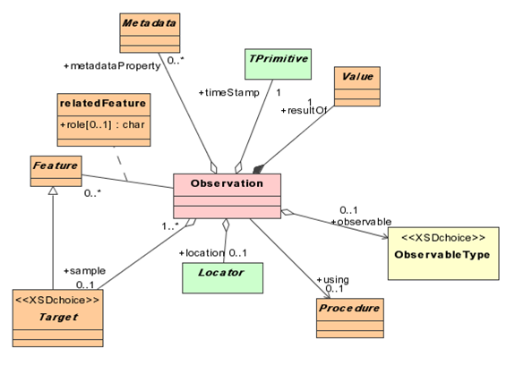
System Middlewares: OGC, Grid, ..., CORBA, ...
<ows:ObservedValue>
<ows:observable>
<ows:ParameterisedObservable gml:id=“TMband1">
<ows:baseObservable xlink:href="#radiance"/>
<ows:parameter>
<ows:TypedValue>
<ows:axis xlink:href="#wavelength"/>
<ows:value>
<gml:ValueExtent>
<gml:low><gml:Quantity uom="#um">0.45</gml:Quantity></gml:low>
<gml:high><gml:Quantity uom="#um">0.52</gml:Quantity></gml:high>
</gml:ValueExtent>
</ows:value>
</ows:TypedValue>
</ows:parameter>
</ows:ParameterisedObservable>
</ows:observable>
<ows:value>
<gml:Quantity uom="#uV">52.</gml:Quantity>
</ows:value>
</ows:ObservedValue>
From OGC’s OWS3 Standards Drafts
Notes:
Sensor Models & Encodings
Sensor identification
Sensor constraints
Observables and response characteristics
Platform to which the sensor is attached
etc
Observation Models & Encodings
Weather
Chemical, Biological, Radiation
Imagery
etc

Slide 21
OGC SensorML Example
<Sensor id="davis7911">
<identifiedAs>
<Identifier type=" http://myTermsDictionary.xml#longName">
Davis Anemometer 7911
</Identifier>
</identifiedAs>
<locatedUsing>
<GeoPositionModel>
<description>
<Discussion>Location of weather station on roof of the National Space Science and Technology Center Building at 320 Sparkman Dr., Huntsville, AL 35805
</Discussion>
</description>
<sourceCRS xlink:href="http://myPlatform.xml#platformCRS"/>
<referenceCR xlink:href=" http://myCRSDictionary.xml #EPSG:4329"/>
<usesParameters>
<LatLonAlt id="platformLocation">
<latitude>
<Quantity uom="http://myUnitsDictionary.xml#degrees">34.72450</Quantity>
</latitude>
<longitude>
<Quantity uom="http://myUnitsDictionary.xml#degrees">-86.94533</Quantity>
</longitude>
<altitude>
<Quantity uom=" http://myUnitsDictionary.xml#degrees">20.1169</Quantity>
</altitude>
</LatLonAlt>
</usesParameters>
</GeoPositionModel>
</locatedUsing>
</Sensor>
<measures>
<Product id="windSpeed">
<identifiedAs>
<Identifier type="shortName">Wind Speed</Identifier>
</identifiedAs>
<observable xlink:href=" http://myTermsDictionary.xml#shortName >
<Phenomenon>wind speed</Phenomenon>
</observable>
<derivedFrom>
<ResponseModel>
<usesParameters>
<BasicResponse>
<resolution>
<TypedQuantity
uom="http://myUnitsDictionary.xml#metersPerSecond"> 0.1
</TypedQuantity>
</resolution>
<samplePeriod>
<Quantity uom=" http://myUnitsDictionary.xml#seconds">2.25</Quantity>
</samplePeriod>
</ BasicResponse>
</usesParameters>
</ResponseModel >
</ derivedFrom >
</ Product >
</measures>
Source: SensorML Recommendation Paper, Dr. Michael Botts, UAH

