Slide 1
Support Service Tools and Requirements Document
GGF8 Review
Jim Giuliani
Science & Technology Support Group
Ohio Supercomputer Center
jimg@osc.edu
Notes:
MPI truly is a portable standard
Source code portability between machines running MPI
this is the “beauty” of having a standard

Slide 2
Quick Update Information
We are migrating the GUS-RG web site to it’s new GridForge home:
http://forge.gridforum.org/projects/gus-rg/
Group e-mail list:
userserv-wg@gridforum.org
Please create a user account (see next page)
Send one of the GUS Project Admins your GGF user name so that we can add you to the group.

Slide 3
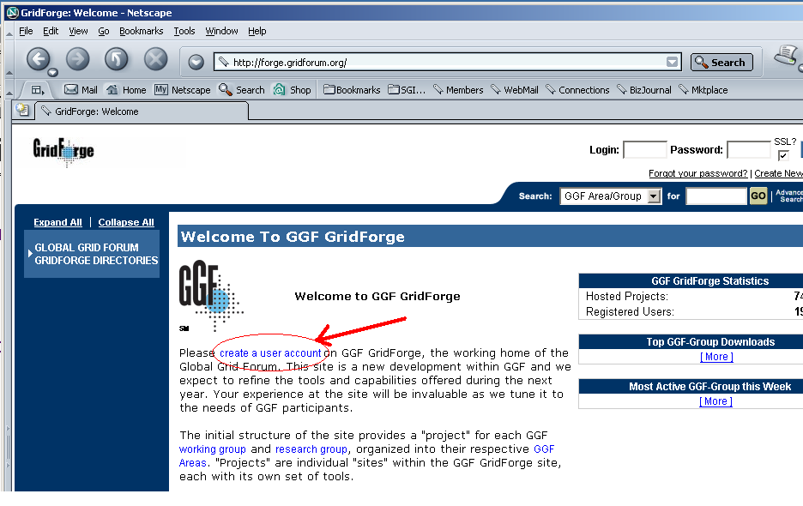
GridForge Front Page

Slide 4
4 Types of GGF Documents
Informational: To inform the community about a useful idea or set of ideas.
Experimental: To inform the community about a useful experiment, testbed, or implementation of an idea of set of ideas.
Community Practice: To inform the community of common practice or process, with the objective to influence the community.
Recommendations: To document a specification, analogous to an Internet Standards track document. GGF Recommendations are initially designated as "proposed," and following further experience and review may become full GGF recommendations.

Slide 5
Basic Document Structure
Abstract
Introduction
User Support Issues
Define the environment and applications which are being supported
Grid Services Requirements
Define what information and services Grid software must provide
Tools
What tools are needed by User Services staff
Capabilities
Additional resources/functionality needed

Slide 6
User Support Issues (chap. 3)
Single Resource vs. Multiple Resources (3.1)
Post Mortem Vs. Live Analysis (3.2)
General Statement
  I believe that a more "post mortem" type of analysis will be prevalent in a grid environment (from the user support view)
Impact on Tools and Requirements
  More emphasis on verbose logging
  More emphasis on tools to collect, filter and browse logs
  Does not eliminate some live analysis
    Is my job running and if so, where
    What is the current status

Slide 7
Grid Services Requirements (chap. 4)
Job Manager Logs (4.1)
Publishing log information in a directory service (MDS w/Globus) needs to be expanded with at little more thought – in regards to simplifying how a tool can easily browse for all log files. Verbose logging needs to be the default.
Grid Enabled Super (4.2)
The “Common Practices” document talks about super user privileges, but more in the context of looking at user files. This document talks about super user privileges, but in the context of performing system administration duties
  restarting processes
  looking at log files
Note: 2nd talk from PGM talk this morning talked about this type of service/capability.
Need to lessen the analogy to “Grid Enabled Super”

Slide 8
Grid Services Requirements (chap. 4)
Published Grid Resource Status (4.3)
Scheduler Service Information (4.4)
Access and Use Policies (4.5)
  Access and policy issues outlined well in “Grid Constitution”. This section simply calls for on-line location of documents to be published in directory service
Software Installation – MDS Registration (4.6)
  In the PGM workshop this morning, a presentation of GPT 3.x showed that they are building in support to publish MDS information on installed packages
  This document should outline a base subset of information required by software developers
    Package name, type, version, installation directory, list of all log files
  Additional information can always be provided

Slide 9
Tools (chap. 5)
Matrix of Test Applications (5.1)
  Ability of users and support staff to build a test application containing a subset of Grid functionality
  Call upon developers to provide test “kernels” with their libraries/utilities
Service Log File Collector/Browser (5.2)
  Given grid job id, collect log entries from all machines allocated. Default start/end time based on grid job. Need advanced filtering capabilities and ability to add machines.
Standard Output and Error Collection (5.3)
  Calls for standard out and standard error to be retained on machines for a certain period of time to allow for access by system staff in post-mortem analysis
Grid Debugger (5.4)

Slide 10
Tools (chap. 5)
MDS/LDAP Browser Enhancements (5.5)
  Reduce to mostly adding in ability to recognize html tags
Grid Resource Browser (5.6)
  Ability to assemble resource map based on grid job id
  Ability to interface to the various performance data records
    Directory service for static data
    Database like Ganglia or some other utility that records dynamic performance data
  Ability to launch diagnostic applications to measure current performance information

Slide 11
Security Considerations (chap. 8)
General Statement
I advocate "a lot" more information to be published in LDAP
  log file locations
  System contact information
I have heard comments that the current default published information by Globus, for example, is too open and should be restricted
  Client machines do not publish information, so not an issue
  Compute resource; could be broken into but not a critical issue if data is the liability (I.e. no local data resources)
  Data storage resource; more critical
I.e. new security flaw found in grid utility run_job.pl
Do an LDAP search across US for all systems that have run_job.pl advertised and attempt hack on that system

