Slide 1
Grid File System WG
Osamu Tatebe
GGF13, Seoul
March 15-16, 2004

Slide 2
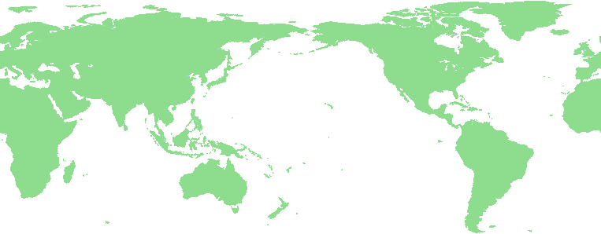
[Big picture] Grid File System
Grid File System federates and shares virtualized data from file systems in a Grid through Global namespace
/grid
Global namespace
ggf
jp
aist
gtrc
file1
file2
Mapping
file1
file2
file3
file4
Grid File System

Slide 3
Goal of GFS-WG
Two goals (two recommendation documents)
  Resource Namespace Service (aka Virtual Filesystem Directory Service)
    Manage Global namespace for any object
  Architecture for Grid File System Services
    Provides functionality of virtual file system in grid environment
    Facilitates federation and sharing of virtualized data
    Uses Resource Namespace Service and standard access protocols
GFS-WG#1
GFS-WG#2
1:30pm,
Tomorrow

Slide 4
Resource Namespace Service
Discussion in OGSA-WG data design team
  Naming service for general purpose use is required
Responding to the discussion
  Document title is changed to RNS
  Junction is a general pointer
    Target is String
  WSRF Compliant Service
  Extensible
    document style messaging
    Profile extension operation
  File system related profile is in appendix
https://forge.gridforum.org/projects/gfs-wg/document/
Resource_Namespace_Service_-_GGF13/en/1

Slide 5
Resource Namespace Service (2)
Three-tier Naming architecture
  Human readable name, Abstract name, physical location
  RNS provides a mapping from Human readable name to Abstract name or physical location
Human readable name
Abstract name
Physical location
Human readable name
Abstract name
Physical location

Slide 6
New Naming WG?
Yesterday, there was a charter discussion BoF session for naming WG
Objective includes to standardize RNS
Main reason is RNS is a general service that requires a specific WG
But, this should not be a reason if GFS-WG can specify RNS general enough

Slide 7
New Naming WG? (2)
Points are
  Is RNS specification general enough?
    If yes, it is not necessary to standardize RNS in new WG
  How much refinement is needed?
    If it is not so much, it can complete in GFS-WG
GFS-WG is a major community to require RNS. That is why we specify the spec by generalizing VFDS.

