Slide 1
Implementation and Performance Assessment of a Grid-Oriented Centralized Topology Discovery Service
Francesco Paolucci, Luca Valcarenghi, Filippo Cugini, and Piero Castoldi
Grid High Performance Networking Research Group (GHPN-RG)
Session I
Monday, Feb. 13th, 2006, Athens, Greece

Slide 2
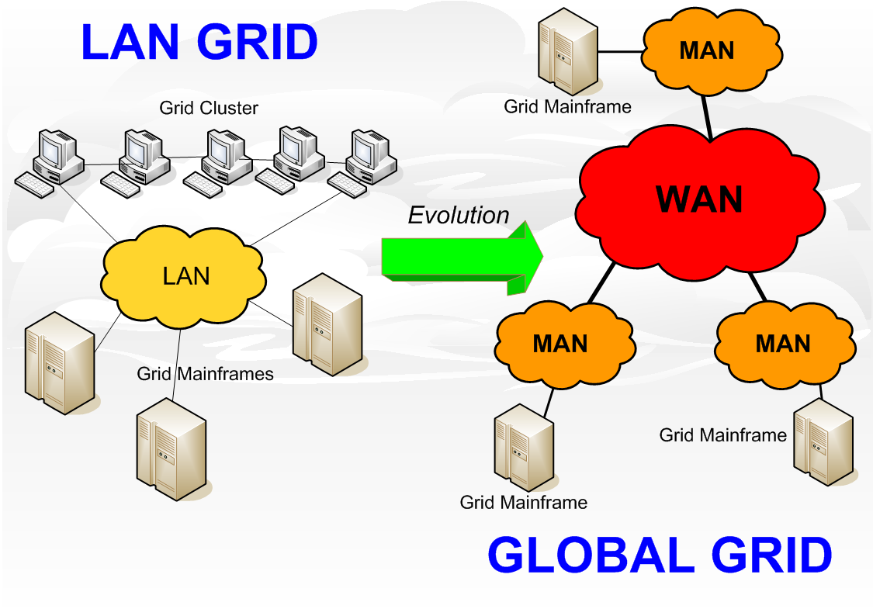
Motivations
Global Grid Computing evolution from LAN to WAN ⇒
Network resource sharing
Grid Network Services
Resource availability monitoring and resources adaptation to QoS requirements
Network-aware application task staging
Network Information and Monitoring Service (NIMS)
It provides a Network-Aware Programming Environment (NA-PE) with an updated snapshot of network topology and resource utilization status
OUR PROPOSAL
Topology Discovery Service (TDS)
NIMS component
Implemented and tested in two different configurations:
DISTRIBUTED (D-TDS)
CENTRALIZED (C-TDS)
Bottlenecks
Computational resources (CPU)
Network Resources
Notes:
While in cluster grid computing applications may generally use almost dedicated network resources, in MAN or WAN they must share these resources with other heterogeneous traffic. Thus the need for reserving network resources in a scalable and deterministic way, e.g. through the utilization of bandwidth guaranteed Label Switched Paths (LSPs) or Virtual Private Networks (VPNs), for global grid applications is rapidly emerging. Grid network services allow either the application or, transparently to the application, the grid programming environment to dynamically interact with the network infrastructure to adapt network resources to the grid applications Quality of Service (QoS) requirements.
Existing monitoring tools provide grid users with a network description in terms of bandwidth and latency for monitoring end-to-end TCP/IP performance being not able to provide details about specific network links. This set of information could not be sufficient, for example information on network topology and current network link status utilization allows to optimally map application tasks to clusters belonging to the virtual organization so that the bandwidth and latency requirements for inter-task communication are met.
Within the Grid High Performance Networking Research Group (GHPN-RG) of the Global Grid Forum (GGF) the implementation of Grid Network Services has been proposed. Grid network services are grid services that handle the monitoring and the allocation of grid network infrastructure resources. Among the proposed services, the Network Information and Monitoring Tools (NIMS) provides the NA-PE with an updated snapshot of the network topology and utilization status.
Two complementary implementations of a topology discovery service (TDS) to be included in the NIMS are proposed: the centralized TDS and the distributed TDS. We will focus on the centralized solution.

Slide 3
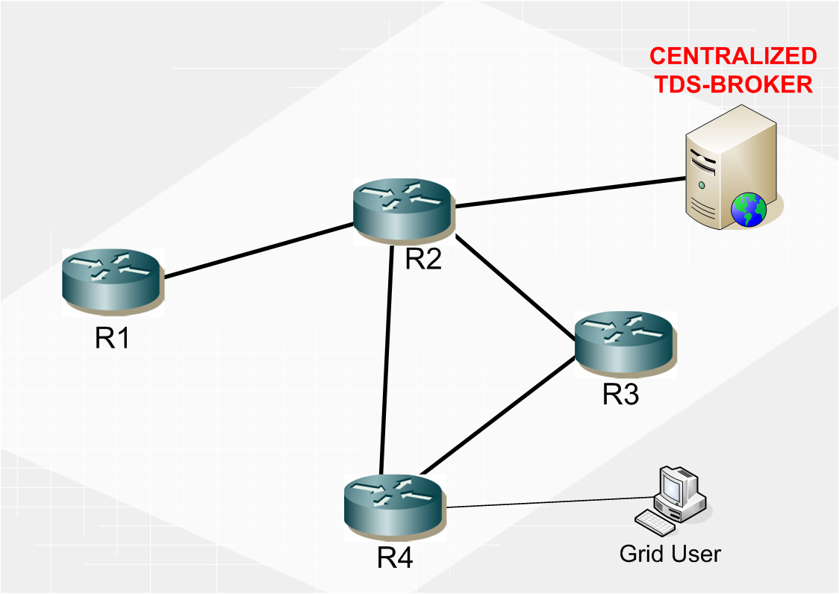
Centralized TDS
ARCHITECTURE
1. Topology request
Based on a central broker
Broker has the routers list and administrator privileges on them
Broker directly queries routers with router-based requests
Three kinds of topology detected (one of them by querying one node only)
2. UNI Queries to Nodes
3. XML Replies
4. XML Topology file
Notes:
The C-TDS is based on a consumer-producer architecture in which a central server/producer, i.e. the C-TDS broker, provides information to the clients/consumers, such as the single Grid user or the Grid Programming Environment.
The C-TDS broker is loaded with the list of the MAN routers that connects the computational resources belonging to a specific Virtual Organization (VO) and has got administrator privileges on the routers. Thus the C-TDS broker is able to retrieve from the routers information reserved to the MAN administrator.
Grid users make a specific service request to the C-TDS through the user-TDS interface. Once the user request has been accepted, the C-TDS broker maps the request into a set of queries to be submitted to each router belonging to the VO through the TDS-router interface. Routers reply, each one with a certain number of replies, and the C-TDS broker collects all the received information and elaborates it building a formatted document. Finally broker sends the replies to the users that requested the information.

Slide 4
C-TDS: XML Topologies and
Retrieval Strategies
PHYSICAL TOPOLOGY
All VO nodes (i.e., routers) queried
XML topology file: nodes, physical and logical interfaces, IP addresses, RSVP resources, node and interface adjacencies.
Adjacency detection: IP subnet match
Routing protocols independence
MPLS TOPOLOGY
All VO nodes queried
XML topology file: active LSP, ingress/egress nodes, intermediate nodes (ERO), reserved bandwidth, load-balancing
TDS Triggering Mechanisms
TIMEOUT BASED
Periodical polling
Delivery time<Timeout
No active monitoring
EVENT-DRIVEN
Network status changes: active network monitoring
SNMP traps sent by VO nodes
TDS Update Methods
LOGICAL TOPOLOGY (IP,OSPF-TE)
One node queried
XML topology file: nodes, IP addresses, RSVP resources, node/interface adjacencies, OSPF areas, TE link metrics
Adjacency detection: TED link objects match
GLOBAL
Brand new topology for each call
Large messages exchanged
INCREMENTAL
Existing topology update
Small messages exchanged
Notes:
The Centralized TDS is able to provide user with different XML-based topology files, with various level of abstraction.
The physical topology XML file contains the list of routers with the physical and interfaces that belong to each of them, each one with its own IP address, RSVP allocated resources and available bandwidth, including nodes adjacencies. The MPLS layer topology describes the existing LSPs, their direction (input or output), the router role (ingress, egress, transit), TE bandwidth, Explicit Routing Objects (ERO) and the LSP source and destination. The logical topology represents the connectivity at the IP-OSPF layer including routing metrics, obtained by using TED database queries, it contains the TE links connecting the routers, each one consisting of the IP source and destination addresses, the nominal, unreserved, available and reserved RSVP bandwidth, OSPF area and TED metrics. This is the only topology retrievable by querying only one node, however it is routing protocol dependant.
Two different topology update triggering methods are considered: the timeout-based method and the event-driven method.
In the timeout-based method every t seconds the C-TDS performs a new set of queries to the routers, independently of network status change occurrence. This results in periodically polling network resources. The timeout value must be a trade-off between the accuracy of the current topology status information and the amount of traffic generated by the updates.
The event-driven method consists in running the topology update exclusively in presence of network status changes. These events, such as link failure and LSP set up and tear-down, are signalled to C-TDS by using SNMP traps. In the event-driven method, each VO router is set to send a trap to the C-TDS broker IP address in case of variations on its configuration.
Two methods for dynamically updating network topology status information are considered: incremental update and global update.
In the incremental update method the current XML topology is selectively updated by querying only the routers that underwent some configuration changes.
In the global update method the topology stored in the C-TDS is completely substituted by a new one.

Slide 5
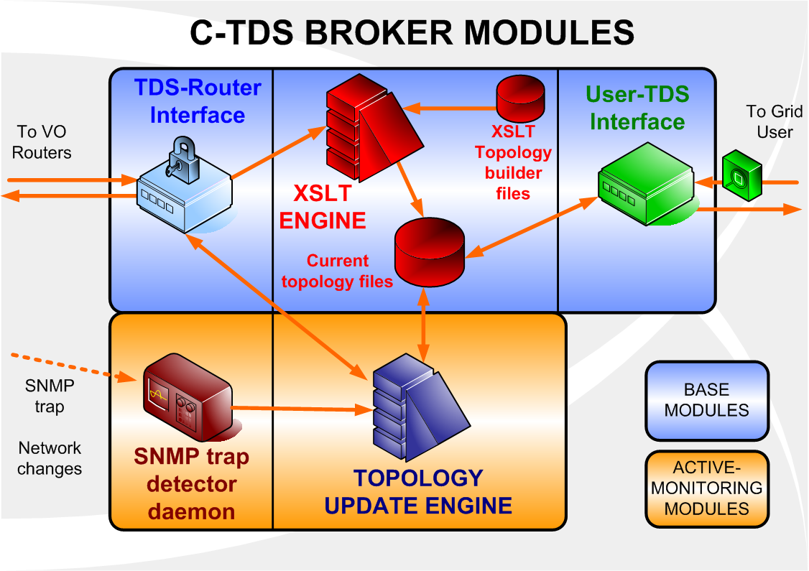
C-TDS Implementation
BASE MODULES
TDS-router Interface
TCP Socket communication
UNI request-reply platform (router-dependent)
Topology-based requests
Security: router password needed
XSLT Engine
Provided by XSLTProc
Topology builder files are router-dependent
User-TDS Interface
TCP Socket communication: only GRID users allowed
SNMP trap detector daemon
C++ module based on pcap network libraries
Detected events: LINK ON/OFF, LSP ON/OFF
Topology Update Engine
Current file updates exploiting SNMP trap information
In case of LSP UP a new query to ingress router is performed
ACTIVE-MONITORING MODULES
Notes:
The C-TDS broker is implemented in C++ and consists of two main modules groups, base and active-monitoring (optional) modules.
The TDS-router interface is responsible for the communication with the MAN routers and utilizes Junoscript as UNI to communicate with MAN routers. Juniper routers offer a direct communication to a Junoscript Server, which is capable of replying with XML-formatted files to a large range of status queries. In this study a specific set of requests are included in the TDS-router interface: physical interface, RSVP interface, MPLS active LSPs information. Each router is queried with the same set of requests.
The XSLT engine is responsible for elaborating the information retrieved from the routers and formatting into an output file for the users; it is provided by the Xsltproc LINUX application. XSLT file transformations allow to calculate node adjacencies.
The user-TDS interface is responsible for GRID users communications and is implemented through a bidirectional TCP socket with login and authentication procedures in order to permit access just to certified grid clients. The user requests must specify the kind of topology required.
Active-monitoring modules allow the Broker to perform the incremental update and event-driven topology triggering: a SNMP trap detector, based on pcap libs, is able to detect SNMP traps occurring during netwok changes. Traps are collected by the Update Engine, which is able to update the existing files with new modified up-to-date versions. If new LSP are set up, an information query is sent to the ingress node.

Slide 6
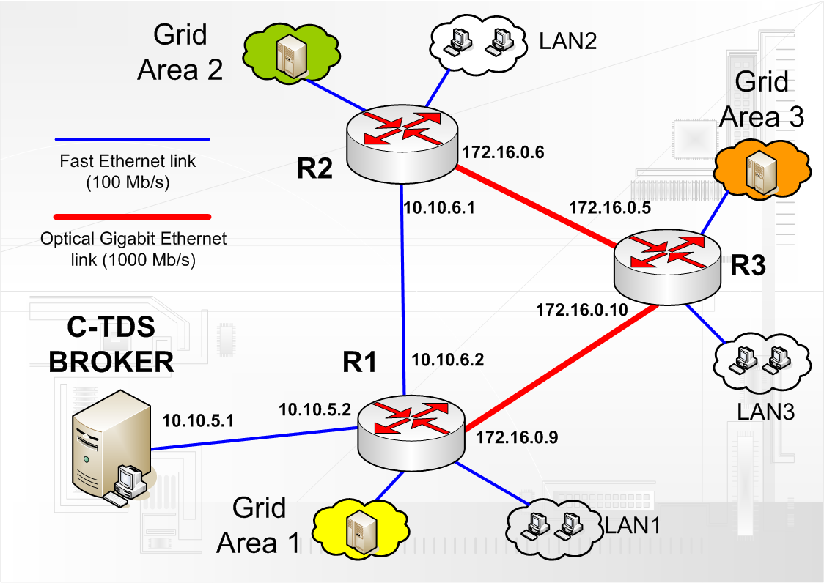
TDS Experimental MAN Testbed
TESTBED FEATURES
3 MPLS-native Juniper Mx© routers, Linux PC Broker
MAN 5 km-long optical ring
All routers run OSPF-TE and RSVP-TE
Junoscript Server activated for XML-file exchange platform
FAILURE
EVENTS
1. 11 LSP R2-R3 on (10 LSPs 10 Mbit/s resv, 1 LSP 300 Mbit/s resv): total 400 Mbit/s resv.
2. OPTICAL LINK R2-R3 FAILURE.
3. 10 LSP re-routed on path R2-R1-R3 (fulfilled FE link), 1 LSP down.
Notes:
The C-DTS is evaluated in the test-bed depicted in the figure: it consists of the interconnection of 3 Juniper routers through the Metrocore MAN 5 km-long optical ring, each one responsible for a different Grid Area. All routers run OSPF-TE, RSVP, MPLS.
Measurements and performance test is built by triggering the following events: 11 LSP are set up and a optical link failure is simulated, so that some LSPs are re-routed through the alternative path.

Slide 7
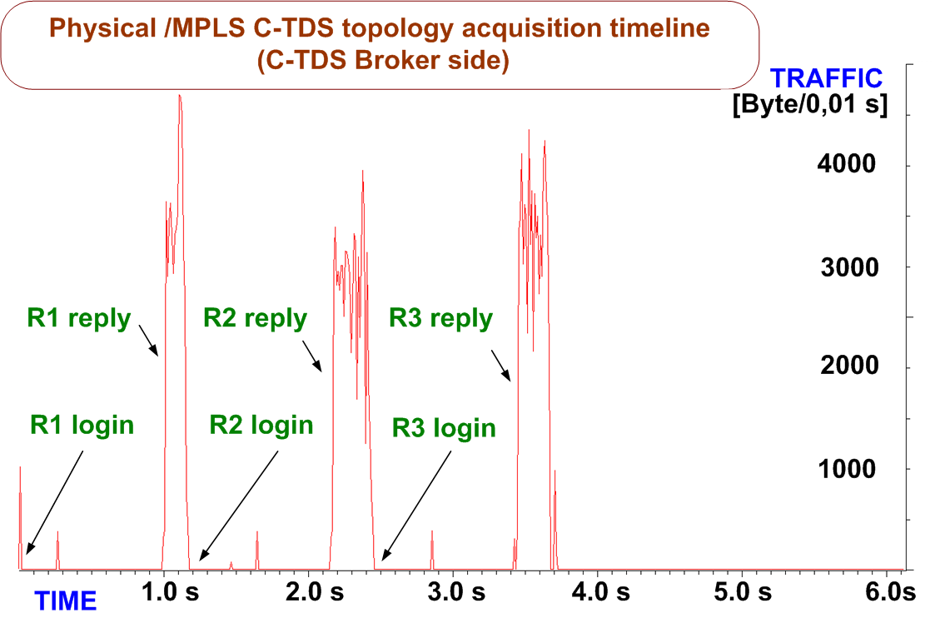
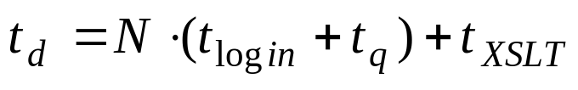
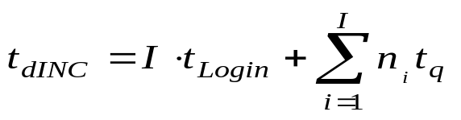
Results - 1
Physical and MPLS Topology with Incremental Event-Driven Updates
DELIVERY TIME
BEFORE FAILURE
Physical and MPLS topology information
200 kB traffic totally exchanged by Broker
32 kB Physical topology XML file
8 kB MPLS topology XML file
N= Nodes number | 3
t_{login}= Router login time | 1 s
t_{q}= average query time | 0.25 s
t_{XSLT}= XSLT engine time | 0.1 s
t_{d}= topology delivery time | 3.85 s
Parallel-mode detection t_{d=}1.35 s
Incremental event-driven update
23 SNMP traps detected: 11 LSP DOWN, 10 LSP UP, 2 LINK DOWN
Topology update: 10 new LSP queries to one ingress router.
10 KB traffic exchanged by Broker
AFTER FAILURE
I= New LSPs Ingress nodes queried | 1
t_{Login}= average router login time | 1 s
t_{q}= average query time (shorter) | 0.05 s
n_{i}= i-th node new LSPs number | 10
t_{dINC}= inc. topology delivery time | 1.6 s
Notes:
In this test the C-TDS utilizes physical interface information, RSVP interface information, and active LSP queries to build both the physical and the MPLS topology. The test is divided in two phases and active-monitoring modules are activated. In the first phase a topology retrieval demonstration from scratch in the steady-state scenario is assessed. The average topology delivery time depends on nodes number, router login time, average request-reply time and XSLT transform time.
Thus t_{d} results to be about 3.85 s. This value represents an upper bound to the average delivery time because router queries are done serially. Indeed the parallelization of the router queries reduces the topology delivery time to 1.35s because login and queries to each router could be done in parallel.
In the second phase, shortly after the link failure, 23 SNMP traps are detected by the SNMP daemon: 2 link-down, 11 LSP-down, 10 LSP-up.
Upon receiving the LSP-up traps the C-TDS broker performs a multiple query to R2 (the LSP ingress router) for retrieving the information concerning the 10 rerouted LSPs. Based on the LSP names, retrieved from the SNMP traps, the broker finds the LSP new paths. The total delivery time is given by t_{d}=t_{login}+10t_{q}, because the topology updates are not performed by the XSLT engine but by C++ functions implemented inside the C-TDS broker. The router replies are very short resulting in t_{q}=0.05 s and t_{d}=1.6 s.

Slide 8
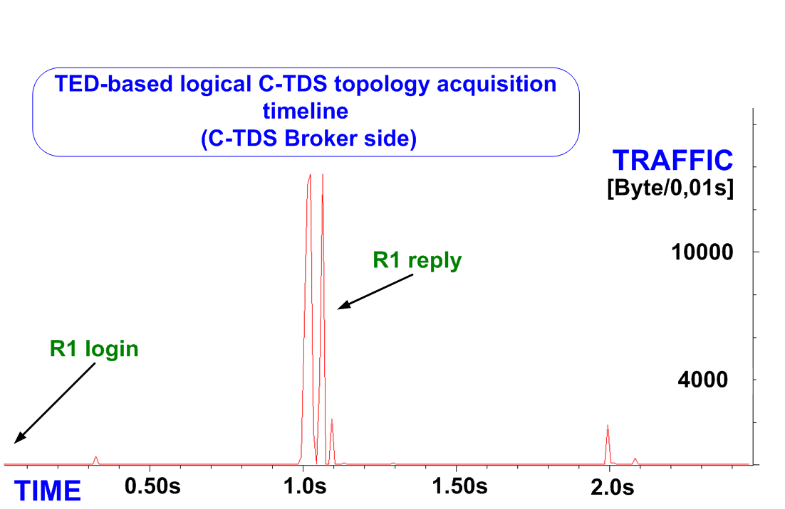
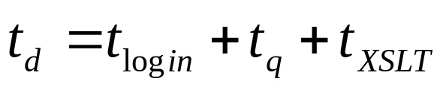
Results - 2
Logical Topology with Global Timeout-based Update
BEFORE FAILURE
DELIVERY TIME
Logical topology information
Only one node queried
60 kB traffic totally exchanged by Broker
8 kB Logical toplogy XML file
t_{login}= Router login time | 1 s
t_{q}= TED query time | 0.2 s
t_{XSLT}= Broker XSLT trans time | 0.1 s
t_{d}= topology delivery time | 1.3 s
SNMP traps ignored by Broker
At timeout expiry, a new global topology detection is performed
CPU load is low anyway
Timeout = 15 seconds
Reasonable trade-off between TED update time, CPU load and topology consistency.
AFTER FAILURE
Notes:
In this test (also divided in two phases) an initial global C-TDS is performed. The C-TDS broker queries only one router belonging to the VO, specifically router R1, asking for the TED. The initial LSP situation is the same as described in the test presented in the previous subsection. The test first phase timeline is shown in Figure 3.
The topology delivery time is, in this case, independent on the nodes number.Thus t_{d} is 1.35 s.
The update timeout has been set to 15 seconds. This value represents a reasonable trade-off between the time needed for OSPF flooding and TED update, and router CPU and traffic load. Results shows that router CPU load is low, however it could be appropriate to choose a low-load node or, in alternative, to put an OSPF-TE listener node. Such a node would not be involved in traffic forwarding and any external query do not produce any negative impacts on node performance. It must be underlined that in this case, since the time-out based update is adopted, the SNMP traps are completely ignored by the broker.

Slide 9
Conclusions and future activities
Implementations of Centralized Topology Discovery Service for Grid NIMS
  Network Status Information: Physical Topology, MPLS Topology, Logical Topology
  Topology Update Methods: global and incremental
  Update Triggering Method: time-out based and event-driven
Experimental results on an IP/MPLS metropolitan network based on commercial routers
  Different network status topology information
  Delivery time of few seconds
  Limited requested traffic
NEXT STEPS
Integration with Distributed TDS and Globus Toolkit 4
New tests on wider network scenarios to verify scalability issues
Thank you for your attention!
Notes:
These slides have presented several implementation aspects of a grid topology discovery service (TDS). The TDS can be utilized in Metropolitan Area Networks to provide either grid computing application or programming environment with the capability of retrieving information on the network status.
Active (query-based) and cooperative (trap-query) mechanisms for the Grid topology discovery are detailed and global and incremental update strategies are presented.
Experimental results show that Man topologies are complete and updated without high router CPU consumption in time ranges of few seconds.
Future extensions for the present activity expect D-TDS integrations, covering situations in which router login operations are not possible (WAN scenario).
New services for NIMS platform will be built and proposed as well, as optimal path computation.
New testbeds and simulation to improve scalability will be made on wider scenarios.

Slide 10



E-mail: fr.paolucci@sssup.it valcarenghi@sssup.it filippo.cugini@cnit.it castoldi@sssup.it
Sant’Anna School & CNIT, CNR research area, Via Moruzzi 1, 56124 Pisa, Italy

Slide 11
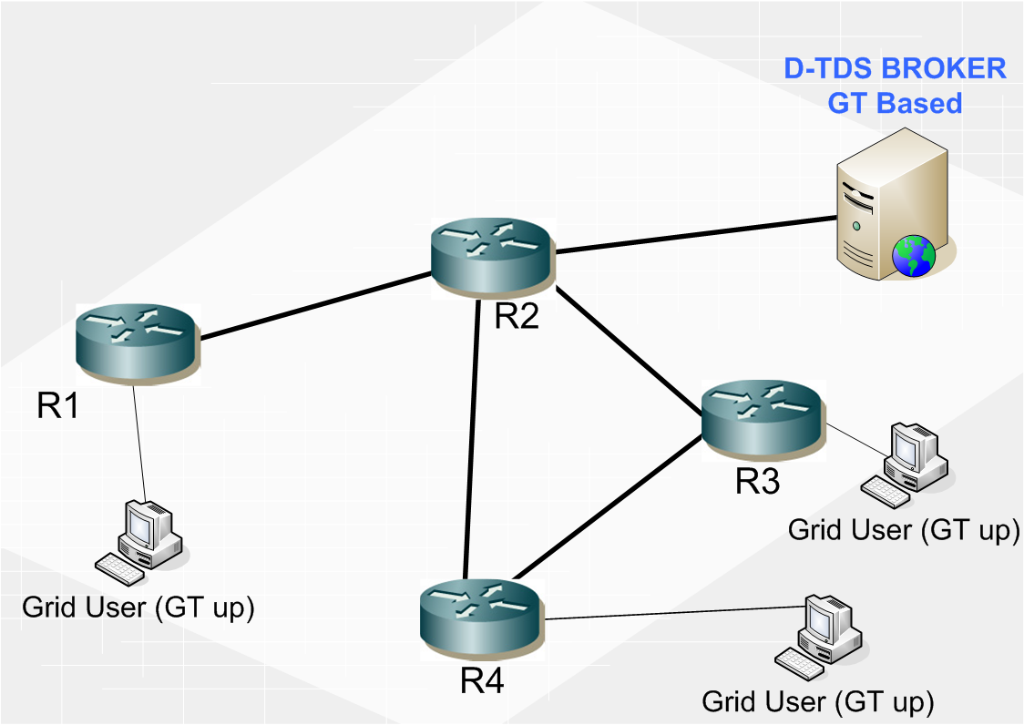
Distributed TDS
1. Topology request
ARCHITECTURE
2. GLOBUS request
Each user runs a network sensor service.
Users are coordinated by the D-TDS Broker.
Users and broker work within a grid service domain (peer visibility).
Broker builds topology graph by joining and pruning users multigraphs.
3. Network sensor towards other clients
4. GLOBUS replies
5. XML Topology file
Notes:
The Distributed TDS (D-TDS) architecture, consists of a set of grid hosts (i.e., users) and a broker. The hosts run a service capable of discovering the link-by-link paths to other hosts belonging to the Virtual Organization (VO). Depending on the network sensor adopted for the discovery procedure it is possible to have additional information on the network links connecting the hosts, such as the link bandwidth and the round trip time (i.e., latency).
A user (i.e., hosts) submits a query. The broker chooses a set of hosts, within the pool of hosts running the topology discovery service, and contacts them triggering the topology discovery procedure. Each contacted host runs the sensor command to find the path, on the logical topology, to any other host in the set. Upon termination, each host sends to the broker the tree rooted on itself to every other host in the selected host set. The broker merges them to compute the logical network topology. Finally the broker sends to the host that triggered the topology discovery service the reply containing the computed VO logical network topology.

