Slide 1

Development of a Grid Infrastructure for Functional Genomics
Dr Richard Sinnott
Technical Director National e-Science Centre
|||
Deputy Director Technical Bioinformatics Research Centre
University of Glasgow
8th June 2004
Building Castles with Shifting Sands?

Slide 2

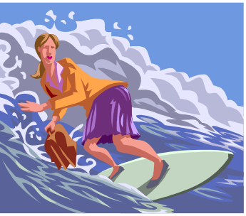




NeSC in the UK
  NeSC
    Prof Malcolm Atkinson (Director)
    Dr Richard Sinnott (Technical Director - Glasgow)
  NeSC and UK Grid Engineering
    Brief background and achievements
    Brief outline current and future developments
  Life sciences & Grids
    Challenges & Opportunities
    Bridges (Security focused Grid infrastructure for CFG)
    Conclusions
Transition to OGSI/OGSA under discussion
  Two UK OGSA Test Grid projects started in January
    UCL, Imperial College, Universities of Edinburgh and Newcastle
    Universities of Portsmouth, Reading, Manchester, Westminster and CCLRC
There are still issues to be resolved
  OGSA definition and delivery
    Standards OGSI, WSRF, …
    …and Technologies GT3, GT4…
  Hosting environments & Platforms
  Combinations of services supported
  Material and grids to support adopters
NeSC
HPC(x)
Previous work on UK e-Science Grid based on GT2
  Demonstrated broad set of applications across it
    Monte Carlo simulations of ionic diffusion through
    radiation damaged crystal structures
    Integrated Earth system modelling
    BLAST on the Grid
    Grid Integration Test Script Suite
    …
Glasgow
Edinburgh
Shifting sands?
The next Grid software
Newcastle
Belfast
White Rose Grid
Daresbury Lab
Manchester
Core National Grid Service
CSAR
Oxford
Cambridge
Hinxton
RAL
Cardiff
London
Southampton

Slide 3
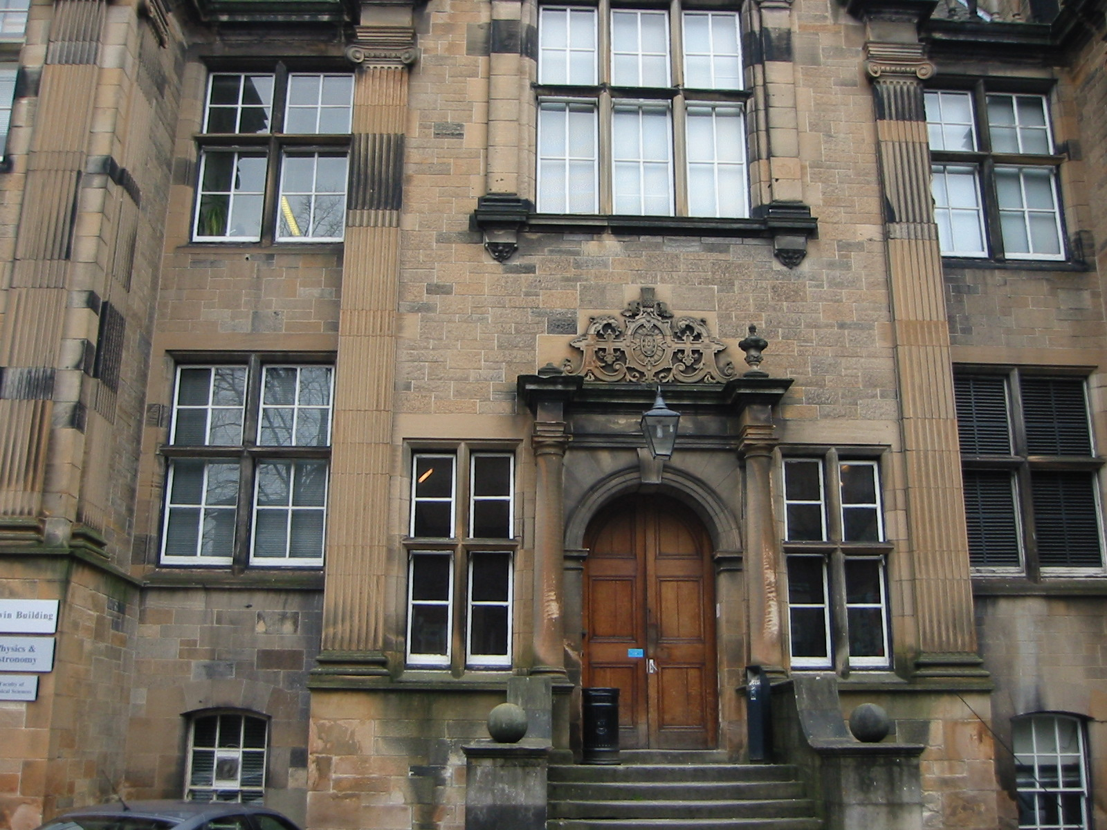


Glasgow e-Science Hub
E-Science Hub
  Externally
    Glasgow end of NeSC
      Involved in UK wide activities
        ETF: In May 2003 became first UK e-Science Centre to run integration tests across every site of the UK (Level 2) Grid. Therefore 100% access to UK Grid resources at this time
      Public visibility of NeSC
        responsible for NeSC web site
  Internally
    Focal point for e-Science research/activities at Glasgow
    Work closely with foundation departments
      Department of Computing Science
      Department of Physics & Astronomy
    Also working closely with other groups including
      Bioinformatics Research Centre
      Electronics and Electrical Engineering
      Biostatistics
      …

Slide 4
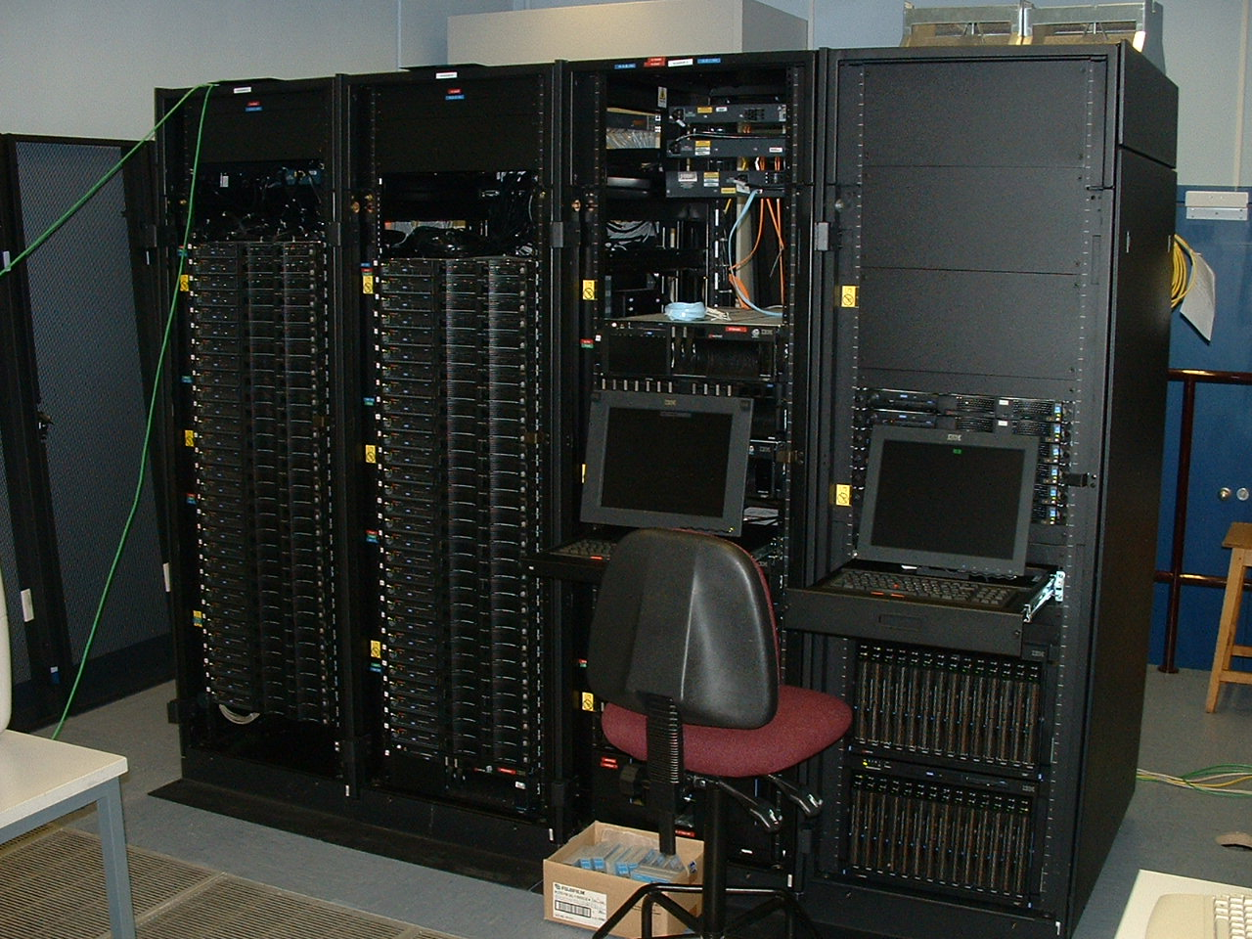
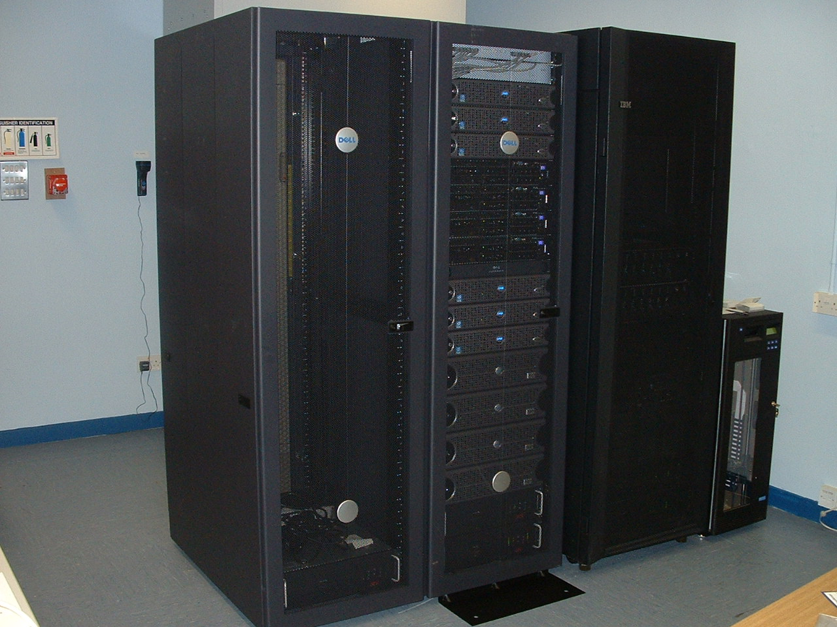
Glasgow e-Science Activities
Consolidating resources
  Building around ScotGrid
    Providing shared Grid resource for wide
    variety of scientists inside/outside Glasgow
      Particle physicists, computer scientists, bioinformaticians, …
        Target shares established
      Focal point for e-Science at Glasgow
Hardware
59 IBM X Series 330 dual 1 GHz Pentium III with 2GB memory
2 IBM X Series 340 dual 1 GHz Pentium III with 2GB memory
3 IBM X Series 340 dual 1 GHz Pentium III with 2GB memory
and 100 + 1000 Mbit/s ethernet
1TB disk
LTO/Ultrium Tape Library
Cisco ethernet switches
New..
IBM X Series 370 PIII Xeon with 32 x 512 MB RAM
5TB FastT500 disk 70 x 73.4 GB IBM FC Hot-Swap HDD
eDIKT 28 IBM blades dual 2.4 GHz Xeon with 1.5GB memory
eDIKT 6 IBM X Series 335 dual 2.4 GHz Xeon with 1.5GB memory
CDF 10 Dell PowerEdge 2650 2.4 GHz Xeon with 1.5GB memory
CDF 7.5TB Raid disk
Shared Resources:
Disk ~15TB
CPU ~ 330 1GHz
CDF
LHC
BIO

Slide 5
Grids & Life Sciences
Extensive Research Community
  >1000 per research university
Extensive Applications
  Many people care about them
    Health, Food, Environment, …
Interacts with many disciplines
  Physics, Chemistry, Maths/Statistics, Nano-engineering, …
Huge and expanding number of databases relevant to bioinformatics community
  Heterogeneity, Interdependence, Complexity, Change, Dirty…
Linking using in co-ordinated, secure manner full of open issues to be addressed
Compute demands growing as more in-silico research undertaken

Slide 6
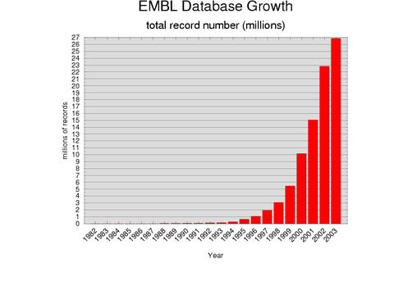
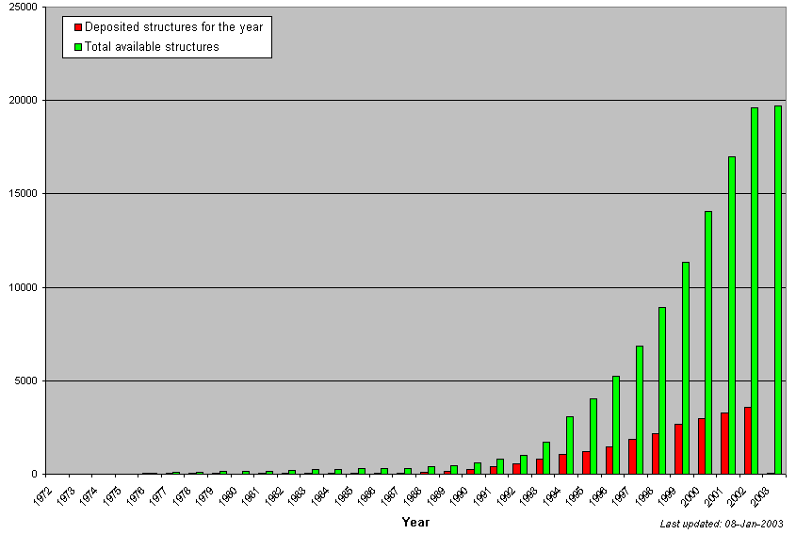
Database Growth
PDB Content Growth
DBs growing exponentially!!!
  Biobliographic (MedLine, …)
  Amino Acid Seq (SWISS-PROT, …)
  3D Molecular Structure (PDB, …)
  Nucleotide Seq (GenBank, EMBL, …)
  Biochemical Pathways (KEGG, WIT…)
  Molecular Classifications (SCOP, CATH,…)
  Motif Libraries (PROSITE, Blocks, …)

Slide 7













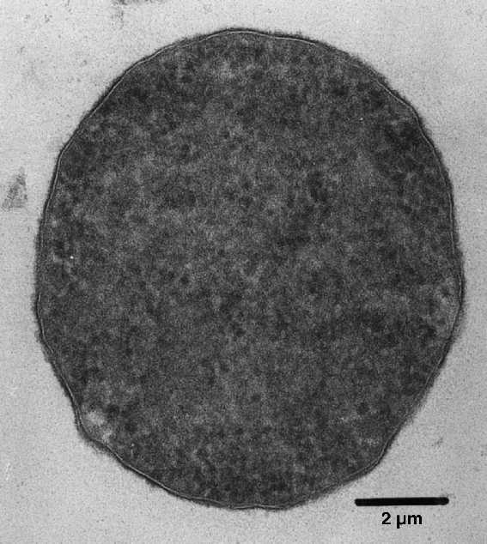














More genomes …...
Yersinia
pestis
Arabidopsis
thaliana
Buchnerasp.
APS
Aquifex
aeolicus
Archaeoglobus
fulgidus
Borrelia
burgorferi
Mycobacterium
tuberculosis
Caenorhabitis
elegans
Campylobacter
jejuni
Chlamydia
pneumoniae
Vibrio
cholerae
Drosophila
melanogaster
Escherichia
coli
Thermoplasma
acidophilum
Helicobacter
pylori
Mycobacterium
leprae
Neisseria
meningitidis
Z2491
Plasmodium
falciparum
Pseudomonas
aeruginosa
Ureaplasma
urealyticum
mouse
rat
Rickettsia
prowazekii
Saccharomyces
cerevisiae
Salmonella
enterica
Bacillus
subtilis
Thermotoga
maritima
Xylella
fastidiosa

Slide 8
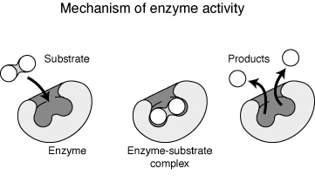
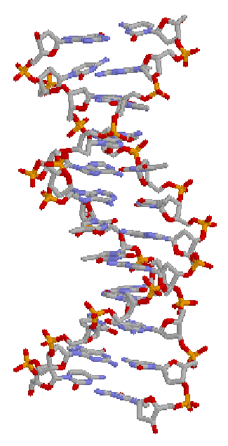
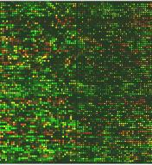
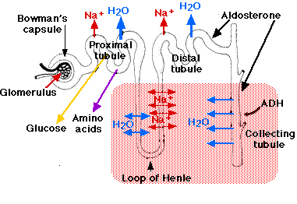
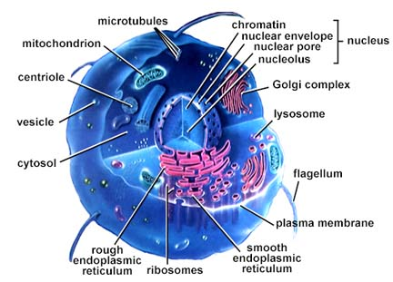
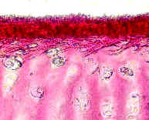
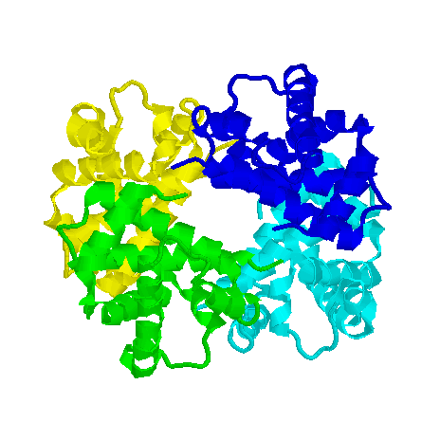
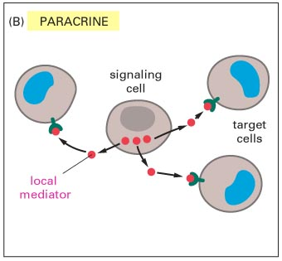
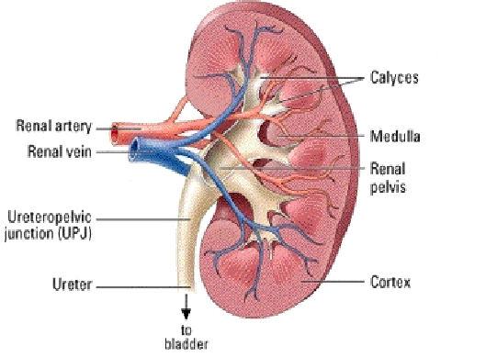

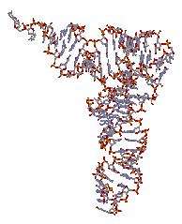
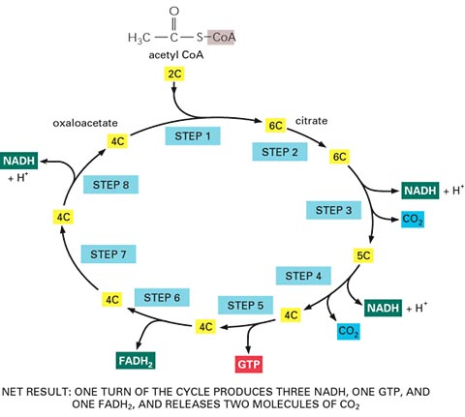
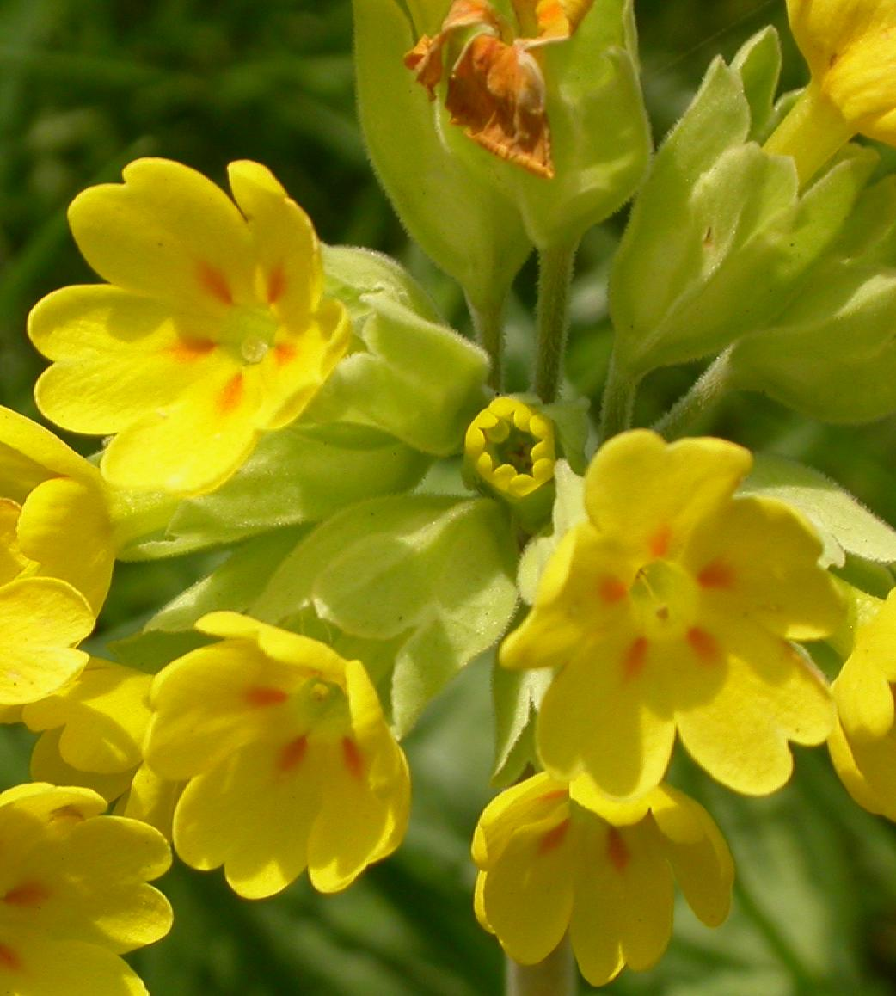
Complexity of Biological Data
Protein functions
Cell
Tissues
Organs
Protein Structures
Physiology
Organisms
Gene expressions
Populations
Nucleotide structures
Cell signalling
Nucleotide sequences
Protein-protein interaction (pathways)
+ links to plant/crops, environmental, health, … information sources

Slide 9
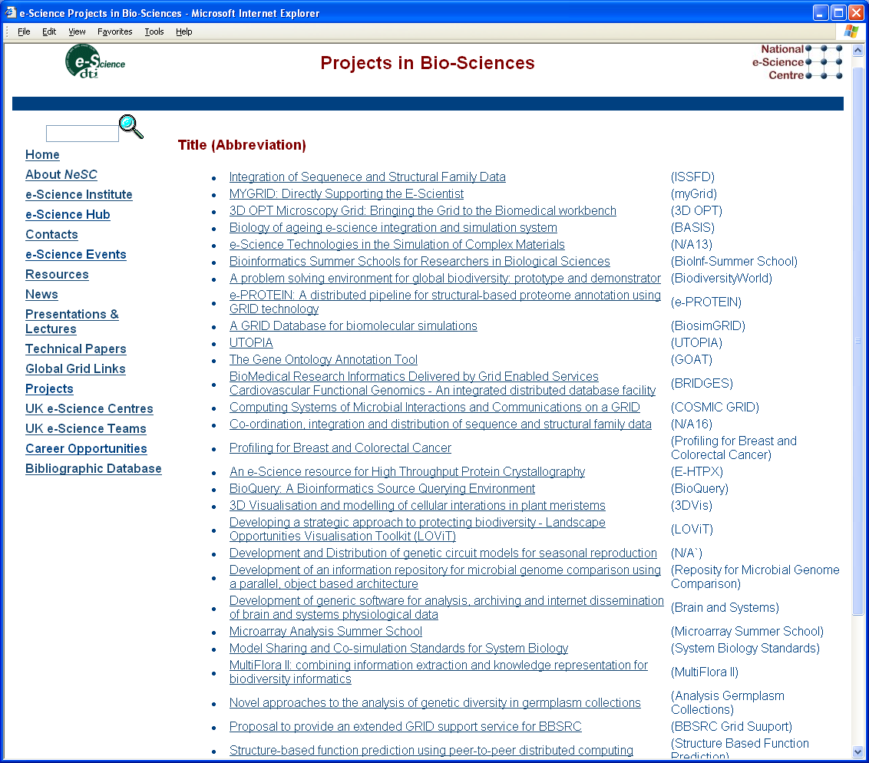
Bio e-Science Projects

Slide 10
Overview of BRIDGES
Biomedical Research Informatics Delivered by Grid Enabled Services (BRIDGES)
  NeSC (Edinburgh and Glasgow) and IBM
    www.brc.dcs.gla.ac.uk/projects/bridges
Supporting project for CFG project
  Generating data on hypertension
  Rat, Mouse, Human genome databases
Variety of tools used
  BLAST, BLAT, Gene Prediction, visualisation, …
Variety of data sources and formats
  Microarray data, genome DBs, project partner research data, medical records, …
Aim is integrated infrastructure supporting
  Data federation
  Security

Slide 11
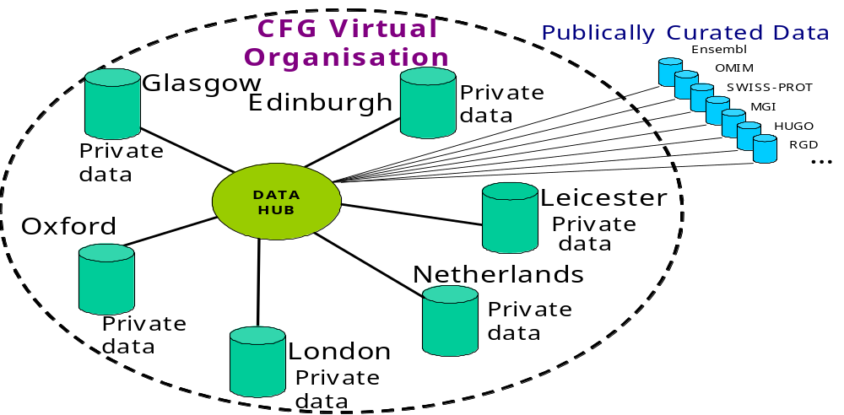
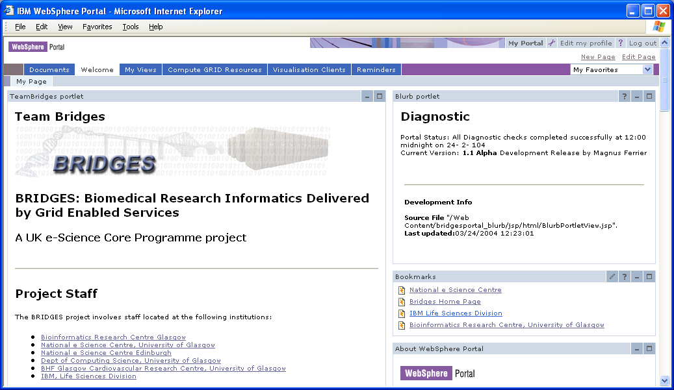
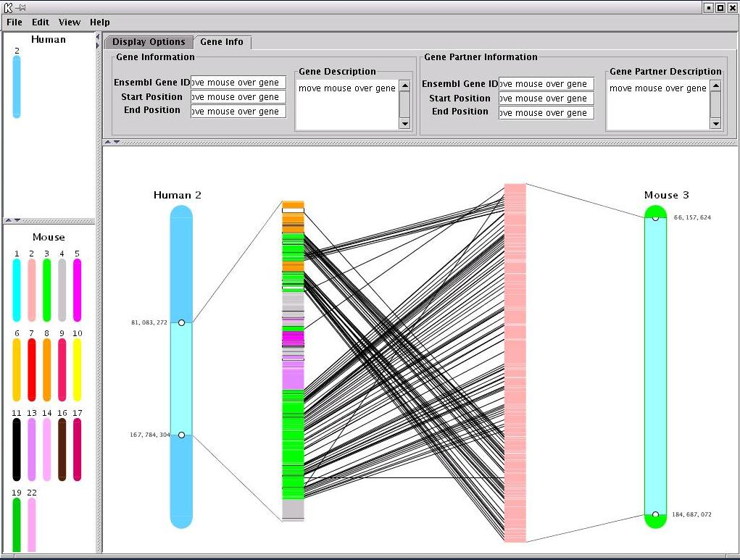
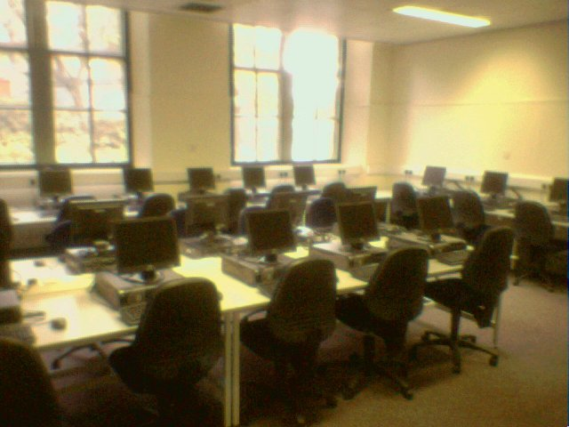
Bridges Project
SyntenyGrid Service
blast
+

Slide 12
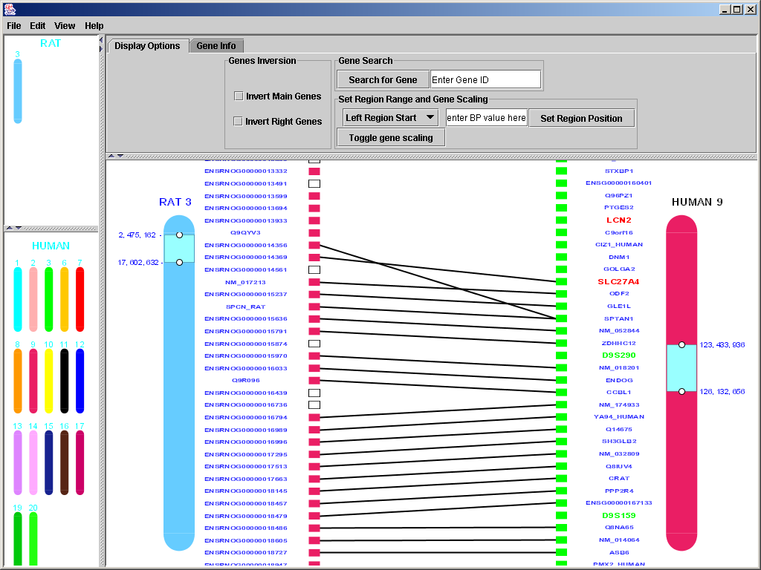
System Usage Scenario
Generic services
used by other
projects
Push relevant data onto ScotGrid for BLAST’ing
BRIDGES Portal
Secure access for CFG VO
Browser based clients…
Up to date results input to DB
Personalised
Services
Client
Site X
BLAST
MV
SV
OGSA-DAI
Secure Data
Repository
(DB2)
Shared/
Private
Data Sets
Authorisation
Per user, per site
Java App downloaded (via WebStart)
wrappers
IBM II
Data in DB2
Data in Flat files
Data in XML DB
Data in Oracle
SyBase, Excel…

Slide 13
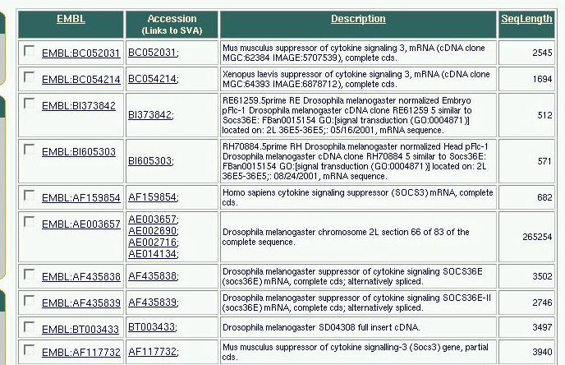
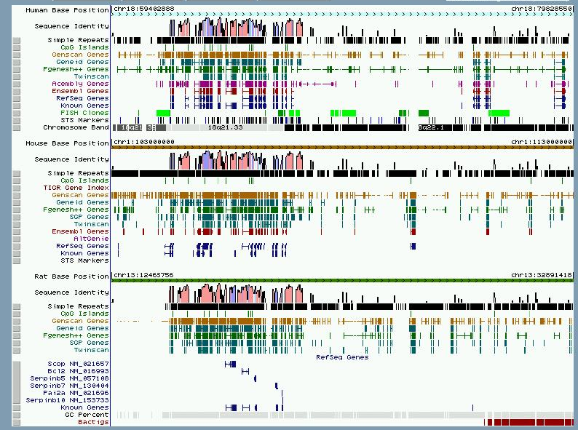
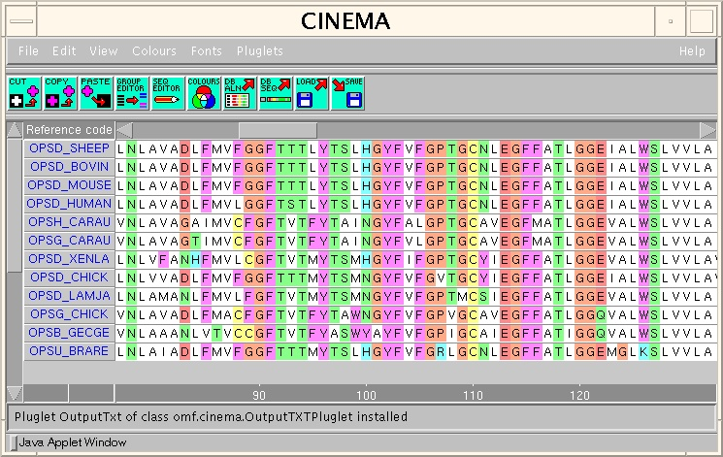
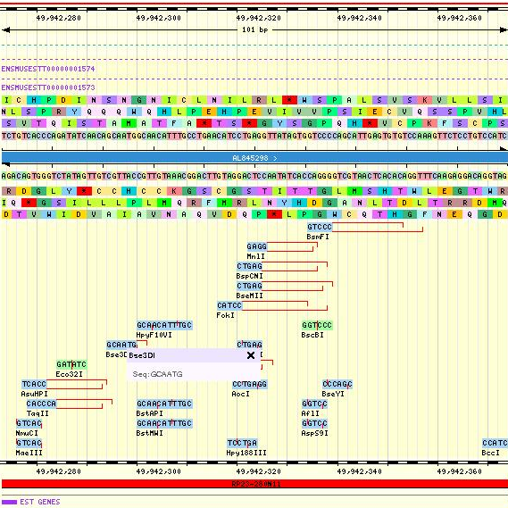
Future tools available via Portal
DRILL-DOWN
FUNCTIONS
To tabular
summaries
To sequence
To multiple
alignment

Slide 14
Grid Security
OGSA security
  Single sign-on based on (X.509) digital certificates
    establish credentials
      Certification authority based (RAL in UK)
  Services (and clients) have APIs for fine grained security
    Based on GSS-API
  Provides for authentication but need authorisation
    No standardised way of doing this right now!
  Collaborating with PrivilEge and Role Management Infrastructure Standards Validation (PERMIS) team
    Lead by Prof David Chadwick, University of Salford
      (www.permis.org)

Slide 15
Security Authorisation
PERMIS allows to
  Define roles for who can do what
  Based on Privilege Management Infrastructure certificates
  Users get certificate for what they are allowed to do
    Defines dynamic attributes for privileges
    Can user X invoke service Y and access or change data Z?
  Exploring prototype solutions from Globus (Von Welch) and PERMIS (Chadwick) teams
    Based on first implementation of GGF Security Assertion Markup Language AuthZ specification

Slide 16
Where we are today!
Information Integrator DB repository established and populated
  … with public data sets (OMIM, HUGO, RGD, SWISS-PROT)
  … linked to relevant resources (ENSEMBL- rat, human, mouse, MGI)
GT3 based Grid services developed (BLAST, …)
  General usage of ScotGrid and local Condor pool
Initial portal developed using IBM WebSphere
Genome visualisation browsers
  SyntenyVista – for viewing synteny between local/remote data sets
  MagnaVista – for exploring genetic information across multiple (remote) resources
Gaining experience with security technologies
  Setting up policies with Grid security authorisation software etc
Just rolled-out Alpha version of system to CFG group

Slide 17
Lessons learned
Public data resources openness
  Often cannot query directly
  Often not easy/possible to find schemas
  Joint Data Standards Study investigating this
    Starts on 1st June and involves
      Digital Archiving Consultancy
      Bioinformatics Research Centre (Glasgow)
      NeSC (Edinburgh and Glasgow)
    Look at technical, political, social, ethical etc issues involved in accessing and using public life science resources
      Will liase with NDCC
      Interview relevant scientists, data curators/providers
    8 month project with final report in January
      Funded by MRC, BBSRC, Wellcome Trust, JISC, NERC, DTI
GT3 not without pain! (… understatement!!!!)
  Hopefully GT4 will be better?

Slide 18
Summary
NeSC Glasgow establishing itself as leading centre in
  Grid Security
    Authentication, authorisation, usability
  Data access and integration
    Working closely with NeSC Edinburgh (OGSA-DAI, DAIT, ELDAS)
  Education
    Developing Grid Computing courses in advanced MSc at Glasgow
      DyVOSE project started 1st May
        Grids & security to the masses!
Life sciences focal point for NeSC Glasgow
  Close liaison with
    Bioinformatics Research Centre (Prof David Gilbert)
      Scottish Bioinformatics Research Network
        4 year project (£2.5M) to establish Grid infrastructure for Bioinformatics across Scotland
    Biostatistics (Prof Ian Ford)
      VOTES
        3 year project (£2.8M) to establish Grid infrastructure for clinical trials
…others?

Slide 19
demo...???

Slide 20
Questions?
www.nesc.ac.uk

