Slide 1
Introduction to Workflows and Use of Workflows in Grids and Grid Portals
Aleksander Slominski
(Dennis Gannon, Geoffrey Fox)
Indiana University

Slide 2
Goals
What is Workflow?
Positioning of Business and Scientific Workflows
Relation of Workflows And Portals
Use Of Workflows in Grids And Scientific Computing

Slide 3
Historical Perspective
‘70s: Skip Ellis And Michael Zisman
  Xerox Parc “Office Automation Systems”
“Representation, Specification, and Automation of Office Procedures” Zisman, PhD Thesis 1997
Over 20 years gap …
  Availability of Computer Networks
  Workflow (Business Process) was integral part of applications
“Workflow Management” Aalst, van Hee

Slide 4
Historical Perspective
’65-’75 Decompose Applications
  Data And Code Separated
’75-’85 Database Management
  DBMS Used To Share Data
’85-’95 User Interface Management
  UIMS User Interface Separated
’95-’05 Workflow Management
  Isolate Business Process
“Workflow Management” Aalst, van Hee

Slide 5
Workflow
“The automation of a business process, in whole or parts, where documents, information or tasks are passed from one participant to another to be processed, according to a set of procedural rules “
  Workflow Management Coalition

Slide 6
WFMS And WF Engine
Workflow Management System (WFMS)
  “A system that defines, creates and manages the execution of workflows through the use of software, running on one or more workflow engines, which is able to interpret the process definition, interact with workflow participants and, where required, invoke the use of IT tools and applications.”
Workflow Engine
  “A software service or "engine" that provides the run time execution environment for a process instance.”

Slide 7
Workflow Levels
Inside domain
  One unit/organization/Virtual Organization
Level Up Above
  Multiple Virtual Organizations
Global Model More dynamic More Grid …
  Global Model
  Global Process
  Peer-To-Peer
Orchestration …
Choreography …

Slide 8
Categories Of Workflows
Collaborative | Production
Ad Hoc | Administrative
Scientific
Business Value →
Repetition →
“Production Workflows” Leyman, Roller

Slide 9
Business Workflow
Driven by Business Process
  Allow controlled flow of execution and simplify workflow management (explicit vs. implicit)
Required support for security, reliability, transactions, and performance
  Solution to performance: buy faster server …

Slide 10
Workflow Lifecycle
Design
  Typical workflow is graph oriented
  Language: how expressive is workflow
  GUI: Visual Service Composition Environment
Deployment
  Workflow Description is sent to Workflow Engine
  Possibly validated and compiled
Execution
  Workflow Engine enacts Workflow Description
Monitoring
  Events reflecting from workflow and services execution
Refinement

Slide 11
Workflow Usage Concerns
  Constructs supported
    Expressiveness of Programming Language
  Ease of creation and modification by non programmers (GUI)
  Extensibility
  Ease of Integration
  Support for Standards
  Support for Web Services
  Support for Grid, GT2, OGSI
  Ease of Use (Very subjective …)
  Status, Availability
  Licensing, Price
  …

Slide 12
Orchestration and Web Services
WSFL
  IBM: Web Services Flow Language, May 2001
XLANG
  Microsoft, May 2001
GSFL
  Grid Services Flow Language, July 2002
WSCL / WSCI/ W3C WS Choreography WG
  HP WS Conversation Language, March 2002
  Web Service Choreography Interface, August 2002
    BEA, SAP, Sun, Intalio
BPEL4WS / OASIS WSBPEL
  Replaces WSFL and XLANG, August 2002

Slide 13
BPEL4WS
OASIS WSBPEL group:
    BEA, Choreology Ltd, Collaxa, EDS, HP, IBM, Intalio, NEC, Novell, Microsoft, Oracle, SAP, Sun, Sybase, Workflow Management Coalition (WfMC), and many more ...
Unique merge of two different paradigms
  XLANG: hierarchical structure with specialized control constructs
  WSFL graph structure with control patterns based on transition and join conditions.

Slide 14
BPEL4WS Overview
Specifies how to connect multiple web service to provide new web service
The same language is defined to define executable and abstract process (contract)
Executable process describes everything needed to execute workflow
Abstract process describes required observable behavior of workflow based on message exchange (this allows to verify contracts between business partners)
Provide support for basic Web Service activities: invoke, receive, reply
Implicit lifecycle: workflow process instance is created when a message is marked as "start" and arrives to workflow engine

Slide 15
Scientific Workflow
What makes it different (how it is applied)?
  Support for large data flows
  Need to do parameterized execution of large number of jobs
  Need to monitor and control workflow execution including ad-hoc changes
  Need to execute in dynamic environment where resources are not know a priori and may need to adapt to changes
  Hierarchical execution with sub-workflows created and destroyed when necessary
Science Domain specific requirements…

Slide 16
Forces / Players
Users
  Portals (Problem Solving Environments)
Grid Resources
  Web Services, Grid Services
Need to “program Grid”
  Discover, orchestrate, and monitor multiple services
Ideal place for workflow …

Slide 17

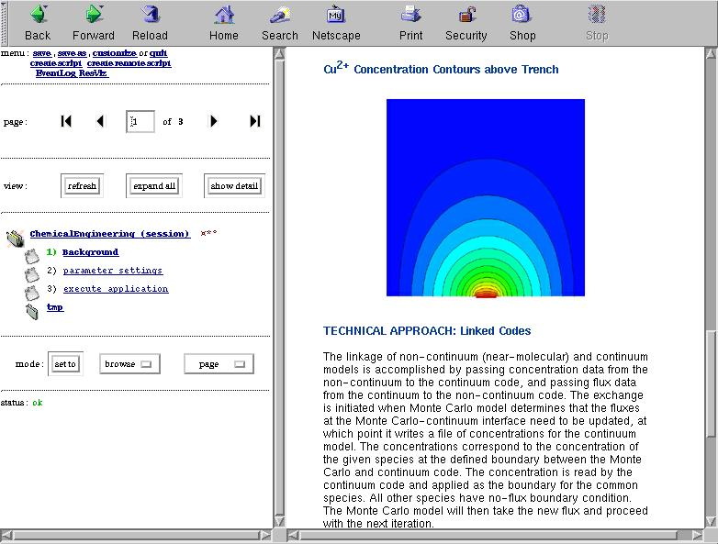
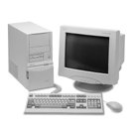

The Big Picture
Launch, configure
And control
  Orchestration Service
Workflow Engine
User Portals/ Science Portals
Workflow Instance
Workflow Instance
Workflow Instance
Application Services Layer
OGSI / OGSA
(co-)scheduling
Service
Peer Creation
& resolution
Services
Information/
Naming
Services
Discovery
service
Security
Service
Accounting
Service
Information
Routing
User Help
Services
Monitoring
Service
Event/Mesg
Service
Resource layer
1000s of PCs ->massive supercomputers

Slide 18
Workflows And Portals
Provide view on Grid Resources and Tools to Use Them to do scientific tasks
Jetspeed portlet based portals
  Alliance Portal: NCSA, IU, Utah, ANL
  http://www.extreme.indiana.edu/alliance/
  NMI Portlet Middleware just started
GAT GridSphere
  http://www.gridsphere.org
JSR 168 Portlet API
  Industry standard with wide support

Slide 19
Projects Snapshots
To give a feeling what is out there.
For each workflow product
  One slide with highlights
  Second slide with information about Ease-of-use, Standards implemented, Availability, Tooling, Interoperability, Supports For Monitoring, Portal Integration, License
Disclaimer: Information is accurate to the best knowledge of the author
  It is moving target and online documentation is sometimes not reflecting current status

Slide 20
Projects Overview
Focus: Grids And Workflows
Programs: in Java, C, C++, …
Scripts: Perl, Python
Condor DAGMan
Apache Ant
Chimera
Experiments with WS standards
  WSFL
  BPWS4J
myGrid
GAT
…

Slide 21
Condor DAGMan
Based on Direct Acyclic Graph (DAG)
  Describes inter-dependencies between jobs
  PRE & POST scripts
  Throttling
Does not deal with either Web or Grid based services (yet?)
Job A
Job B
Job C
Job D
  # diamond.dag
  Job A a.sub
  Job B b.sub
  Job C c.sub
  Job D d.sub
  Parent A Child B C
  Parent B C Child D

Slide 22
Condor DAGMan Snapshot
Ease-of-use: Simple DAG
Standards: Simple DAG
Availability: Integrated with Condor
    http://www.cs.wisc.edu/condor
Tooling & Interoperability: Limited to Condor
Monitoring: Condor
Portal Integration: Soon
Source code available under GPL

Slide 23
Chimera
Chimera Virtual Data System (VDS) part of the Grid Physics Network (GriPhyN)
Provides on-demand data generation (so-called "virtual data")
Data provenance
  Track all aspects of data capture, production, transformation, and analysis
Pegasus planner uses Condor DAGMan meta-scheduler
    receives an abstract workflow (AW) description from Chimera, produces a concrete workflow (CW), and submits it to DAGMan for execution

Slide 24
Grid ANT
Idea: add to Apache Ant Grid related tasks and runtime extensions
  Make ANT script more procedural
Usage modes:
  Script is executed locally and controls remote jobs
  Script is execute remotely
Joined separate efforts
  NCSA Open GCE Runtime Engine (OGRE)
  ANL Grid Ant

Slide 25
Grid ANT Snapshot
Ease-of-use: Simple build.xml
Standards: ANT is “de facto” standard
  To build java code and much more …
Availability: Apache and extended ANT runtime
  Upcoming official site
Tooling & Interoperability: Limited to Java
  Tasks are describe in XML but ANT build.xml is not standard
Monitoring: OGRE integrates events service
Portal Integration: Not Available (yet)
  By hand

Slide 26
myGrid (UK)
Focus on the Bioinformatics domain
Workflow component
  Initially based on subset of WSFL
  XScufl: XML Scufl (Simple Conceptual Unified Flow Language)
  Parts:
    Freefluo reusable orchestration framework
    Taverna implements Scufl with GUI to build workflow
    Talisman web based user interface
Focus on semantic service composition

Slide 27
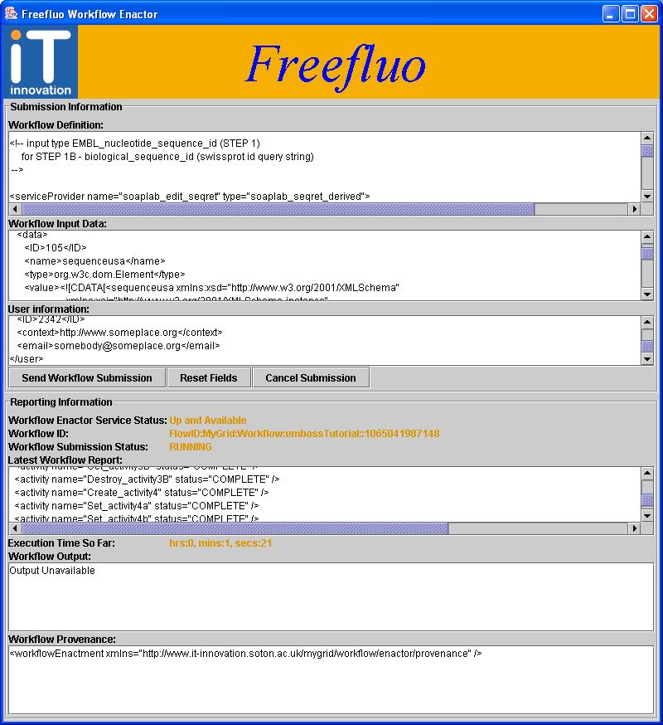
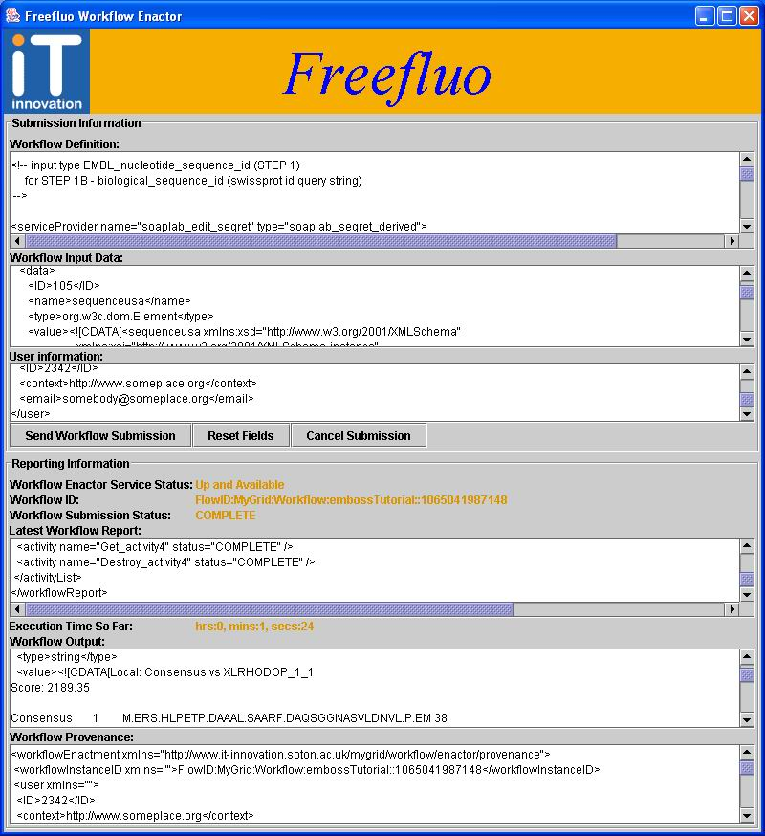
Freefluo with WSFL

Slide 28
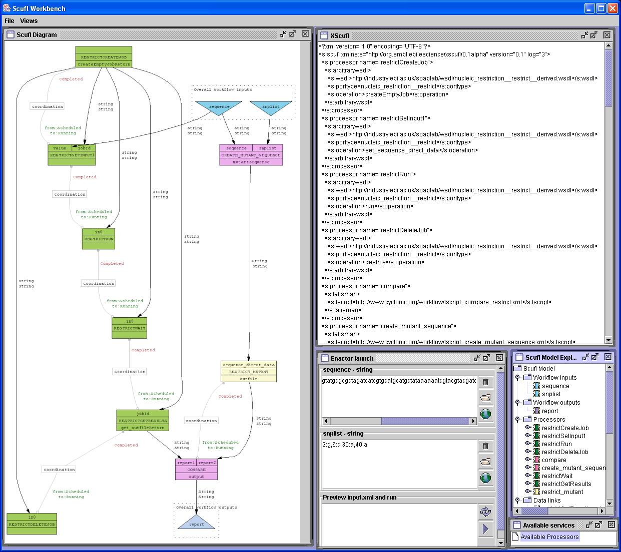
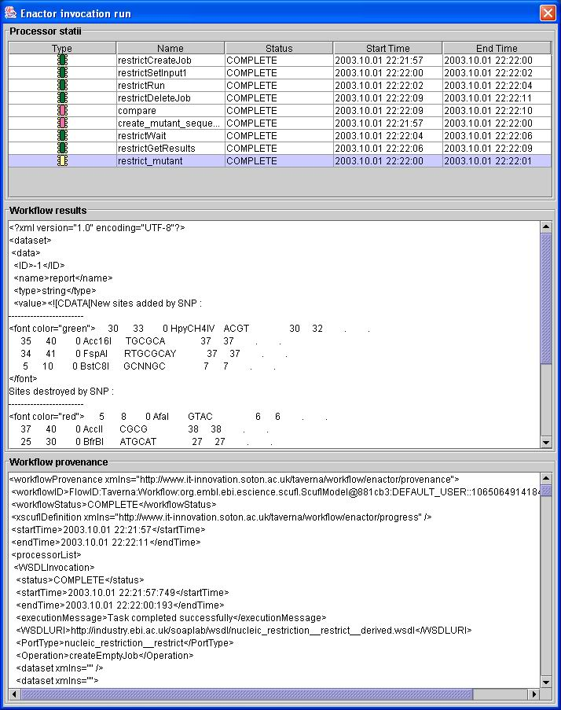
Taverna: (X)Scufl Workbench

Slide 29
myGrid (UK) Snapshot
Ease-of-Use: Integrates with multiple tools
Standards:
  subset of WSFL (no longer developed)
  (X)Scufl (Simple Conceptual Unified Flow Language)
Availability: part of myGrid
Tooling: GUI editor, web front-end (Talisman)
Interoperability: Limited to myGrid, WSFL gone
Monitoring: integrates with myGrid provenance (and logging?)
Portal Integration: limited (Talisman)
Source Code Available under LGPL

Slide 30
Triana GridLab (EU)
GridLab Work Package 3 (WP3) Triana
  Workflow is represented in XML WSFL-like format
  Nice Java GUI and simple to use execution runtime with master/worker
  Triana Grid Application Toolkit (TGAT) goals:
    “Execution model to include heterogeneous modules executing on remote machines in different languages with automatic compilation”
    “Integrate or extend an existing wrapper generator (such as SWIG, JCI or the XML based wrapper developed at the Dept. Computer Science, Cardiff) to interface with native codes”
  Plans to “develop metadata associated with main data flows e.g. history of processing, duration and cost of execution. Standardize metadata into a common XML format and interface to databases of data, programs, and scripts that use metadata
  Uses JXTA via a high-level application API called JXTAServe to be extended to support GAT Grid Services API
Work in progress (Prototype described in PDF)
  http://www.gridlab.org/WorkPackages/wp-3/intro.html

Slide 31
More projects
Service Workflow Language (SWFL) Cardiff University
  Extends WSFL by supporting programming constructs, such as (parallel) loops and conditional execution, more general data link mappings
  Integrated with Triana?
BioOpera (CS Department of the Swiss Federal Institute of Technology)
  Domain specific solution (another plain text workflow language)
  Recently added extension to execute WSDL described operation

Slide 32
Projects, projects, …
DiscoveryNet
  Discovery Process Markup Language (DPML) which allows the definition of data analysis tasks to be executed on distributed resources
Semantic Workflow Composition
  go to Semantic Grid http://www.semanticgrid.org
And many more …
  Working on survey – please send pointers
  http://www.extreme.indiana.edu/swf-survey/

Slide 33
Conclusion?
Fast moving target
  Web Services
  Grids
What is available now?
What are common features?
And differences?

