Slide 1
The National Virtual Observatory: Publishing Astronomy Data
Robert J. Hanisch
US National Virtual Observatory
Space Telescope Science Institute
Baltimore, MD USA
Reagan Moore
San Diego Supercomputer Center

Slide 2
Topics
Virtual Observatory description (VO)
Discovery Services
Data Management Services
Interactions with the GGF
  Astrophysics Research Group

Slide 3
The Virtual Observatory
“The Virtual Observatory will provide a ‘virtual sky’ based on the enormous data sets being created now and the even larger ones proposed for the future. It will enable a new mode of research for professional astronomers and will provide to the public an unparalleled opportunity for education and discovery.”
—Astronomy and Astrophysics
in the New Millennium

Slide 4
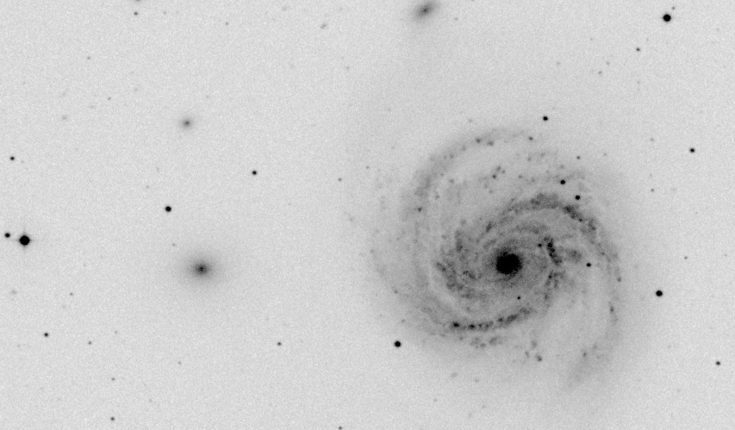
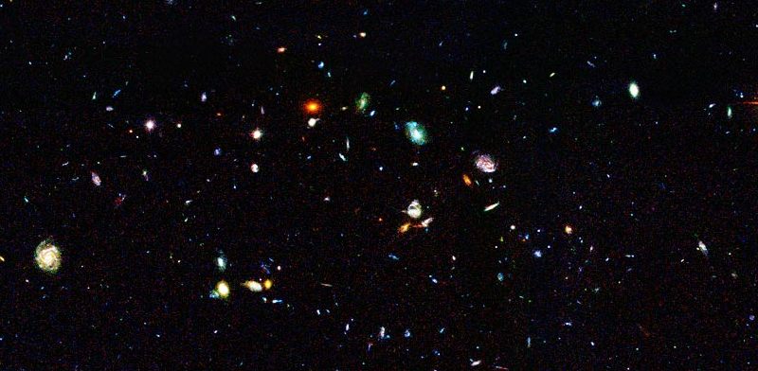
Astronomy is Facing
a Data Avalanche
Multi-Terabyte (soon: multi-Petabyte) sky surveys and archives over a broad range of wavelengths
1 microSky (DPOSS)
Billions of detected sources, hundreds of measured attributes per source
1 nanoSky (HDF-S)

Slide 5
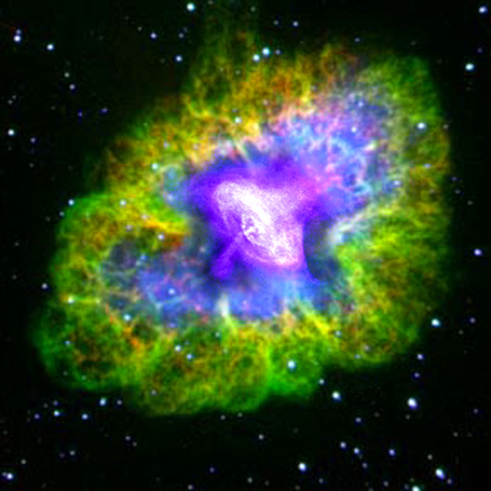
Composition of Results from Multiple Collections
…reveals
a more complete
physical picture
The resulting
complexity of
data translates
into increased
demands for
data analysis,
visualization, and
understanding

Slide 6
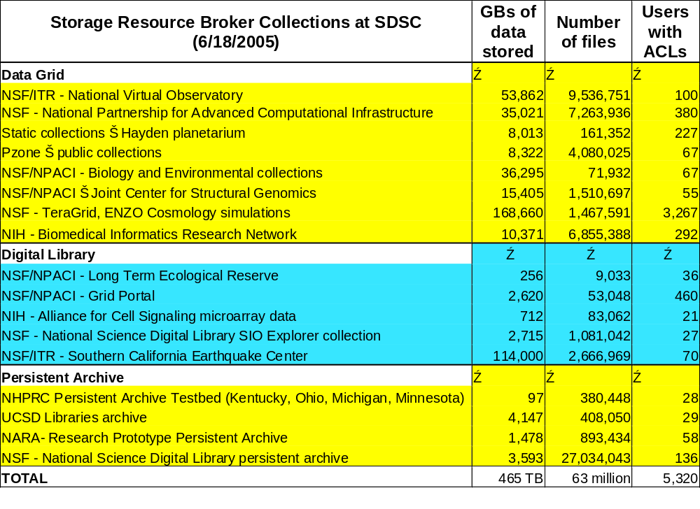

Slide 7
Large-scale Synoptic Survey Telescope
LSST will take pictures of the entire observable sky every 3 days
  Compare images to detect changes
    Asteroids - sizes down to 250 meters
    Micro-lensing events - structure of dark matter
    Supernovae
  Expect to generate 100 PBs of data
  Expect to sustain over 50 TeraFlops computation
Distributed architecture
  Processing at telescope (14,000 feet, perhaps Chile)
  Processing at base station (perhaps Chile)
  Processing in the US

Slide 8
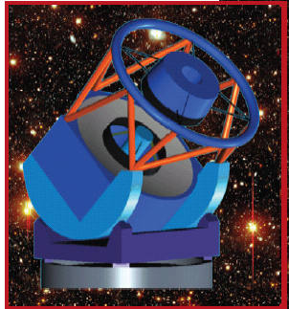
An overview of the Large Synoptic Survey Telescope
Jim Brase, LLNL
8.4 meter aperture telescope surveying the full sky every 3-4 nights to visual magnitude 23-24
Primary missions are to study dark energy - dark matter, transient universe, outer solar system and near-earth> objects (NEO)
> 13 TB / night
> 100 PB over its 10 year mission
Event detections on the Web in < 1 minute
Pioneering new way of doing science – mining petabyte image databases
First light January 2012

Slide 9
Publication of Results
What does it mean to publish large scientific collections?
Requirements include:
  Authenticity and integrity, the characterization of the source of the material and an assurance that the data is uncorrupted
  Discovery mechanisms to identify sets of appropriate data
  Access mechanisms to support expected usage patterns and analyses

Slide 10
Research Problems that Drive Publication Requirements
Statistical astronomy done right
  Precision cosmology, Galactic structure, stellar astrophysics …
  Discovery of significant patterns and multivariate correlations
  Access to observations from multiple collections
Systematic exploration of the observable parameter spaces
  Searches for rare or unknown types of objects and phenomena
  Low surface brightness universe, the time domain
  Confronting massive numerical simulations with massive data sets
  Access to large portions of a collection

Slide 11
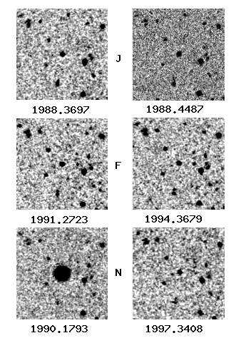
Comparison of Images within Large Collections
Megaflares on normal main sequence stars (DPOSS)

Slide 12
Scientific Data Publication
Standard vocabulary
  Uniform content descriptors for all physical variables registered in astronomy catalogs
Standard data format
  FITS encoding format for astronomy images
Standard services for accessing collections
  Simple image access service
  Cone search for catalog access
  Sky query node for distributed search across catalogs
Enable large-scale applications
  Support access to tens of terabytes of data and millions of catalog entries

Slide 13
Data Publishing Roles
(who is using the system?)
Roles
Authors
Publishers
Curators
Consumers
Traditional
Scientists
Journals
Libraries
Scientists
read->analyze
Emerging
Collaborations
Project www site
Massive Archives
Scientists & public
query-> analyze

Slide 14
Interactions with Publishers
Provide validation of tabular digital data submitted to astronomy journals
  Validate semantics - Uniform Content Descriptors for each table column
  Validate coordinates for each named object
  Check consistency of coordinates across objects
  Aggregate data into a common catalog for future queries - CDS
  Provide an archive of tabular data
    Current size is about 5 billion records

Slide 15
Interactions with Publishers
Validate image data submitted to astronomy journals
  Validate encoding format - FITS
  Check semantic terms in the FITS header
    Naming conventions for coordinates, resolution, wavelength
  Check consistency of header variables
  Support archiving of the original image
    Build consistent collection of all images published
    Cross correlate to other images of the same object
    Current aggregate survey size is about 50 Terabytes (50,000 Gbytes)

Slide 16
Virtual Observatory Publication Services
A suite of international standards for the discovery, exchange, intercomparison, and analysis of network-accessible astronomical data
A data access and analysis environment that exploits the emerging computation/software/data Grid
A framework for data processing that enables and encourages the re-use of algorithms
A tool for astronomy research
A catalyst for world-wide access to astronomical archives
A vehicle for education and public outreach

Slide 17
Types of Grid Services
VOTable - standard table structure for data from catalogs
Conesearch - retrieve entries from an object catalog that are spatially located within a circle mapped on the sky
Simple Image Access Protocol - retrieve an image from an image archive, cropped to the desired size
Simple Spectrum Access Protocol - retrieve a spectrum from a catalog
Skyquery - distribute queries across multiple object catalogs, join results
Mosaic service - create composite of multiple images

Slide 18
Data Management Services
VOStore - interface for simple get, put of files from an image archive
VOSpace - data management interface for assembling uniform name spaces across multiple image archives
Uniform Content Descriptors - standard naming conventions for all physical quantities in catalogs
VO Ontology - relationships between the UCDs, also a time-space coordinate ontology for astronomy

Slide 19
International VO Alliance
The IVOA brings together the astronomers, developers, and managers of the VO initiatives world-wide
  Agreements on standards for data access (VOTable, catalog queries, image retrieval, resource descriptions, etc.)
  Coordination of development activities
  Sharing of software and experience
  International policies on data sharing and publication
13 participating organizations: Astrogrid, AVO, US-NVO, VO-Australia, VO-Canada, VO-China, VO-France, VO-Germany (GAVO), VO-India, VO-Italy (DRACO), VO-Japan, VO-Korea, VO-Russia
http:www.ivoa.net

Slide 20
Data Management Approaches in Scientific Disciplines
Data Grids
  Focus on shared collections that may be distributed across multiple sites
Digital Libraries
  Provide discovery and display services for scientific collections
Persistent Archives
  Assert authenticity and integrity of collection while underlying systems evolve

Slide 21
NVO Digital Library Interactions
Dublin Core metadata standard
  Describe provenance of all objects
Open Archives Initiative - Protocol for Metadata Harvesting
  Used to populate service registry
Carnivore v 1.0 service registry
  Register all of NVO services
  http://mercury.cacr.caltech.edu:8080/carnivore
DSpace - digital library
  Port of top of data grids for distributed data management
Fedora - digital library

Slide 22
Characteristics
Standard vocabularies, data formats, services
Collection management
  Descriptive, administrative metadata
  Access controls on creation of data, metadata, annotations
  Audit trails, versions, locking, pinning, containers
Distributed data
  Data created at multiple sites
  Data used at multiple sites
  Replicas at multiple sites
Persistence
  All systems must manage technology evolution
Federation
  Sharing of data between independent collections

Slide 23
Questions
Reagan W. Moore
moore@sdsc.edu
http://www.sdsc.edu/srb/

