Slide 1
Data Architecture Strawman - Grimshaw
Important points
Everything is a service (object)
  All have a name (EPR) and an interface (type)
One or more base types
  stream, byte_vector, directory, cache, file container, authorization_server, stored_procedure, RDBMS, etc.
  Derived types such as parallel file, replicated file, read_only file possible
Multiple levels of abstraction to users
  High-level standard interfaces for low activation energy
  Direct access for performance
Management control and site autonomy are REQUIREMENTS

Slide 2
Avaki Data Grid 4.0
A single, integrated system to provision, access and integrate distributed data
A data service layer for connecting multiple, federated data sources to applications
  Single service
  Abstracts underlying data sources
  Framework for executing actions on data
Access
Integration
Provision
DATA GRID

Slide 3
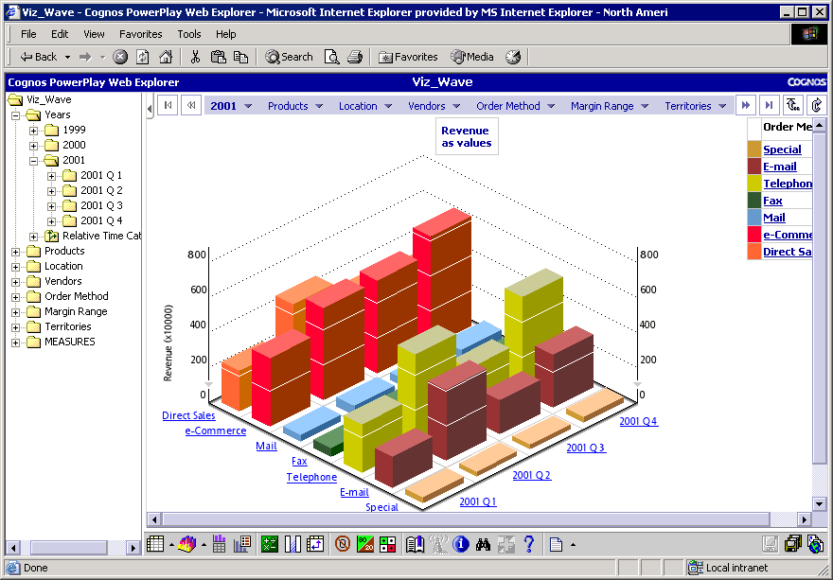
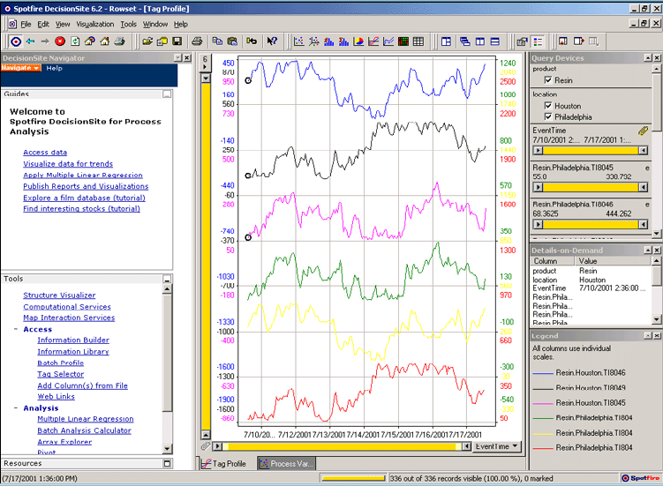
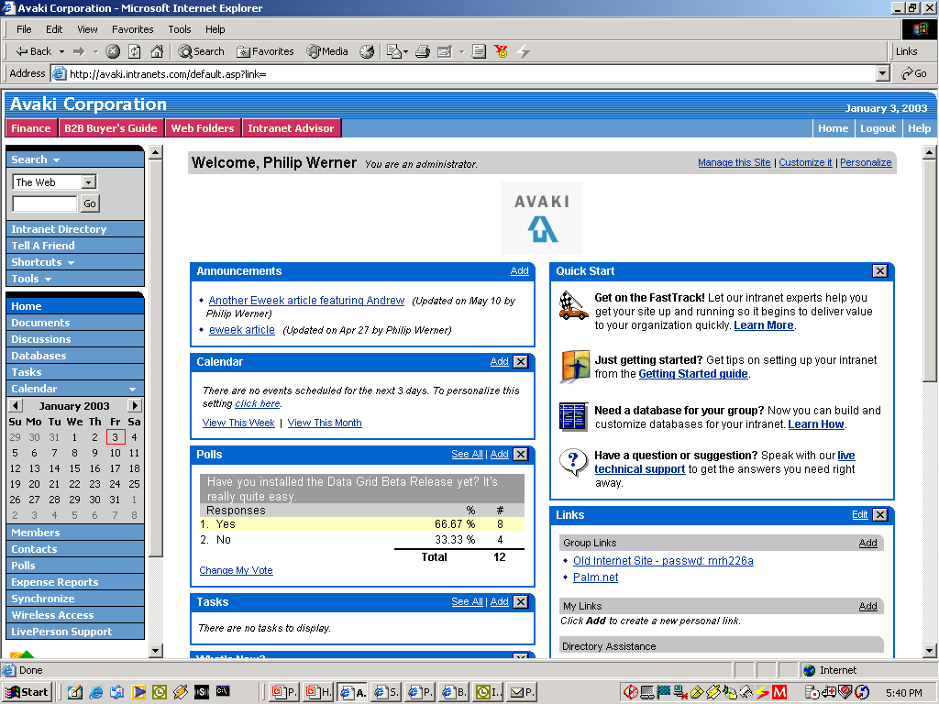

Data Services Framework – Three Layer Architecture
ETL
Data
Catalog
Access
Profiling & Quality
XML Mapping
Integration
Development Tools
Metadata Registry
Provision
Distributed Query
DATA GRID
Additional & 3rd Party Data Integration Capabilities
Core “Data Service Layer”

Slide 4
Data Services
Core Data Services
  Single data service – hides interfaces & security of many data sources
  Caching – speed data access – protect source
  Data Catalog – find, invoke, and track data
  Security – single sign-on
Additional Data Services
  Data execution “framework”
    Data as Web services or Java objects
    Data flows
    Data aggregation & transformation through XML/XSL
  Data “entities” – coarse grain abstraction of multiple data elements
    Customer, order, entities, etc.
  Third-party data tools – ETL, profiling, cleansing XML schema

Slide 5
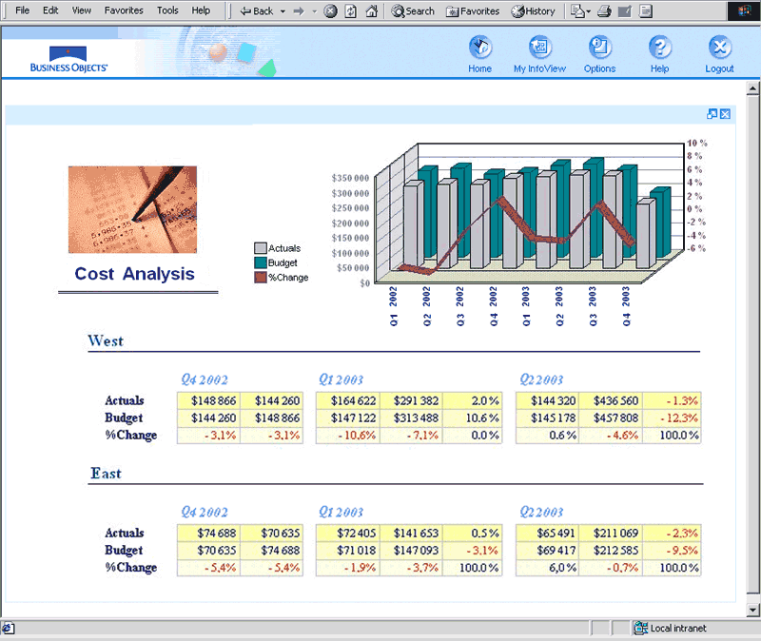
Data Provisioning
  “Publish” any relational data, files, XML, and application data sources
    Federated data service across heterogeneous, distributed sources
    Unified data catalog
    Data remains local & local ownership
    Files shared from source location
    SQL statements, stored procedures
    Application data via HTTP or Java classes
  Control access with one unified system
    Data owners control access rights at data object level
    Integration with multiple, heterogeneous authentication services (LDAP, Microsoft Active Directory, NIS)
Access
Integration
Provision
DATA GRID
Data Sources

Slide 6
Data Access
  Simplified access to federated data
    Unified view of all available data provides a single service for retrieving all data objects
    SQL result sets, XML views, files, application data sources
    Access data anywhere as if it were local
    Read and write
    Caching speeds performance
  Standard Access
    ODBC
    JDBC
    File read/write – NFS, WinFS
    Web Services/SOAP
    JSP/Tag library
  “Drill Down”
    For performance
UNIX
App
Win32
App
BI App
Portal/
Dash-
board
NFS
WinFS
ODBC/
JDBC
JSP
Access
Integration
Provision
AVAKI DATA GRID
Data Sources

Slide 7
Data Integration
  Data manipulation
    Transformers
  Multiple data sources into a single view
  Transform data formats
    Technical and semantics
  Schedule and trigger transformations
  Link and trigger transformations for automated data flows
UNIX
App
Win32
App
BI App
Portal/
Dash-
board
NFS
WinFS
ODBC/
JDBC
JSP
Access
Integration
Provision
AVAKI DATA GRID
Data Sources

