Slide 1
Web services and genome annotation in GRID by DNA Data Bank of Japan (DDBJ)
Center for Information Biology and DNA Data Bank of Japan
National Institute of Genetics
Hideaki Sugawara and Satoru Miyazaki
hsugawar@genes.nig.ac.jp
smiyazak@genes.nig.ac.jp

Slide 2
Contents
Background and motivation
SOAP servers by DDBJ
Web services by DDBJ
A work flow
GRID test-bed

Slide 3
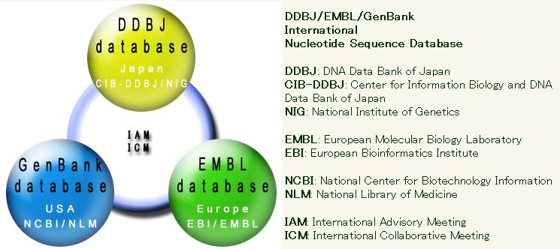
The International Nucleotide Sequence Database (INSD): DDBJ/EMBL/GenBank

Slide 4
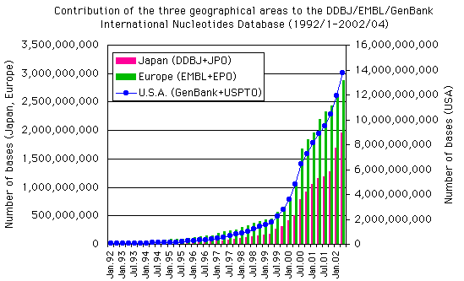
Number of bases (atgc) in INSD
Mouse genome draft sequencing
Human genome draft sequencing
ABI PRISM3700
1,000 for 250 labs

Slide 5
Genome projects and biodiversity studies are going on
US Europe Japan Others
Archaea １１ ４ ２ １
Procaryote １６８ ６３ １２ １４
Eucaryote １１２ ５４ ６ ３
Ref http://wit.integratedgenomics.com/GOLD/
Environmental sequences in INSD
2002/09 97,512 entries
2002/11 107,936 entries
2003/02 149,284 entries

Slide 6

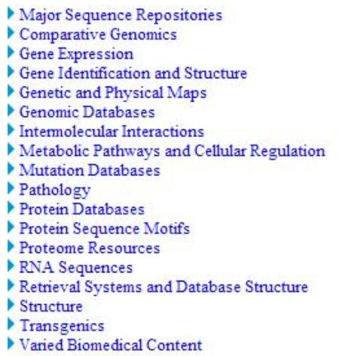
www3.oup.co.uk/nar/database/c/

Slide 7
A mission of DDBJ
Biological data resources are diverse
Some biological data resources are very large scale databases (VLSD)
Diverse requirements to integrate these biological data resources
To contribute to the interoperability of biological data resources

Slide 8
Integration of distributed diverse
data sources by use of CORBA & XML
Internet
file a
XML file
CSV file
Local DB (XML file)
tool i
Remote DB
e-Workbench
file b
tool j
XML file
public server
laptop
: CORBA (Common Object Request Broker Architecture)

Slide 9
DDBJ-XML

Slide 10
DDBJ entry
LOCUS AK025000 2589 bp mRNA HUM 29-SEP-2000
DEFINITION Homo sapiens cDNA: FLJ21347 fis, clone COL02724.
ACCESSION AK025000
VERSION AK025000.1
KEYWORDS oligo capping; fis (full insert sequence).
SOURCE Homo sapiens colon cDNA to mRNA, clone_lib:COL clone:COL02724.
ORGANISM Homo sapiens
Eukaryota; Metazoa; Chordata; Craniata; Vertebrata; Euteleostomi;
Mammalia; Eutheria; Primates; Catarrhini; Hominidae; Homo.
REFERENCE 1 (bases 1 to 2589)
AUTHORS Sugano,S., Suzuki,Y., Ota,T., Obayashi,M., Nishi,T., Isogai,T.,
Shibahara,T., Tanaka,T. and Nakamura,Y.
TITLE Direct Submission
JOURNAL Submitted (29-AUG-2000) to the DDBJ/EMBL/GenBank databases. Sumio
Sugano, Institute of Medical Science, University of Tokyo,
Laboratory of Genome Structure
- - - - - - -
FEATURES Location/Qualifiers
source 1..2589
/clone="COL02724"
/clone_lib="COL"
/note="cloning vector pME18SFL3"
/organism="Homo sapiens"
/sequenced_mol="cDNA to mRNA"
/tissue_type="colon"
CDS 18..2378
/codon_start=1
/protein_id="BAB15051.1"
/translation="MLGARAWLGRVLLLPRAGAGLAASRRGSSSRDKDRSATVSSSVP
- - - - - - -
SFLSRQLPFLSTLRRLEDQATAYVCENQACSVPITDPCELRKLLHP"
BASE COUNT 529 a 797 c 773 g 490 t 0 others
ORIGIN
1 atcggccccg agcagccatg ctgggcgcgc gggcctggtt gggccgcgtc cttctgctgc
- - - - - - -
annotation
protein sequence
DNA sequence

Slide 11

The data structure
The DDBJ/EMBL/GenBank Feature Table: Definition
  Feature key: e.g. CDS (coding sequence; sequence of nucleotides that corresponds with the sequence of amino acids in a protein; ---)
  Qualifier: e.g. /gene (symbol of the gene corresponding to a sequence region)
  Value, e.g. “text”
Taxonomy Database

Slide 12
ex. CDS of DDBJ/EMBL/GenBank AB000100
FF（Flat File）format
CDS 121..912
/gene="cynB"
/codon_start=1
/transl_table=11
/product="intrinsic membrane protein"
/protein_id="BAA21794.1"
/translation="MVRTPVPLYLRWAVSILSVLAFLAIWQIAAASGFLGKTFPGSLR
TLQDLFGWLSDPFFDNGPNDLGIGWNLLISLRRVAIGYLLATVVAIPLGIAIGMSALA
----------“
XML document
<cds>
<location>121..912</location>
<qualifiers name="codon_start">1</qualifiers>
<qualifiers name="gene">cynB</qualifiers>
<qualifiers name="product">intrinsic membrane protein</qualifiers>
<qualifiers name="protein_id">BAA21794.1</qualifiers>
<qualifiers name=“translation”>MVRTPVPLYLRWAVSILSVLAFLAIWQIAAASGFLGKTFPG
SLRTLQDL --------- LLDQGFRFLENQFSYAGNR</qualifiers>
<qualifiers name="transl_table">11</qualifiers>
</cds>

Slide 13
DDBJ SOAP

Slide 14
DDBJ SOAP servers
BLAST (homology search)
FASTA (homology search)
SSearch(Smith-Waterman homology search)
GetEntry (retrieve entries by Acc#s)
DDBJ (get the DDBJ full entry and extract
some Features)
ClustalW (multiple alignment)
SRS (Sequence Retrieval System)
TxSearch (Taxonomy database Search)

Slide 15
DDBJ WSDL

Slide 16
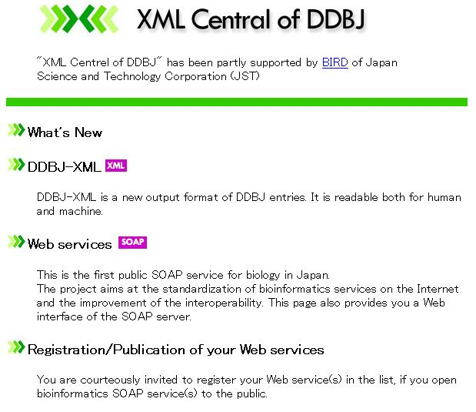

Slide 17
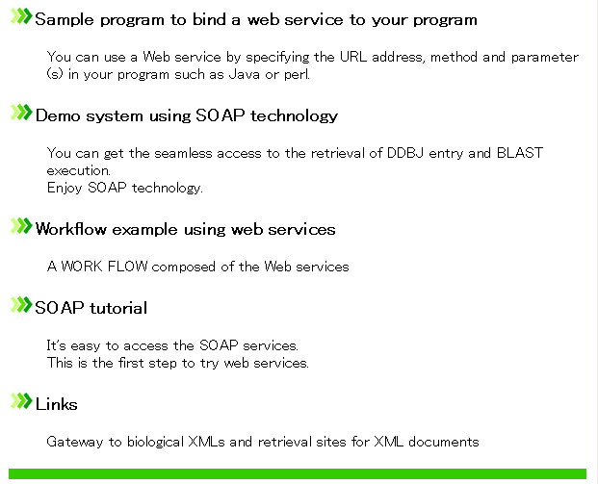

Slide 18
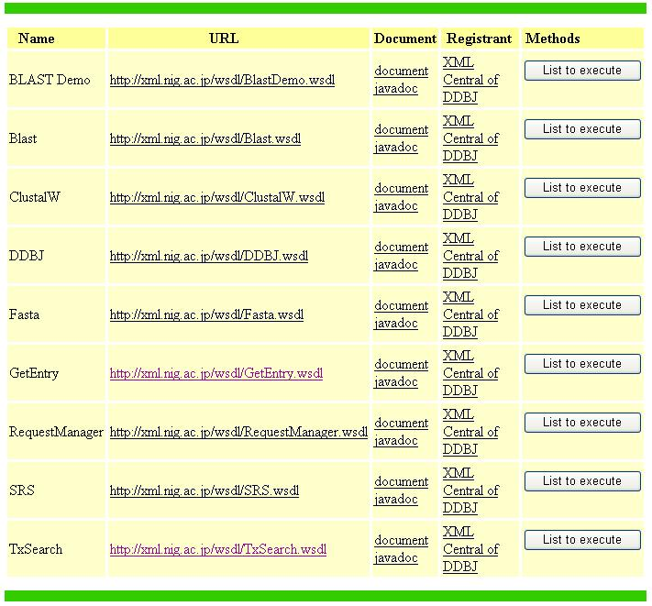

Slide 19
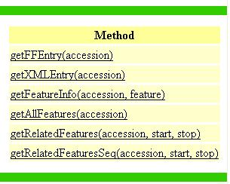
A list of methods in the Web services named DDBJ

Slide 20
ex.1: Find and list sub-sequences
that are annotated
(features are attached)
DEMO
[Use case]
Retrieve all the sub-sequence with annotation (features) between 59000th base and 64000th base of AL121903
[Method]
getRelatedFeatures(accession, start, stop)

Slide 21
ex.1: Find and list sub-sequences that are annotated
(features areattached)
[Result]
repeat_region 423..717
CDS join(37..121,4775..4917)
repeat_region 1775..2064
repeat_region 2067..2362
source 1..5001
repeat_region 3067..3374
mRNA join(26..121,4775..4917)

Slide 22
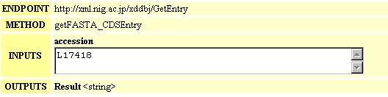
ex.2: Find and list CDSs
[Use case] Retrieve CDSs by concatenating exons
Entry:
exon1 exon2 exon3 exon4
CDS:
[Method]

Slide 23
ex.3: Find and list the aligned
sub-sequences in the result of
blast
[Use case]
Make a file of coordinates of sub-sequences from the result of blast
[Method] extractPosition(result)
query string
hit from the database

Slide 24
ex.3: Find and list the aligned
sub-sequences in the result of
blast
[Result]
AF058428 | AF058428.1
Query 86 248
Hit 86 248
Query 320 384
Hit 320 384
Query 564 601
Hit 561 598
．．．

Slide 25
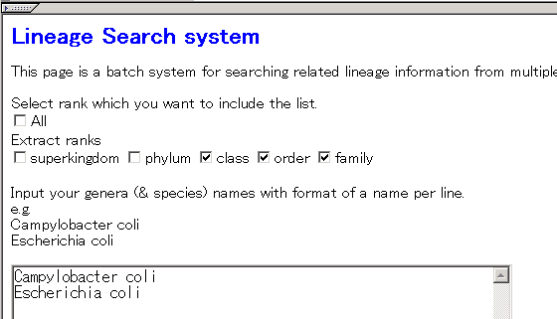
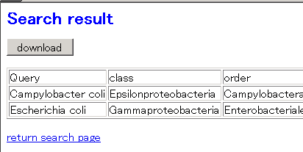
ex.4: Find the full lineage
DEMO
[Use case] Check/retrieve the lineage information of species

Slide 26
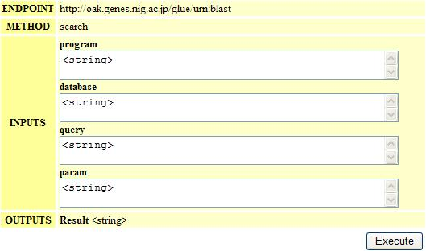
Tutorial 1: Understand the usage

Slide 27
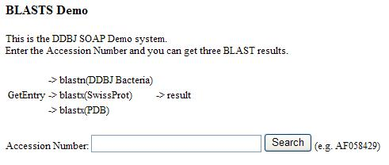
Tutorial 2: Understand the function
Retrieve data from the nucleotide sequence database (INSD), the protein sequence database (SWISS-PROT) and the protein 3D structure database (PDB) all together by an accession number (Acc#) referred in a published paper

Slide 28
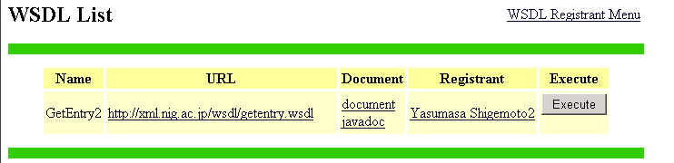
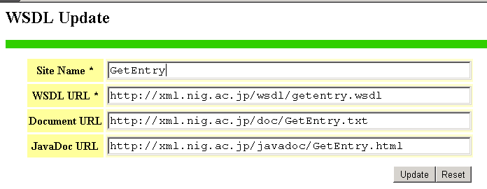
Simplified registry

Slide 29
Work Flow

Slide 30
Map piece entries to genome
Example: Escherichia coli K12 MG1655
E. coli. K12
Genome Sequence
formatdb
BLAST
DB
GIB
blastn
Extract
location
Mapping
List of
piece entries
Piece Entry
in FASTA
format
SRS
GetEntry

Slide 31
The result of the work flow
3,292 piece entries are mapped to genome sequence
Accession Start Stop
AB005050 908577 907298
AB028043 534934 535710
．．．
Genome (Eshcherichia coli K12 MG1655)
3876263
3877433
534934
535710
907298
908577
AB083829
AB005050
AB028043
AB083832
Piece Entries

Slide 32
GRID Use case: an annotation project
ORF detection
Clustering
Homology search against multiple databases
Patter matching against multiple databases
Multiple alignment/phylogenetic analysis
Interactive and repetitive analysis and review by annotators

Slide 33
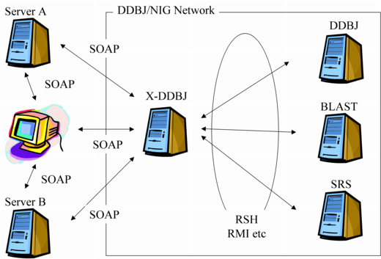
Test bed
OBIGrid
OBIEnv , NinfG etc.

Slide 34
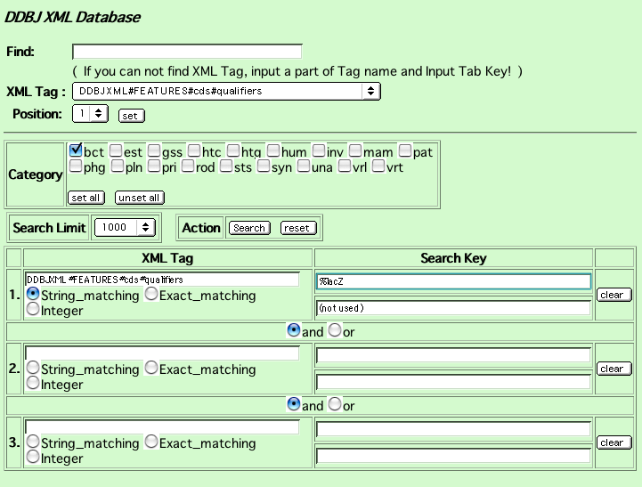
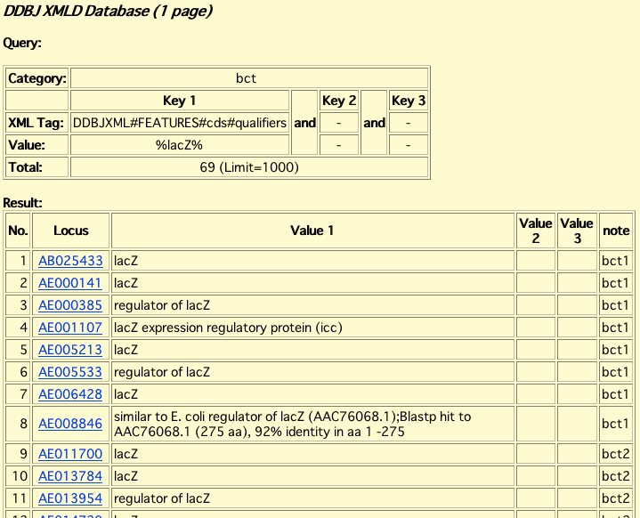
JAIST
Keyword search engine based on RDB
VPN
OBIGrid
Communication by SOAP
VPN
X-DDBJ SOAP server
NIG

Slide 35
Acknowledgements
You are the sunshine of our project.
SOAP servers and Web services
YAMAGUCHI Masahito sun (Fujitsu Limited)
SHIGEMOTO Yasumasa sun (Fujitsu Limited)
MATSUO Masashi sun (Fujitsu Limited)
OBIGrid and OBI-Env linkage
KONAGAYA Akihiko sun (JAIST and RIKEN GSC)
SATOU Kenji sun (JAIST)
TSUJI Shinichi sun (JAIST)

