Slide 1
The Americas Grid Policy Management Authority
Darcy Quesnel, CANARIE

Slide 2
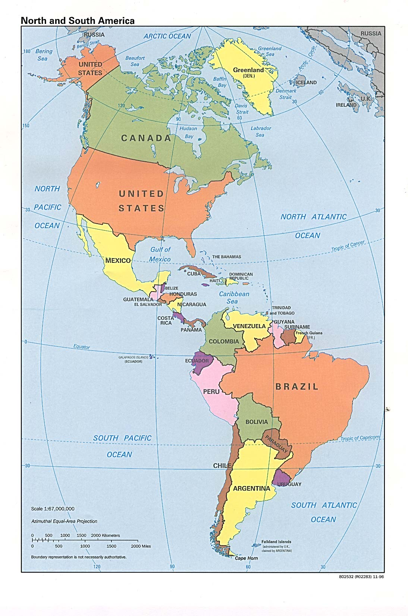

Slide 3




Drivers

Slide 4
Past
Previous face-to-face in Austin, USA
  Accepted TACC Root, TACC Classic CA, REUNA Chilean CA, LAC Catch-All

Slide 5
Future
Next face-to-face in Mexico City, Mexico, March 20-21, 2007

