Slide 1
The 21st Open Grid Forum (OGF21)
IGTF Session
The TAGPMA Update
Vinod Rebello
TAGPMA
The Americas Grid
Policy Management Authority
Seattle, USA
October 17, 2007

Slide 2
TAGPMA Officers
Elections held at the end of May 2007
Chair
  Vinod Rebello (UFF – Brazil)
Vice-Chair
  Jim Marstellar (PSC – USA)
Secretary
  Margaret Murray (UT-Austin – USA)
Trusted Introducer (nominated by the chair)
  Mike Helm (ESNet/LBL – USA)

Slide 3
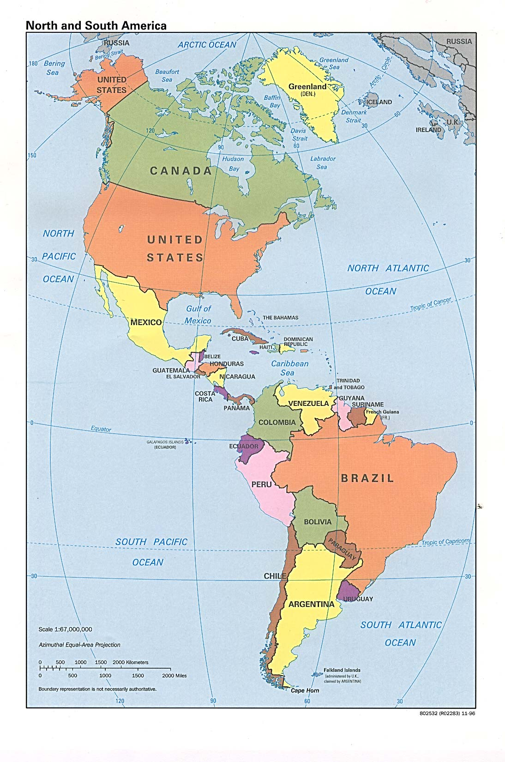

TAGPMA Membership
CANARIE – Canada
DOEGrids (ESNet) – USA
EELA
Fermi National Accelerator Laboratory
HEBCA/USHER/Dartmouth College
Lawrence Berkeley National Laboratory
LCG
NCSA – USA
Open Science Grid
Purdue University – USA
REUNA – Chile
San Diego Supercomputer Center – USA
TACC – USA
TeraGrid – USA
Texas High Energy Grid
University of Virginia – USA
UFF – Brazil
ULA – Venezuela
UNAM – Mexico
UNLP – Argentina
IGTF Accredited CA Operators
CA Accreditation in progress
Interested in accreditation
Relying Party

Slide 4
TAGPMA Meetings
3 face-to-face meetings annually
  5th F2F held in Banff, Canada in July 2007
  6th F2F to held in Santiago, Chile from 6th to 9th November 2007
Fortnightly video/phone conferences
  Tuesdays 12noon CDT
Mailing list (tagpma-general@tagpma.org)
TAGPMA twiki http://tagpma.es.net
Secure communication (when required) via PGP keys and/or Thawte Certificates

Slide 5
5th TAGPMA F2F Meeting
12 attendees (3 from Europe) + 8 remotely
EUGridPMA and APGridPMA solicited changes incorporated into approved MICS Auth. Profile
New CAs in the IGTF Distribution
  NCSA SLSC CA – USA
  NCSA MICS CA – USA
  REUNA Classic CA – Chile
  LA and Caribbean Catch-all CA (Classic)
Total of 5 TAGPMA accredited CAs in distribution.
Mexican and Argentinean CAs reviewed and ready for approval

Slide 6
Issues under discussion
Accreditation process
CA compliance with current Authentication Profiles
Self auditing, Operational reviews
Charter updates
CA software requirements
Documentation/tutorials on setting up and operating IGTF Grid CA
Language update to SLCS Authentication Profile to bring it in line other APs

