Slide 1
TeraGrid
Charlie Catlett, Director
Pete Beckman, Chief Architect
University of Chicago & Argonne National Laboratory
June 2003
GGF-11
Honolulu, Hawaii

Slide 2

The TeraGrid
Distributed resources & expertise can be leveraged to accelerate scientific discovery
Action:
Interconnect large-scale shared scientific databases, computing systems, instruments, and facilities to improve scientific productivity by removing barriers to collaboration and use of distributed resources
Funding: US National Science Foundation, industry partners, states
Partners: UC/ANL, Caltech, NCSA, PSC, SDSC, TACC, ORNL, Purdue, Indiana

Slide 3
What we are doing
Creating a Grid infrastructure that focuses first and foremost on ease of use for users.
  Common TeraGrid Services & Software (CTSS)
Creating a software and services infrastructure that is robust and persistent.
  Inca Verification and Validation System
Doing this in a way that is easily reproducible and/or extensible
Not in today’s talk… Science Gateways
  TeraGrid as a wholesale service provider behind discipline-oriented portals, for instance.

Slide 4
Timeline and Program Overview
Distributed TeraScale Facility (DTF; $50M, 3 yr)
  IA-64 homogeneous systems at CIT, ANL, NCSA, SDSC
  Use Grid technologies to embed Grid resources in existing large-scale centers
  Offer NSF PACI user community a migration path from client-server supercomputing to Grid computing.
Extensible TeraScale Facility (ETF; $35M, 1 yr)
  Add Power4 (SDSC), Alpha (PSC) systems
  Create extensible backbone network (hubs in LA, Chicago)
TeraGrid Extension Program (TEP; $10M, 1 yr)
  Add ORNL, TACC, Indiana, Purdue
  Add network hub in Atlanta
TeraGrid Operation, Mgmt & Evolution ($150M, 5 yrs)
  Target date for Production: October 1, 2004 (now in pre-production)
  TeraGrid OM&E Program currently under review

Slide 5
General Overview
TeraGrid System Management & Integration Group (~40 staff)
9 Resource Providers (~80 staff at 9 sites)
  Resources & Services Described via Grid “Service Level Agreements”
  Resource: Computers, networks, instruments, databases/collections, storage systems…
TeraGrid Architecture defines what it means to “Join TeraGrid”

Slide 6
How To Add a New Site:
An Objective, Open Process
Identify Resource
Participate in Allocations Process (for compute resources)
  Accounts, accounting processes
Support CTSS user environment
  Accept authentication and operation of shared coordinated software
Participate in Operations Process
  Define Contacts
  Accept trouble tickets
Join Security Infrastructure
  Sign Security Memorandum, participate in reporting, vulnerability & risk analysis, etc.

Slide 7
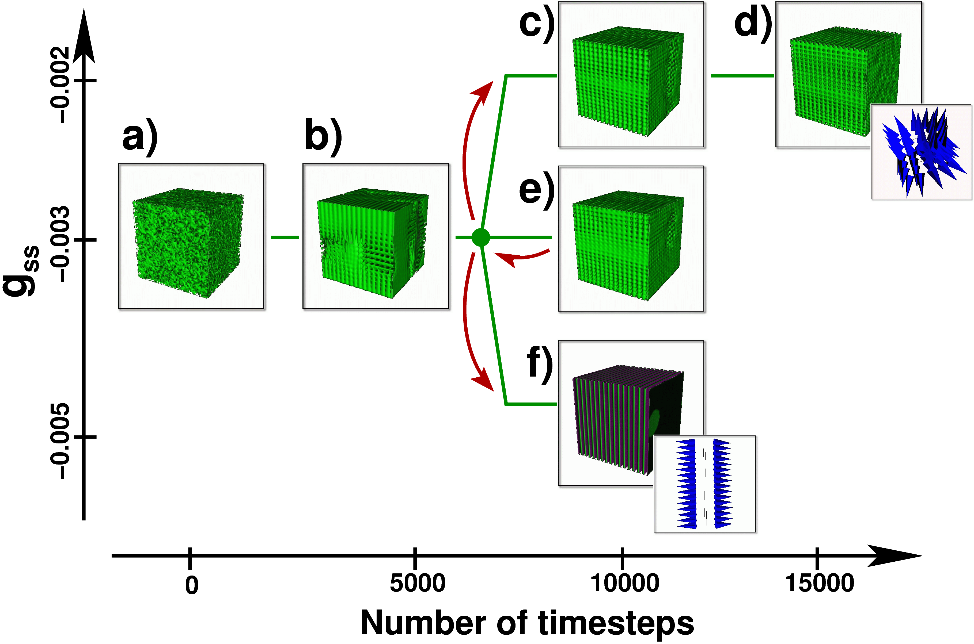
Example use Scenario (one of many)
Cubic micellar phase, high surfactant density gradient.
Cubic micellar phase, low surfactant density gradient.
Exploring parameter space through computational steering
Initial condition: Random water/ surfactant mixture.
Self-assembly starts.
Lamellar phase: surfactant bilayers between water layers.
Rewind and restart from checkpoint.
Notes:
Explain how to reach different states of the system by rewinding and changing parameters

Slide 8
ETF Hardware Deployment
Chicago Starlight
LA
100 TB DataWulf
96 GeForce4 Graphics Pipes
32 Pentium4
52 2p Itanium2
20 2p Madison
Myrinet
96 Pentium4
64 2p Madison
Myrinet
20 TB
Caltech
ANL
750 4p
Alpha EV68
Quadrics
128p EV7 Marvel
1.1 TF Power4
Federation
128 2p Itanium2
256 2p Madison
Myrinet
256 2p Itanium2
670 2p Madison
Myrinet
150 TB Storage
20p Vis
500 TB FCS SAN
230 TB FCS SAN
16 2p (ER)
Itanium2
Quadrics
SDSC
NCSA
PSC
Notes:
See Q&A text on Phase I and Phase II. The DTF site network experts have discussed this architecture with a number of networking experts including Bill St.Arnaud (CA*Net), the Abilene backbone team (led by Steve Corbato), the I-WIRE/Startap/Starlight team (led by Argonne staff), Qwest (Wes Kaplow), and Indiana University’s NOC staff.
Architectural options include:
Large routers (phase 1, illustrated). Traffic segregation, including dedicated 10 GbE paths, can be accomplished via available means such as MPLS. Concern is whether the routers (or switch/routers) can handle the load. Hence testing will begin in October 2001 with multiple router vendors.
Optical mesh (phase 2). Most optical switching architectures assume many paths, whereas the DTF backbone is only 4 wavelengths. It would be possible to architect this network as 16 wavelengths, each running at 2.5 Gb/s, but it is unclear that partitioning the bandwidth in this way would provide benefits offsetting the additional complexity. Nevertheless these options exist as fall-back architectures should we find that the phase 1 approach introduces bottlenecks.

Slide 9
TeraGrid Network (June 2004)
Caltech
UC/ANL
PSC
Los Angeles
Chicago
Atlanta
SDSC
TACC
NCSA
Purdue
IU
ORNL
Operational
All Links are 10 Gb/s
Due Oct2004

Slide 10
User-Centric Guiding Principles:
The larger the pool of distributed, networked, unified resources, the greater the benefit
Promoting Adoption:
  Usability Stability Capability
  CIO Magazine: “Timing is Everything. Seizing the perfect moment to present a new technology to your company can make or break a strategic plan.”
It Must Be Easy
It Must Be Ready
It Must Be Better

Slide 11

Unified Policies and Common Resource Currency (TROO)
The Rule Of One
  One help desk
  One NRAC submission
  One account req. form
  One accounting currency
  One set of user policies
  One documentation set
Result:
  Improved Usability
  Very attractive target for adoption
  Unified networked resources more valuable to community (Metcalf)

Slide 12
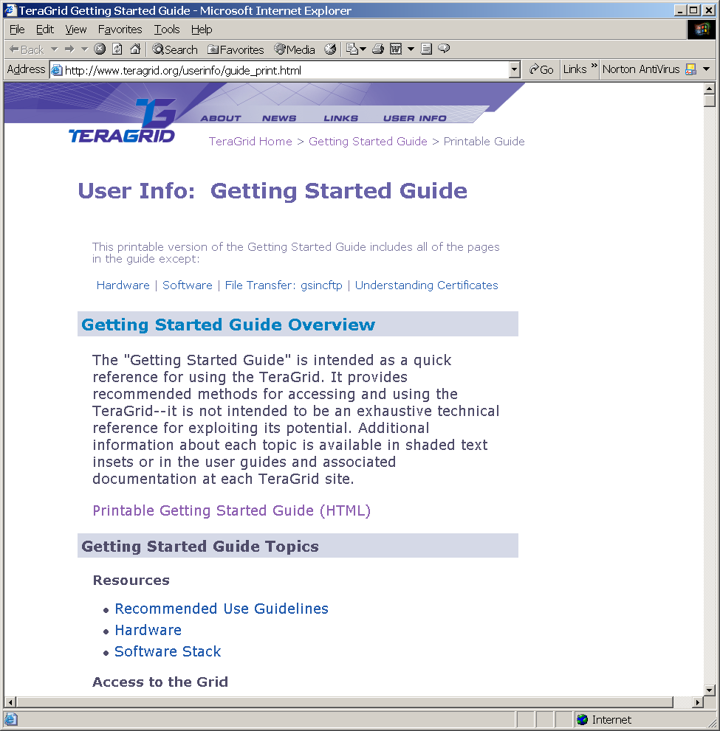
Commitment To Adoption
Learn Once, Run Anywhere (LORA)
  A single training course and a single set of manuals preserve user investment
  “TeraGrid Roaming” supported:
    Develop app locally, run on any TG resource
Result:
  SC03 TeraGrid User Tutorial was over subscribed! Plans for road show under way
  Smiling users
    Improved usability & stability of TeraGrid architecture

Slide 13
TeraGrid Architecture
CTSS: A Single Shared Grid-enabled Infrastructure
Inca
CTSS-Storage
CTSS-Viz
CTSS-Compute
CTSS-Storage
CTSS-Viz
CTSS-Compute
Services
Services
Inca
Software
Inca
Services
CTSS-Storage
Software
Inca
Software
CTSS-Compute
Inca
Services
Inca
Inca
Software
Services
Services
Software
Software
CTSS-Compute
Software
Inca
Software
Inca
Services
RP Viz Resource
Services
RP Compute Resource
RP Storage Resource
Software
Inca
RP Storage Resource
RP Viz Resource
Services
RP Compute Resource
RP Storage Resource
RP Compute Resource
RP Compute Resource
Common TeraGrid Software & Services (CTSS)
C. Catlett, P. Beckman - University of Chicago / Argonne National Laboratory

Slide 14
A Grid Hosting Environment
The core infrastructure for Virt Orgs to build Grid-based projects
Special Capabilities
Experimental math libraries
Unique storage system
Large shared memory arch….
Example:
TeraGrid Hosting Env.
Web Hosting Env.
Single Contact: help@teragrid.org
Unified Ops center
Certified Software Stack
MPICH, Globus
GridFTP, BLAS, Linpack,
Atlas, SoftEnv, gsi-ssh
$TG_SCRATCH, …
PHP, Perl, Python scripting.
MySQL, FrontPage
100 POP accts, 100MB disk
SMTP, IMAP & Webmail
US$49 per year
$100 Million
Classic Unix-like Environment
/bin/sh, bin/cp, /bin/ls, Unix file system & tools, dev tools (make, compilers) etc

Slide 15
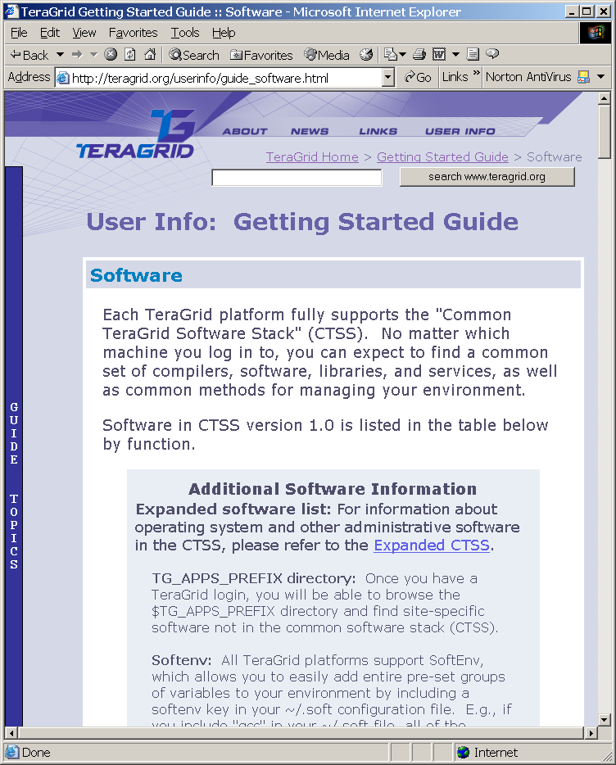
Common TeraGrid
Software Stack
CTSS Provides a single, unified set of interoperable components and services that define the TeraGrid’s Grid Hosting Enviroment and enable “TeraGrid Roaming”

Slide 16
Core CTSS Components Across All Platforms: Linux, AIX, Tru64
atlas
blas
condor-g
gcc
globus-2.2.4-gcc
globus-2.4.3-gcc
gsi-ncftp
gsi-openssh
gx-map
hdf4
hdf5
Java_COG
mpich-g2-gcc
mpich-p4-gcc
myproxy
openssh
openssl
petsc-gcc
python
softenv
srb-client
tcl
vmi-crm
Additional component sets, by category, include:
Intel compilers, IA64 (Myrinet, BIOS, etc), Linux kernels & patches

Slide 17
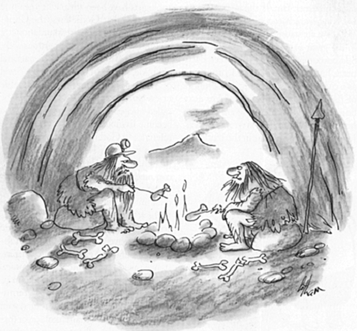
High Quality Production System:
Integrated Verification & Validation
“And then one day the grid went down and never came back up.”
New Yorker Magazine, 2003

Slide 18
V & V Concepts for Production-Quality Grid Systems
Formal specifications of supported environment and “operational” must exist
A set of independent tests should check for compliance and correctness
A human should not be “in the loop”
Testing should include performance, and be archived over time for trend analysis
Scalability: Adding new sites should require minimal resources

Slide 19
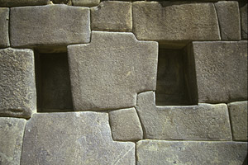
Inca: A Test Harness Framework for Builders
Clients
Web Interface
Application
Monitor
Java GUI
Harness
Query Interface
Archive Depot
Engine
Reporters
version
unit
integrated
self-sched
Distributed Resources
Source: Shava Smallen, SDSC

Slide 20
Across the Entire TeraGrid:
A Single Language For Reporters
<?xml version="1.0" encoding="UTF-8" ?> <!-- Generated by Turbo XML 2.3.1.100. Conforms to w3c http://www.w3.org/2001/XMLSchema -->
<xsd:schema xmlns:xsd="http://www.w3.org/2001/XMLSchema" elementFormDefault="qualified">
<xsd:element name="INCA_Reporter">
<xsd:complexType>
<xsd:sequence>
<xsd:element ref="INCA_Version" />
<xsd:element ref="localtime" />
<xsd:element ref="gmt" />
<xsd:element ref="ipaddr" />
<xsd:element ref="hostname" />
<xsd:element ref="uname" />
<xsd:element ref="url" />
<xsd:element ref="name" />
<xsd:element ref="description" />
<xsd:element ref="version" />
<xsd:element ref="INCA_Input" />
<xsd:element ref="body" />
<xsd:element ref="exit_status" />
</xsd:sequence>
</xsd:complexType>
</xsd:element>
<xsd:element name="gmt" type="xsd:string" />
<xsd:element name="localtime" type="xsd:string" />
<xsd:element name="hostname" type="xsd:string" />
<xsd:element name="ipaddr" type="xsd:string" />
<xsd:element name="uname" type="xsd:string" />
<xsd:element name="url" type="xsd:string" />
<xsd:element name="name" type="xsd:string" />
<xsd:element name="version" type="xsd:string" />
<xsd:element name="INCA_Version" type="xsd:string" />
<xsd:element name="description" type="xsd:string" />
<xsd:element name="exit_status" nillable="true" fixed="0">
<xsd:complexType mixed="true">
<xsd:choice>
<xsd:element ref="message" minOccurs="0" />
</xsd:choice>
</xsd:complexType>
</xsd:element>
<xsd:element name="message" type="xsd:string" />
<xsd:element name="body" abstract="true" />
<xsd:element name="ID" type="xsd:string" />
<xsd:element name="INCA_Input">
<xsd:complexType>
<xsd:sequence>
<xsd:element ref="input" minOccurs="0" maxOccurs="unbounded" />
</xsd:sequence>
</xsd:complexType>
</xsd:element>
<xsd:element name="input" />
<xsd:element name="verbose" type="xsd:integer" substitutionGroup="input" />
<xsd:element name="help" substitutionGroup="input">
<xsd:simpleType>
<xsd:restriction base="xsd:string">
<xsd:enumeration value="yes" />
<xsd:enumeration value="no" />
</xsd:restriction>
</xsd:simpleType>
</xsd:element>
</xsd:schema>

Slide 21
Current Status of V&V Program
More than 900 components are tested
Output is “engineer quality”, and not prioritized or user readable
Definition of “Up” underway
Inca has been well received by other Grid communities, and we are beginning to receive requests for copies and presentations

Slide 22
In Practice…

