Slide 1
Grid Network Services:
Lessons from SC04 draft-ggf-bas-sc04demo-0.doc
Bas Oudernaarde (UvA)
Madhav Srimadh (Nortel)
Inder Monga (Nortel) (presenter)

Slide 2
Agenda
Scenario Description
Services Model
Components
  AAA
  DRAC
Discussion points
Conclusion

Slide 3
Scenario
Grid application in Amsterdam
Data in Chicago
Requirement:
  Need the data from Chicago ASAP with best QoS (low latency, dedicated, high bandwidth)
Solution:
  Provision the fastest path from Amsterdam to Chicago
  Money no objection ☺
Collaborative effort across institutions (administrative domains)

Slide 4
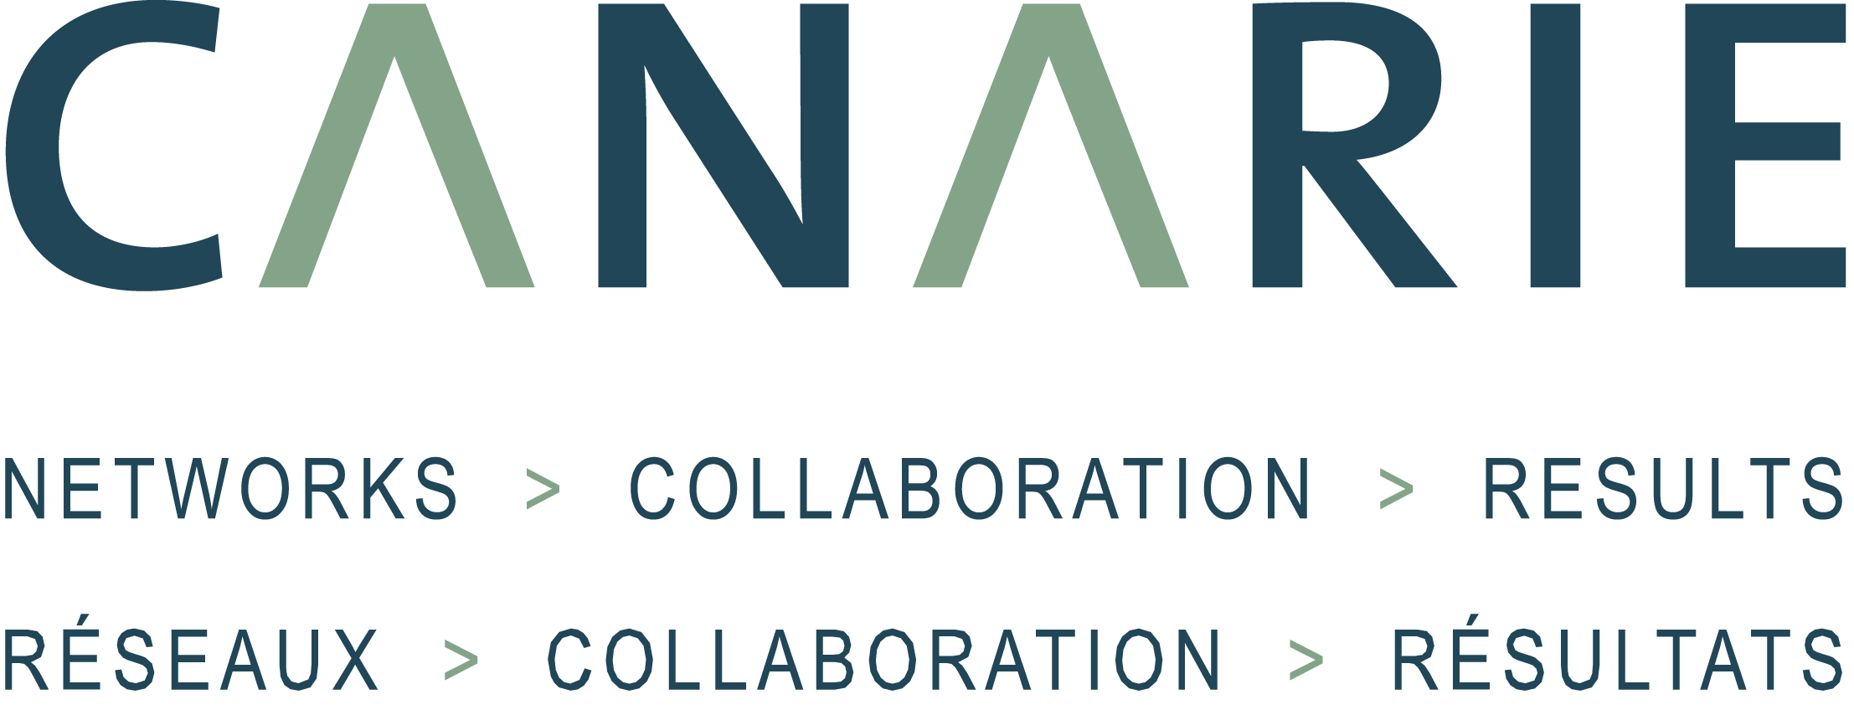








Multi-domain setup
GridFTP Server
GridFTP Client
Network Service Plane
AAA
AAA
AAA
AAA
HOME
Data
Data
DRAC
DRAC
DRAC
DRAC
OMNInet
Starlight
ODIN
Netherlight
UvA
Chicago
Internet 2/
Canarie
Amsterdam

Slide 5
Highlights
Network Service Plane
  Driven by Grid application
  Service Authorization
Multi-domain Service setup
Inter-domain service recovery
Network virtualization
  Multiple Control Planes
  Different layers and network elements
Notes:
L2 switch, optical crossconnect, photonic switch

Slide 6
Network Services Plane
Layered above legacy network control planes:
  Turns network into a virtualized manageable resource
  Bridges disparate network domains
  Exposes programmatic interfaces to authorized users/applications.
  Automates network resource allocation requests by user applications (ex. Grid)
Bridges the gap between networks and Grid Services Architecture
Two ingredients in each administrative domain
  AAA
  Network Services Manager

Slide 7
AAA (UvA)
Network AAA is one facet of its functionality
  Handle other resource types
Dual role
  Authorization to use it’s own domain’s resources
  Manage trust between administrative domains for peering
    Peer model
      Trust your direct neighbor
    Non-transitive trust
      Can’t necessarily trust neighbor’s neighbor
Authorization hierarchy
  User obtains authorization within domain
  Organization obtains authorization across domains
  Intermediate domains unaware of requesting application or user
  User billed by its own organization

Slide 8
Network Services Manager (DRAC)
http://www.nortel.com/drac
Network services provider to apps
Represents resources in its domain
  Decentralized architecture
Works with variety of control plane/configuration protocols
Ability to make end-to-end domain-path decisions based on requested service (QoS)
  Source-routed
Abstract API for applications/AAA
  Path Setup
  Error Notification
Various interaction models with AAA

Slide 9
DRAC-AAA Operational Models
App
AAA
App
P-DRAC
App
AAA
P-DRAC
AAA
P-DRAC
DRAC
DRAC
DRAC
Peer
Proxy
Agent
Peer
  Token first, then request DRAC
Proxy
  Proxy-DRAC has interface to application. AAA is hidden
Agent
  AAA authorizes request and relays to DRAC
  DRAC communication between domains embedded between AAA to AAA server communication

Slide 10
Discussion Points
Resource reservation mechanism for Service Plane
  Commit on the way out
  Commit on the way back
Deadlock and starvation avoidance
  Hungry applications can starve later requests
  Two applications waiting for the same network resource
  Service request arbitration/SLA enforcement
    Resource request, release and pre-emption policies need to be provided
Inter-domain network failure, restoration and accountability
  How to propagate network failure and restoration to members of the established path(s) in other domains?
  Best way to compute an alternate path when inter-domain route fails, iterative process?
  Should the application be made aware?

Slide 11
Discussion Points (contd.)
Trust, Privacy and Roles (AAA)
  User information or application details not propagated across domains.
  Roles-based authorization considered, consistency required across domains. Should roles be used to guarantee a certain QoS?
Policy framework for admission control (AAA)
  Critical in managing resource allocation
  Combination of trust tokens, auth tokens and role-based policies
  Rule based policy engine can combine attributes like time, role to provide differentiated network resource usage
Source based routing versus traditional routing
  Inter-domain path setup
Service tolerance of services provided and expected behaviors – SLA?
  Software/Middleware failures
  Connectivity breaks due to partial network failures

Slide 12
Conclusion
Demonstrated a new provisioning plane/model for networks
Independent of control planes technology adopted by adjacent domains
Inter-domain failures and restoration can be handled at a different layer than intra-domain failures
Other Network knowledge services can be exposed through the same plane:
  Topology
  Network failures
Good fit as GNS/NS modeule being specified by GNSA?

