Slide 1

Token Based Networking
GGF-14 FI-RG
Chicago June 29th 2005
Welcome
Leon Gommans
leon.gommans@science.uva.nl
LAMBDAGRID

Slide 2
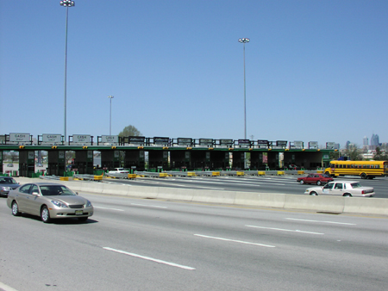
The problem
Regulatory changes allowed organizations to acquire optical connections (e.g. 1996 US Telecommunications Act).
National Research Networks and Grid communities acquire their own Lambda’s
Collaborative efforts build a “Lambda Grid” creating “private highways” intended to by-pass the Internet (www.glif.is)
The Internet has no notion of private highways or toll roads
How can an application data-flows signal that it is allow to use a private highway ?
How can private highway access be arranged ?
How can a Lambda Grid be integrated into the existing Internet ?

Slide 3
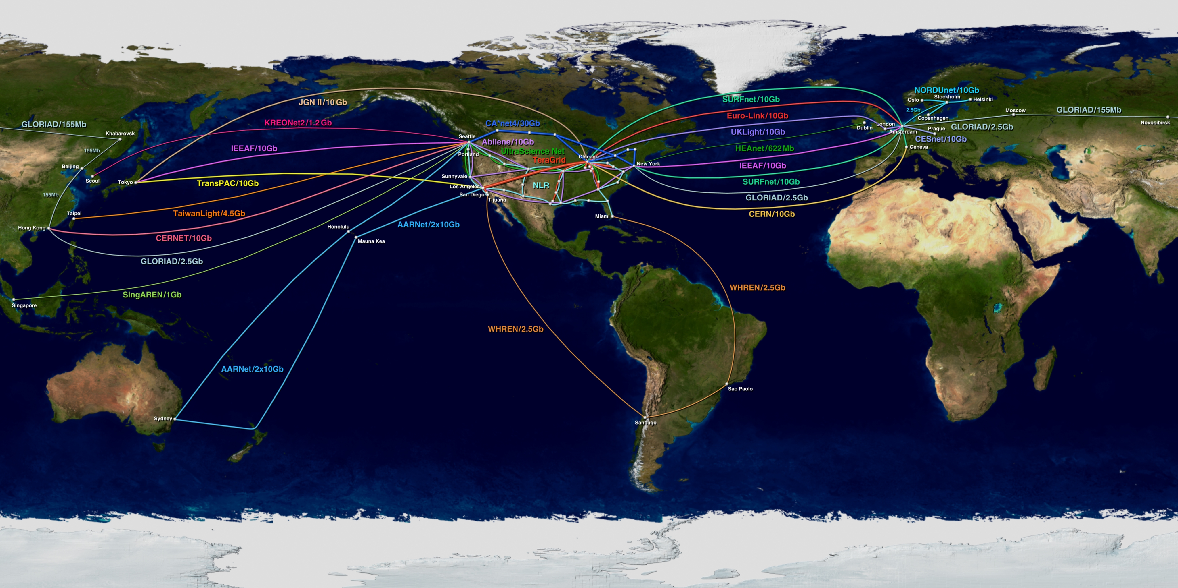
Global Lambda Integrated Facility

Slide 4
The Internet structure
Tier 1
Tier 1
Tier 2
KPN
Tier 1
MCI
Tier 1
AT&T
Tier 2
France
Telecom
Tier 3
XS4ALL
Tier 3
@home
Tier 3
BIT
Tier 3
Tier 3
Source: AMS-IX
Internet Exchange Point

Slide 5
Transit
Network
Peering Link
ISP B
ISP A
Border Router
Leon Gommans University of Amsterdam 6/29/05

Slide 6
Transit
Network
Internet Exchange
ISP A
ISP B
Border Router
Leon Gommans University of Amsterdam 6/29/05

Slide 7
Transit
Network
Unauthorized
Traffic
Hybrid
ISP A
Hybrid
ISP B
ICP
A
Stakeholder
Links
ICP
B
Lambda Grid
Leon Gommans University of Amsterdam 6/29/05

Slide 8
Available Link Advertisement
Link
Request
Server
ICP Broker
Request to other brokers or authorities
Link Access Request
Link Admission
Policies from
Stakeholders
Link
Access
Request
Token-key
Ingress Switch
usr
Hybrid
ISP A
Token
Based
Switch
Stakeholder X connection
Token
Packets
Stakeholder Y connection
usr
To Transit Network
BGP Router
InterConnection Point A
Leon Gommans University of Amsterdam 6/29/05

Slide 9
IP HEADER DATA CRC
MASK
Token Key
AES-XCBC-MAC-96 algorithm
Token
IP HEADER Options DATA CRC
Leon Gommans University of Amsterdam 6/29/05

Slide 10
Conclusion
Tokens can authorize path selection at interconnection points
Tokens can do admission control at ingress network
Tokens allow temporal split between (service based) collection of authorization(s) and use of the authorization.
Tokens allow seamless integration of Lambda Grid links into the Internet structure.
Crypto-functions in NPU based switching technology are marketed at 10 Gb/s.

