Slide 1
UK Grid:
Moving from Research to Production
Steven Newhouse
  Neil Geddes & Alistair Dunlop

Slide 2
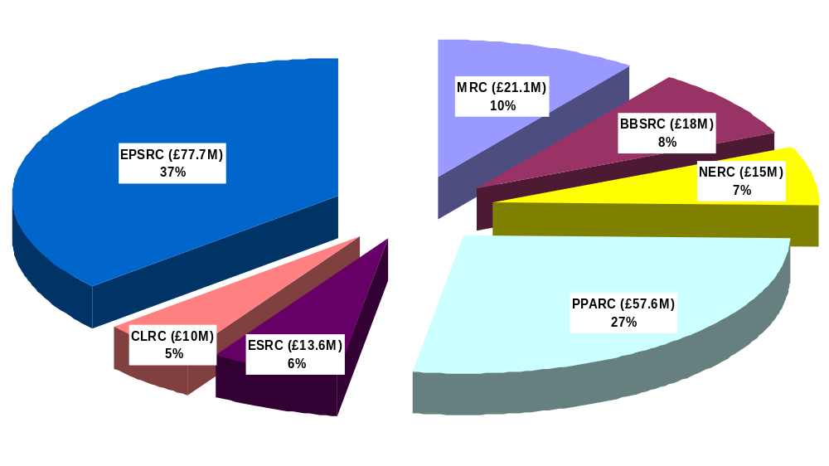
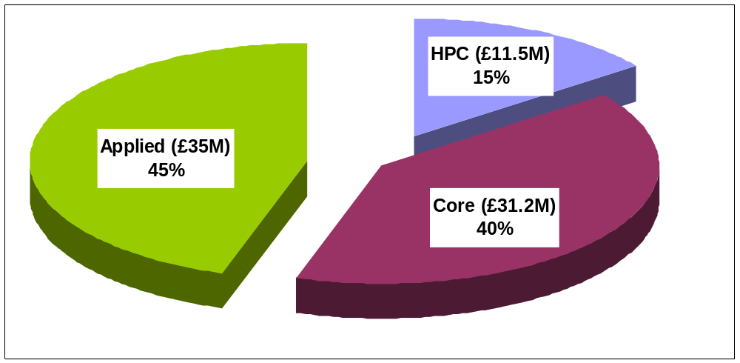
UK e-Science Budget (2001-2006)
EPSRC Breakdown
+ Industrial Contributions
Total: £213M
Source: Science Budget 2003/4 – 2005/6, DTI(OST)

Slide 3
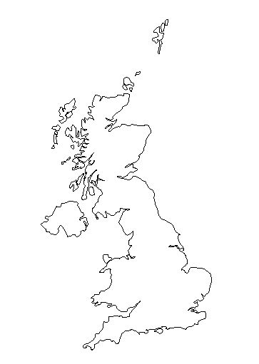

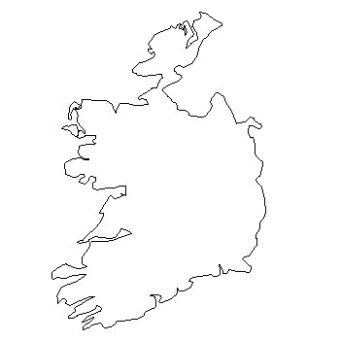
UK e-Science Programme
Multi-disciplinary applied projects
  Applied Scientists
  Computer Scientists
Core Technology Programme
  Regional e-Science Centres
  Centres of Excellence
  Demonstrators
Edinburgh
Glasgow
Newcastle
Belfast
Manchester
Oxford
Cambridge
Cardiff
London e-Science Centre
Southampton

Slide 4



UK e-Science Pilot Projects
GRIDPP (PPARC)
ASTROGRID (PPARC)
Comb-e-Chem (EPSRC)
DAME (EPSRC)
DiscoveryNet (EPSRC)
GEODISE (EPSRC)
myGrid (EPSRC)
RealityGrid (EPSRC)
Climateprediction.com (NERC)
Oceanographic Grid (NERC)
Grid Enabled Integrated Earth System Model (NERC)
Molecular Environmental Grid (NERC)
NERC DataGrid (NERC+OST-CP)
Biomolecular Grid (BBSRC)
Proteome Annotation Pipeline (BBSRC)
High-Throughput Structural Biology (BBSRC)
Global Biodiversity (BBSRC)
myGrid

Slide 5
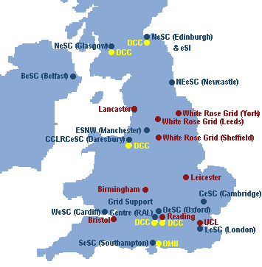
UK Grid Institutions
Regional Centres
Centres of Excellence
Grid Operational Support Centre
Open Middleware Infrastructure Institute
Data Curation Centre
National Grid Service

Slide 6
Grid Operational Support Centre (GOSC) &
Open Middleware Infrastructure Institute (OMII)
New organisations for emerging UK Grid
OMII (Director: Alistair Dunlop)
  Ingest software from UK & other projects for hardening
  Provide integrated & tested software stack
GOSC (Director: Neil Geddes)
  Research: Engineering Task Force (ETF)
    Leverage resources, expertise & people at the regional centres
  Production: Support UK Grid activity
    National Grid Service (resources)
    Certificate Authority
    Other Services: Portals, Scheduling, etc.

Slide 7
OMII (www.omii.ac.uk):
Open Middleware Infrastructure Institute
The source of open source grid software
Based at the University of Southampton
Conservative, production focused software development
Regular releases of integrated and tested software stack
Builds on widely accepted WS specifications and stable OS software (e.g. Apache, Axis)

Slide 8
ETF (www.grid-support.ac.uk/etf):
UK e-Science Grid (2001-2004)
Uses existing resources at the regional centres
Heterogeneous: Linux, Solaris, AIX, …
No centralised management
Centralised co-ordination
Gained experience on Grid construction
Provided a testbed for application use

Slide 9
ETF: Software Environment
Globus 2.4.3 (now)
  Interoperability between different version
GITS: Grid Integration Tests
  Regular automated check of Grid fabric
  http://www.soton.ac.uk/~djb1/gits.html
VOM: Virtual Organisation Management
  Co-ordinate account generation
  Distribute gridmap file entries
  Upload local job accounts to centre for monitoring

Slide 10
NGS (www.ngs.ac.uk):
National Grid Service
‘Free’ dedicated resources accessible only through Grid interfaces, i.e. GSI-SSH, GT
Compute clusters (York & Oxford)
  64 dual CPU Intel 3.06 GHz nodes, 2GB RAM
  Gigabit & Myrinet networking
Data clusters (Manchester & RAL)
  20 dual CPU Intel 3.06 GHz nodes, 4GB RAM
  Gigabit & Myrinet networking
  18TB Fibre SAN
Also national HPC resources: HPC(x), CSAR
Affiliates: Bristol, Cardiff, …

Slide 11
NGS: Focus on production
Staff:
  4 FTE systems staff (1 at each core site)
  1 FTE co-ordination management
Current Software:
  Use GT software through VDT 1.1.14 distribution
  BDII (GIIS), GSI-SSH, SRB
Additional software:
  GITS (Fabric testing)
  VO & accounting tools
  Resource Brokering
Deploy & provide robust national services
Need deployable & manageable software

Slide 12
UK Grid Goal:
Provide a reliable Grid Infrastructure
NGS can only deploy software that works!
OMII provides robust & packaged software services for the UK Grid community
ETF evaluates software to inform deployment decisions:
  Heterogeneous resources
  Expose software to production environment
  Examine usability

Slide 13
The OMII, ETF & NGS in context
Other Software Services
ETF
NGS
Software with proven
capability & realistic
deployment experience
OMII
‘Gold’ Services
Prototypes &
Specifications
Feedback &
future requirements

Slide 14
Emerging Role for the ETF…
…bridge between development & operation
Deployment and evaluation of software
  Fitness for deployment?
  What needs to be fixed (by the OMII?) to be deployable?
Leveraging UK expertise & resources
  To develop specifications and/or prototypes to fix problems
  To provide a distributed testbed for Grid software

Slide 15
Conclusions
Emerging UK Grid community & infrastructure
Relevant research services from UK projects to be picked up and hardened by the OMII
ETF evaluates software products on research testbed for NGS
NGS deploys and maintains stable production UK service

Slide 17
Talk Abstract
The UK e-Science programme has now established two key elements required to deliver a production quality e-research infrastructure within the UK: the OMII (Open Middleware Infrastructure Institute) with a remit to deliver a high-quality software infrastructure to support e-research, and the GOSC (Grid Operational Support Centre) to deploy a software environment that will deliver production quality e-research services to the UK community. The GOSC has direct responsibility for the delivery of the production quality National Grid Service (NGS) and the co-ordination of the Engineering Task Force (ETF).
This talk will describe the processes now being put in place within the UK to establish a production Grid infrastructure focussed on the requirements of the applied user communities that will develop and expand as new stable middleware products becomes available.

